Slide 1
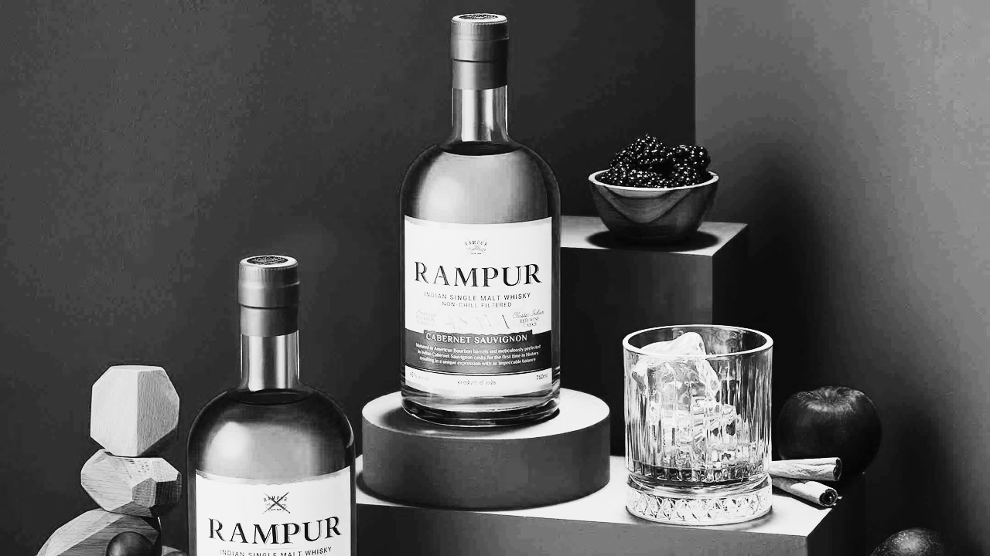
Strengthening The Brand On Digital
A White Rivers Media Presentation

Slide 2
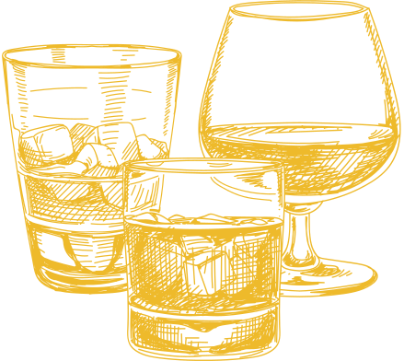
PRESENTATION OUTLINE
  Understanding the Indian Single Malt Whisky landscape
  Decoding whisky drinkers
  Mapping peer conversations
  Communication gaps and opportunities
  Brand Approach

Slide 3
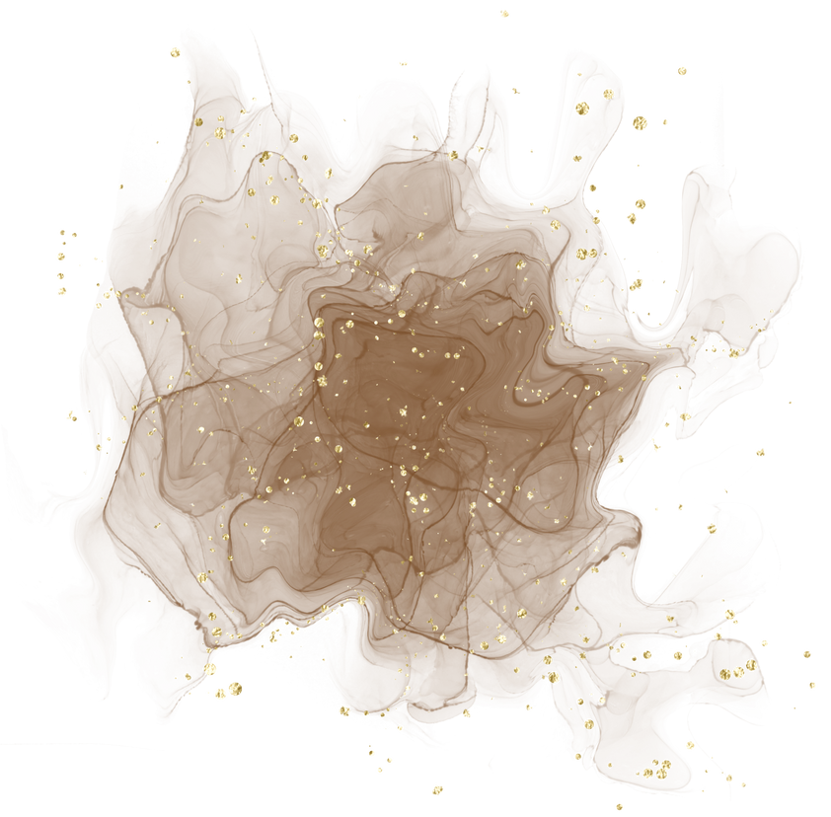
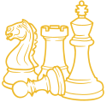
Understanding Indian Single Malt…

Slide 4
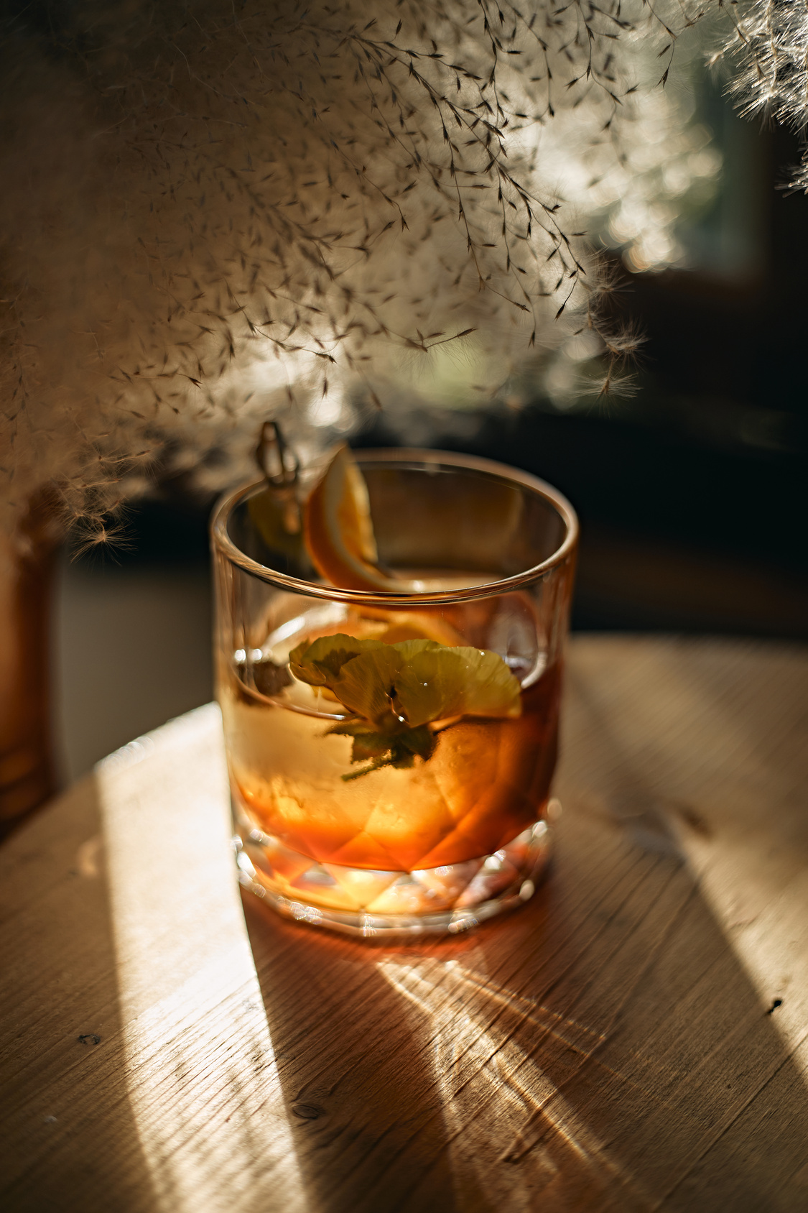
From Blend to Malt, Whisky is truly captivating the palates of the nation
Indians consume about 1.5 billion litres of whisky every year. It accounts for half of the world’s entire whisky production.
Almost 48% of whisky that is produced in the world is consumed by one country alone.
With a population of more than 1.3 billion people, an individual’s average consumption is more than a litre of whisky per year.
Source: Times of India
Notes:
https://timesofindia.indiatimes.com/business/india-business/desi-single-malts-at-new-high-sales-up-83/articleshow/90485309.cms

Slide 5
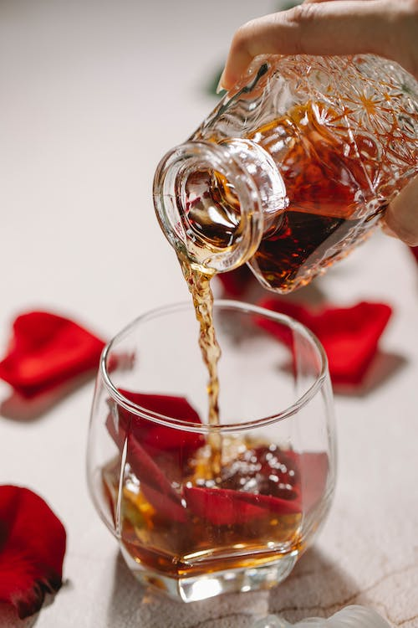
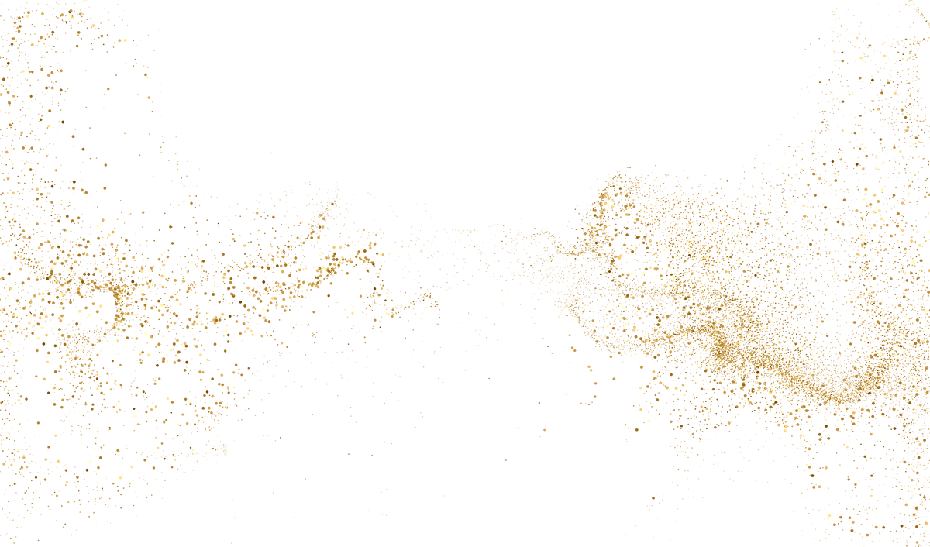
This love for Whisky is especially being reigned by Indian Single Malts
Earlier only the crème de la crème of Indian society was familiar with single malts. However, the space is growingly lapped up by aspirational flavor curious millennials.
Today homegrown single malts account for over a third of the market in India, compared to only 15% in 2017
Source: The Guardian
Notes:
https://www.theguardian.com/global-development/2022/jun/04/how-indias-new-taste-for-local-whisky-is-shaking-up-the-global-drinks-market

Slide 6
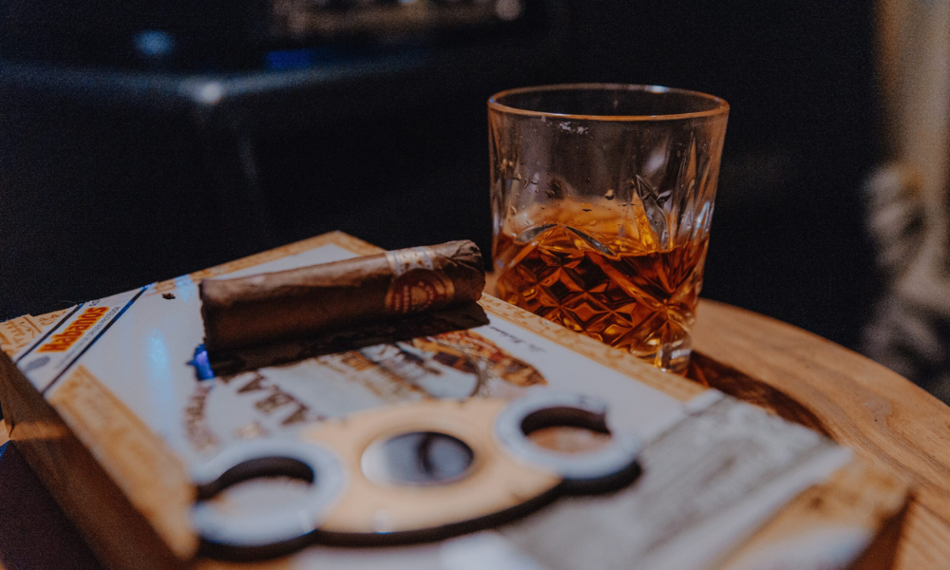
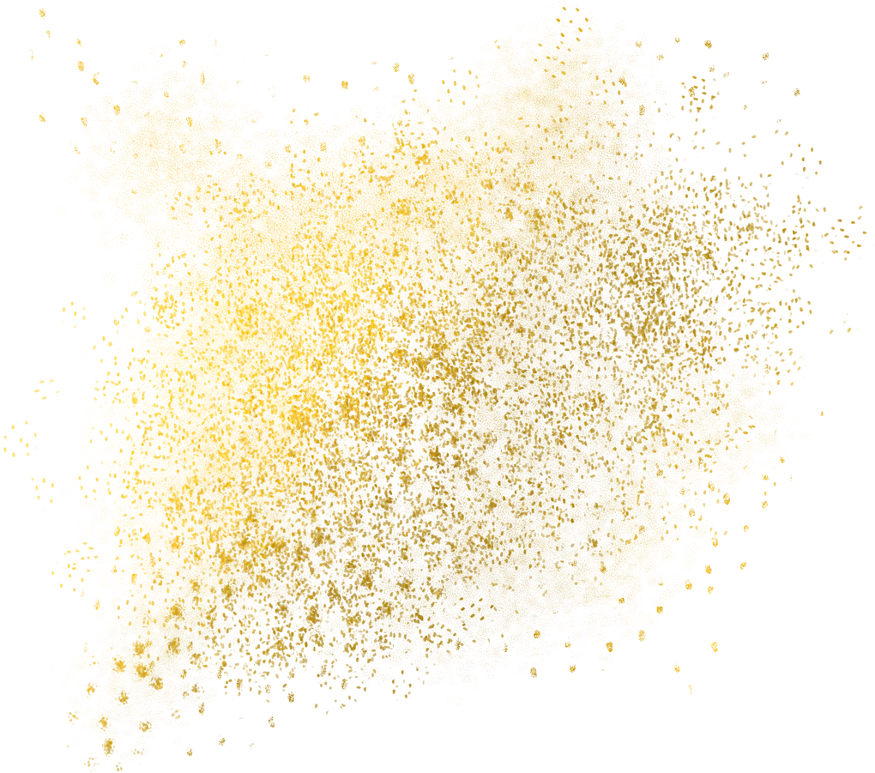
Taking the Great Indian Whisky parade into international boulevards
India has become the 2nd largest exporter of Single malt whisky in the World with most of its Single malt whisky going to the United States, Netherlands and France
Uniquely Indian terroir, signature style of its own and premium pricing have helped the single malts to capture ground in the global market rapidly.
Source: Volza
Notes:
https://www.volza.com/p/single-malt-whisky/export/export-from-india/

Slide 7
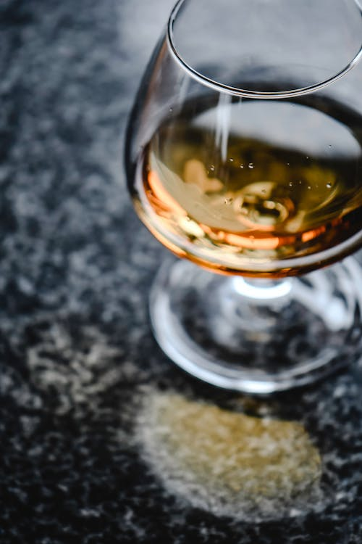

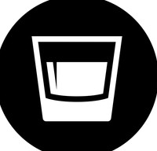
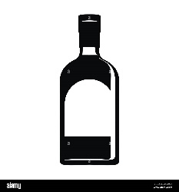
Thriving on novel home ground conditions, Indian single malt stands out from its contemporaries
India’s hot and humid climate helps age whisky much faster than the average brands outside
Beyond the subtle infusion of Indian tastes, there is uniqueness to the taste profiles such as a unique fruity and malty character
Presenting a distinctive texture to the ultimate product exclusive of the rich Indianness
Source: Slurrp
Notes:
https://www.slurrp.com/article/for-love-of-single-malt-the-unexpected-rise-of-indian-whisky-1669980845637

Slide 8
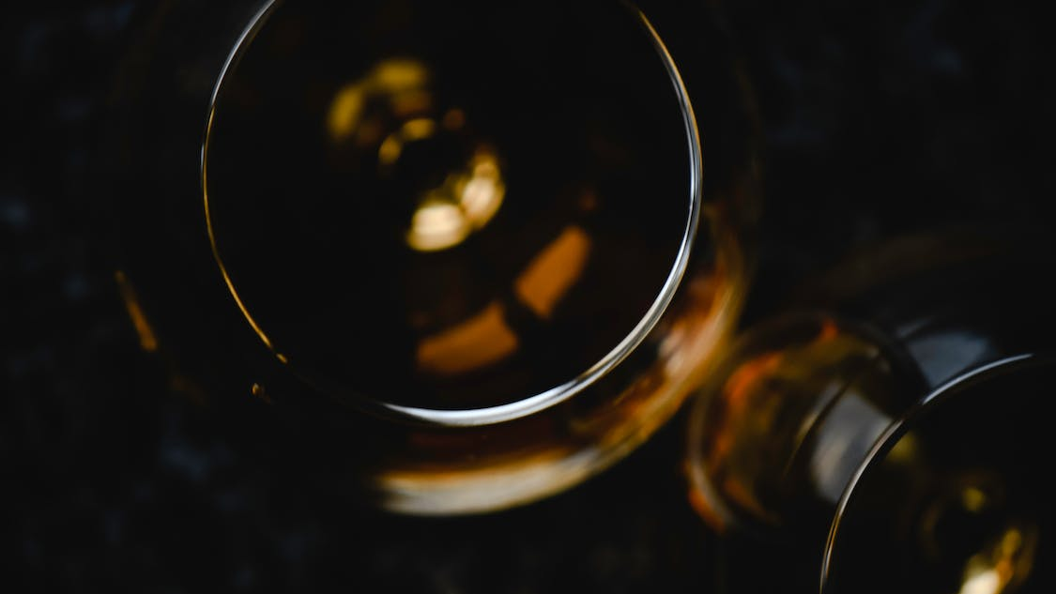
While Indian single malt is increasingly loved, understanding the broader golden elixir drinkers is crucial as they are as complex as the characteristically complex whisky notes

Slide 9
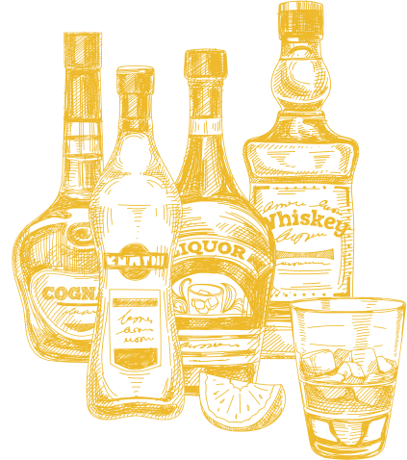
Decoding our Whisky consumers…

Slide 10
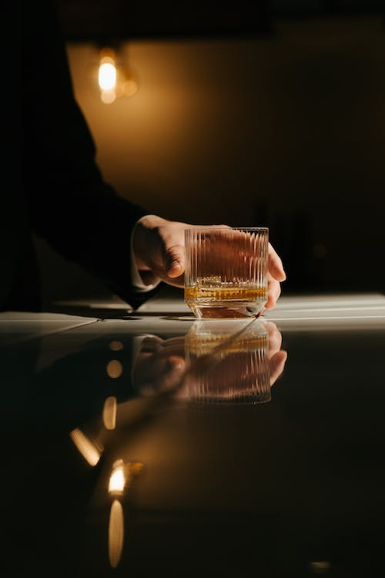
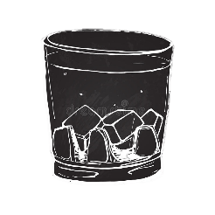
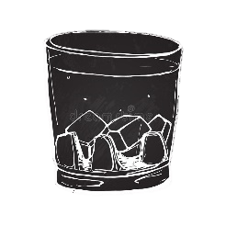
Conversations around Whisky have been inspiring intimate category nuances
“
I want to know how the whisky was made so that it can help me pinpoint certain elements I might prefer.
”
“
”
Whisky-drinking is not a monogamous pursuit
“
The smoky flavor of some whiskies do not appeal to me. I am not sure how to navigate my way through the notes
”

Slide 11
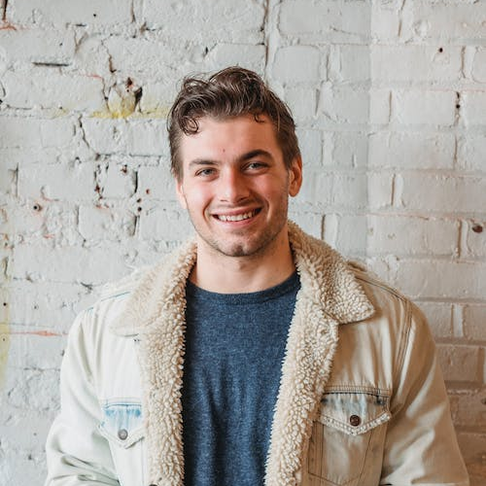
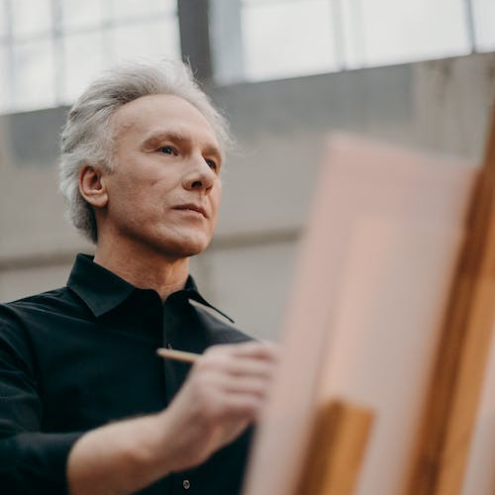
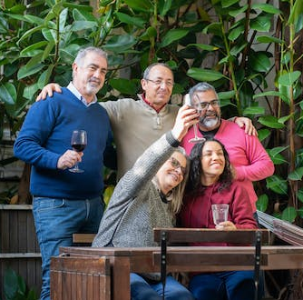
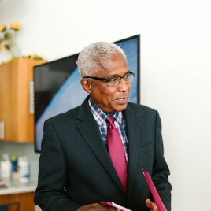
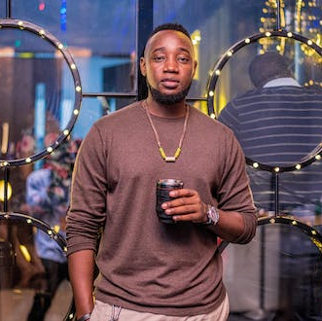
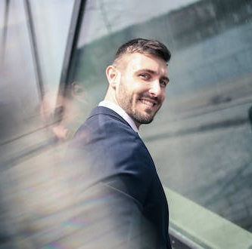
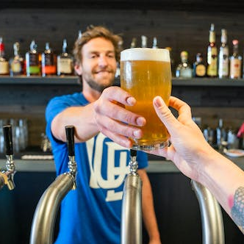
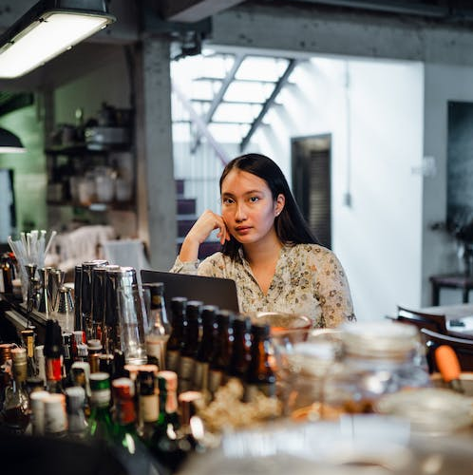
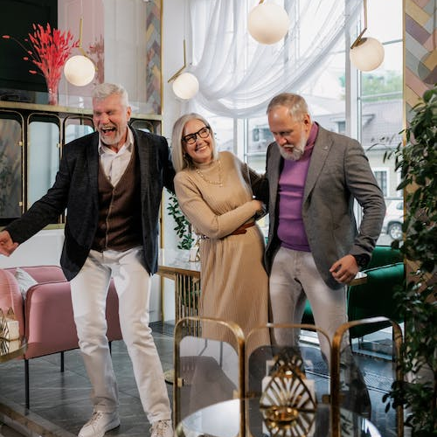

The whisky drinking spectrum is large and embodies multigenerational consumers
DIGITAL FIRST TG
SECONDARY TG
AGE 40
AGE 30
AGE 50
The Newbie
Fairly new to the whisky world, they are learning about the taste of straight, aged spirits
The Enthusiast
Casual drinkers who love to understand everything about their spirits
The Aficionado
A fully-fledged connoisseur who enjoys the quality of their spirits
The Host
May not always be a whisky fan themselves, they have an indirect relationship with spirits often hosting and gifting
Note : There can be an overlap across age groups and segments

Slide 12
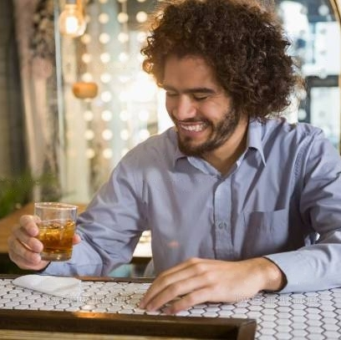
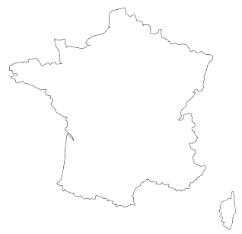
VICTOR
ABOUT
Age 31
Creative Strategist, France
CORE NEEDS
Victor is just starting to discover his bearings with whisky. Having being exposed to the world of alcohol in general, he has acquired taste for high-end premium brands. Being a newcomer in the whisky universe, no brands have quite leveled to his exquisite taste buds, but he believes that finding a favorite is part of the fun. He is inquisitive and grateful for any long-time whisky drinkers to impart their wisdom. He is navigating through his notions around whisky being ‘too strong’ and ‘too complicated’
MOTIVATIONS
PAIN POINTS
Victor is eager to learn all there is to know about this fantastic spirit. He loves experimenting with his whisky through mixers and cocktails looking to find flavors to compliment his classy interest
Looking for a full yet simple exploration of single malt through very approachable expressions, he is looking to build his preferences basis new ways to consume whisky
The Whisky Newbie
Note: Overlap can exist across individual personas and territories
Notes:
https://www.gaasly.com/blog/social-media-trends-france#:~:text=44%25-,Average%20time%20spent%20on%20social%20media,in%20general%20on%20social%20media.

Slide 13
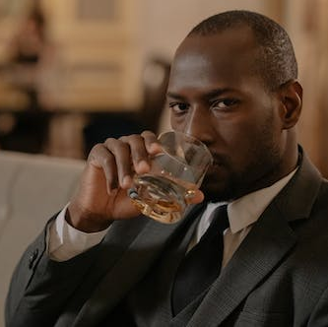

DAVE
ABOUT
Age 38
Financial Advisor, USA
CORE NEEDS
Whisky isn’t just a beverage for Dave, it’s a way of life. A whisky hermit, he is here to spread the gospel of how great the spirit is. He is a seasoned whisky drinker with elite preferences. He takes pride in drinking high-quality whisky and is intuitively drawn to lush, high-end liquor brands. Whilst others may have jumped onto G&T bandwagon in the past few years, he has remained a loyal whisky drinker. In his opinion, a glass of whisky is the perfect toast to every occasion.
MOTIVATIONS
PAIN POINTS
Affinity for whisky comes from the whisky culture in his family – his father drank it, so did his grandfather. He comes with sophisticated experience as well as expertise. Rapidly interested in the category, taste and luxurious quality have always been a top priority for him
Looking for premium quality whisky, legacy takes the front-end seat. He needs transparency from his brands to give detailed information around where and how the whisky was made like the age statement, the mash bill, the distillery, the backstory about the makers etc.
The Whisky Enthusiast
Note: Overlap can exist across individual personas and territories

Slide 14
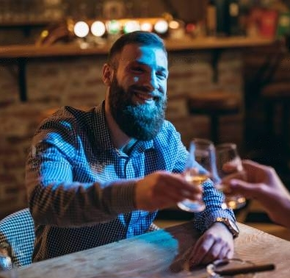
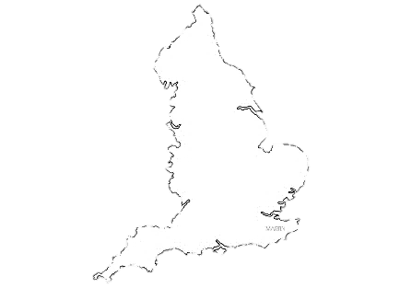
STEVE
ABOUT
Age 40
Investment Banker, UK
CORE NEEDS
Steve is a whisky encyclopedia and can talk about endless facts around the drink. For him, seeking whisky brands is not a linear pursuit. He loves exploring in the hopes to find unique flavors. Having been to innumerable tasting events, he loves vocalizing his opinions and seeks solace with like-minded people. He has found some of his favorite expressions in the premium category and considers association with sophisticated whisky brands as a seal of approval of his rich taste. He loves advocating his favorites. However, he does not want to adopt a brand for life.
MOTIVATIONS
PAIN POINTS
The
Whisky Aficionado
He is likely to be open to trying whiskies from all over the globe. He is looking to increase his expertise. Being intuitively dedicated to the category, he is looking for more exclusivity with his whisky experience
He seeks premium & exclusive experiences with his brand while being increasingly interested in the story behind his drink. Driven by variety, he would like to explore brands that compliment to balance his refined expectations
Note: Overlap can exist across individual personas and territories
Notes:
https://www.statista.com/statistics/284506/united-kingdom-social-network-penetration/#:~:text=As%20of%20the%20third%20quarter,by%20Instagram%20with%2056.4%20percent.

Slide 15
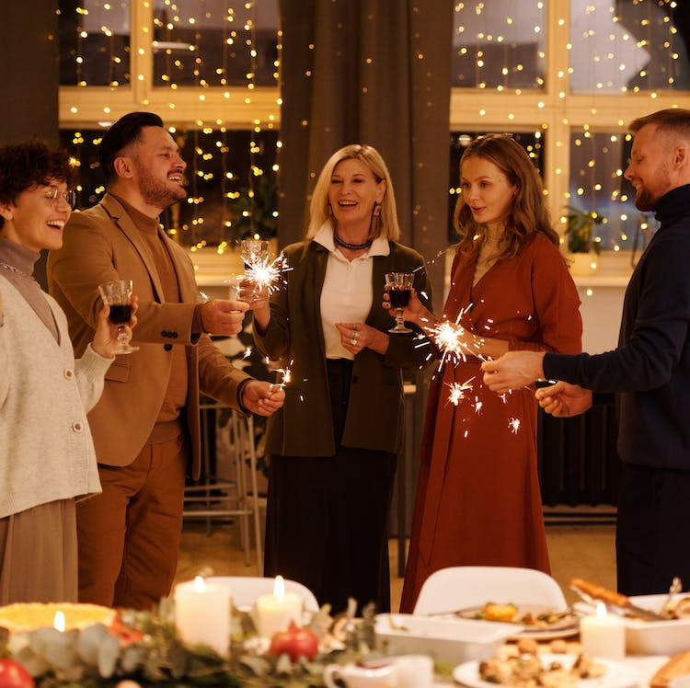
SANDRA
ABOUT
Age 33
Marketing Director, UK
CORE NEEDS
Sandra doesn’t drink often but loves to be a good hostess. As a C-suite executive, there is a high-end social status to maintain when hosting parties or looking for fancy gifts during celebrations. She often explores within the whisky world trying to indulge in classy, different & unique whisky labels in hopes of being the one to introduce something new to her guests. Celebrating occasions have her stocking-up her liquor cabinet or looking for the perfect whisky to gift
MOTIVATIONS
PAIN POINTS
Choosing the right whisky is a daunting task already and choosing a premium taste is even more dreadful for a light drinker and Sandra is usually looking for recommendations and actively exploring digital to purchase and evaluate her options
Sandra is looking for product and social understanding of the whisky she would be buying. She seeks recommendation guides, beautiful packaging and an assurance of taste
The
Whisky
Host
Note: Overlap can exist across individual personas and territories
Notes:
https://www.statista.com/statistics/284506/united-kingdom-social-network-penetration/#:~:text=As%20of%20the%20third%20quarter,by%20Instagram%20with%2056.4%20percent.

Slide 16
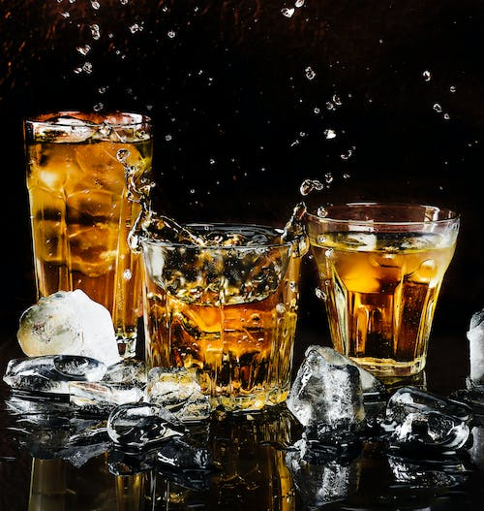
Thus, indicating a strong essence of whisky
Statement Of Character
Symbol of Camaraderie
Status Symbol
Whisky Is…
A Luxurious Asset
Collector's Item
Sign Of Progress
Drink Of Success

Slide 17

Therefore, Learnings from our consumers
NEED FOR RICH EXPERIENCES
NEED FOR DEPTH OF KNOWLEDGE
NEED FOR A VALUABLE COMMUNITY
Exploration, acknowledgement of consumer sentiments for whisky and narratives are powerful transitional persuaders, and help the brand in building high end experiences, simultaneously resulting in evaluation and trial.
Providing familiarity with the quintessential and daunting world of drink labels serves the whisky-curious universe of the newbies to develop a deeper appreciation for the and loyalty for the brand
Showcasing the social currency of the drink and its associated appreciators triggers intrigue and deepens love for the spirit

Slide 18


Analyzing our Peers…

Slide 19
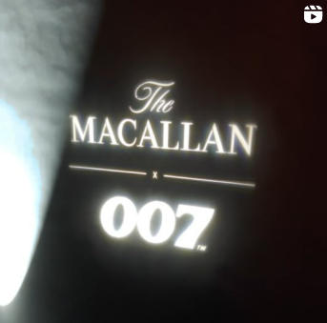
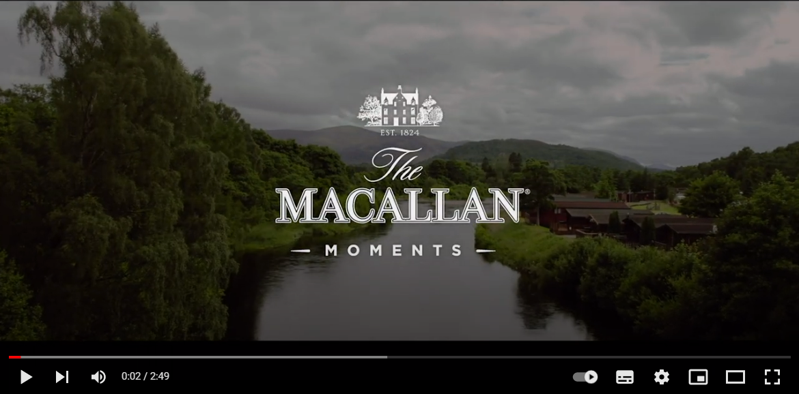
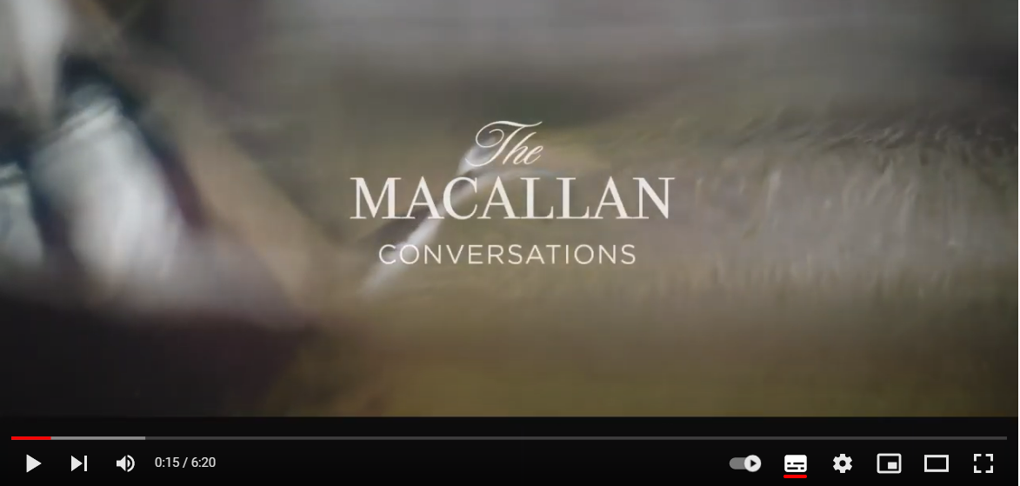
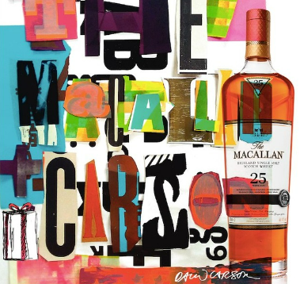
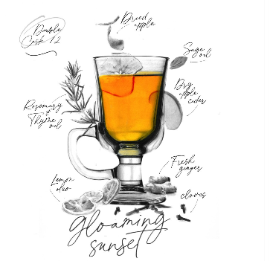
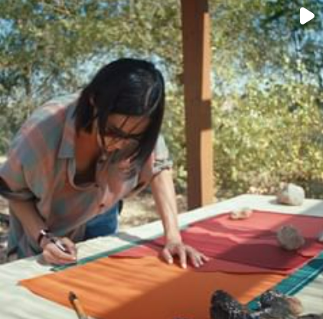
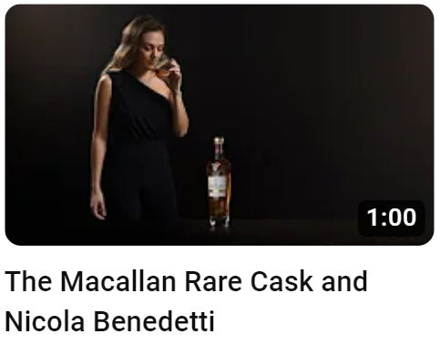
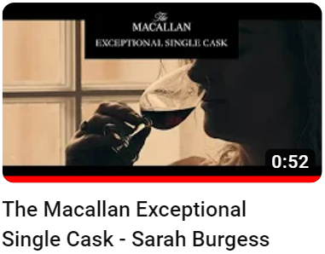
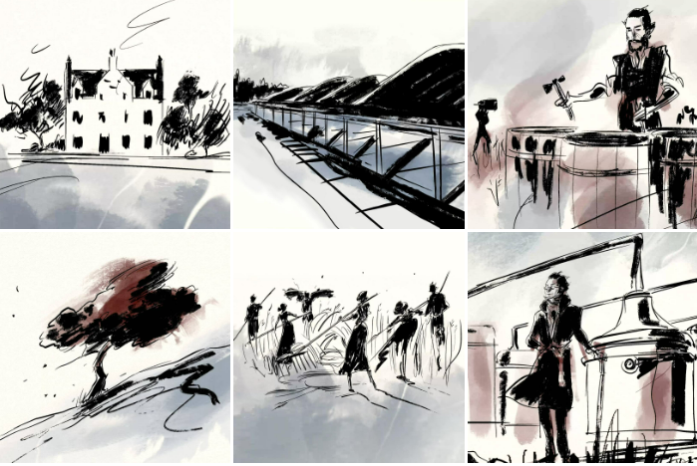
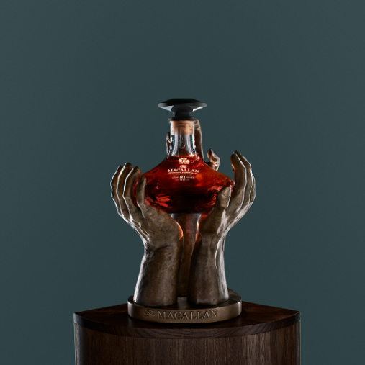
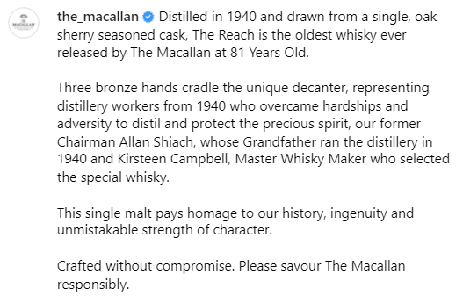
BRAND SPACE: THE RULER
BRAND USER
BRAND TONALITY
SOCIAL MEDIA PRESENCE
CONTENT OFFERING
The Macallan is status-first focusing on commitment to excellence highlighting legacy, luxury and sophistication through products and experiences. It exemplifies the Scottish lineage of traditional whisky-making
Discerning and affluent collectors of refine taste and sophisticated experiences valuing exceptional quality and craftsmanship
Heritage-bound, Artsy, Editorial, Honorable, Expert
Comes across as a canvas of stories and conversations around product, giving life to each of brand’s whisky expressions – from its history to its concept and inspiration
Informational & educational content around product history, gifting guides to develop understanding, appreciation and enjoyment of their whiskies.
IMMERSIVE EXPERIENCES
WHISKY IN CONVERSATION
Highlights pop culture brand experiences to inspire the whisky community
CREATIVE EXPLORATION
Leverages YouTube to hold conversations around similarities between pioneers across industries and the Macallan philosophy
COLLABORATIONS & REVIEW
Showcases inspiration behind whisky expressions, product packaging and whisky cocktails
PRODUCT INFORMATION
HISTORY
Highlights the Macallan whisky making process and their vision of sustainability and nurture driving the brand legacy through communication
Highlights artist collaborations to introduce whisky segments and outline whisky taste and texture
Narrates product details through educational nuances informing about the history of the whisky, the age statement, the cask used, building brand transparency

Slide 20
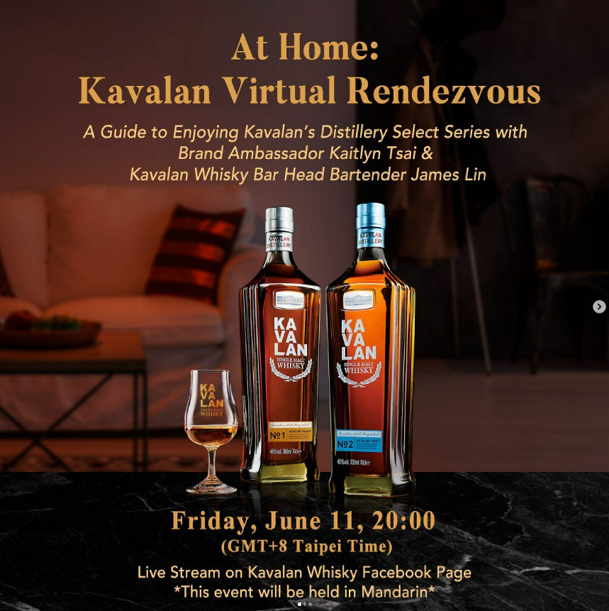
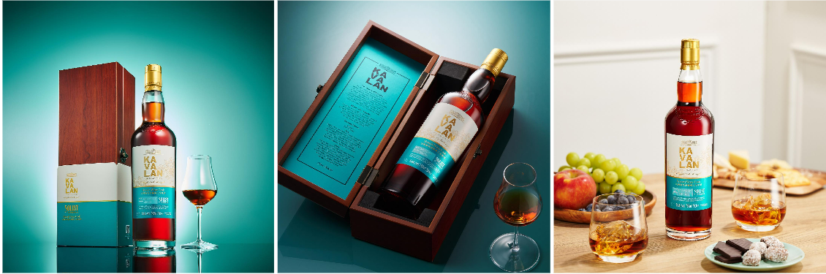
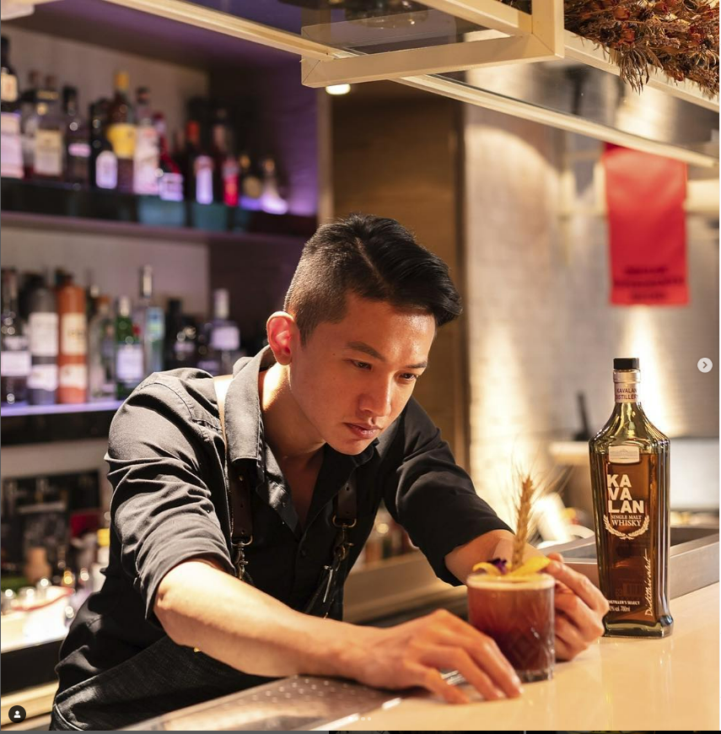
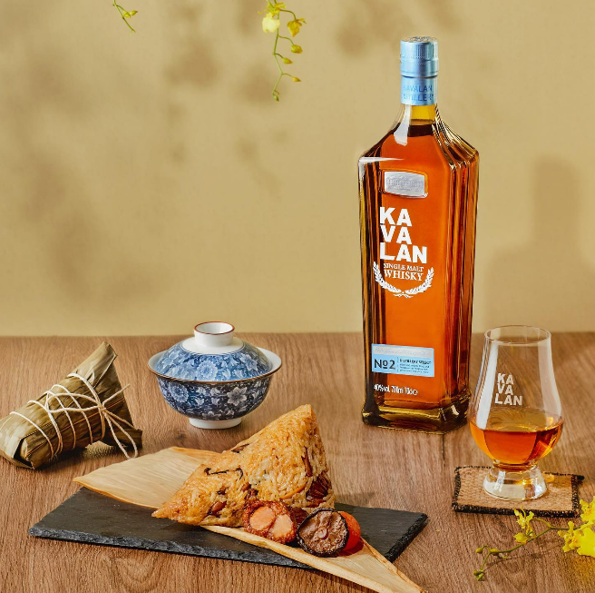
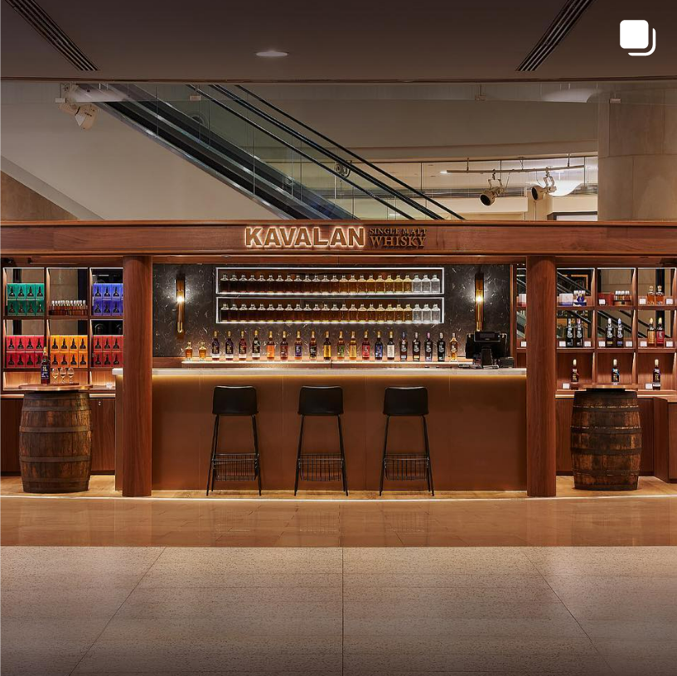
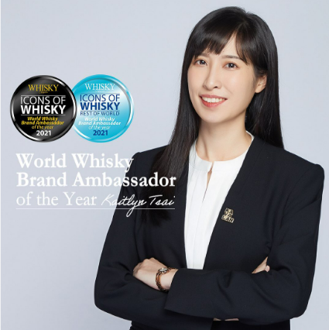

BRAND SPACE: THE CREATOR
BRAND USER
BRAND TONALITY
SOCIAL MEDIA PRESENCE
CONTENT OFFERING
Kavalan focuses on establishing itself in the international markets by introducing unique-tasting whisky, taking an informational approach characterized by the willingness to explore new territories.
Young, curious and open-minded whisky drinkers who value innovation, taste exploration and unique flavor experiences
Vibrant, Tropical, exploratory
Communication is product-first and highlights value-based uses of whisky as a drink
No YouTube presence was noticed
Product based informational content to develop an transactional understanding of brand offerings.
PROPOGATING COMMUNITY
PRODUCT AS THE HERO
Offering online tasting meets to nurture brand community
Product heavy communication highlighting offerings and complimentary packaging
DRIVING EXPLORATION
Ideas on whisky cocktails and mixology to inspire whisky drinkers to experiment and explore tastes
CULTURAL ASSOCIATION
Products are occasionally married into the Taiwanese culture to drive impact among users
BRAND MOUTHPIECE
Information around store launches and brand accomplishments to showcase brand growth and drive brand trust in the whisky community

Slide 21




When it comes to the overall presence, our peers have been able to occupy a distinct position…
HERITAGE ORIENTED
PRODUCT ORIENTED
Macallan is a storyteller acting like a timeless portal to the world of whisky.
Demonstration of legacy, strong expertise and traditional values is the core of the brand DNA.
Kavalan is more informationally inviting in nature. Highlighting a few cultural associations, it encourages the whisky community to be experimental with their taste platter. However, it has a catalogue-type approach to content.
An Indian brand gone global, Amrut has a cluttered space marrying all its offerings under a single umbrella with a product-first approach.

Slide 22

Reviewing how Rampur Single Malt is delivering value in the space…

Slide 23







HITS
PRODUCT INFORMATION
BRAND CREDIBILITY
Currently, the social platforms highlight product, flavor notes and transactional information for the audience.
Highlights on brand tasting events and accomplishments and accolades to strengthen brand trust among audience
LEANING INTO THE WHISKY COMMUNITY
Reposts from whisky enthusiasts helps highlight reviews and individual tasting experiences propagating brand recognition

Slide 24




UNEXPLORED OPPORTUNITIES
ENHANCE EXPLORATION
OPTIMISING ON EXPERIENCE
While Rampur has tried Mixology collaborations, we still have not optimized on encouraging users to explore OUR world of whisky that could help add value to our relationship with the consumers
Leveraging visual imagery that reflects the premium experience provided by the brand while also providing an escape to a world of all things Rampur
FURTHERING REACH
UNDEFINED NARRATIVE
Facilitating new age digital environments to reach a wider audience could help establish brand in the international market
Product skewed presence gives a catalogue-type essence. Shifting the narrative scales to talk more about the story of the product would help build brand resonance
While there are layers to our communication space, there is a missing overarching guiding thought stemming from the traditional roots highlighting the Indian lineage. This would help combine these fragmented puzzle pieces to introduce the Indian and mainly Rampur’s canvas to the world

Slide 25
Therefore, the learnings and opportunities…
Our peers have established distinct brand roles among their audiences looking to add value in the consumers’ lives through their communication. While Macallan leads by status and lineage, Kavalan leads by information around products
Thus, establishing a brand role stemming from the traditional roots of Rampur, providing users a window into a rich culture legacy will be the road to an ownable and distinguishable narrative.
Established brand voice and tonality has been helping our peers to appeal to key audiences furthering their individual brand associations.
Being clear on defining our key audience for the international market creates opportunities to own the diffused space. For a Rampur Whisky user, we are looking at a segment intrigued with the quaint Indian culture and inspired by the spirit of whisky
Our peers are providing their users with digital experiences that go beyond the utilitarian and transactional purpose inspiring their audience to explore and educating the whisky community
With our target audience residing internationally, it becomes crucial for us to introduce a digital bridge that helps strengthen brand association and further nurtures a deep bond with Rampur

Slide 26
THANK YOU

