Slide 1
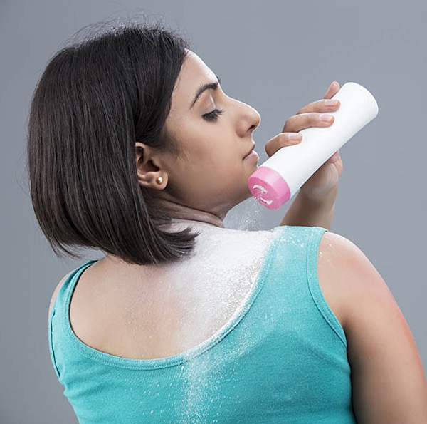


CRAFTING A DIGITAL STRATEGY FOR CANDID
Complied by :

Slide 2

Research Outline
Understanding the fungal skin infection landscape in India
Decoding consumer mindsets
Mapping peer conversations
Learnings and opportunities

Slide 3
Understanding the fungal skin infection landscape in India

Slide 4

“From a simple itch to fungi’s grand pitch, India’s skin story takes a compelling twist!”
Once dominated by ringworm and candidiasis, fungal skin infections have long been a part of India's dermatological landscape.
From traditional tales to modern challenges, dermatologists are facing a significant upswing and encountering 8-10 cases daily
Source : Times of India
Source: The Times of India
Notes:
https://timesofindia.indiatimes.com/city/bengaluru/fungal-skin-infections-rising-not-responding-to-usual-drugs-docs/articleshow/102047373.cms?from=mdr

Slide 5

Embedded within India's health scenario, this rise is influenced by a complex interplay of various factors, each playing a role in the spread of these infections…..
Climate and Environmental Dynamics
Within India's warm and humid climate, an ideal breeding ground is fostered for fungal propagation, leading to an upswing in conditions like ringworm, athlete's foot, and fungal nail infections
Transmission Nexus
Contagious in nature, fungal infections often harness direct contact with infected surfaces, acting as vectors for swift proliferation
Densified Demographics and Hygienic Practices
The dense population fabric coupled with uneven hygiene practices imparts impetus to fungal transmission, perpetuating these infections in varied communities
Skin Terrain Susceptibility
Those grappling with pre-existing skin ailments, such as eczema or psoriasis, stand more vulnerable to fungal intrusion due to compromised dermal layers
01
03
Antifungal Resistance
The emergence of fungal strains resistant to traditional treatments, propelled by the injudicious use of antifungal agents, heightens the intricacies of combating these infections effectively
Limited Awareness
Insufficient dissemination of knowledge concerning preventive measures and timely treatment exacerbates the challenges posed by fungal infections, impeding effective mitigation strategies
Source: Derma360, NetMeds
Notes:
https://www.dermathreesixty.com/the-rising-demand-for-topical-antifungals-in-the-pharmaceutical-industry/
https://www.netmeds.com/health-library/post/fungal-infections-causes-treatment-and-the-right-products-to-cure-this-monsoon-skin-condition

Slide 6

In the past, the management of fungal infections was interwoven with external considerations such as societal judgments and prevailing misconceptions
Leading to fungal treatments for skin being administered discreetly and after enduring a great ordeal

Slide 7

However, with newer generations taking the reins of consumption, attitudes towards fungal infections are undergoing a remarkable transformation in today's present-day panorama.
From Hush-Hush to Health: Gone are the days of considering fungal infections a mere social embarrassment. Today, it's all about proactive self-care and awareness.
Preventive Power: The spotlight is now on prevention! Young minds are adopting healthier lifestyles, hygiene practices, and seeking professional guidance for early intervention.

Slide 8
Decoding the ‘new age’ mindsets

Slide 9

Younger consumers are driving a phenomenal metamorphosis that goes beyond surface appearances, embracing a broader idea of 'personal empowerment’
This, is leading to a more informed attitude and expectation from the players in the category

Slide 10

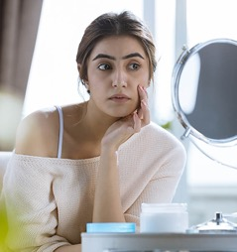

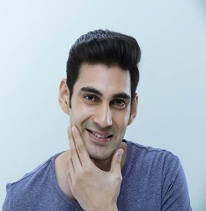
Their mindsets can be broadly categorized into...
Immediate Relief Seekers
Long term Relief Seekers
Health-Conscious Individuals
Preventive Planners
Encompasses individuals with active lifestyles, such as athletes, sportspersons, and others who are prone to infections due to sweat and physical activity. Their primary concern is to find products that can provide fast relief, alleviate discomfort and allow them to continue their activities without hindrance
Individuals dealing with persistent and severe fungal infections. They are in search of permanent solutions that address the root cause of the problem. They are likely to have experienced recurrent infections and are determined to find treatments that offer lasting relief
Individuals embodying a holistic approach to well-being, where skin care is an integral facet of self-care. For them, tending to skin health goes beyond superficial concerns, resonating with their commitment to overall vitality and confidence. They embrace antifungal care as an extension of their holistic wellness philosophy
Proactive individuals who aim to avoid issues before they arise. They take measures to prevent fungal infections due to factors like having sensitive skin, an underlying health condition, or a history of infections. These individuals are focused on maintaining their skin health to prevent potential disruptions to their daily lives

Slide 11
With each segment displaying distinct needs
Immediate Relief Seekers
Long term Relief Seekers
Health-Conscious Individuals
Preventive Planners
NEEDS:
- Fast acting remedies that swiftly alleviate symptoms without interrupting their routines
- Solutions that offer both immediate relief and ongoing prevention
- Convenient packaging for on-the-go use
NEEDS:
Long lasting treatments that not only provide relief but also address the underlying cause
Products with proven track records of preventing relapses
Personalized guidance from experts
NEEDS:
- Products that align with their wellness-driven ethos
- Formulations that nourish skin health while addressing infections
- Solutions that enhance both physical and emotional self-assurance
NEEDS:
Science-backed preventive treatments that cater to their unique circumstances
Products that offer a proactive shield against infections without causing irritation

Slide 12

Hence, Candid must assume a distinct role on social media – one that transcends product limitations and fosters a connection catering to emotional needs of consumers across mindsets.

Slide 13
Therefore, the emotional lens for Candid on social will be an embodiment of…
Immediate Relief Seekers
Long term Relief Seekers
Health-Conscious Individuals
Preventive Planners
QUICK RESILIENCE
Fast-acting solutions that fit seamlessly into their active routines, enabling them to overcome challenges swiftly and unleash their full potential
ENDURING COMFORT
Comprehensive solutions that promise enduring freedom from discomfort by being a trusted ally in their quest for sustained relief, whilst empowering their sense of control
EMPOWERED WELLNESS
Weaving antifungal care into a narrative of holistic wellness, empowering individuals by demonstrating how skin care is a powerful expression of self-love, confidence and internal harmony
PROACTIVE PROTECTION
Science-backed preventive solutions, empowering them to proactively safeguard their skin health and maintain their stride with uninterrupted vitality

Slide 14
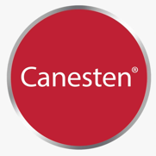
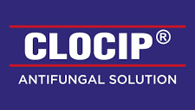

Analyzing our Peers

Slide 15
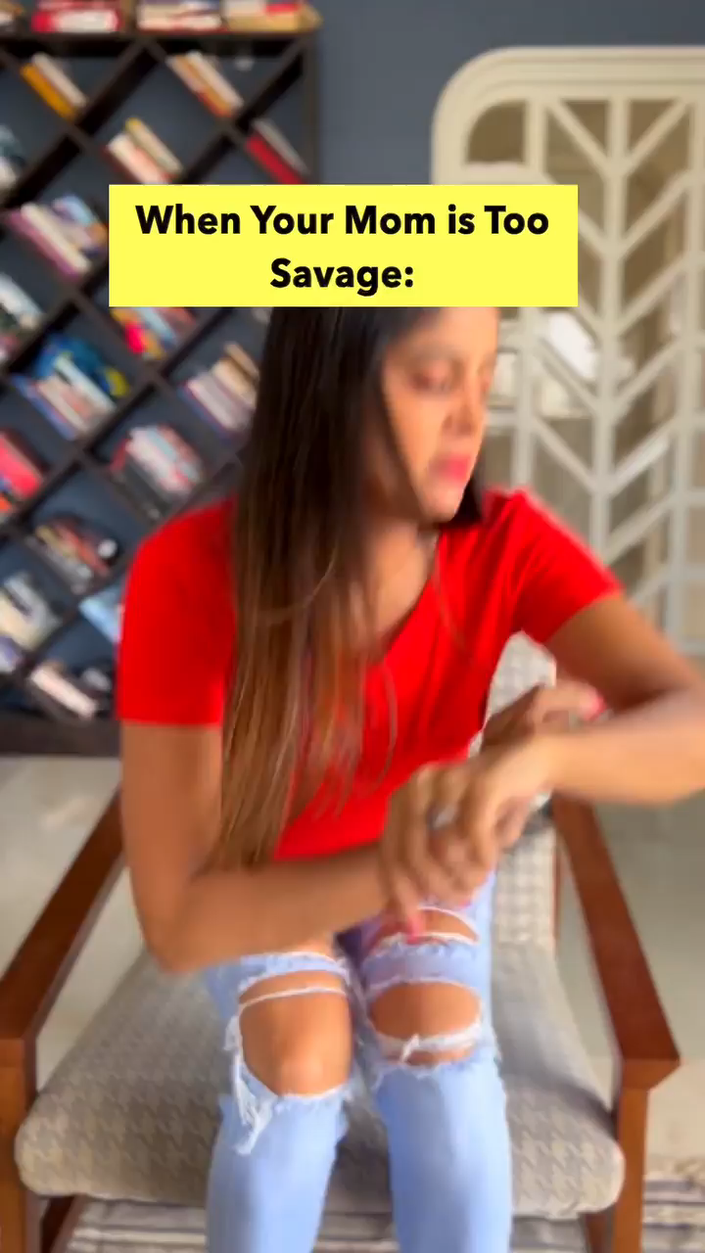

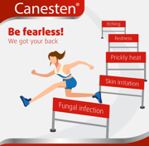
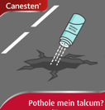
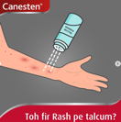



BRAND APPROACH:
BRAND USER:
BRAND TONALITY:
SOCIAL MEDIA PRESENCE:
CONTENT OFFERINGS:
Centers on encouraging individuals to think wisely and choose Canesten over talcum powder for rashes, highlighting its superiority in addressing skin issues and positioning Canesten as the ideal solution for combating and eradicating rashes at their root
The brand caters to active youngsters and families seeking effective solutions for rash management during their day-to-day activities
Cleverly straightforward with a hint of sarcasm and humor
Dedicated to showcasing the product's versatility across various scenarios, all underlined by the core message, “Dimaag lagao, rash pe Canesten lagao”
The product takes the spotlight in their content, featuring its usage in diverse scenarios. It is further amplified by incorporating influencers driving home the brand’s core message
Influencer Collaborations
Collaboration with influencers to craft comedic sketches portraying the product’s versatility across diverse situations, all while reinforcing the brand’s core message
For eg: Sameera Reddy, Anisha Dixit, Sakshi Shivdasani, Shibani Bedi, and many more
Brand Role:
Specialized Rash Care Management
The brand establishes itself as a trusted partner in eradicating rashes and enhancing skin well-being. As India's premier Antifungal brand, it redefines rash management through its specialized 5-in-1 solution, addressing a spectrum of skin concerns
Play Video
Play Video
Leveraging sarcasm
Employing a playful and sarcastic tone, the brand's core message ingeniously nudges users to use their brain wisely and tend to rashes with Canesten
*Vernacular communication observed on YouTube campaigns

Slide 16
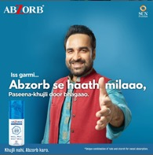
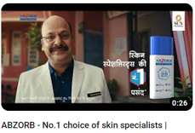
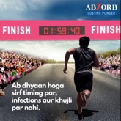



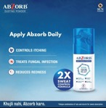
BRAND APPROACH:
BRAND USER:
BRAND TONALITY:
SOCIAL MEDIA PRESENCE:
CONTENT OFFERINGS:
Abzorb Dusting Formula's innovative dual-action sweat formula not only effectively manages sweat but also proactively prevents itchiness. Thereby, liberating customers to focus on more meaningful pursuits, unburdened by the nuisances of incessant itching or sweat concerns
Millennials who aspire to smoothly navigate through their daily routines without any disruptions
Concise, Straightforward, Informative and Relatable
Creating awareness about the importance of averting itching and sweating while highlighting their product's role in enabling uninterrupted pursuits of personal goals
Centers on campaigns and diverse product use-case scenarios, showcasing the effectiveness of the product
Brand Face: Mr. Pankaj Tripathi
Focus on Credibility
The brand strategically utilizes Pankaj Tripathi's relatable image to connect and resonate with the audience, infusing a delightful touch of humor
Seeking to nurture trust and enhance credibility, the brand underscores its position as the preferred choice of skin specialists
Incorporating product usage into daily lifestyle
Shedding light on the daily challenges posed by itching during routine tasks, the brand encourages individuals to incorporate the product into their daily regimen for relief
Brand Role:
Aspiration aligned Relief Provider
Highlighting reliability, the brand encourages directing attention towards goals & aspirations while addressing the inconvenience of itching
*Vernacular communication observed on YouTube campaigns
Notes:
https://twitter.com/myabzorb
More active on Twitter

Slide 17
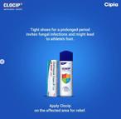

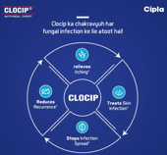


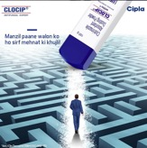

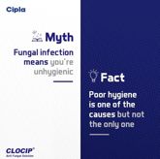
Positioned as a solution for itchiness and fungal infection prevention, Clocip offers a specialized formula that addresses both problems, providing relief and a cure. It ensures no distractions while individuals focus on their goals, allowing hard work to be their only itch
BRAND APPROACH:
BRAND USER:
BRAND TONALITY:
SOCIAL MEDIA PRESENCE:
CONTENT OFFERINGS:
Tailored for driven youngsters who remain highly motivated and unwaveringly focused on their goals
Informative, Educational, Straight forward and Approachable
Educating consumers regarding the adoption of healthy habits to prevent fungal infections. Furthermore, they emphasize the importance of seeking treatment through their product that intends to provide effective assistance
Product usage across diverse situation, Informative content highlighting the benefits of the product, and Educational content that guides individuals on the habits that help prevent fungal infections
Product as the ‘Hero’
Showcasing the advantageous benefits of the product while underscoring its suitability as the brand of choice for hardworking individuals
Product Usage
By highlighting the regular hurdles presented by persistent itching and discomfort, the brand imparts knowledge to individuals, guiding them to integrate the product into their routine as a preventive measure against both fungal infections and itching
Brand Role: Ambition Enabler
The brand aims to empower ambitions aligning with the ambitions of determined and diligent individuals, where the pursuit of achievement guides their path.
Positioned as a remedy for itchiness and fungal infection prevention, Clocip's specialized formula offers relief, allowing undistracted focus on aspirations
Educational Content
Enlightening consumers about strategies for averting fungal infections
Play Video
Notes:
Only Marathi communication observed on YouTube

Slide 18
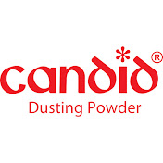
Assessing how Candid is delivering value in the space……..

Slide 19
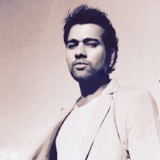
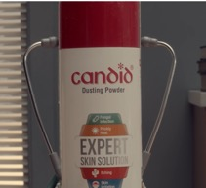

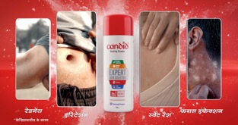
Candid's online presence is limited to YouTube, primarily for brand campaigns, potentially hindering the establishment of a deeper connection with consumers across broader social media platforms…..
Brand Face: Rohit Sharma
Just as Rohit Sharma showcases all-round proficiency in cricket, Candid Powder stands as a confirmed remedy for four prominent skin concerns
Brand Role: Expert Skin Solution
Aiming to cultivate trust and boost credibility, the brand highlights its role as an Expert skin solution, favored by dermatology experts and often recommended by them for fungal infections
Candid Powder offers alleviation from four specific skin issues: redness, irritation, sweat rash, and fungal infection.
Candid Powder emerges as a steadfast ally, addressing the comprehensive range of challenges associated with fungal infections. By providing effective solutions, it ensures that individuals can maintain an unshakable focus on their aspirations, enabling individuals to navigate their journey with confidence, undeterred by the distractions that skin issues can bring
*Vernacular communication observed

Slide 20
To summarise, the Gaps and Opportunities…
Brand Advocacy Disparity
Opportunity for Candid
Gap 1
Palpable Storytellers
Despite enlisting Mr. Rohit Sharma as our brand ambassador, Candid’s brand advocacy footprint remains limited. In the contemporary digital landscape, influencers are gaining traction as authentic and relatable voices, particularly among the younger demographic
Expand its reach by collaborating with influencers beyond the category who resonate with the younger audience.
By forging connections through relatable and authentic narratives, Candid can extend its brand's impact, fostering deeper engagement and relevance in the ever-evolving consumer landscape
Gap 2
Opportunity for Candid
Visual Imagery
Visualizing the brand tribe
Across the category, brands are attempting to articulate the audience through visuals but are missing out on the opportunity of including younger faces.
Additionally, Candid's similarity in brand color to Canesten blurs its distinct identity, resulting in reduced brand recognition
Candid needs to identify and define its audience and must be conscious of including resonating imagery of its young users.
We will also have to create ownable and distinct visual assets to overcome the challenge of the similarity in brand colors with our peers.
Gap 3
Brand Role
Opportunity for Candid
Defining ‘Why us’
Our peers have strategically assumed distinctive brand roles that strongly resonate with their respective audiences
The fungal infections category can get commodified making it crucial for Candid to uniquely define its brand role and strengthen its distinct role in the life of its users.

Slide 21
THANK YOU
Notes:
\

