Slide 1



Strengthening The Brand’s Digital Footprint In India

Slide 2
SR No | Table Of Content | Page No
1 | About WRM | 03-20
2 | Research & Analysis (Brand & Competitor) | 21-65
3 | Creative Approach | 66-149
4 | Content Summary (Creative Approch) | 150

Slide 3
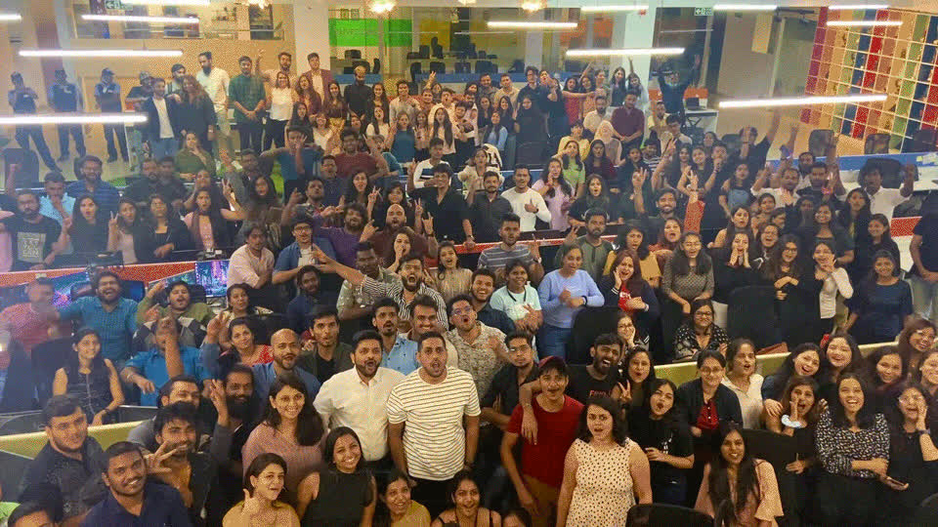


Slide 4

We are a full-stack ad agency that thrives on experiences, perspectives, and ideas that our people bring to the table.
We consume and are consumed by the world around us, as the work we do is made more real and resonant by it!
We are Culture hackers!
450+
12
600+
Years
Awards
Fam

Slide 5


Globally credited as the Best Independent Digital Agency

Slide 6





South Asia’s Top Agency
CSR Achievement
Of the Year
Social Media
Agency Of the Year
Entertainment
Agency Of the Year
Influencer Marketing
Agency Of the Year
Production Company
Agency Of the Year

Slide 7
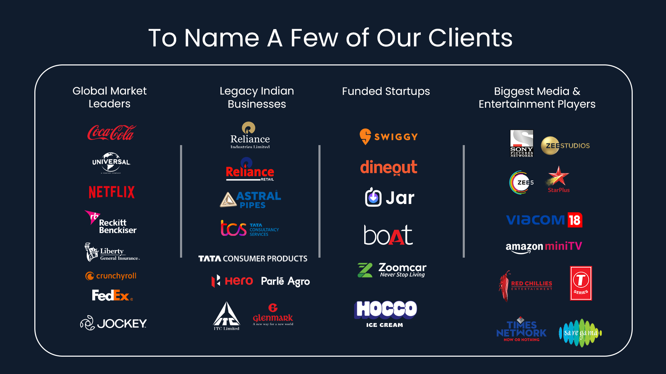
‹#›
Notes:
‹#›

Slide 8
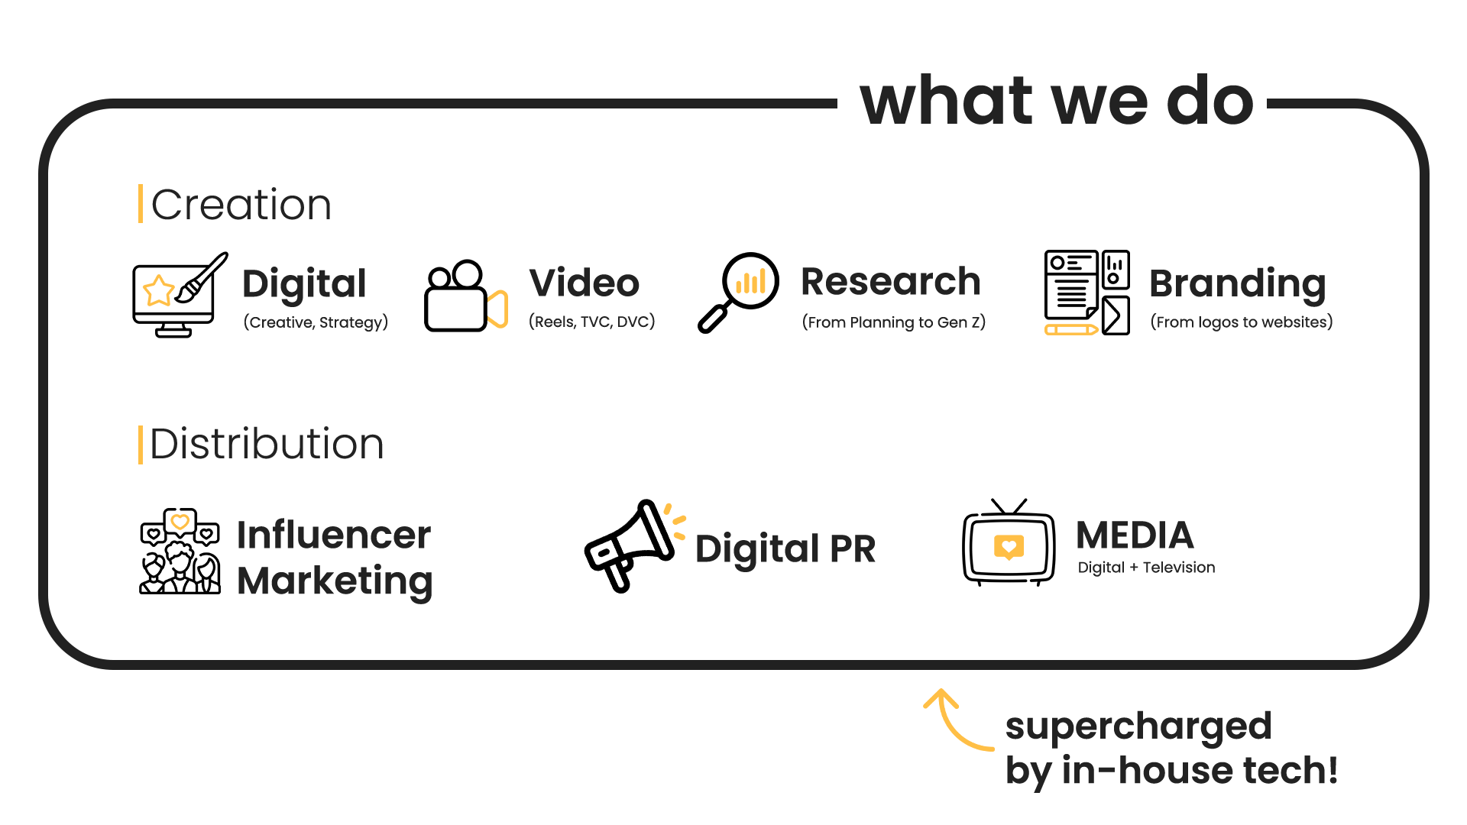

Slide 9
CASE STUDIES
Quick Read

Slide 10


SMFG INDIA CREDIT
#BadloApniPehchaan
CAMPAIGN
‹#›
Notes:
‹#›

Slide 11
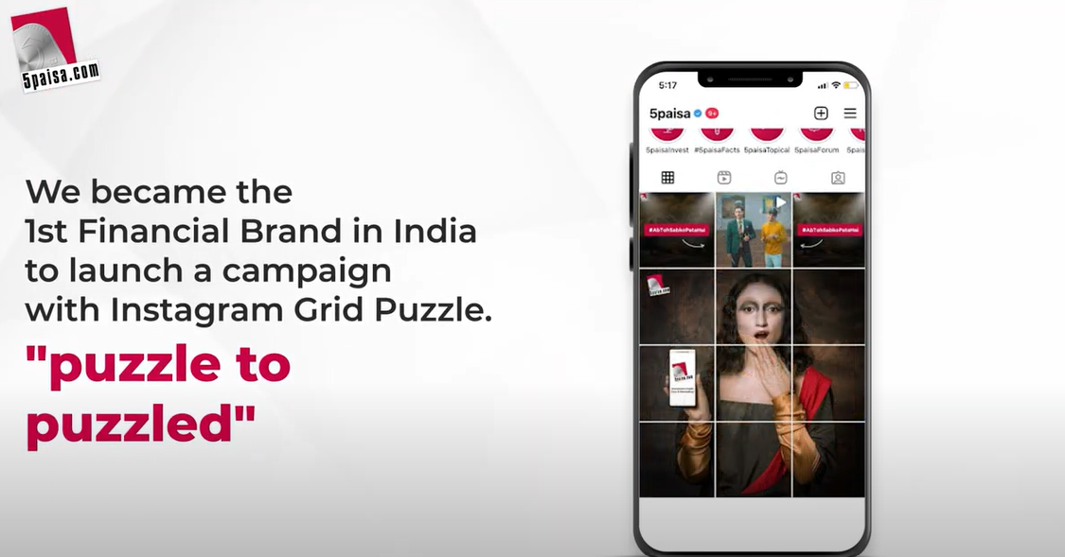
5 PAISA
#AbTohSabkoPataHai
CAMPAIGN
‹#›
Notes:
‹#›

Slide 12
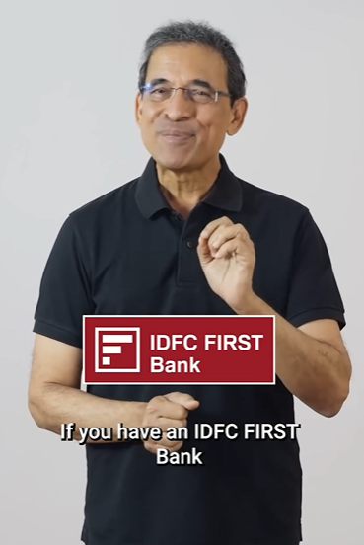
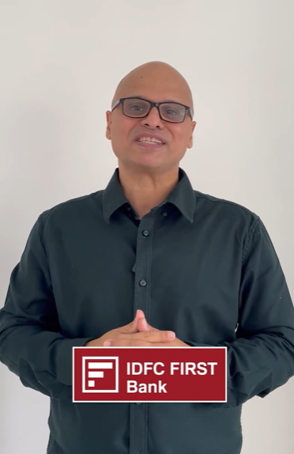
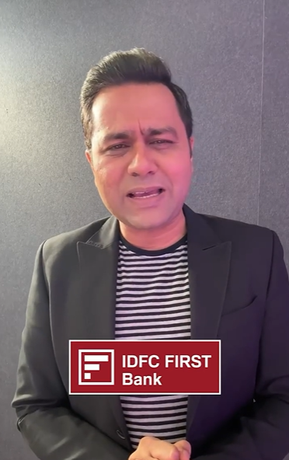
IDFC FIRST BANK
#Credit Card &SavingsAccountxT20
CAMPAIGN
Harsha Bhogle
Vikram Sathaye
Aakash Chopra
Notes:
‹#›

Slide 13
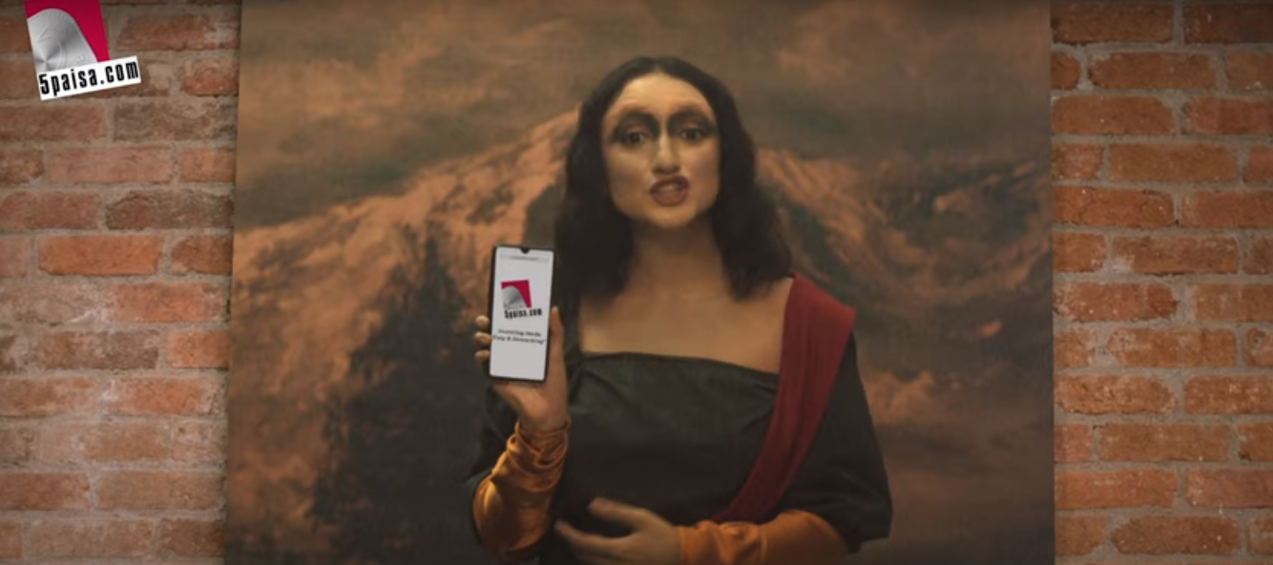
5PAISA.COM
#AbTohSabkoPataHai
TVC
‹#›

Slide 14

ACTYV AI
#Actyv.ai_Pe_Score_Karo
DVC
‹#›

Slide 15


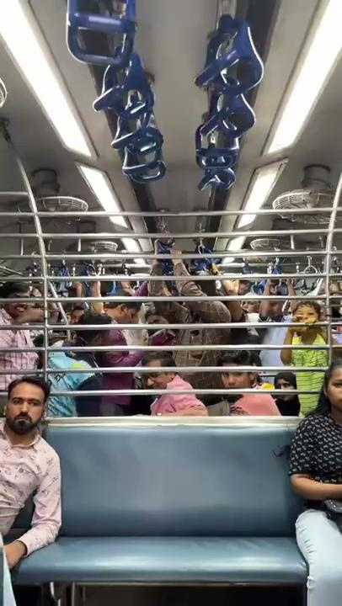
Crocs x The Quick Style
Coca Cola x The Quick Style
BoAt x The Quick Style
Notes:
‹#›

Slide 16

DS GROUP: PULSE CANDY
INNOVATION
‹#›

Slide 17

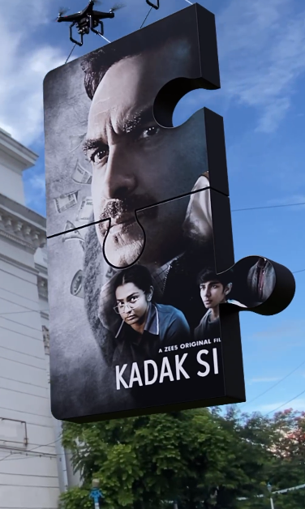

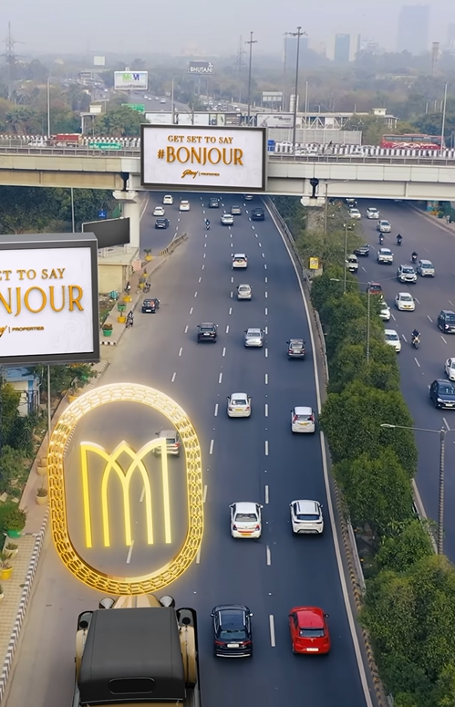
Innovation- CGI
UNIVERSAL
PICTURES INDIA
ZEE5 INDIA
ZEE5 GLOBAL
GODREJ PROPERTIES

Slide 18






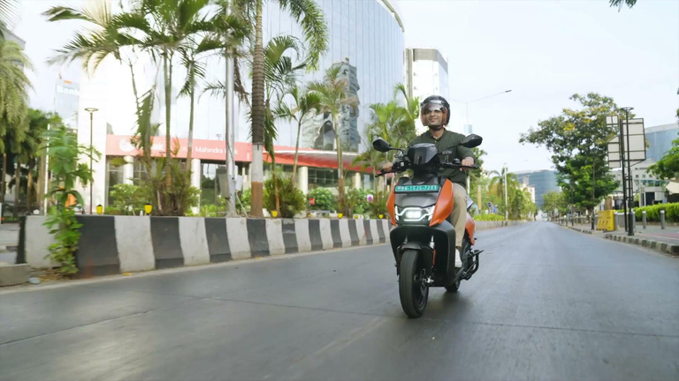

Innovation- AI
ZEE5 GLOBAL
JUNGLEE PICTURES
HERO VIDA

Slide 19

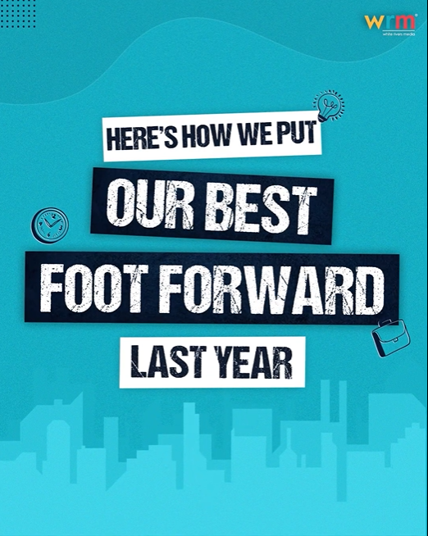

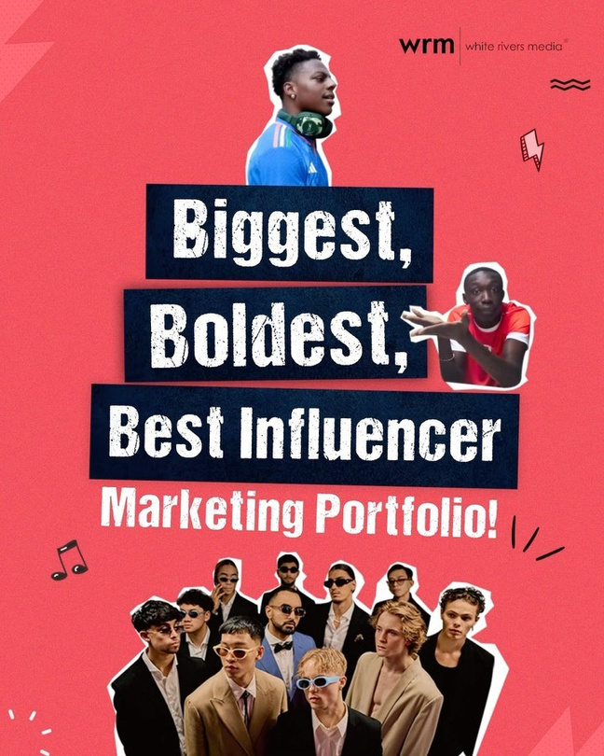

And the best part? It doesn’t stop there!
Play the videos

Slide 20



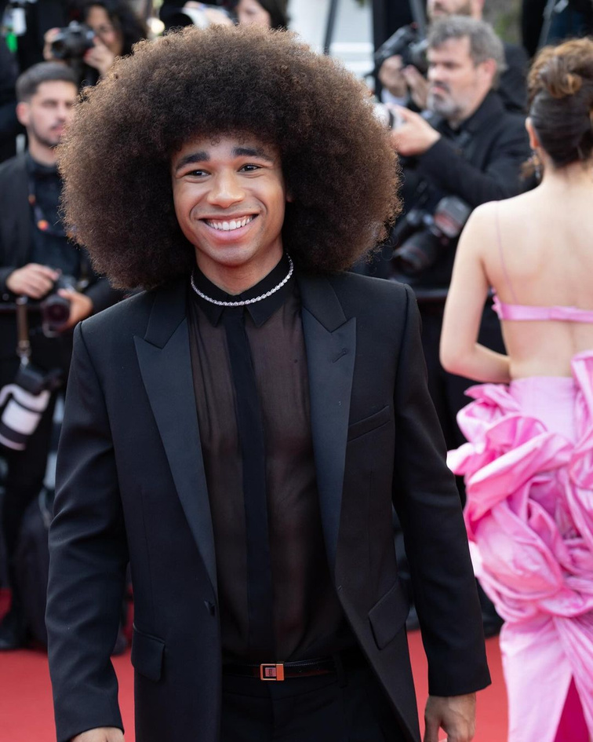
The Exclusive Agency to Bring
Global Internet Sensations to India
Khaby Lame
The Quick Style
iShowSpeed
Noel Robinson

Slide 21



Research Approach

Slide 22

OUR
AGENDA
1
Exploring The Category & Consumer Behaviour
2
Deep Dive into Competitor Brands
3
A Look At Our Brand & The Way Forward

Slide 23

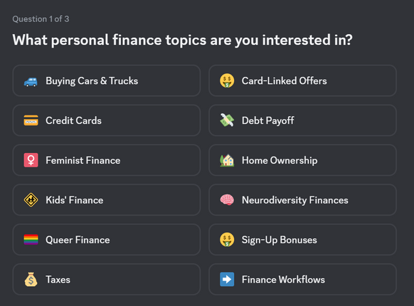


Shifting customer expectations are set to disrupt the Indian banking sector by 2030
But, what is changing?
A demanding youth consumer base
Over 50% of banking transactions in India occur on digital channels, driven by the demand for real-time processing and approvals.
A Tech native banking experience
75% of India’s workforce will consist of Millennials and Gen Z
With 55% of Gen Z in India prefer AI-driven recommendations for managing their finances
A hyper personalized context
36% of customers are willing to switch banks if their needs aren’t met through personalized services.
Source : BCG, Deloitte, McKinsey
Notes:
McKinsey’s insights suggest that by 2025, over 50% of banking transactions in India will occur on digital channels, driven by the demand for real-time processing and approvals.
4

Slide 24
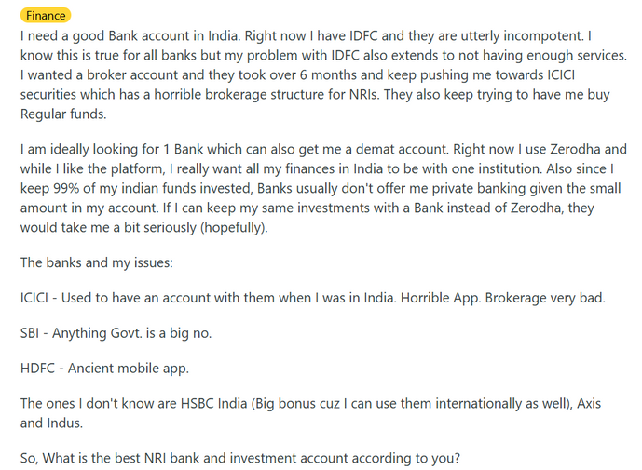
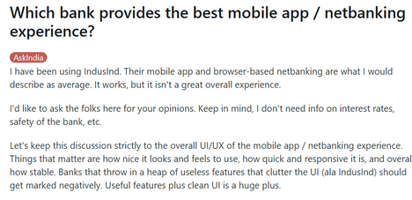
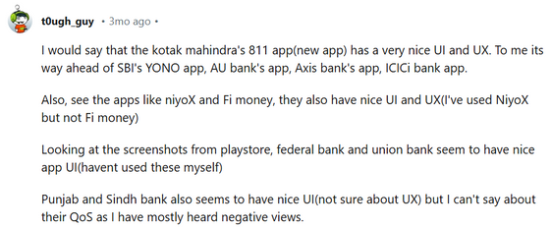
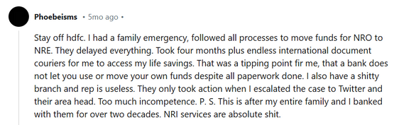
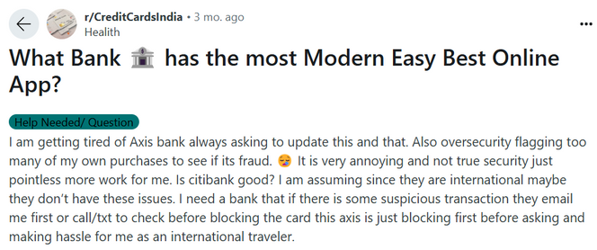
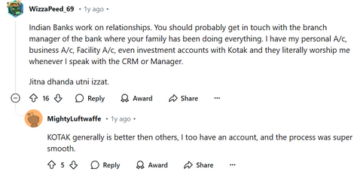
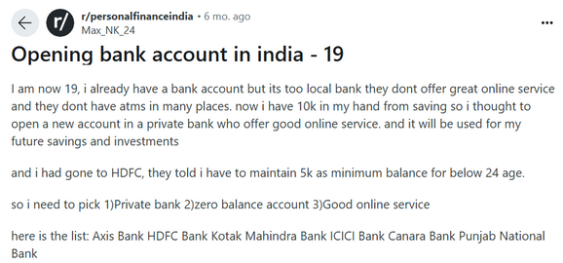
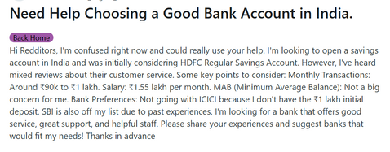
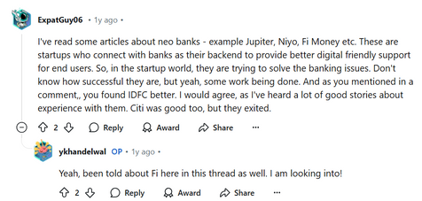
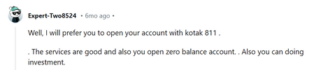
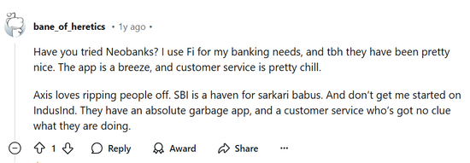
Indian Consumers are increasingly seeking higher-value banking experiences while turning to trusted communities and going beyond peer recommendations
DEMAND FOR EMBEDDED FINANCE
PRIORITISING UI/UX AND TECH FEATURES
SIMPLIFICATION OF PROCESSES
FIRST TIMERS SEEKING COST EFFICIENT OPTIONS
GRAVITATING TO NEO BANKING FOR DIGITAL EASE
SOURCE: REDDIT

Slide 25
Indian Consumers are increasingly seeking higher-value banking experiences while turning to trusted communities and going beyond peer recommendations
DEMAND FOR EMBEDDED FINANCE
PRIORITISING UI/UX AND TECH FEATURES
SIMPLIFICATION OF PROCESSES
These consumers, while diverse, are united by the common search for seamless banking features and promises beyond interest rates
FIRST TIMERS SEEKING COST EFFICIENT OPTIONS
GRAVITATING TO NEO BANKING FOR DIGITAL EASE
SOURCE: REDDIT

Slide 26
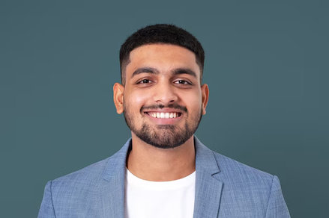



They are driven by their financial goals and distinguished mindsets towards banking & finance
THE EARLY
EARNER
THE ASPIRING
PLANNER
THE WEALTH
BUILDER
THE EXPERIENCE
SEEKER
First Jobbers, Young Professionals, Paycheck Optimizers
Mid-Jobbers, Young Entrepreneurs, Early Savers
Senior Professionals, Growing Entrepreneurs, strategic investors
High Earning, Lifestyle-Oriented Consumers
Income 3-7L
Income 7-15 Lac
Income 15-50L
Income 50L+
Notes:
7

Slide 27




NEEDS:
- Basic salary account with minimal fees
- Easy access to credit (first credit card, BNPL, small loans).
- Simple investment options (SIPs, recurring deposits).
- Budgeting tools and financial literacy resources.
BEHAVIOUR:
- Prefers mobile-first, app-based banking with instant access.
- Avoids complex banking jargon; prefers straightforward, guided experiences.
- Explores credit but is cautious due to a lack of financial history.
PROFILE OVERVIEW
The
Early Earner
DIGITAL BEHAVIOUR & CONTENT CONSUMPTION:
- Relies on Google searches, Instagram Reels, and YouTube for finance learning.
- Follows finfluencers like Ankur Warikoo, CA Rachana Ranade for beginner tips.
- Engages in finance meme culture, making banking seem more approachable.
₹3L - ₹7L annual income
Starting their financial journey, eager to manage earnings but often uncertain about financial planning
DIGITAL OVERVIEW
KEY PLATFORMS
NOTE: Overlap may exist between profiles
Notes:
8

Slide 28



NEEDS:
- Higher savings returns, structured investment options (mutual funds, ELSS, PPF).
- Personal finance insights to optimize expenses, taxes, and savings.
- Low-cost insurance and financial safety nets.
BEHAVIOUR:
- Regularly tracks expenses and investments via apps.
- Prefers digital banking but values some human guidance for financial planning.
- Actively compares financial products for best interest rates and benefits.
PROFILE OVERVIEW
The
Aspiring Planner
DIGITAL BEHAVIOUR & CONTENT CONSUMPTION:
- Reads personal finance blogs, LinkedIn articles, and money management guides.
- Uses Reddit finance communities for peer advice.
- Engages with podcasts and YouTube deep dives into financial planning.
₹7L - ₹15L annual income
Actively saving and investing, but still seeking guidance on financial growth
DIGITAL OVERVIEW
KEY PLATFORMS
NOTE: Overlap may exist between profiles
Notes:
9

Slide 29

NEEDS:
- Holistic wealth management and tax optimization strategies.
- Diversified investments (stocks, real estate, global markets).
- Premium banking services with priority support and personalized advisory.
BEHAVIOUR:
- Prefers a blend of digital and personal banking, valuing expert guidance.
- Actively engages with market trends, investment opportunities, and financial reports.
- Seeks seamless banking experiences across personal and business accounts
PROFILE OVERVIEW
The
Wealth Builder
DIGITAL BEHAVIOUR & CONTENT CONSUMPTION:
- Subscribes to financial newsletters, wealth reports, and market trend analysis.
- Attends webinars and online workshops on investment strategies.
- Reads LinkedIn articles from banking and finance experts.
₹15L - ₹50L annual income
Wants a mix of wealth preservation and growth, looks for efficiency in banking.
DIGITAL OVERVIEW
KEY PLATFORMS
NOTE: Overlap may exist between profiles
Notes:
10

Slide 30

NEEDS:
- Exclusive banking benefits (concierge services, travel perks, luxury spending rewards).
- Global investment opportunities and cross-border wealth management.
- Alternative assets (VC funding, crypto, art investments).
BEHAVIOUR:
- Values high-touch, relationship-driven banking over self-service.
- Prefers exclusive, invite-only banking experiences.
- Expects priority service, dedicated wealth advisors, and bespoke financial planning.
PROFILE OVERVIEW
The
Experience Seeker
DIGITAL BEHAVIOUR & CONTENT CONSUMPTION:
- Follows high-end finance publications and private banking thought leadership.
- Attends exclusive networking events and financial summits.
- Engages with luxury lifestyle content on Instagram and financial forecasts on Bloomberg.
₹50L> annual income
Wants a mix of wealth preservation and growth, looks for efficiency in banking.
DIGITAL OVERVIEW
KEY PLATFORMS
NOTE: Overlap may exist between profiles
Notes:
11

Slide 31



Our consumers keep multiple Digital Touchpoints & Educational Content at the center of their decision-making journeys
In fact, in India, 87% of consumers have adopted mobile banking apps, more than 91% consumers are active on various digital platforms, while 73% consumers have used social media for research before making decisions.
Therefore, underscoring the importance of a robust digital presence synergized across platforms for influencing consumer choices
Source : BCG, Forrester Report
Notes:
12

Slide 32







PEER ANALYSIS
Let’s see how our peers are communicating with consumers through their digital ecosystem

Slide 33



Social Media Approach
OVERALL STRATEGY
Social media serves as a dynamic platform to entertain, engage, and captivate individual customers—including professionals, HNIs, and UHNIs—with a strong emphasis on Instagram, followed by YouTube.
“Opening up a world of opportunity”
We’re here to use our unique expertise, capabilities, breadth and perspectives to open up new kinds of opportunity for our customers. We’re bringing together the people, ideas and capital that nurture progress and growth, helping to create a better world – for our customers, our people, our investors, our communities and the planet we all share.
COMMUNICATION LENS
“Opening up a world of opportunity” continues to act as a central thought for social media and the brand actively drives recall with sonic branding, logo and tagline to every content.
KEY TARGET CUSTOMERS
Top of the pyramid customers
  INDIVIDUALS: For high-net-worth and ultra-high-net-worth individual, including professionals, entrepreneurs, and their families with investable assets exceeding US$2 million
  BUSINESS, CORPORATE & INSTITUTION
TONALITY
Feel-good, elegant, sophisticated, trustworthy
MAINLINE COMMUNICATION
PLATFORM STRATEGY
HSBC brings “Opening up a world of opportunity” to life, positioning itself as a seamless, trusted ally for NRIs, professionals, and HNIs.
Brand Ambassador: Virat Kohli
A vibrant & engaging space that taps into pop culture to drive resonance, inspires participation in the HSBC experience highlighting offers, and empowers smarter financial decisions through education.
Campaigns
#Homecoming Campaign: Celebrating NRIs and their bond with India, HSBC bridges the distance with seamless banking and a global network.
#BankSmartWithHSBC: Targeting NRIs, professionals, and HNIs with tailored services, positioning itself as a trusted partner at every life stage.
Content Duplication from Instagram
Inactive since 2022

Slide 34
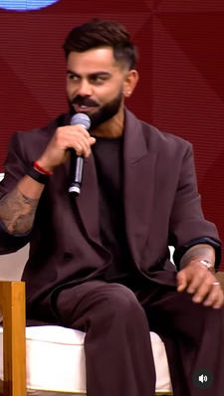


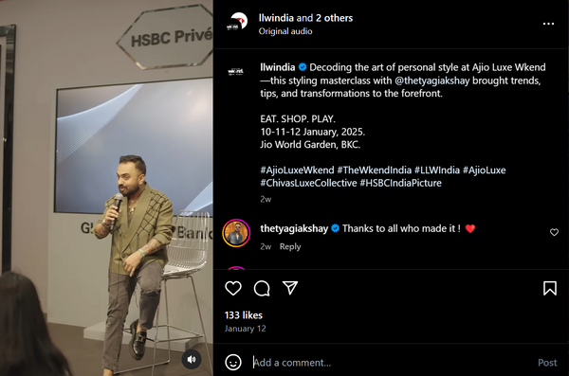

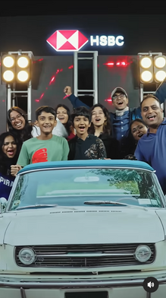
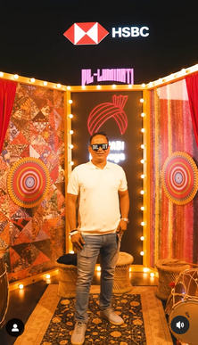
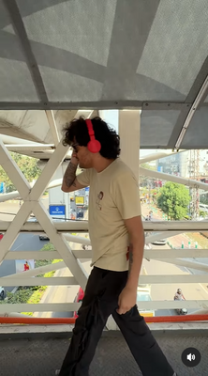
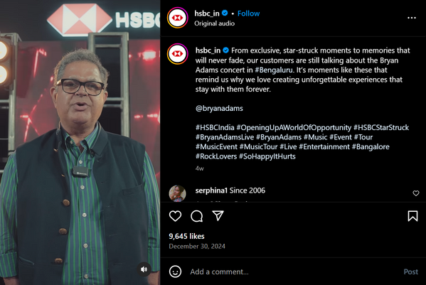

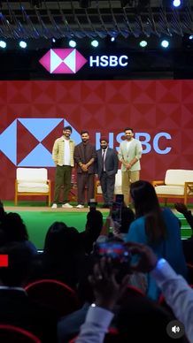
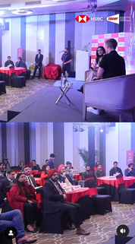

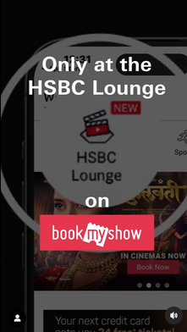
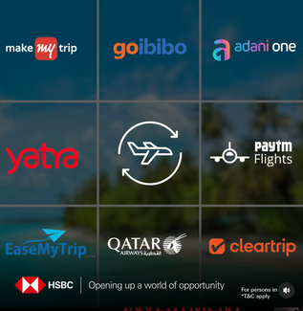
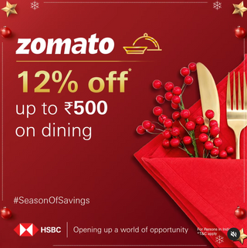

Their content revolves around five core pillars;
RESONANCE, EXPERIENCE, BRAND IMMERSION, EDUCATION, AMPLIFICATION
RESONANCE
EXPERIENCE
1. Tap into the pop-culture
1. Taking the experiences online
HSBC leads in pop culture through sports, music, and Bollywood, leveraging sponsorships & brand collaborations. Alongside a strong presence in cricket, golf, and badminton, they also tap into fashion, and photography.
HSBC extends its event sponsorships online with teasers and reel-format content, recreating on-ground experiences.
Brand Ambassador
HSBC X BWF | YONEX-SUNRISE India Open 2025
48 hour presale and 15% discount* for HSBC Credit and Debit Cardholders
Ajio Luxe Wkend X HSBC Prive lounge
Diljit Event teaser
2. Celebrations with Offers
3. Products X Affinity correlation
2. Exclusive Experiences
HSBC curates exclusive events to enhance its aspirational appeal for high-net-worth customers.
They highlight credit card offers tailored to shopping trends on special occasions.
Showcasing credit & debit cards aligned with diverse interests.
interact with superstars like Virat, Zaheer Khan, Gaurav Kaps
National Tourism Day
Christmas
Nykaa offers for fashion
Taj Hotel Offers for Travel & Tourism
Meet and greet with Olympic Gold Medalist Viktor Axelsen
BookMyShow HSBC Lounge

Slide 35

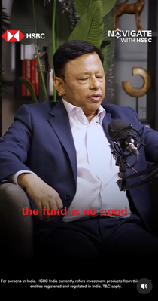
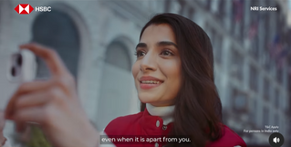

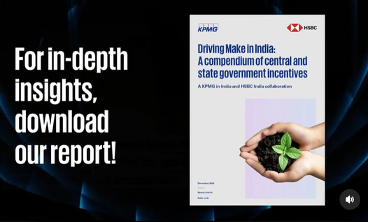
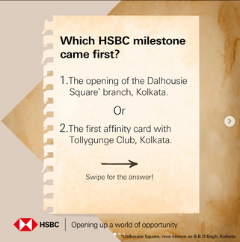
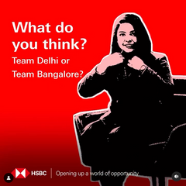
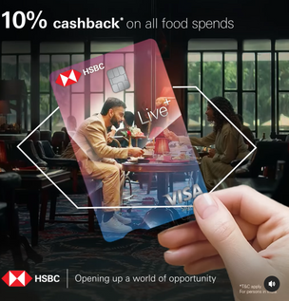

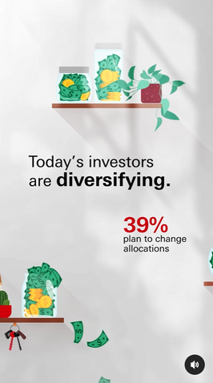




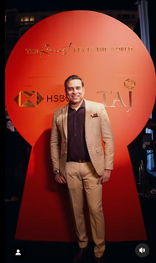
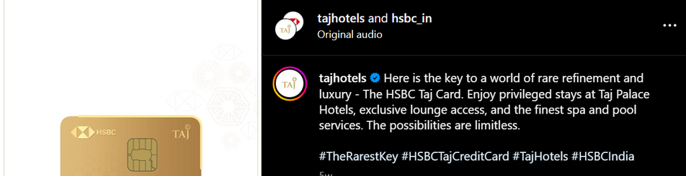
Primarily appealing to business customers
EDUCATION
BRAND IMMERSION
1. Learn with the leaders
1. Leveraging Heritage
2. Campaign Extension
HSBC integrates online and offline properties to educate customers on finance via podcasts, webinars, seminars and research reports, featuring industry experts and company leaders.
With 170 years in India, HSBC highlights its legacy, nostalgia and economic impact.
They extend mainline campaigns on social media using a three-phase approach.
Campaign Activation
Teaser
Campaign extensions with creative assets
HSBC x CNBC Investment Summit
#NavigatewithHSBC content IP
Dalhousi Square Branch
Research Report
Faces of influencer are activated for specific campaigns & depending on context
AMPLIFICATION
1. Celebrity Collabs
2. Influencer Engagement
To boost buzz around HSBC Taj Hotels & Privé Credit Cards, they partnered with Ananya Panday, Gauri Khan, VVS Laxman, and Ambika Anand to target luxury shoppers.
Teamed with food (affinity) influencer Natasha Gandhi to promote Live+ credit card dining discounts.
2. Knowledge Bites
Instagram statics & infographics to simplify finance and investment.
3. Content Collabs
Tapping into the audience of partner brands & event organizers

Slide 36
KEY TAKEAWAYS
PLATFORM-AUDIENCE SYNERGY
With individual customers as their primary social media audience, HSBC strategically leverages Instagram’s platform dynamics to engage active users with curated, interest-driven content.
REAL TO REEL
With many of HSBC’s exclusive events tailored for high-end customers, they seamlessly extend these offline experiences to digital, creating a true omnichannel engagement.
PHASED CONTENT DEPLOYMENT
Event & brand content are structured into three key phases: Pre-event / release announcements, teasers to drive excitement, and virtually immersive experiences through testimonials and on-ground reels.

Slide 37

Social Media Approach
OVERALL STRATEGY
Platforms to educate and empower an elite audience in wealth creation while showcasing Standard Chartered’s expertise and services to establish authority and drive consideration.
“Here for Good”
We are committed to making a positive impact in the world through sustainable and responsible banking while giving back to society. We also strive to create meaningful change for our clients and stakeholders by delivering world-class banking services that truly make a difference.
COMMUNICATION LENS
Catering exclusively to top-tier clients focused on wealth maximization, the bank’s communication strategy remains highly targeted, prioritizing financial growth of clients over broader brand purpose or philosophy.
KEY TARGET CUSTOMERS
Top of the Pyramid customers;
  INDIVIDUALS: HNI and UHNI individuals seeking personalized banking solutions, global opportunities, and exclusive experiences to facilitate wealth creation.
  B2B: businesses and institutions looking to expand internationally, optimize cross-border trade, and access expert financial advisory
TONALITY
Professional, Sophisticated, Inspirational, Knowledgeful
PLATFORM STRATEGY
MAINLINE COMMUNICATION
Equip audience with knowledge and insights through short format content.
From here, possibilities are everywhere
Standard Chartered fulfills its promise of positive change by connecting people’s potential to opportunities & dynamic markets, enabling growth and prosperity through world-class banking.
Content duplicated from Instagram
Content duplicated from Instagram, sharing featured leadership insights & replies to customer grievances

Slide 38
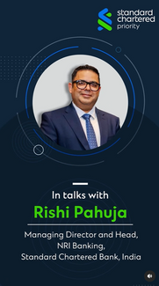



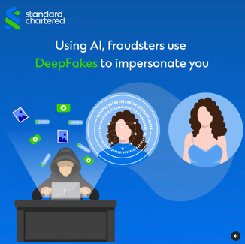





Their content revolves around five core pillars;
EDUCATION, BRAND IMMERSION, SOCIAL RESPONSIBILIY, EXPERIENCE, RESONANCE
most prominent bucket
EDUCATE
BRAND IMMERSION
1. Tips & Guides For Investors
3. Cyber Security Awareness
Webinars, masterclasses, interactive sessions & expert insights to help investors in wealth creation, reinforced by content IPs for recall.
Statics, audio-graphics, and video-graphics to raise awareness & educate on digital fraud and financial scams with safety tips.
1. Leaders Speaks
Leaders reinforce the brand's message, building trust and credibility.
Master Class on Growth Inflation
IP #Wealthwise
2. Employer Branding
Showcasing employee success stories and testimonials to attract talent and reflect brand values.
2. Industry Thought Leadership
Showcases industry expertise through content on macro & microeconomics, featuring company leaders in long-form videos.
4. Tutorials
Video-graphic tutorials guide customers through the company's digital solutions.
2. Campaign Extension
They amplify mainline campaigns on social media for wider reach and stronger brand recall.
IP - #IndiaMarketOutlook
How to Use UPI on SC App
LEADERS Insights

Slide 39










SOCIAL RESPONSIBILITY
EXPERIENCE
1. CSR Initiatives
1. Exclusive Customer Experiences
2. Exquisite Architecture
Aligned with its "Here for Good" promise, the brand showcases its impact on social causes, especially initiatives for the visually challenged like free treatments & events
Showcasing the flagship branch’s luxury, history, and five-star hotel-like architecture.
Hosting exclusive experiences for NRIs and Priority Banking clients to enhance prestige.
CSR program
Showcasing Impact
Events for visually challenged
Onam Celebration cultural event
Brunch with Harsha Bhogle
Virtual Bank Branch Tour
Diving into legacy of the branch
low priority bucket
RESONANCE
2. Environmental Sustainability
Highlighting the bank’s sustainability commitment by funding green solutions and mobilizing USD 300B for net-zero transition by 2030.
1. Tapping Into Pop-culture
Standard Chartered’s pop-culture emphasize is minimal, limited to football through Liverpool FC sponsorships and corporate leagues.
Panel Discussion: Climate Financing by Indian Banks
Featuring McManaman
Hosting corporate soccer league

Slide 40
KEY TAKEAWAYS
CLEAR AUDIENCE-CONTENT FOCUS
The brand is clearly focused on ‘Wealth Progressors’ and ‘Empowered Elites,’ shaping its communication strategy around wealth maximization to align with the mindset of this audience.
PLATFORM-CONTENT SYNERGY
Although the audience is present across multiple platforms, their platform expectations vary. The brand has strategically tailored its content treatment to suit each platform, ensuring maximum impact.
DIGITAL IPs
With education as a key focus, they have strategically developed recurring IPs such as #WealthWise, #IndiaMarketOutlook, and #MoneyInsights to drive recall—delivering value through podcasts, webinars, and expert insight videos.

Slide 41

Social Media Approach
OVERALL STRATEGY
Primarily targeting mass-tige individuals, the brand curates light-hearted content that highlights app features and offers to drive consideration. The content is strategically tailored for different audience segments with a platform-specific approach.
The brand lacks a clearly defined overarching purpose, though a deep dive into its communication suggests—
“Banking Made Easy”
Continuously leveraging innovation and technology, the brand aims to simplify banking and enhance the customer experience, positioning itself as the most convenient bank.
COMMUNICATION LENS
Centered on the idea of "Banking Made Easy," the brand consistently highlights its digital solutions to showcase how technology simplifies banking. Additionally, it reinforces recall through sonic branding and logo integration.
KEY TARGET CUSTOMERS
Mass-tiege consumers
  INDIVIDUALS: Emerging and affluent professionals with active lifestyles, engaging in shopping, travel, and entertainment.
  BUSINESS: Progressive, New-age MSMEs and large businesses which use technology to enhance profitability & efficiency.
TONALITY
Light hearted, Fun, Upbeat, Salesy
PLATFORM STRATEGY
MAINLINE COMMUNICATION
The mainline communication emphasizes the brand’s digital solutions, positioning it as an innovative, tech-savvy, and highly convenient bank accessible anytime, anywhere.
Brand Ambassador: Anil Kapoor and Samantha Ruth
Leveraging aminations, reels and appealing visual story telling, they showcase technology, products/features & offers to drive consideration
Campaigns
Mobile On, Banking full on Campaign: The campaign positions iMobile Pay as a one-stop banking solution, highlighting its comprehensive features for seamless mobile banking.
All Fast, All Easy: Targeting South India, the campaign positions ICICI as the go-to bank for B2B solutions, offering fast, seamless digital services, amplified by regional star Samantha.
Content Duplication from Instagram
Targeting professionals and B2B audiences with tailored business solutions, industry insights, and scam awareness. Content also duplicated from Instagram.

Slide 42














Their content revolves around six core pillars;
PRODUCT SPOTLIGHT, AMPLIFICATION, REGIONALIZATION, EDUCATION, SOCIAL RESPONSIBILITY, EMPLOYER BRANDING
PRODUCT SPOTLIGHT
AMPLIFICATION
1. Leveraging Brand Partnerships To Spotlight Products
2. Marrying Topicals With Products
1. Celebrity Brand Ambassadors
2. Influencer Amplification
Leveraging festivals to highlight solutions and promote products contextually.
Partnering with celebrities like Anil Kapoor, Samantha, Tanu, and Murli Sharma to reach mass and regional audiences.
Boosting credit card and app promotions with influencers across travel, tech, infotainment, music, and finance.
ICICI partners with travel, sports, and entertainment brands to create niche products, leveraging Instagram collaborations to expand reach and engage audiences.
Travel
Make my Trip
CSK Card
Young Star savings account on children’s day
REGIONALIZATION
1. Regional Dialects And Faces Of Influence
2. Celebrating Regional Culture
Talent hunt for Bengali NRIs aged 50+, featuring dance, music, poetry, comedy, and photography.
3. Highlighting Offers To Promote Credit Cards
The brand uses regional influencers and local-language content to deepen mass-tige customer engagement.
Focused on exclusive travel and shopping offers, making the brand essential to an aspirational lifestyle.
Snippets of TVCs on Instagram in Tamil, Telugu

Slide 43










EDUCATION
SOCIAL RESPONSIBILITY
1. Cyber Security Education #BeatTheCheat
1. Spotlighting Impact With Moving Stories
Leveraging diverse formats like influencer collab and DVC to raise awareness around frauds and scams hence expanding touchpoints
ICICI crafts immersive storytelling films and reels on rural development, showcasing the testimonials of beneficiaries and the brand’s impact.
a small bucket
EMPLOYER BRANDING
Influencers
1. Career Opportunities On Instagram
2. Spotlighting
i-Universe App
Using Samantha in statics and audiographics to attract talent.
Showcases i-Universe app as a one-stop hub for ICICI careers
Featuring Patil as a cop and Tabu as an investigator to illustrate scams, boosting brand recall and awareness.

Slide 44
KEY TAKEAWAYS
PLATFORM-AUDIENCE SYNERGY
ICICI customizes content for each platform, aligning with audience preferences and consumption habits. They focus on reaching the masses on Instagram while engaging businesses and professionals on LinkedIn and X.
REGIONAL CONNECT
ICICI strengthens regional engagement by featuring faces of influence like Samantha and Murli Sharma in and curating content in regional-language (DVCs), enhancing brand affinity in South India
EASILY CONSUMABLE CONTENT TREATMENT
ICICI creates engaging, easily consumable content by incorporating animation, a fun and light-hearted tone, and collaborations with affinity-based influencers to capture and retain user attention

Slide 45

BRAND ANALYSIS
Let’s see how we are fairing against our peers

Slide 46
Social Media Approach
“Live more, Bank Less”
OVERALL STRATEGY
Social media serves as a dynamic platform to reinforce the brand's philosophy and values with a touch of infotainment. It primarily targets B2B customers, followed by individual customers & potential employees.
At DBS, we believe that banking should be simple and effortless, so that you can spend more time with the people and things that you care about. Through good and tough times, we want to be the constant that helps you live more, live better, and bank a little less.
Stance: A different kind of bank
COMMUNICATION LENS
The content on social media subtly layers back into the two key messages that the brand wants to push – “Live More, Bank Less” & “A Different Kind of Bank”.
CHALLENGER | DIGITAL-FIRST | INNOVATOR | PARTNER | TIMELY
KEY TARGET CUSTOMERS
TONALITY
Informative, Inspirational, Authoritative, Salsey
Everyone Banks! And Everyone Who Banks! – Individuals, Businesses, Institutions
PLATFORM STRATEGY
MAINLINE COMMUNICATION
Campaigns
DBS Ideal: Secure, Simple & Smart Campaign – Aligning with DBS Bank’s core message, Live More, Bank Less, the campaign showcases how business banking can be effortless—just one click and a face scan away—while you focus on what truly matters. Targeted at businesses, it positions DBS Ideal as a digital savvy bank with simple, secure, and seamless solutions
Live More, Bank Less campaign: The "Live More, Bank Less" campaign, tailored for India, adapts HSBC's global narrative to highlight its innovations and vast network. The campaign emphasizes on the seamless, joyful banking enabled by DBS for both individual and business customers while maintaining a mass-tige appeal.
All social media content happens here targeting everyone hosting every digital content.
Content Duplication from Instagram
Content duplicated from Instagram alongside replies for customer grievances

Slide 47

















The content revolves around four core pillars;
BRAND TRUST, SOCIAL RESPONSIBILITY, EDUCATION, RESONANCE
With social responsibility at its core, DBS curates diverse content that showcases its impactful initiatives and commitment to facilitate sustainable business practices.
BRAND TRUST
SOCIAL RESPONSIBILITY
1. Employer Branding
1. DBS Foundation-Values & Initiatives
Showcasing employee success stories & testimonials to attract talent and highlight commitment to well-being.
Highlighting DBS foundation, we spotlight the brand’s social responsibility initiatives, specifically grants provided to promote sustainable & responsible businesses.
DBS Foundation Grants
Impact
Trust Your Spark Content
Grant Winner Speaks
2. Awards / Recognitions
2. Promoting conscious living
3. Gender Inclusivity
Showcasing the brand’s and employees’ awards and recognitions to highlight DBS’s expertise and commitment—reinforcing the credibility
Educational content to drive awareness around the importance of eco-conscious lifestyle
DBS leverages its Women and Finance report to drive conversations on women's empowerment and its societal impact.
Zero Food Waste

Slide 48


















Although the brand hasn’t leveraged the full potential of pop culture hacking, they have tapped into Badminton, Bollywood, Music/Poetry, TV & Online Entertainment
EDUCATION
RESONANCE
1. Learn from the Leaders
1. Faces of Influence limited to badminton
Showcasing leadership insights through interviews highlighting industry expertise, vision, and innovation.
3. Music/Poetry through events
Badminton stars Chirag Shetty, Satwiksairaj Rankireddy, Treesa Jolly, and Lakshya Sen feature in topicals, brand narratives, and event content.
DBS joined Spoken Fest 2024 as a Sustainability Partner, aligning with its eco-conscious mission.
2. Seminars / Events
DBS X CNBC ‘India Singapore Connect’
4. TV with Shark Tank
Advanced its strategy for a sustainable ecosystem by providing grants to innovative green businesses.
Beyond banking, DBS highlights its role in strengthening bilateral economic ties and its Singaporean heritage through Trivias
2. Bollywood cinema integration
Partnering with real and reel Srikanth for Srikanth, starring Rajkummar Rao, the brand embraced pop culture & celebrated diversity.
3. Safety & Security Awareness
5. Web-Series – DBS Spark
Humanizing the financial sector and communicating the core philosophy that drives bankers at DBS
Using puzzles and showcases realistic scenarios to educate customers on data security, reinforcing DBS as a trusted ally.

Slide 49
TACTICAL RECOMMENDATIONS
Content treatment and audience focus aligning with platform nuances
Instagram is a platform where audience goes for creative inspiration and connect with their interests. They expect light hearted, lo-fi, entertaining content on Instagram. We need to curate our content accordingly. Similarly, Twitter could be a great platform to engage with business audience
Maximize current faces of Influence
Explore the possibilities of leveraging the badminton stars better. Also use more affinity specific social media & mainstream influencers to amplify comms.
Create content IPs to facilitate easy navigation and drive recall
Content IPs to drive recall and easy navigation of content. It will also help in the content deployment. For instance, we could curate tailored educational content for both Individual customers and businesses through separate IPs
Co-branded products & brand partnerships to drive appeal & resonance
Leverage these partnerships to connect with audiences across diverse interests. Taking inspiration from HSBC, we can highlight how partnering with DBS unlocks new opportunities for audiences to explore their passions.

Slide 50
STRATEGIC APPROACH
Mapping our current approach with the competitors to define the strategic pivots
  The Audience
  The Content
  The Communication

Slide 51
THE AUDIENCE

Slide 52
In context of the communication landscape, every brand in our category targets specific individual customer mindsets, creating distinct positioning within the industry
THE EARLY
EARNER
THE ASPIRING
PLANNER
THE WEALTH
BUILDER
THE EXPERIENCE
SEEKER
First Jobbers, Young Professionals, Paycheck Optimizers
Mid-Jobbers, Young Entrepreneurs, Early Savers
Senior Professionals, Growing Entrepreneurs, strategic investors
High Earning, Lifestyle-Oriented Consumers

Slide 53
To fully capitalize on the Lakshmi Vilas Bank acquisition and the renewed opportunity to establish ourselves as a mass-tige international bank, we must shift our focus to an audience that aligns with a masstige mindset
THE EARLY
EARNER
THE ASPIRING
PLANNER
THE WEALTH
BUILDER
THE EXPERIENCE
SEEKER
First Jobbers, Young Professionals, Paycheck Optimizers
Mid-Jobbers, Young Entrepreneurs, Early Savers
Senior Professionals, Growing Entrepreneurs, strategic investors
High Earning, Lifestyle-Oriented Consumers

Slide 54
THE CONTENT

Slide 55
Analyzing social media communication, it’s clear that brands primarily target either business customers or individual consumers through content, depending on their strategic priorities
Business
Individual

Slide 56
While business customers remain important to us, our focus is now on expanding our business towards individual customers, therefore the pivot on social
Business
Individual

Slide 57
How competitors are using social content to talk to this audience?
Cultural Resonance
Business
Individual
Brand POV communication

Slide 58


Therefore, our pivot in content
Cultural Resonance
Adopt a more culturally attuned strategy and deploy a platform strategy that helps us reach the right audience with the right content
Business
Individual
Brand POV communication

Slide 59
What other edge do we have?
Technology
Business
Individual
Our current communication efforts don’t effectively showcase our technological edge
Expertise

Slide 60
How do we optimize the content strategy to fully leverage out technology?
Technology
Given our brand’s leadership in digital transformation, which sets us apart as ‘A Different Kind of Bank,’ we should leverage our technology to demonstrate to individual customers how we empower them to ‘Live More, Bank Less.’
Business
Individual
Expertise

Slide 61
THE COMMUNICATION

Slide 62
Category communication unfolds around three key pillars
Know our BRAND
We are your perfect ALLY
We blend with your LIFE
  Brand Immersion
  Social Responsibility
  Employer Branding
  Education
  Product Spotlight
  Brand Trust
  Resonance
  Experience
  Amplification
  Regionalization
Key pillars for Business customers
Key pillars for Individual customers

Slide 63
Given our residual equity and the goal of expanding our business to individual customers, we must align our communication efforts across three key pillars
Know our BRAND
We are your perfect ALLY
We blend with your LIFE
  Brand Immersion
  Social Responsibility
  Employer Branding
  Education
  Product Spotlight
  Brand Trust
  Resonance
  Experience
  Amplification
  Regionalization
Key pillars for Business customers
Key pillars for Individual customers

Slide 64
The Manifestation - What it means for our brand?
Know our BRAND
We are your perfect ALLY
We blend with your LIFE
  Brand Immersion
  Social Responsibility
  Employer Branding
  Education
  Product Spotlight
  Brand Trust
  Resonance
  Experience
  Amplification
  Regionalization
“LIVE MORE, BANK LESS”
At DBS, banking blends seamlessly into life, requiring no extra effort. We simplify finances through real-life scenarios, making transactions intuitive and insights actionable. As an ally, not just a bank, we handle the complexities, so you stay focused on what truly matters. From exclusive experiences to cultural connections, we enhance modern living while keeping you rooted. For years, we’ve redefined convenience, turning banking into an effortless companion—so life stays at the forefront, and banking happens in the background. Live fully, bank seamlessly.

Slide 65
Summarizing Our Approach
THE
AUDIENCE
THE
CONTENT
THE COMMUNICATION
THE
MANIFESTATION
THE EARLY EARNER
INDIVIDUAL CONSUMER FOCUS
While we focus on business consumer equally, social focus needs to shift more towards individual consumers
We Blend with your LIFE
  Resonance
  Experience
  Amplification
  Regionalization
LIVE MORE, BANK LESS
At DBS, banking blends seamlessly into life, requiring no extra effort. We simplify finances through real-life scenarios, making transactions intuitive and insights actionable. As an ally, not just a bank, we handle the complexities, so you stay focused on what truly matters. From exclusive experiences to cultural connections, we enhance modern living while keeping you rooted. For years, we’ve redefined convenience, turning banking into an effortless companion—so life stays at the forefront, and banking happens in the background. Live fully, bank seamlessly.
First Jobbers, Young Professionals, Paycheck Optimizers
Starting their financial journey, eager to manage earnings but often uncertain about financial planning
THE ASPIRING PLANNER
BRING CULTURAL RELEVANCE
With our approach becoming more masstige, we need to build cultural relevance to resonate with the diverse Indian audiences
Mid-Jobbers, Young Entrepreneurs, Early
Savers
Actively saving and investing, but still seeking guidance on financial growth
Know your BRAND
  Brand Immersion
  Social Responsibility
  Employer Branding
THE WEALTH BUILDER
EMPHASIS ON TECHNOLOGY
While expertise still remains a core content approach for us, our content needs to reflect more about our technological edge
We are your perfect ALLY
  Education
  Product Spotlight
  Brand Trust
Senior Professionals, Growing Entrepreneurs, strategic investors
Wants a mix of wealth preservation and growth, looks for efficiency in banking.

Slide 66

CREATIVE STRATEGY
Building the way forward for DBS on social media

Slide 67



Doesn’t it feel amazing when the Wi-Fi connects instantly?
Or when your map reroutes you to the fastest route...
Or when your password autofills right when you need it?

Slide 68

Isn’t it great when life’s small but important things run in the background, without any pressure on you?

Slide 69

What if banking also worked the same way?

Slide 70

Effortless, in the background!
So you never have to think about it?

Slide 71



Imagine If your bills were auto-paid effortlessly!
And your investments grew smartly in the background?
Or when you get an instant fraud alert before any damage is done

Slide 72

Well that’s exactly how banking should be!
Effortless and Easy!

Slide 73

This is where DBS steps in!!
To help you with seamless transactions, effortless payments, and smart investments. So why not let DBS takes care of it all!
Because..

Slide 74


Slide 75

Imagine having someone who does it all—from transactions to reminders, from investments to bill payments. No follow-ups, no stress, no effort from your end.
When Your Bank Does It All
You get to..
#LiveMoreBankLess
Only when your banking needs are taken care of by someone in the background, you are truly able to live more and bank less.

Slide 76





Neha's corporate banking needs?
Now she’s finally ticking off that Europe backpacking trip from his bucket list.
Sorted!
Shruti’s flight payments? Sorted!
Now she’hosting parties in her sea-facing apartment.
Sorted!
When Your Bank Does It All
Live More, Bank Less
Vikram's wealth management?
He’s perfecting his beach volleyball game in Goa.
Sorted!
Neha's corporate banking needs?
She’s now cruising down Marine Drive with her favorite playlist on full blast.
Sorted!

Slide 77

Brand Personality On Social Media
“Dependable Friend”
DBS will not be just a bank; it will be a reliable friend who’s always got your back in organizing plans, handling the details, and making sure things run smoothly. It’s like the bestie who nudges you toward your happy place and cheers you on to be your best self.
How it Talks: “You live, I got this!”/ “Weekend plan? Just say when I’ll handle everything.”
Tone: Witty, Friendly, Dependable, Hassle-Free
Purpose: Making banking feel effortless while blending into your everyday life

Slide 78

ROLE OF INSTAGRAM
DBS’s Instagram isn’t just another banking page, it’s about enabling a life free from financial hassles. Every post reinforces the brand’s promise: When Your Bank Does It All, You #LiveMoreBankLess.
Ultimately becoming the ‘Inspiration Corner’
Through snappy skits, relatable memes, and handy hacks, DBS proves that banking doesn’t have to steal the spotlight. It works quietly in the background—handling the boring stuff—so you can focus on living more, stressing less, and doing what you love.

Slide 79



CONTENT STRATEGY
OWNED
PAID
The Invisible Enabler
Culture Meets Convenience
Our owned content brings this to life with binge-worthy, snackable formats that seamlessly integrate DBS into everyday moments.
To amplify our message, we tap into the pulse of digital culture—leveraging influencers, meme pages, and brand collaborations that make banking feel like second nature.

Slide 80
CREATIVE EXECUTION
Diving into the creative ideas that will drive the campaign and keep it going

Slide 81
Dividing the campaign into 3 phases
When Your Bank Does It All
Campaign
Amplification
Sustenance
Launching a campaign via creating buzz with the help of activation, influencer and unqiue brand collaborations
From supporting social impact through DBS Foundation to the creation relatable content, we place DBS in the conversations that shape culture. By aligning with trends, topical moments, and consumer passions, we make it like an enabler of life.
Sustaining momentum by consistently sharing stories and engaging with audiences through ongoing social media initiatives, while also promoting DBS Bank's products.

Slide 82
Launch Plan

Slide 83

1.
Launch Idea
Hear It From The Liver!

Slide 84

We all know Orry is the ultimate “liver”
Known for living his best life, attending every major event, and always having his Minions (a.k.a. his personal team) take care of things for him.
Becoming the true definition of LIVING MORE!!!!

Slide 85
But what if things took a sudden turn?

Slide 86

1. The Forex Dilema
To set the stage, Orry is seen creating a ruckus in a cafe as he cannot complete payment becasue his minions haven’t sorted his forex.
Meme pages flood the internet with posts about Orry panicking over his payments because his forex isn’t sorted, fueling buzz.

Slide 87

2. Orry’s “Minion Firing” Bombshell
Now, Orry drops the bombshell which sparks conversations and chatter around why is Orry taking such a huge step?
He uploads an Instagram story and says, “Time to let go of my beloved minions, I need someone who can do it all for me so that I get to be a ‘liver’.”

Slide 88

3. Orry’s Hunt for a ‘Chief Do-It-All Officer
Since he’s losing his Minions, Orry then moves on to look for a replacement. Orry takes to his LinkedIn and puts up a job posting as he’s looking out for a “CDO - Chief Do-It-All Officer”
LinkedIn Job Post: Looking for someone who can do it all! Must handle EVERYTHING, EVERYWHERE, ALL AT ONCE. Must never take breaks. Apply now.

Slide 89


4. The Speculation Frenzy
Meme pages, influencers and brands all hop onto the bandwagon and start flooding Orry’s LinkedIn comment section showing interest as being his CDO.

Slide 90

5. Orry’s CDO
After all the pre-buzz, teasers, and speculation, it’s time for the big reveal, Orry’s posts a story and a LinkedIn post, saying that he’s finally found his Chief Do-it-All Officer.”
He sits comfortably sipping coffee and pulls out his DBS Card saying “DBS does it all—banking, payments, investments, so I can just #LiveMoreBankLess and be the ultimate liver.”

Slide 91

2.
When Your Bank Does It All | DVC
Live More, Bank Less

Slide 92

Post the reveal of the collaboration with DBS, Orry now truly lives up to his proper potential of being the ultimate liver as DBS handles it all for him and we showcase that in a DVC.
In typical fast paced motion style, we showcase that how Orry goes about his daily tasks and with every activity he does, we interject quick cuts of his banking needs being sorted simultaneously.
For example: As he sips coffee -cut to- DBS taking care of his investments

Slide 93

3.
When Your Bank Does It All | Content Series
30 Days 30 Ways To Live More

Slide 94
Orry made the first move, he chose DBS because it does it all and he gets to live more!
But how does one truly live more?

Slide 95
To find out, we’re launching “30 Days, 30 Ways To Live More”
A youtube series where we show how to go all-in on living life to the fullest, because you bank is doing it all in the background.

Slide 96

For 30 days, 30 real people from different walks of life take on an experiment. Their mission? Live their best day, uninterrupted—while DBS handles all their banking in the background.
How It Works:
Each participant, from chefs to travellers, artists to entrepreneurs, will document their day in a vlog-style digital series, showcasing how DBS seamlessly integrates into their routine—allowing them to focus on what they love, stress-free.

Slide 97

The participants come together to reflect on their experience realizing that when your bank does it all, you truly Live More, Bank Less.
  A street food vendor? More selling, no cash hassles. (DBS QR payments)
  A frequent traveler? More exploring, no forex worries. (DBS multi-currency card)
  A creative entrepreneur? More creating, no invoice tracking. (DBS business banking)
Alternate Execution: Create in-house reels (piece to camera) that demonstrate how DBS is an enabler for everyday tasks, making life easier (Life Hack)

Slide 98
4.
When Your Bank Does It All | Outdoor Activation
Our Ad Asks You To Bank Less

Slide 99

People today crave experiences—weekend getaways, concerts, trendy cafés—but every outing involves transactions. Whether it’s booking a stay in Lonavala, grabbing coffee at an airport, or splurging at a concert, spending is part of living.
The idea is to strategically place billboards in locations where people are heading towards and give them a reason to live more at that place.

Slide 100


The Execution
Hyperlocal Billboards Across India—placed strategically at travel and lifestyle hotspots like:
Lonavala:
If you’re in Lonavala, you MUST stop at XYZ Café, have ths strawberry cream from ABC and take in the scenic views of the place.
Banking? Leave it all to us! Live More, Bank Less!.
Concert Venues:
You’re here for the music, but don’t miss the food truck at Gate 3, selfies at the booth and crazyyy merch at Zone 3.
Banking? Leave it all to us! Live More, Bank Less!
Going to Lonavala?
You must have Maganlal Chikki

Slide 101
5.
When Your Bank Does It All | Brand Banter
Do More, Live More, Bank Less

Slide 102

What if brands joined the conversation on doing it all?
DBS is all about handling banking seamlessly in the background, so people can Live More, Bank Less. But what if other brands also embraced this mindset in their own way?
DBS will initiate a social media conversation by creating a fun post on Instagram where we say “From transactions to forex to investments—We Do It All. #LiveMoreBankLess”

Slide 103

The DBS Brand Banter
Popular brands reply with their own spin on it, e.g.:
  Zomato – "From biryani to burgers—Eat It All. #EatMoreBankLess"
  Swiggy Instamart – "From toothpaste to tacos—Order It All. #StockMoreBankLess"
  Netflix – "From thrillers to rom-coms—Watch It All. #BingeMoreBankLess"
  Nike – "From sprints to marathons—Run It All. #MoveMoreBankLess"

Slide 104

The Closure Of Brand Banter
After brands have had their fun tweaking the tagline, DBS jumps in with the ultimate flex.
Final DBS Post:
"Nice try, everyone. But guess what? We do all of these too. 😉

Slide 105

6.
When Your Bank Does It All | Print AD
Pass It To DBS

Slide 106

Pass It to DBS
What if banking was as easy as passing the burden on? This interactive 2 page print ad visually demonstrates how DBS seamlessly takes over financial tasks, allowing people to truly Live More, Bank Less.
Page 1 (Before - Stress Mode)
A person looks overwhelmed, holding a stack of loan papers, bills, or investment documents. The papers are a die-cut cutout, creating a window in the page. Headline: “Still handling all this yourself?”
Page 2 (Flip to Reveal - After - Stress-Free Mode)
As the user flips the page, the cutout aligns perfectly to show that the same papers are now in the hands of a DBS representative. The original person is now relaxed, enjoying a coffee completely stress-free. Headline: “Pass it to DBS. When Your Bank Does It all, #LiveMoreBankLess.”

Slide 107

An Ad That Owns It All
Imagine a newspaper page filled with news headlines—
  Travelling to Singapore has increased
  Home loan rates hit an all-time low
  Insurance companies record a profit in Q2
We highlight all the words that matters from these headlines— Travel, Insurance, Home Loan — and place one simple message in the ad:
"Every story points to us. That’s why we do it all. #LiveMoreBankLess”

Slide 108

7.
When Your Bank Does It All | Outdoor Activation
The Do-It-All Concierge

Slide 109
Imagine a world where you never have to stress about the little things, because someone (or something) has already handled it for you.
That’s exactly what DBS does with seamless banking solutions. But what if we brought this idea to life in the real world?

Slide 110

The Do-It-All Concierge
Introducing the DBS Do-It-All Squad Concierge a pop-up activation at high-footfall locations where a dedicated DBS team helps people complete everyday tasks in real-time, just like the bank does for them digitally.
How It Works:
  A DBS "Do-It-All" squad is stationed at these locations, ready to assist people with everyday tasks—whether it’s paying for their coffee, buying metro tickets, or handling grocery checkouts.
  People experience firsthand how effortless life can be when someone handles the things that slow them down—just like DBS does with banking.
Alternate Execution: Instead of concierge we will have one person in a DBS T-shirt who will be go around helping people with mini errands for the day.

Slide 111



Sample Situations For The Concierge
Helping travellers with last-minute forex, lounge access, and quick payments so they can focus on their journey, not logistics.
Assisting professionals with coffee runs, lunch orders, and instant bill payments, letting them power through work without distractions.
Covering food, drinks, and merch payments so people can stay in the moment and enjoy the experience hassle-free.

Slide 112
AMPLIFICATION

Slide 113

1.
LEVARAGING THE MOMENT

Slide 114

Who’s the Mr ‘Do-It-All’?
Influencer Tease
Cricket fans love an all-rounder—the player who does it all, whether it's batting, bowling, or fielding. But in life, who’s the real MVP? Just like a cricketer who plays every role, DBS handles all your needs seamlessly—so you can focus on what matters.
Execution:
  Vox-Pop Activation: We have our host/influencer asks fans: Who’s your Mr. Do-It-All in IPL? While people respond to the question with their pov of who did they think performed best and did it all in the latest matches, so that the team can perform more and stress less.
  Social Media Buzz: In the comments section we see fans passionately debate—who’s the real all-rounder? While DBS bank pitches in saying that while on field the cricketer might be the one doing it all but when it comes to banking, DBS is here to do it all so that you can live more and bank less.

Slide 115

Long Weekends: Your Ally for Living More
Brand Collabrations
We all look forward to long weekends—because that’s when we truly live more! But what if your bank made those weekends even better by doing it all for you?
Introducing ‘Your Long Weekend Ally for Living More’—a social-first content series where DBS does all the planning, so you just do the living.
Every time a long weekend approaches, we drop the ultimate 3-part weekend playbook—curated with everything you need, fully powered by DBS so you don’t have to lift a finger.

Slide 116



Each long weekend, we roll out a 3-part reel series that dives into all the exciting possibilities:
Where to Go – Spontaneous getaways made easy with DBS Travel Now Pay Later & Forex solutions.
What to Do – Exclusive experiences, events, and activities, booked seamlessly with DBS Rewards & Card Benefits.
What to Buy – Shopping and fashion picks, made effortless with DBS One-Click Digital Payments & Cashback Offers.

Slide 117
2.
COLLABORATIONS & ASSOCIATIONS

Slide 118

CID Ka Red Alert
Influencer Tease
The legendary CID team is on a new case, there’s a suspiciously red man present at life’s everyday hassles. With him being present at various locations the hustle of payments, ATMs lines, forex get automatically sorted
In classic CID-style fahion we collaborate and make a fun DVC/Reel where we highlight how DBS does it all while everyone #LiveMoreBankLess.
Alternate Collaboration: Just Neel Things Neel (KID)

Slide 119
Sample Script
CID investigates a mysterious man in red, spotted across the city—always around when something needs to be done. We see Daya & ACP sitting in a room and closely watching multiple CCTV, footages.
Airport CCTV: A long forex queue, but a traveler’s phone pings—forex sorted.
Restaurant Footage: A couple reaches for their wallet—waiter says, “Already paid.”
Petrol Pump: A biker forgets his wallet—payment confirmation pops up on his phone.
ACP Pradyuman: “Daya, yeh insaan har jagah hai, bina kuch bole sab kuch sambhal raha hai.”
CID finally “catches” the red man—but when they try to catch him. He disappears leaving a clue of DBS
The Truth? There is no red man. He is a guy from DBS
It’s DBS—handling it all, so people can just live.
ACP Pradyuman: “Daya, yeh laal rang ka bhoot nahi, DBS Bank hai!”
Daya: “Matlab jab bank sab kuch kar raha hai, toh hum sirf jee sakte hain?”
DBS does it all. You just #LiveMoreBankLess.

Slide 120
DBS x Mashable India
Podcast Integration
Some places hold memories of the times we truly lived—carefree, present, and enjoying every moment.
To bring these moments back, DBS collaborates with Mashable India for an experience where one lucky audience member and an influencer revisit their favorite spots, reliving stories, nostalgia, and laughter. While they immerse themselves in the experience, DBS ensures their banking needs are seamlessly taken care of, letting them truly live more and bank less.

Slide 121
DBS x Mashable India
Podcast Integration
Execution:
  Contest & Selection: Mashable India announces the initiative, inviting users to share their most cherished "live more" moments and locations. One winner is selected to go on this journey.
  On-Ground Experience: The chosen guest and an influencer explore their favorite spots, reminiscing about past experiences while creating new memories.
  Seamless Transactions: Throughout the journey, DBS ensures that payments, bookings, and transactions happen effortlessly in the background, reinforcing the "Do-It-All" experience.
  Content Amplification: The journey is captured in a compelling video series, highlighting the ease of living more when DBS takes care of banking. Shared across Mashable India’s platforms and DBS’s digital channels for maximum reach.
  PR & Social Buzz: Influencers and audience engagement amplify the concept, creating FOMO and reinforcing DBS as the bank that does it all.

Slide 122

3.
CONTENT IPs

Slide 123

Being Suku – Love, Life & Living More
A lighthearted, lifestyle-driven short Instagram series where Suku’s husband goes the extra mile to surprise her with thoughtful gestures. From planning impromptu dates to making everyday life easier, he does it all—without stress. But the secret? DBS is handling all the payments, bookings, and banking seamlessly in the background.
The series subtly integrates how Suku’s husband can do it all for Suku but when it comes to banking DBS does it all for us so that we can #LiveMoreBankLess
EXAMPLE EPISODES
"The Surprise Getaway"
  Suku casually mentions how she needs a break.
  Her husband surprises her with a spontaneous weekend trip.
  Flights, hotel, and even a fancy dinner—all booked & paid effortlessly via DBS
The Big Move, Made Easy"
  The couple decides to upgrade to a new home.
  While Suku worries about the logistics, DBS Home Loans & financing options make the process stress-free.
.

Slide 124



For reference purpose

Slide 125
The Do-It-All Race: Powered by DBS
What if you could complete an entire day’s worth of tasks in just 15 minutes? That’s exactly what The 15-Minute Do-It-All Challenge is all about!
DBS brings you a high-energy, fast-paced street activation turned digital content IP where contestants must complete multiple real-world tasks in just 15 minutes—with DBS handling all the banking in the background.

Slide 126
Can You Do-It-All? : Powered by DBS
Hosted by a dynamic emcee, each monthly episode features a mix of everyday people, staged guests, and influencers. The twist? Every task ties back to a DBS feature, proving that with the right bank, you can truly do it all—seamlessly, quickly, and stress-free.
  The Bill Split Hustle – The contestant has to place an order at a café and split the bill among ‘friends’ using DBS Pay Auto-Split, proving how easy group payments can be.
  Shop, Pay, Done! – They must buy three items at a store using DBS Digital Payments, without fumbling for cash or waiting in line.
  Book & Go – They’re challenged to book a last-minute flight using DBS Travel Now Pay Later, simulating a spontaneous getaway.

Slide 127
Content Pillars

Slide 128
Content Pillars
KNOW OUR BRAND | WE ARE YOUR PERFECT ALLY | WE BLEND WITH YOUR LIFE
Establish DBS as the ultimate Do-It-All bank that empowers users to live more and bank less. | Showcase DBS’s seamless banking solutions that handle everything—payments, investments, forex—so users don’t have to. | Highlight real-life scenarios where DBS integrates effortlessly into people’s lives, freeing them to focus on what truly matters.

Slide 129
Content IP’s

Slide 130

Know Your BRAND
When DBS Does It All, Live More Report Less
Format: Reel
Concept:
A laid-back, effortlessly cool host sits in the foreground, unbothered, sipping coffee or casually working, while the real action happens in the background, where DBS does it all. As he chill, a group of energetic executive in DBS branded clothing frantically deliver updates on the top three biggest financial, business, or tech happenings of the week—because, just like DBS, they do it all, while you focus on living more.
Format:
Opening Shot: The host relaxes at a desk/café/home while the chaos unfolds behind them.
Segment 1: The host in a chill manner says, “ Today we are telling you "Top 3 financial/tech/business updates of the week’, chalo lets start!”– The ‘news crew’ then moves on to quickly break it down in overly dramatic, high-energy way.
Segment 2: "Know Your Bank" – In a quick, seamless transition, we see the host turn while sipping coffee, break the fourth wall and speak directly to the camera as to how DBS effortlessly handles somethieverything tied to that week’s headlines.
Closing Shot: Barely acknowledging the chaos, he moves on to looking at the camera with a smirk saying: “When your bank does it all, you just sit back and live more.”

Slide 131

We Are Your Perfect Ally
When DBS Does It All, India Lives More
Format: Reel
Concept:
IThis content series brings to life how DBS Bank India, strengthened by its merger with Lakshmi Vilas Bank, is actively shaping India's future. Through building blocks as a visual metaphor, we showcase how DBS does is all and is enabling businesses, students, and individuals to "build more"—whether through SME funding, investments, or education loans.
Format:
Opening Shot: The host starts with an empty surface and a pile of blocks.
As They Build: Each block represents a financial pillar—funding for businesses, investment growth, education loans, etc.
Narration: The host explains how DBS acts as an ally, making each financial goal achievable.
Final Shot: The complete structure stands tall with the DBS logo, reinforcing the idea: “When your bank does it all, India Lives More.”

Slide 132

We Blend With Your Life
When DBS Does It All, Live More Together
Format: Reel
Concept:
This visually compelling series uses a split-screen format to show how one person’s ability to use DBS features not only allows them to "Live More" but also enables others to Live More through the DBS Foundation. Each episode follows a different protagonist whose financial decisions—made easy as DBS does it all by creating a ripple effect, positively impacting someone else’s life.
Format:
Split-Screen Format: One side focuses on the main protagonist (a DBS user), while the other side highlights the indirect but powerful impact of their actions on someone else.
Fast-Paced Transitions: A seamless blend between how effortless banking leads to meaningful change.
Personal & Relatable Stories: Realistic scenarios that show how a simple financial action leads to bigger changes.

Slide 133
Always On Ideas

Slide 134
KNOW YOUR BRAND

Slide 135
Know Your BRAND
Do It All, Without Banking Holding You Back
Format: Carousel
Concept: Modern banking isn’t just about transactions—it’s about impact. With DBS handling your finances, you focus on greener choices, mindful living, and what truly matters.
From paperless banking to eco-friendly rewards, every tap isn’t just effortless—it’s meaningful. When your bank not only focus on your banking needs but also contribute to a sustainable life so that you can #LiveMore

Slide 136




Creatives
Caption: Built to clear the air, not banking clutter. When your bank does it all, #LiveMoreBankLess.
Caption: Rooting for a greener world, not rummaging for receipts. When your bank does it all, #LiveMoreBankLess.

Slide 137
Know Your BRAND
Smarter Payments, Greener Planet: Do It All
Format: Seamless Caroussel
Concept: With DBS, payments aren’t just about transactions—they’re about transformation. From supporting green investments to enabling eco-friendly choices, every transaction with DBS helps build a more sustainable future. This reel series highlights how seamless banking can also be smart banking for the planet.

Slide 138


Creatives
Caption: Every tap, every transfer, every transaction—building a greener future, one payment at a time. #LiveMoreBankLess

Slide 139
We Are Your Perfect ALLY

Slide 140

We Are Your Perfect ALLY
Banking For All Your Milestones
Format: Static
Concept: Life’s biggest moments shouldn’t come with financial stress. DBS ensures that while you focus on living, we take care of the banking. From dream homes to bucket-list adventures, you can have it all—seamlessly, with DBS by your side doing it all for you.
Caption: When it comes to achievements, we do it all.

Slide 141

We Are Your Perfect ALLY
Sajan Satrangiya x DBS: Dance More, Bank Less
Format: Reel
Concept: We tap into the trending Sajan Satrangiya reel format to showcase how DBS takes care of all your banking needs while you sit back, relax, and truly live more. The reel features people around stressing over payments, forex, security, and investments—meanwhile, our main guy is completely unbothered, chilling and dancing, because DBS does it all for him.
Caption: Aise doston ko bolo, DBS ke saath, Live More & Bank Less.

Slide 142
We Are Your Perfect ALLY
Your Perfect Ally For You
Format: Static Series
Concept: No matter where life takes you—whether it’s your morning coffee ritual, a late-night drive, or a shopping spree—DBS is always there, silently making things seamless. Through fun and relatable visuals, we showcase how the bank isn’t just about transactions but about enhancing every moment by handling the financial details in the background.

Slide 143


Creatives
Caption: Wherever life takes you, DBS is right there—silently handling all the details, so you don’t have to.
Caption: Your coffee is brewing. Your payments are too. DBS keeps it smooth, so you can start your day right. #LiveMoreBankLess

Slide 144
We Blend With Your LIFE

Slide 145

We Blend With Your LIFE
What If Life Was Like Old-School Banking?
Format: Reel
Concept: How life would be if the simple, everyday tasks you enjoy were as tedious as traditional banking? By contrasting these outdated processes with DBS's smooth, seamless services, it showcases the ease and innovation DBS brings to all banking services.
Caption: You wouldn’t go the extra mile for everyday tasks like these, so why should banking be any different when you know DBS can do it all?

Slide 146

We Blend With Your LIFE
The Bank That Makes It All Vanish
Format: Reel
Concept: With DBS Digibanking, all the tedious banking chores disappear, letting you focus on what truly matters. This reel series focuses on how DBS is doing the job of magically removing unnecessary hassles from everyday banking.
Caption: The bank that also makes your banking chores vanish.

Slide 147
We Blend With Your LIFE
Do It All, So You Can Do More
Format: Carousel
Concept: Life isn’t just about the usual routines—it’s about the spontaneous, the wacky, and the unforgettable! Whether you’re mid-air skydiving, attempting the world’s spiciest food challenge, pulling off an impromptu flash mob, or even racing an ostrich (because, why not?), DBS ensures your banking runs smoothly in the background. Because when your bank does it all, you can focus on living life to the fullest—no matter how wild it gets!

Slide 148



Creatives
Caption: Life is about taking leaps, keeping the momentum, and making things happen. The one thing you shouldn’t worry about? Banking. We’ve got that covered. #LiveMoreBankLess

Slide 149

We Blend With Your LIFE
Banking That Lets You Be You
Format: Reel
Concept: Managing finances often feels like a constant interruption—whether it’s making payments, splitting bills, or handling travel expenses. What if your bank took care of it all, seamlessly?
DBS is not just a bank; it’s an invisible helping hand that ensures you never have to pause your life for financial tasks. Whether it's payments, budgeting, or trip planning, DBS does it all—so you can focus on what truly matters.
Caption: No more pausing life for payments. We’ve got it covered. #DBSDoesItAll

Slide 150

Content Summary
Influencer Led Ideas
Content IPs
Digital Activation
  Orry’s “Minion Firing” Story
  ORRY’S Job Posting for “CDO”
  Orry’s CDO Announcement Video
  30 Days 30 Ways
  IPL Topical Spot: Mr. Do-It-All
  Do It All Race
  Love, Life & Living More
  Can You Do It All
  Live More Report Less
  India Lives More
  Live More Together
  CID Collaboration
  Mashable Collaboration
  Long Weekend Collaborations
  Brand Banter
Print and OOH
Outdoor Activation
Always On
  An Ad That Owns It All
  Pass It to DBS
  Our Ad Asks You To BanK Less
  Do It All - Squad
  Know Your Brand
  We Are Your Perfect Ally
  We Blend With Your Life

Slide 151

When your bank does it all,
Even wrapping up a presentation feels seamless.
X

