Slide 1
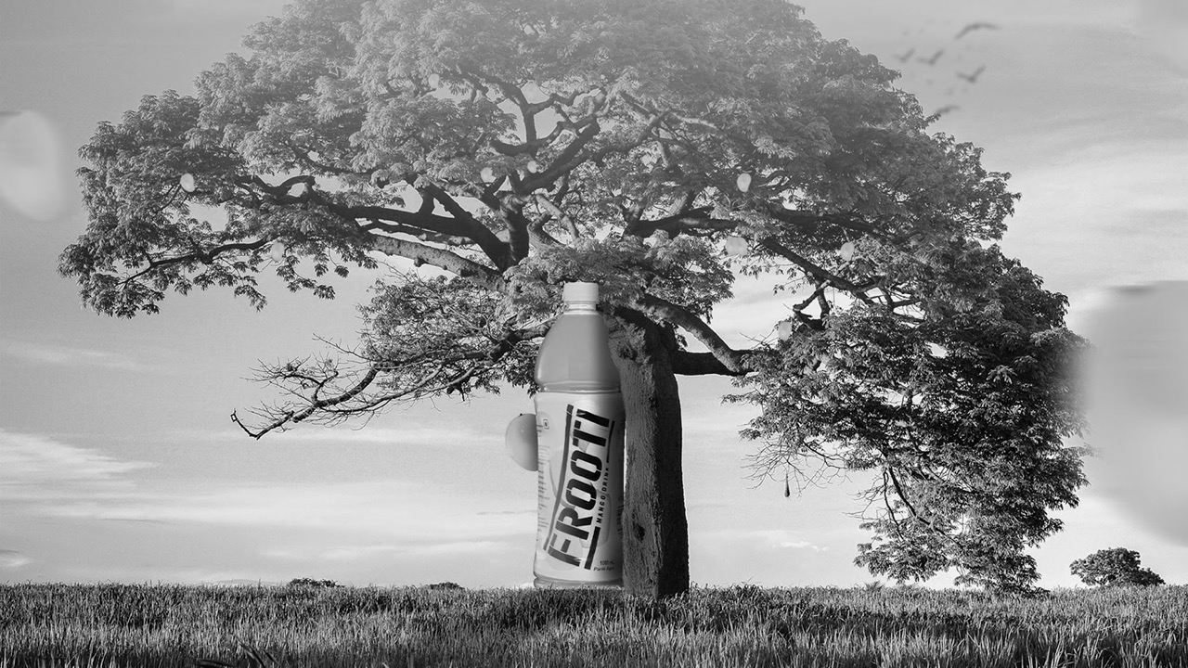



Slide 2
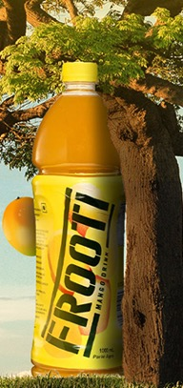
Digital
Strategy
A White Rivers Media Presentation

Slide 3
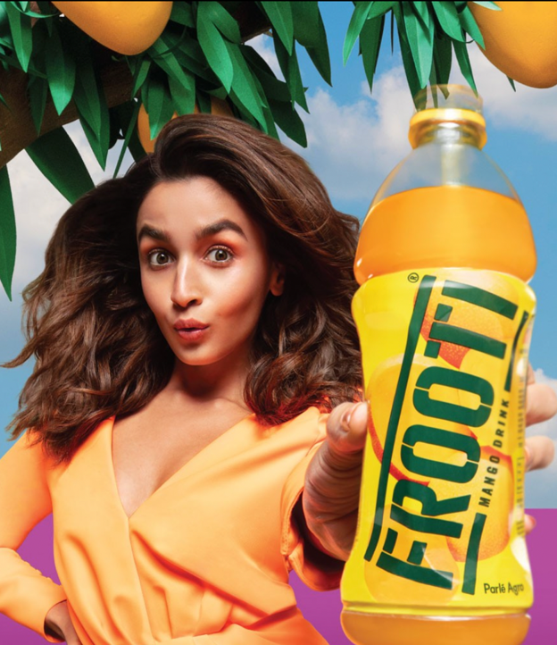
Research Outline
Understanding India’s Mango drink landscape
Decoding the consumers
Mapping their digital behavior
Mapping peer conversations
Understanding the Frooti fandom

Slide 4
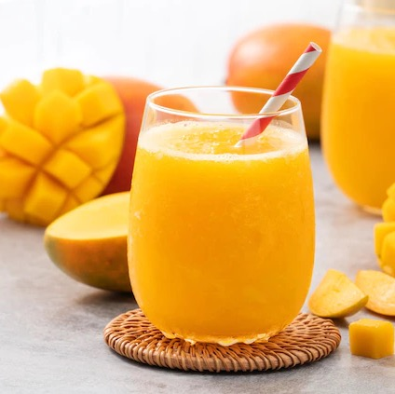

"India is in a Swoon-Worthy Love Affair with the King of Fruits!"
Riding on the back of emotions such as joy, passion and enjoyment, 77.4% respondents consumed their preferred mango drink at least 2-5 Times in a week, leading to making the RTD mango-based drinks a revered category in India
Source : IJCRT
Notes:
https://ijcrt.org/papers/IJCRT2203206.pdf

Slide 5
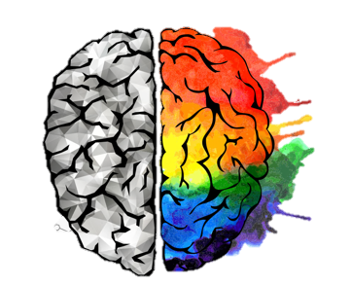
However, this love for mango-based drinks is a multi-dimensional concept…
The appeal for mangoes and its derivatives are deeply rooted in cultural significance, versatility and seasonality stemming from both physical and emotional motivators
PHYSICAL
EMOTIONAL
Hydrate, Refresh, Taste
Relax, Indulgence, Pleasure
Physical associations related to mango drinks demand a more immediate solution for satiation, often associated with occasions when one feels the need to be hydrated and re-energized
For some, Mango drinks have an ‘emotional energy’ – It has positive associations to feeling relaxed or perceived as a means for ‘escape’, connected to happiness & pleasure
Notes:
https://in-sight.symrise.com/article/a-7-step-solution-for-the-most-refreshing-beverages

Slide 6
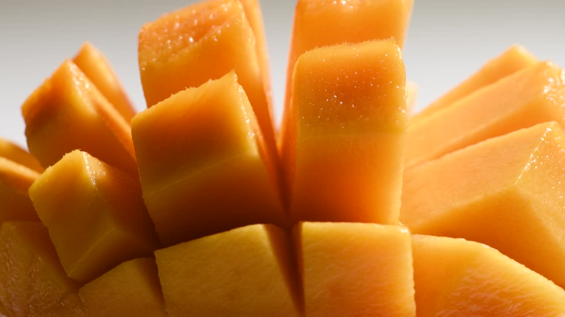
Let’s begin by
understanding its evolution…

Slide 7
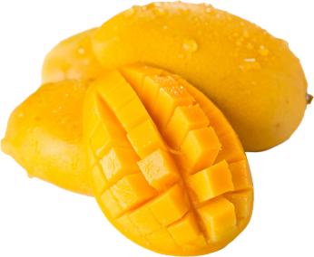
The Emergence
Discovery & Convenience
In the early phase, a new category of cold fruit drinks in tetra packs emerged, offering a convenient and mess-free delight
As people discovered the coolness and ease of cold fruit drinks, a wave of awareness swept through, leading to a rapid increase in their popularity and demand
Individuals embraced the joy and convenience of relishing refreshing mango-flavored beverages, saying goodbye to the hassle of dealing with messy mangoes

Slide 8
The Transition
Flavor and Quality – Delight in every sip
Brands started to realize that only enhancing the packaging and the novel way of enjoying these beverages would not be enough to maintain relevance or connect with their audiences
Making them develop unique flavour profiles with high quality taste, juiciness and texture at the centre of the indulgent sensorial experience

Slide 9
The Present
Contextualization : Embracing Emotional and Social Experiences
Today, Mango drinks have transcended the mere taste and convenience baits
It has become a symbol of joy, camaraderie, and togetherness, making them the ideal companions for shared moments among friends, family, and loved ones

Slide 10
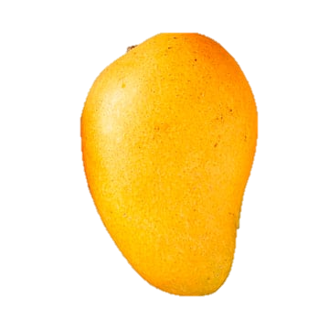
An opportunity for Indulgence
A drink of convenience
A tasty refreshment
Therefore, in its essence, Mango drinks in India have been seen as
A sensorial experience
A symbol of togetherness
Hassle free mango experience

Slide 11
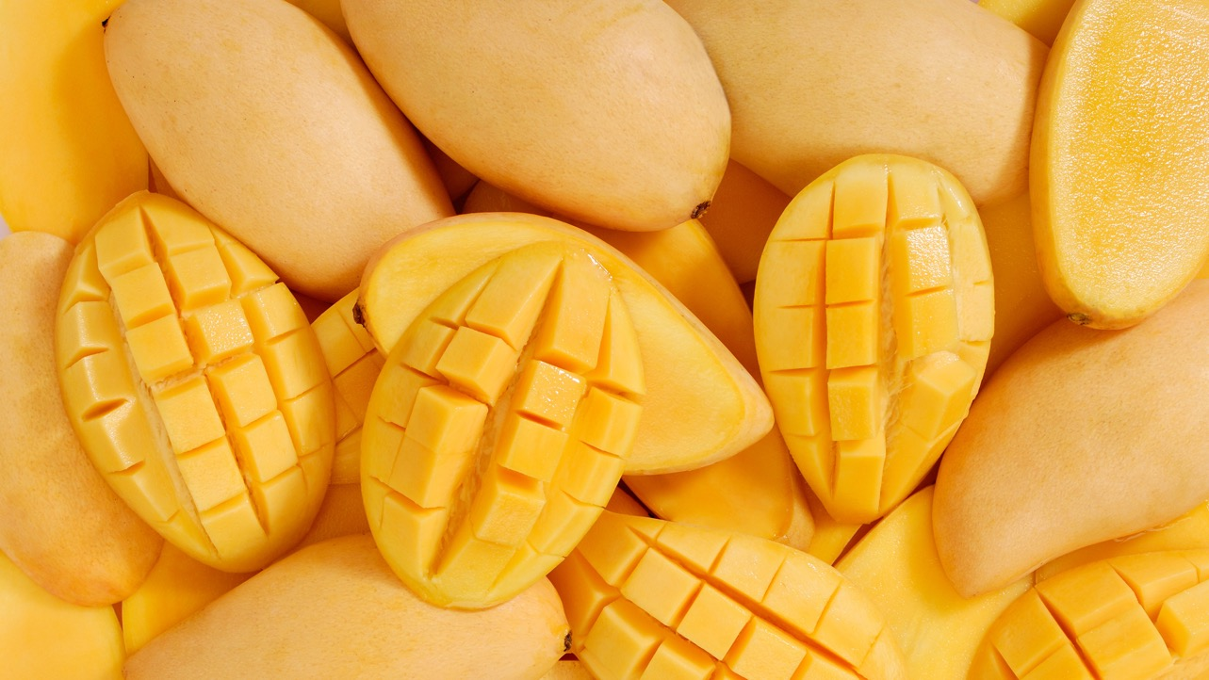
While Indians are united in their love for mangoes, they have certain unique differences in their consumption

Slide 12



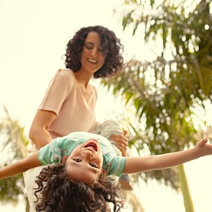

Decoding the Mango Drinks Consumers
Mango Munchkins
Zesty Aspirers
Taste and Fun are the ultimate ingredients that make their beverage choice truly satisfying
Convenient and portable drinks that reflect their individuality and adapt to their fast-paced lifestyles
Teenage Explorers
Family Comforters
A refreshing energy boost that adds a sense of adventure
Guilt-free indulgence for themselves and their children that blend delectable taste with real fruit goodness

Slide 13




Who are they?
Mango Munchkins
Teenage Trendsetters
Zesty Aspirers
Family Comforters
5-12 y/o
13-18 y/o
18-30 y/o
30-35 y/o
Characteristics: Playful, Energetic, Adventurous
Preferences: Sweet and fruity flavors, Colorful and attractive packaging, Fun and engaging branding
Needs: Delightful and delicious options, small-sized packaging for easy handling
Characteristics: Curious, Trend-conscious, Peer influenced
Preferences: Exotic flavors, Modern and trendy packaging
Needs: Exciting and refreshing drink options with quick hydration
Characteristics: Ambitious, Busy, and
Socially active
Preferences: Convenient & portable packaging, Refreshing & energizing flavors, Aspirational branding
Needs: On-the-go refreshment, Quality conscious, Focus on pop culture relevance
Characteristics: Health-conscious, Nurturing, and Family-oriented
Preferences: Familiar and comforting flavors, Reliable, trustworthy, family-friendly branding & packaging
Needs: Nutritious options for the whole family, Affordability, Assurance of high quality and safety standards
Core Audience

Slide 14
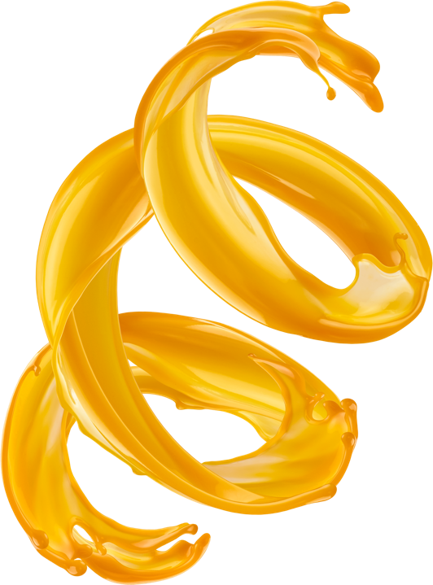

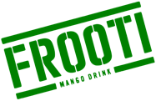
Looking ahead, as Frooti is shifting to build greater appeal for the youth, it’s crucial to deep dive into our core TG, their characteristics and needs from the category

Slide 15
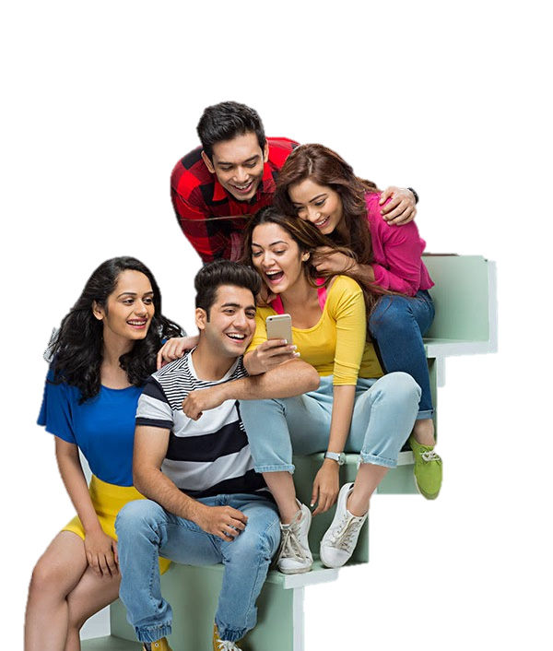






Our TG is a melting pot of nuances
Content chasers
Admire hustlers
Seek windows to express individuality
Cheer for Purpose-driven brands
Rooted in family
Take pride in Indianness
Source: Data Compiled by Capital Z

Slide 16
And when it comes to the RTD category, they display certain needs…
Wellbeing
They look to beverages as a window to escape, seeking peace, and emotional connections, triggered by product rituals
Feed The Mind
Value
They want brands to change the meaning of trust by committing to a higher quality of ingredients and experiences
Emotional Payoffs
Quality Redefined
Identity
They look to drinks brands to complement their need to feel unique and special with the desire to be part of communities of like-minded individuals
United by Drinks
Our young consumer is discerning, so going beyond the actual product to deliver emotional payoffs through a holistic brand experience that resonates with them is imperative
Source: Mintel

Slide 17

And when these consumers traverse through the digital realm, they navigate through multiple touchpoints, displaying unique needs

Slide 18



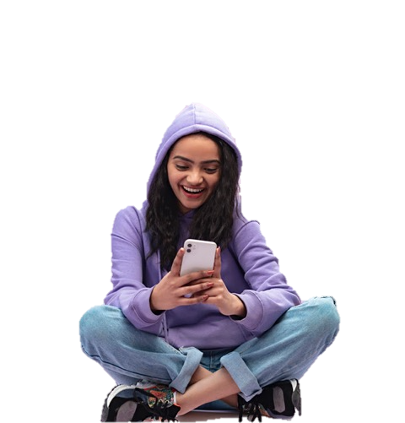







Audio
Micro Communities
News
For moments of self-reflection via the lens of their own auditory experience
To explore connections and share ideas through shared passions
To feel a sense of influence and agency in conversations
Short Form Video
Social Media
For bursts of micro-entertainment spread throughout the day
To further their role as prosumers, consuming and creating content
Digital Payments
OTT
To freely explore aspirational purchases without compromising on their innately digital lives
In search of true representation and relatable stories
Source : Plum Insights, CultureNxt

Slide 19

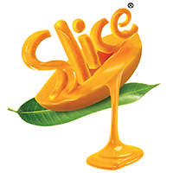

These dynamic audiences have pushed our peers to slowly adapt, creating a unique visual and content landscape

Slide 20
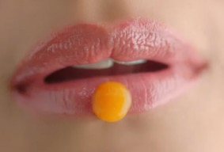
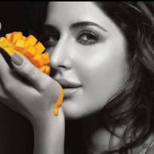

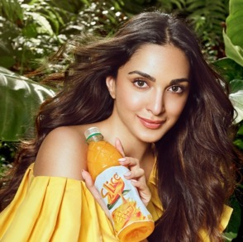
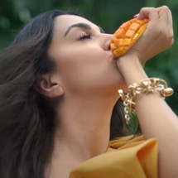
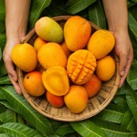

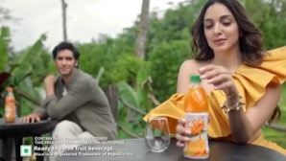
Symbolism - ‘Aam Sutra’
Leveraging sensuality, pleasure and desire
Brand Narrative– ‘Captivating the senses’
Indulgence that acts as a sensorial escape
Brand ambassadors, Kiara(present) and Katrina (former) embodying the sheer bliss of savoring the mango indulgence that transports you to tropical paradise
SLICE
Creative Manifestation – ‘The Slice Bottle’
Letting the consumers experience the brand in its true sensorial form
The iconic visual of delicious & luxurious droplet of Slice gracefully caressing the protagonists’ lips
Putting spotlight on the bottle, showcasing its packaging that closely resembles the shape and essence of real juicy mangoes
Visual Imagery - ‘The Intimate Romantics’
Capturing the essence of young romantic partners, in the prime of their lives, as they indulge in the delightful experience of savoring Slice together

Slide 21
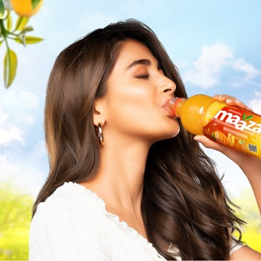
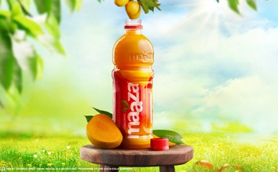
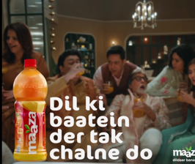
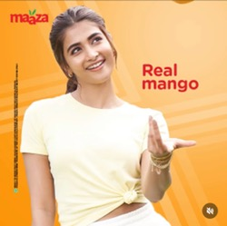
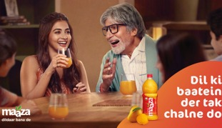
Brand Narrative – ‘Asli Mango’
Goodness of real Alphonso mangoes, offering an authentic and indulgent mango experience, that is truly in the background of natural freshness
Symbolism - ‘Togetherness’
Laughter, and shared experiences, capturing the essence of happiness and positivity
MAAZA
Strategically placed at the center of social moments
Creative Cues – Mango = Maaza
Consistently reminding consumers that Maaza is the only truly authentic flavour with real juicy mangoes
Visual Imagery - ‘The familial glue’
Using Ambassadors such as Pooja Hegde and Amitabh Bachchan, the brand is seen as one with a strong appeal and same vigorous appreciation across ages

Slide 22

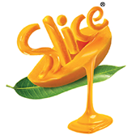

Each of our peers embodies a unique personality crafting a distinct space in the mind of the consumers…
“You’re just like me and I’m just like you”
“You are impossible to ignore”
Lover
Everyman
Intimacy
Connection
Passionate
Magnetic
Sensual
Soothing
Friendly
Authentic
Humble
Togetherness

Slide 23
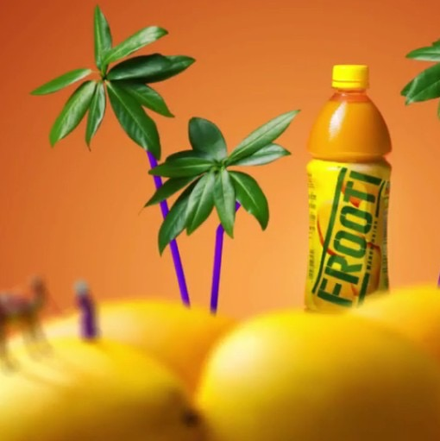
And when we think of Frooti…

Slide 24
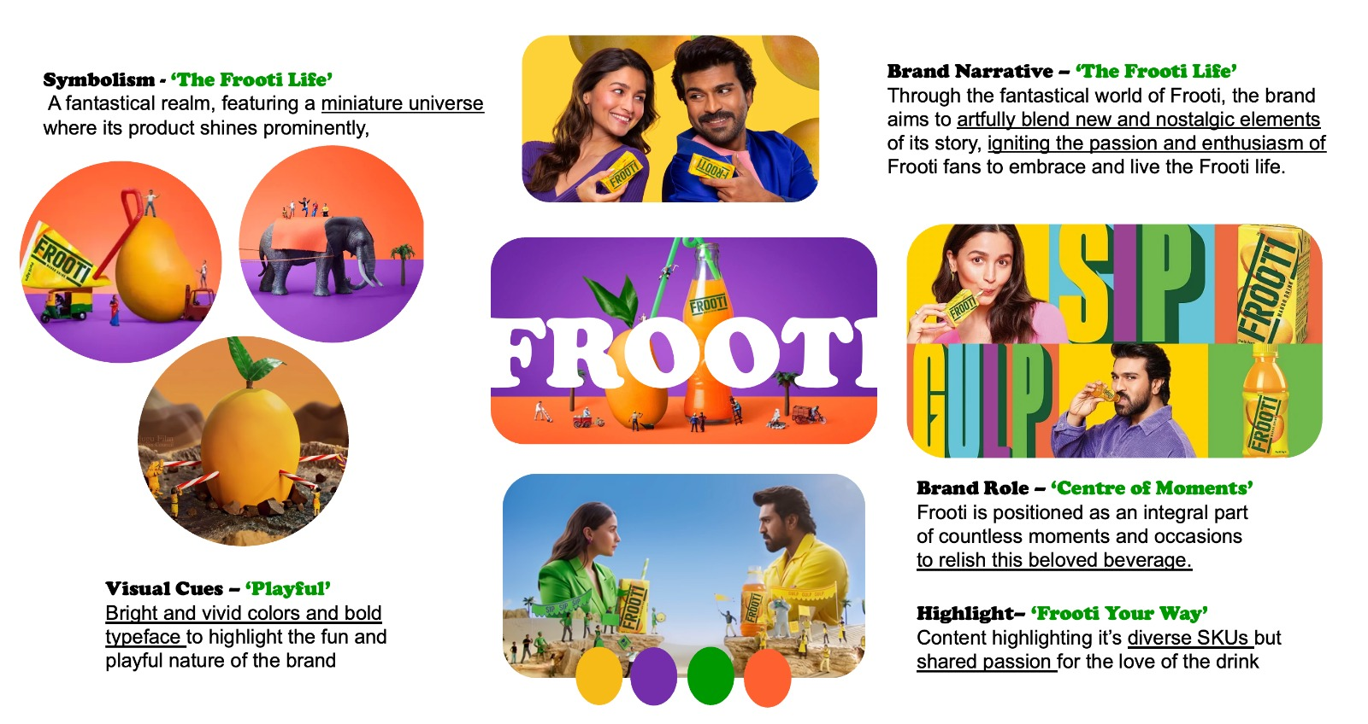

Slide 25

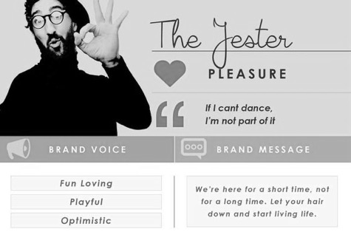
We observe our current personality to be that of a JESTER
Who?
How?
Playful characters
Engaging visuals
Happy Times
What?
We are perceived as a brand that is playful, delightful, and entertaining. It strikes a balance between tradition and contemporary elements, incorporating quirky twists that evoke joy

Slide 26
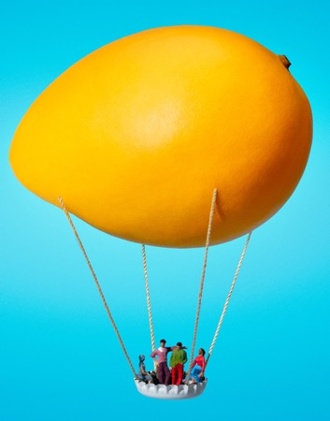

However, there’s a challenge
While we celebrate the brand and its products with strong appeal to the imaginative nature of kids, we are unable to echo the spirit of the brand and what ‘the frooti life’ represents
The Solution
Build a brand that moves beyond celebrating the product to celebrating what we stand for and our universe of users who are young, vibrant and aspirational

Slide 27
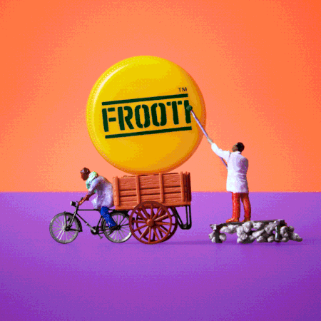
Therefore, the new Brand Approach for Frooti on digital

Slide 28
Consumer Truth
Category Truth
They are looking for brands that transcend the product, delivering on value, wellbeing and echoing their identity
Our Peers are putting a spotlight on high quality premium mangoes, making them a catalyst to captivating and indulging experiences
“ A full serving of entertainment”
The essence of our social media platforms will be to create content that truly entertains our audience through compelling and fun stories
Company Truth
Cultural Truth
Crafted from fresh mangoes’ finest pulp, Frooti’s juicy and flavorful mango taste is playful while evoking a sense of nostalgia
In India, there is a deep-rooted fascination with mangoes. Consumers crave access to mangoes throughout the year, regardless of the season
Source : Inspired by the 4C framework by Mark Pollard

Slide 29
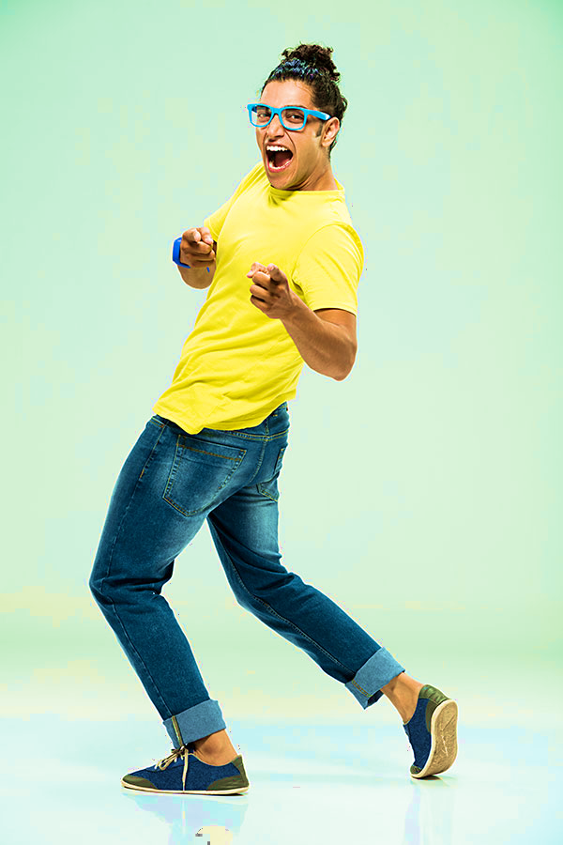
With the spotlight on The Frooti Life
Infectiously entertaining
Unwavering Optimism
Life of every party
Approach every situation with positivity
Radiate Confidence
Zealous
Embodying the spirit of frooti
Highly driven and motivated
Have strong self belief
People’s favorite
Big Dreams
Their charismatic personality, makes them deeply loved and cherished
They are persevering, and aspirational

