Slide 1
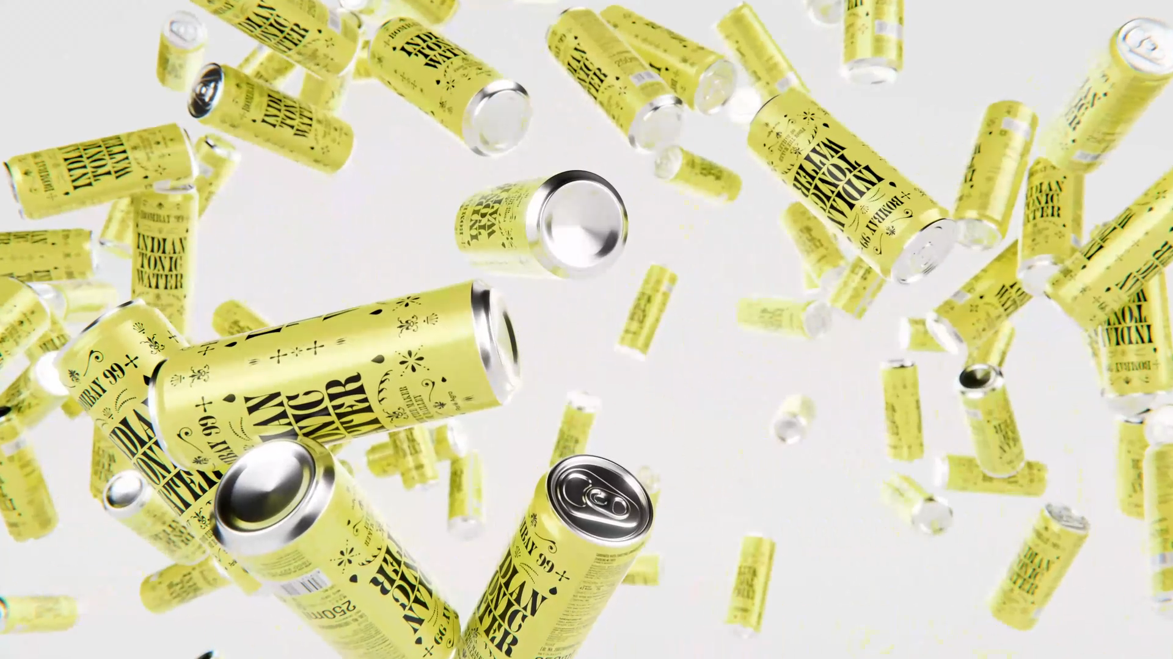

CONSUMER TRUTHS & BRAND LEARNINGS

Slide 2
There’s a New Rising Renaissance
in India’s Drinking Culture
Artisanal, handcrafted, ‘good-for-you’, stuffed with botanicals and aromatics –
we have come a long way from Coke and lime cordial when it comes to what we mix our drinks with. India's booming alternative beverage market is driven a growing crop of conscious and progressive drinkers.

Slide 3


These new-age consumers have their own unique value systems, driven by their increasingly connected context…
VALUE Individuality
DRIVEN BY (Self)Discovery
They lean into their uniqueness, refuse to conform, celebrate diversity & inclusivity & hence also seek ways to express their authentic selves
They are constantly seeking ways to find and express their authentic selves & are not afraid to draw outside of the lines to fully unlock their spirit.
NURTURING Aspirations
CONSCIOUS IN Choices
With increased accessibility, they are seeking inspiration from experiences laced with global influence
They look for progressive alternatives that are ‘mindful’ of their self, across various aspects of their realities
GLOBAL YET Rooted
SEEK Reciprocity
Liberal yet pragmatic, ambitious yet rooted in family ties, gregarious yet acutely individualistic, multitaskers, with a strong grip in personally steering their lives.
Driven by their fluid expression, they push to unlock a mass of likeminded people to connect with, no matter how niche the interest.
Source: McKinsey ‘TrueGen’
Notes:
https://www.vogue.in/culture-and-living/content/what-indias-booming-alternative-beverage-market-says-about-our-drinking-habits
https://www.mckinsey.com/industries/consumer-packaged-goods/our-insights/true-gen-generation-z-and-its-implications-for-companies
https://www.ogilvy.com/sites/g/files/dhpsjz106/files/pdfdocuments/RedPaper_GenZ_OSL.pdf

Slide 4
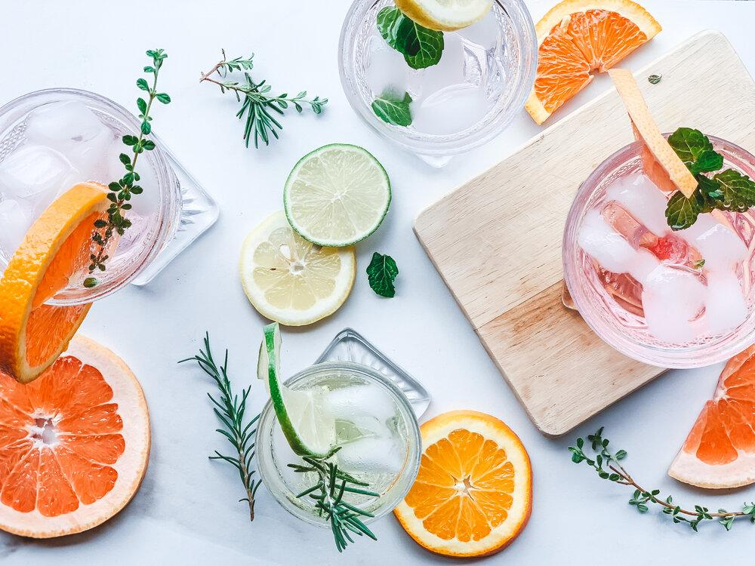
These traits also reflect in their alcohol consumption choices, ushering a shift in in attitude towards drinking being a “just-for-kicks” social act to savoring the experience itself
TRANSFORMATIONAL
SOPHISTICATED
CONSCIOUS
REGIONAL
SIMPLIFIED
Taste
Drams
Drinking
Pride
Sips
There is emergence of liberated attitudes, prioritizing experimentation with new ingredients and flavor combinations at home, during celebratory moments, and everywhere in between.
A discerning mindset and a revitalized attitude towards spirits is driving premiumization across category, as consumers lean into high-quality ingredients & sophisticated flavors
Driven by factors like health consciousness to aspiring for more authentic, less alcohol-influenced connections with people, mindful drinking brings self-reflection to a glass of drink.
While ‘imported is better’ still exists, for young drinkers the origin of the product is incidental; they are comfortable with Indianness. ‘Local’ is now associated with craftsmanship, authenticity
The world of drinking can be intimidating for many, making them seek simplified brands that unravel the complexities, guiding us to the heart of the experience without sacrificing the pleasure.
Source: Bacardi Cocktail Trends Report, 2023 I ET Brand Equity
Notes:
https://mpost.io/wp-content/uploads/BACARDI-Cocktail-Trends-Report-2023.pdf
https://bwdisrupt.businessworld.in/article/Evolving-Preferences-Of-Younger-Indian-Generation-In-Drinks/27-04-2022-426715/
https://brandequity.economictimes.indiatimes.com/news/business-of-brands/how-indian-alcohol-brands-are-raising-the-bar/96204353

Slide 5
These Evolving dynamics and drivers of alcohol consumption have given rise to multiple consumer mindsets…
HIGH EXPERIMENTATION
LOW EXPERIMENTATION
Chameleons
Classics & Romantics
Sober Curious
Purists
Just as chameleons blend in with their surroundings, their drinking behavior changes according to the atmosphere & occasion.
They enjoy adventure in their drink & hence also prioritize new ingredients, taste profiles, exciting flavor combinations, drink formats & may also enjoy DIY experimentation.
These blenders are aware of their preferences & have a more nuanced taste in their drinks
Classics: Stick to known brands for their preferred drinks & opt for classic (not traditional) concoctions.
Romantics: Seek classic drinks that are elevated with a subtle unexpected twist, which reflects their hidden facet.
These substituters, practice ‘mindful drinking’, seeking NoLo drinks in place of full-strength drinks on certain occasions, rather eschewing alcohol altogether.
This moderation mindset or alcohol minimalism is driven by factors like health consciousness, social chatter or aspiring for more authentic connections
They know what they like and aren’t interested in stepping out of the comfort zone.
To them, the social aspect of drinking is less important than the quality & essence of drink. They may or may not be big spenders, but prefer to savour the original taste of the drink. Experimentation is majorly limited to brands & not enhancement.
AUDIENCE UNIVERSE FOR THE MODERN DRINK-MIXER CATEGORY
NOTE: Choice of a drink is situational.

Slide 6
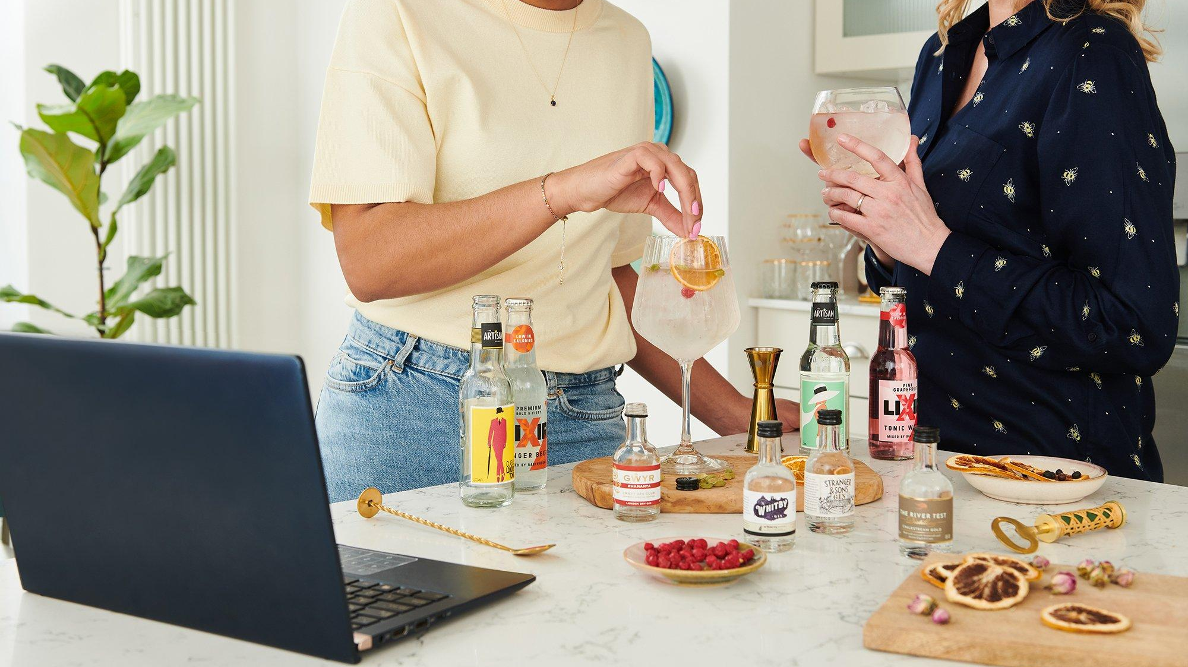
Digital & Social Media Exposure
have had an influential effect on the evolving social norms of alcohol consumption

Slide 7
They're turning to their devices at every stage of the journey – from inspiration to purchase
‘I-want-to-know’ Moments
‘I-need-some-ideas’ Moments
‘How-do-I-make-it’ Moments
‘I-want-to-buy’ Moments
In these moments, consumers are seeking simple ideas for experimenting with their drinks, specifically in terms of mixers to change or enhance the taste, add flavor, or simply to diversify.
The DIY journey starts with a spark — a curiosity about what to make. These moments can be confusing and hence they turn to search or social media for help, seeking ideas, inspiration basis their needs.
Once the decision is set, these moments strikes and individuals look for help in preparing it. They aren't necessarily experts in, so they seek practical advice - Questions around ingredients, alternatives, the ratios etc.
Consumers are searching for the ingredients, seeking product recommendations, understanding easy alternatives available, reading product reviews, product composition, deals available etc.
In these moments consumers are seeking guidance they need and they are first committed to their need.
Winning hearts & driving product need, will therefore require serving up complete assistance in such micro-moments.
NOTE: Micro-moments are not linear, rather fragmented instances.

Slide 8


NOTE: Micro-moments are not linear. They do not represent digital behavior of a single individual, rather is a collection of information needs of different types of drinkers.
HEAVY PEER PRESENCE OBSERVED
‘I-want-to-know’ Moments
‘I-need-some-ideas’ Moments
‘How-do-I-make-it’ Moments
‘I-want-to-buy’ Moments
RIGHT COMBINATION
what to mix with vodka at home
what to mix with vodka low calorie
what to mix with whiskey besides soda
what mixes well with whiskey
Mixers for dark rum
what to mix with dark rum besides coke
what to mix with bacardi white rum
gin and tonic ratio
Whiskey and ginger ale ratio
How much tonic with gin
TASTE/ FLAVOUR-BASED IDEAS
Sweet cocktail recipes
Fruity cocktail recipes with vodka
Classic/ Tropical fruity cocktails
spiced rum/ dark rum cocktail
OCCASION-BASED
Cocktails for house party/ Christmas party
Cocktails for summer
whiskey cocktail recipes for winter
DRINK-BASED IDEAS
Cocktails with rum/ vodka/ gin/ whiskey
Gin/ whiskey/ rum/ tequila cocktails
spicy cocktails with gin
whiskey cocktail recipe for winter
EFFORT-BASED
simple tequila drinks 2 ingredients
easy cocktails for Christmas/ winter
RECIPE/ INSTRUCTIONS
how to make sangria/ mojito/ mimosas/ manhattan
how to make homemade screwdriver
simple martini recipe without vermouth
margarita recipe without triple sec
INGREDIENT LIST
screwdriver cocktail ingredients
cosmopolitan cocktail ingredients
ANCILLARY SUPPORT
how to make spicy cocktail sauce
how to make simple syrup
How to make bitters
SEEKING ALTERNATIVES:
alternative schweppes tonic water
Margarita mix powder
mojita premix/ syrup
pinacolaa cocktail mix
best mojito syrup/ mix India
ready made cocktail mixers
Ready made cocktails India
WHAT ARE MY OPTIONS
Generic
Best mixer for whiskey/ old monk
Mixer-Type based
tonic water brands India
Best tonic mixers for gin
What soda mixes well with gin
Brand-based
best Jimmy’s cocktail flavor
schweppes tonic water ingredients
sepoy tonic water review
This is 100% consumer intent share available to brands. In these moments, consumers are forming opinions, shaping preferences & making decisions
Winning hearts & minds, will require the brand to align with such micro-moments strategically, keeping in mind brand’s offerings & positioning.

Slide 9













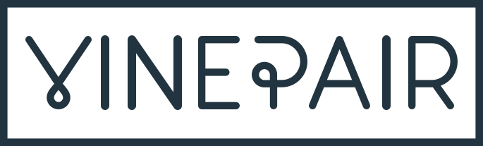






In these moments, consumers are turning to multiple touchpoints…
Marketplaces or grocery delivery portals
Mixologist Influencers
Technical guidance, product recommendations
E.g. Nitin Tewari, Happy High Academy, Sonal C Holland, Cocktails India, Tipsy Bartender)
Food publishers
Also provide inspiration, recipes, guidance for beginners
Search
Gateway to the entire journey – Ideas, Recipes, Ingredients, understanding of alcohol, mixing, etc.
YouTube
Unlike Instagram acts more as a source of technical guidance
Brand Websites & Social media handles
Product updates, shopping, recipes
Food Influencers
Focus on beginner-friendly recipes, with step-by-step guidance, with minimal efforts & tools
(E.g. Sanjeev Kapoor, Get Curried)
Lifestyle Publishers Inspiration, latest trends, product recommendations
Instagram with its Reels & Pinterest often tends to be a source of active or passive inspiration & discovery of new trends & quick mixes
Industry Publishers
Community Handles
Platform for spirits enthusiasts not just for inspiration or guidance, but also to discuss the art of drinking, helping beginners navigate the world of alcohol & drinking
E.g. The Cocktail Story, World Class IN, Gin Explorers Club, Alcohowl, The Dram Club
These touchpoints provide opportunity for distribution or audience sourcing

Slide 10

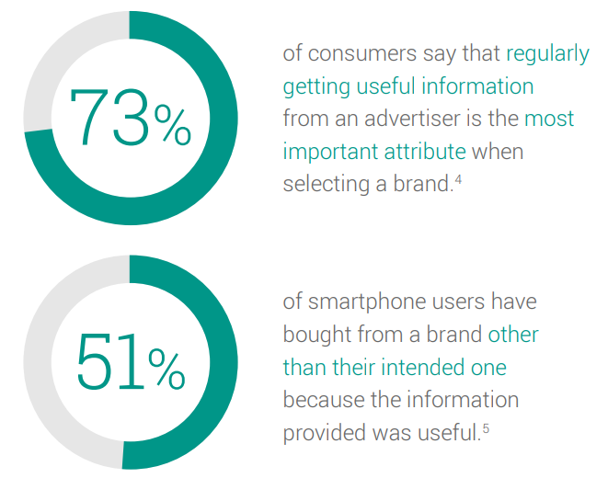
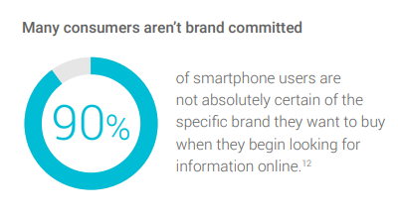
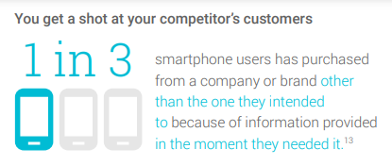
Thus, to win the hearts, minds and intent, capturing maximum share of consumer intent will be key by…
WHY: Build and influence brand perception
Being There
Being Useful
Consumers gravitate toward brands that provide ‘value’. Hence, it is key to find sweet spot where your customers’ goals and your own align & building symbiotic two-way ‘value exchange.
This will involve marrying our product proposition with specific micro-moments.
Being Quick
WHY: Build and Grow Share of Intent
Identify the micro-moments of prospective customers that fit the product offering & positioning, then commit to being there to help when they happen.
Provide immediate action, instant gratification and a fast & frictionless experience to keep pace with impatient consumers.

Slide 11
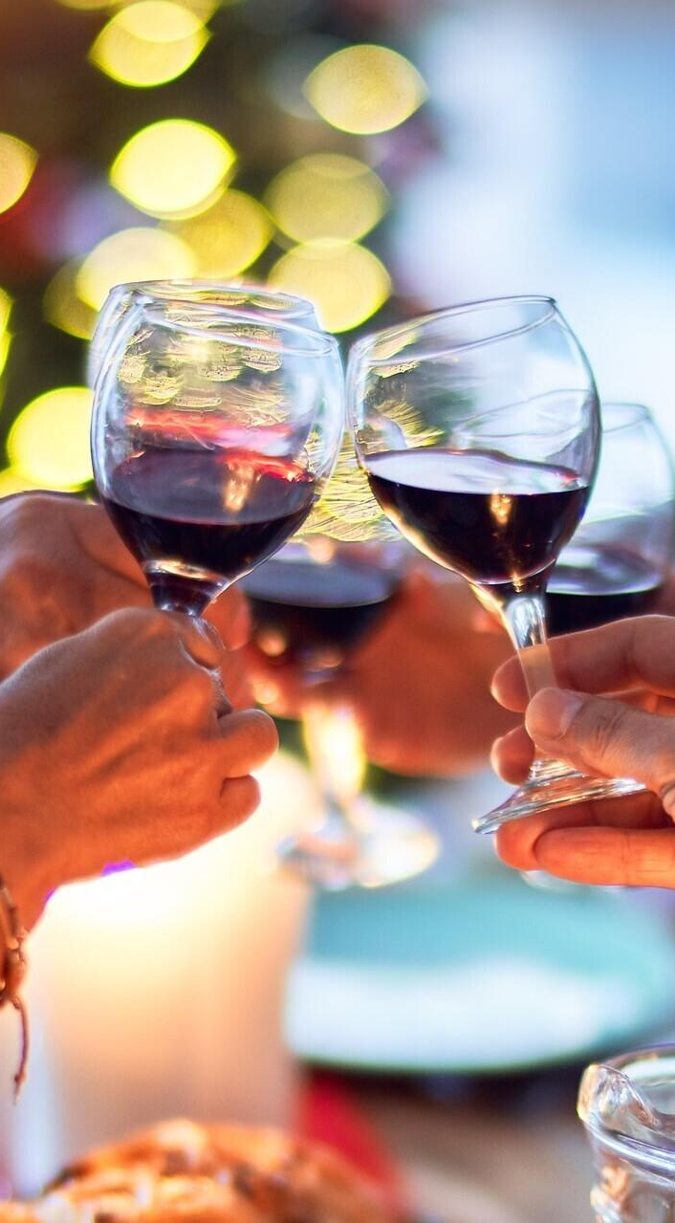
Choice of beverage however isn’t just a matter of personal taste, but is also a symbolic vehicle…
STATUS INDICATOR
Choice of beverage is an indicator of social status. The drinking practice acts as ‘definitional ceremonies’ through which people enact not only ‘what they think they are’.
E.g. Wine was, and is today in many cultures, "a focus of eloquent choices“. Its sophistication is an expression of ones taste and aspirations.
SITUATION DEFINER
The act of drinking & the choice of beverage defines the nature of occasion & establish the context for social interactions allowing individuals to initiate a sense of situational appropriateness, be it for creating shared experiences or for individualistic pleasure.
STATEMENT OF AFFILIATION
Communicating exclusiveness, beverages acknowledge aspects of one’s identity, or their declaration of membership in a particular group, generation, class, ‘tribe’, sub-culture & its associated values or beliefs. .
Notes:
http://www.sirc.org/publik/drinking6.html

Slide 12
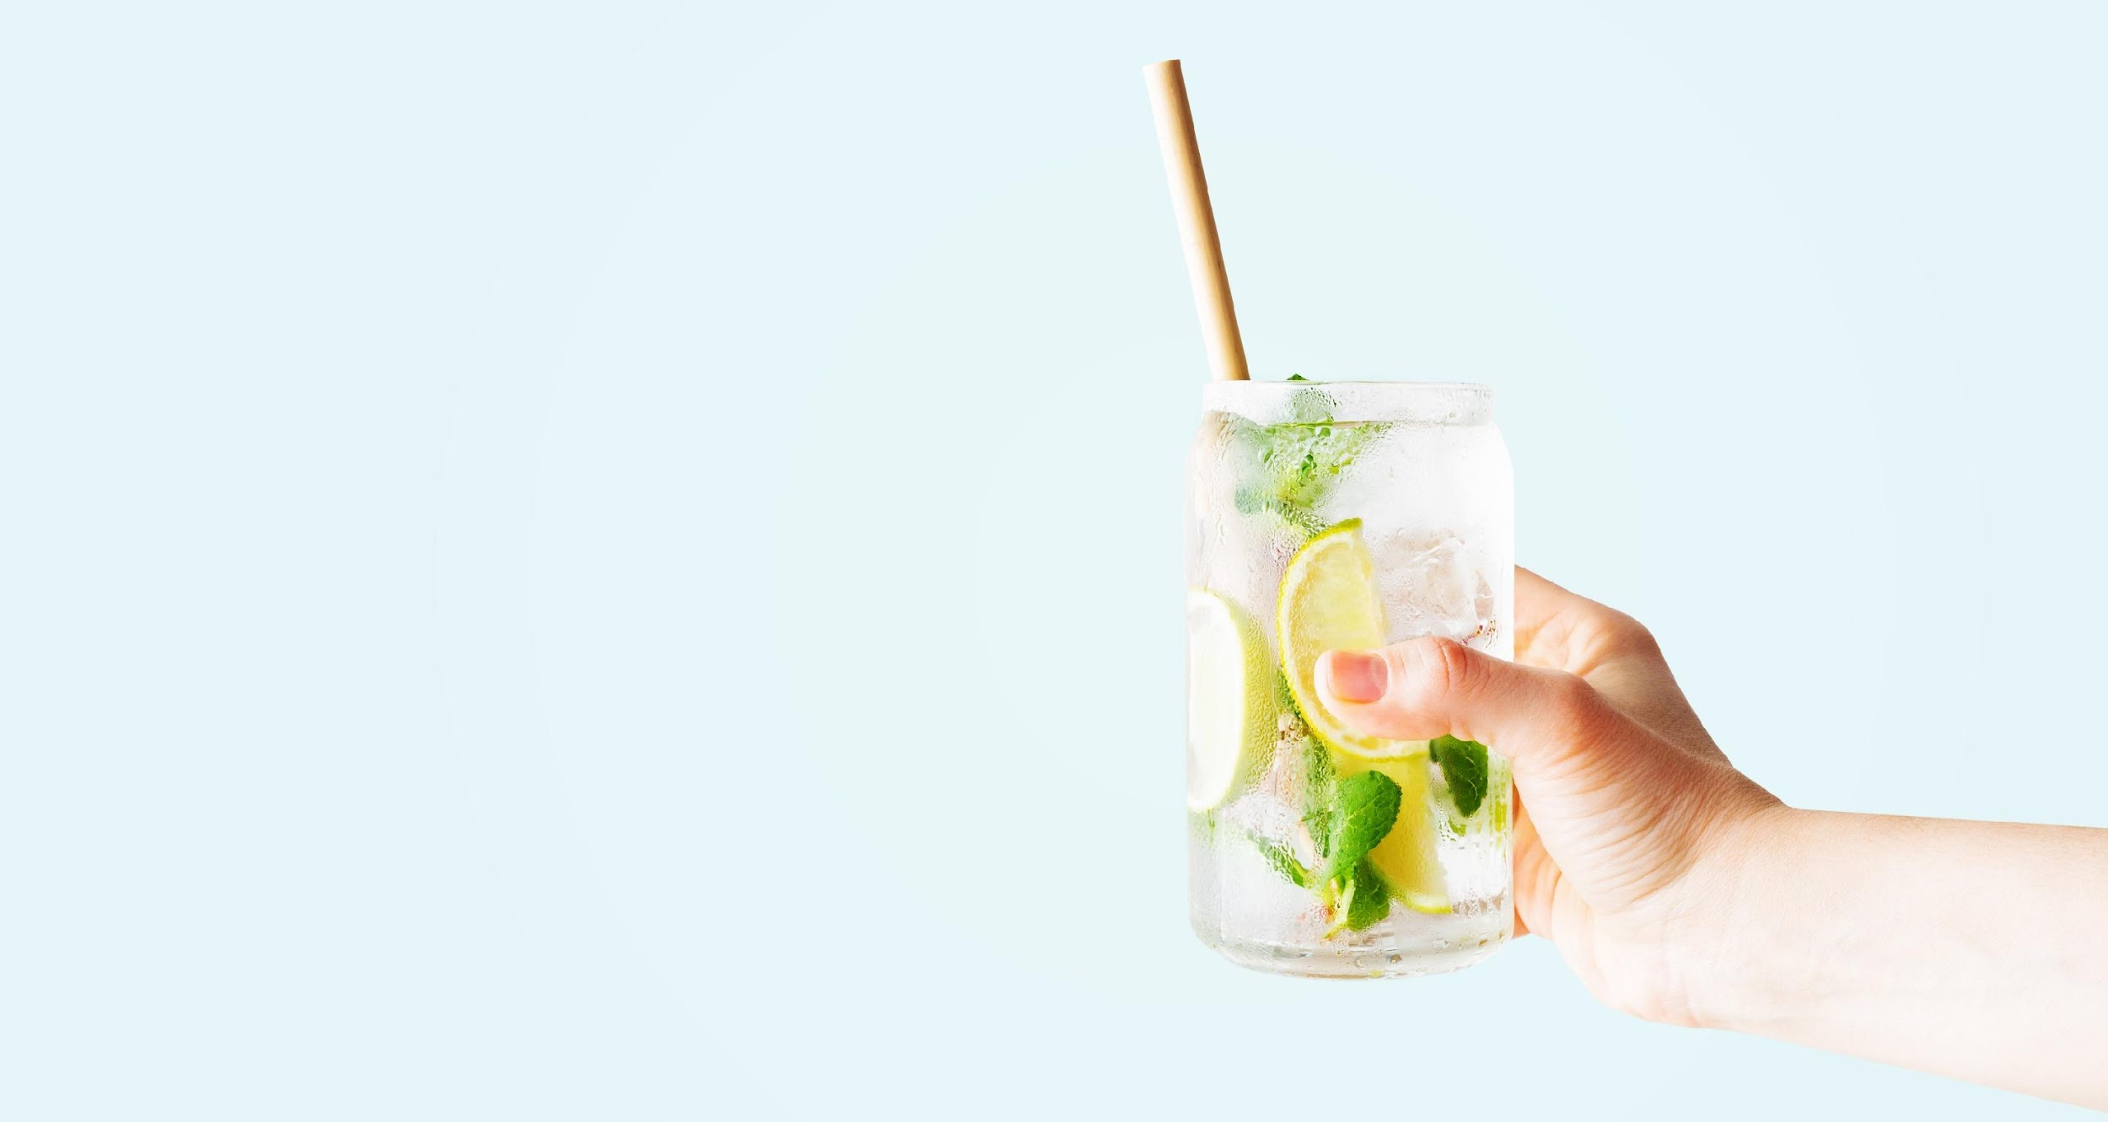
Peer Analysis
Analyzing how our peers are delivering value to the consumers with the evolving tastes

Slide 13
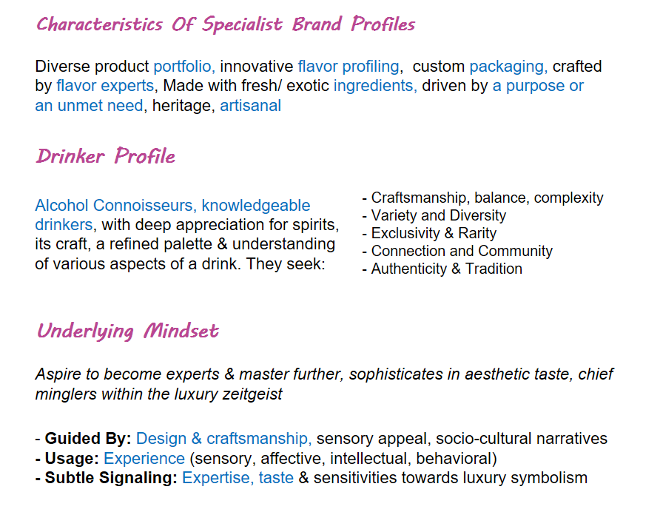
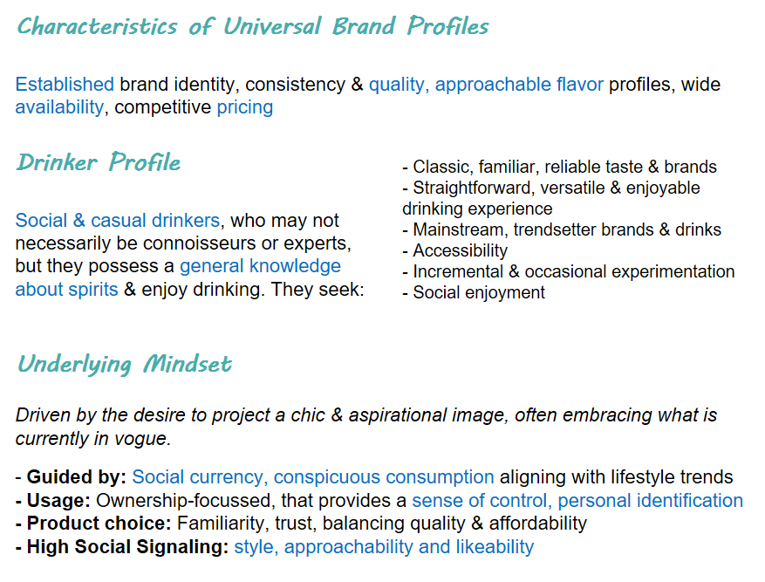
LEARNING 1: The market landscape can be broadly mapped into two…
Specialists
Universals
AUDIENCE VOLUME
NOTE: Choice of type of a brand is situational.
Notes:
They navigate choices laced with grace & higher level of sophistication,

Slide 14


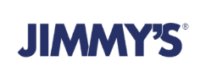

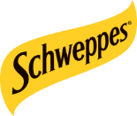

LEARNING 2: Product characteristics majorly influence the brand positioning in category…
Specialists
Universals
Brand Spaces To Build Appeal
Brand Spaces To Build Appeal
Taste I Ingredient Story I Creativity & Convenience I Lifestyle Payoff
Elevation
Broad Communication Approach
An uprising against the industrialised/ conformists, a return to traditions, and intelligent union of flavours, choice of mindful drinkers, revisiting the culture of ‘sophisticated cocktail-sipping’.
Broad Communication Approach
Elevating beverage experience, where every sip is a statement, transporting you to a world of refined enjoyment & elevating any moment with style
AUDIENCE VOLUME
AUDIENCE VOLUME
NOTE: Choice of type of a brand is situational.
Notes:
They navigate choices laced with grace & higher level of sophistication,

Slide 15


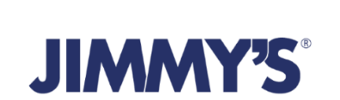

Thoughtfully Crafted Drinks
Premium Botanical Mixers
House of Delicious Drinks
BRAND SPACE: Mindful Lifestyle
BRAND SPACE: Ingredient Story
BRAND SPACE: Taste & Creativity
Brand endeavors to bring about a holistic change to how people consume beverages by providing drinks in the "Better for you" category, keeping up with evolving consumer preferences
Brand stands as a testament to the timeless allure of flavors, building a narrative around its ingredients while striving to create a symphony of taste experiences that elevate moments of pure indulgence.
Svami stands tall as a champion of taste & flavor elevation - placing itself as a companion in elevating the taste experience while embodying the spirit of enjoyment and flavour-curiosity.
BRAND
Summary
Bring bar home
Remarkable Drinks, Without Compromise
Mix It Up With Schweppes
BRAND SPACE: Creativity
BRAND SPACE: Lifestyle Payoff
BRAND SPACE: Elevation
Brand indulges in the consumer desire to replicate bar-like drinking experience at home through easy creativity – making the art of mixology as a personal journey of discovery.
Brand lays great emphasis on not only complimenting but committing to deliver quality by creating delicious high-quality sips, endeavoring to strike a balance in taste and textures
Schweppes celebrates the brand as the perfect mixer to ensure that each sip is a refreshing and satisfying experience – enhancing moments of consumption while placing themselves at the core of enjoyment

Slide 16
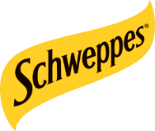


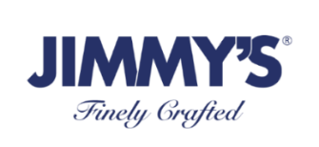

Status Indicator: Conscious Curated Lifestyle
Tonality: Young, Encouraging, enterprising
Status Indicator: Trendsetters & Trendchasers
Brand Tonality: Vibrant, Enthusiastic, Energetic, Quirky
Brand appeals to aspirations of conscious lifestyle seekers, who prioritize thoughtful choices, sustainability, and overall well-being
Schweppes aims at inclusivity with a belief that everyone deserves to experience the joy and excitement that comes with indulging in life's pleasures.
Status Indicator: Refined Indulgence
Tonality: Stylish, fresh, refined, upscale, minimalist
STATUS INDICATOR
Status Indicator: Experimental Lifestyle
Brand Tonality: Bold, young, peppy, celebratory
Portrays an upscale lifestyle with visual styling and collaborations leaning towards artistic affiliations, & refined aesthetics, creating a sense of luxury & elegance
Brand appeals to engaged socializers with appetite for experimentation, encouraging them to explore art of mixology and up their bar-game
Status Indicator: Premium Aspirations
Brand Tonality: Rich, Millennial, elegant
Status Indicator: Refined Indulgence
Brand Tonality: Bold, Premium
Brand aligns with an aspirational mindset that loves exploration, staying ahead of the curve, and going beyond the ordinary.
Brand strives to inspire a journey of taste and deliver value to discerning palates that are seeking unparalleled flavor and savory experiences

Slide 17

STATEMENT OF AFFILIATION:
Conscious Lifestyle Curators
STATEMENT OF AFFILIATION:
Style Seekers & Trend Chasers
Building “Friends of Jade”, a supportive network who prioritise conscious choices
(association with fitness influencers
Leading as a commercial brand, Schweppes aims at celebrating the young and refreshing spirit building an appeal for every type of consumer
STATEMENT OF AFFILIATION:
Refined Gourmands
STATEMENT OF AFFILIATION
STATEMENT OF AFFILIATION:
Creative Experimenters
Appeals to a community of tastemakers and connoisseurs who share a passion for the finer things in life (associations with art, ballet, jazz)
Celebrates community of people creative at heart that that seek thrill of experimentation & unique experiences (engagement outreach to both cocktail lovers & bartenders)
STATEMENT OF AFFILIATION:
Creative Experimenters
STATEMENT OF AFFILIATION:
Refined Gourmands
Celebrates community of people creative at heart that that seek thrill of experimentation & unique experiences (engagement outreach to both cocktail lovers & bartenders)
Tastemakers and connoisseurs who share a passion for the finer things in life (often feature highly-regarded establishments)

Slide 18

SITUATION DEFINER:
A.M. TO P.M. CELEBRATORY SOCIAL
Cues: WFH set-up, post-workout hydration, brunch, clubs & at-home parties etc.
SITUATION DEFINER:
SOCIAL CELEBRATION
Cues: Mainstream Club parties, At-the-bar serves, Classic cocktail recipes etc
SITUATION DEFINER
SITUATION DEFINER:
CELEBRATORY SOCIAL DRINKING
Cues: Big ticket wedding, refined social parties, refined settings at-home consumption moments etc.
SITUATION DEFINER:
AT-HOME & SOCIAL CELEBRATIONS
Cues: At-home consumption moments, house parties, outdoor parties, DIY cocktail recipe etc.
SITUATION DEFINER:
HIGH-END SOCIAL APPEASEMENT
Cues: Holiday-esque relaxing moments, enjoy-with-friends moments, Bartender serves etc
SITUATION DEFINER:
REFINED SOCIAL INTERACTIONS
Cues: Work events, premium bar interactions, top coktail bar guides, cocktail DIY presentation, etc

Slide 19
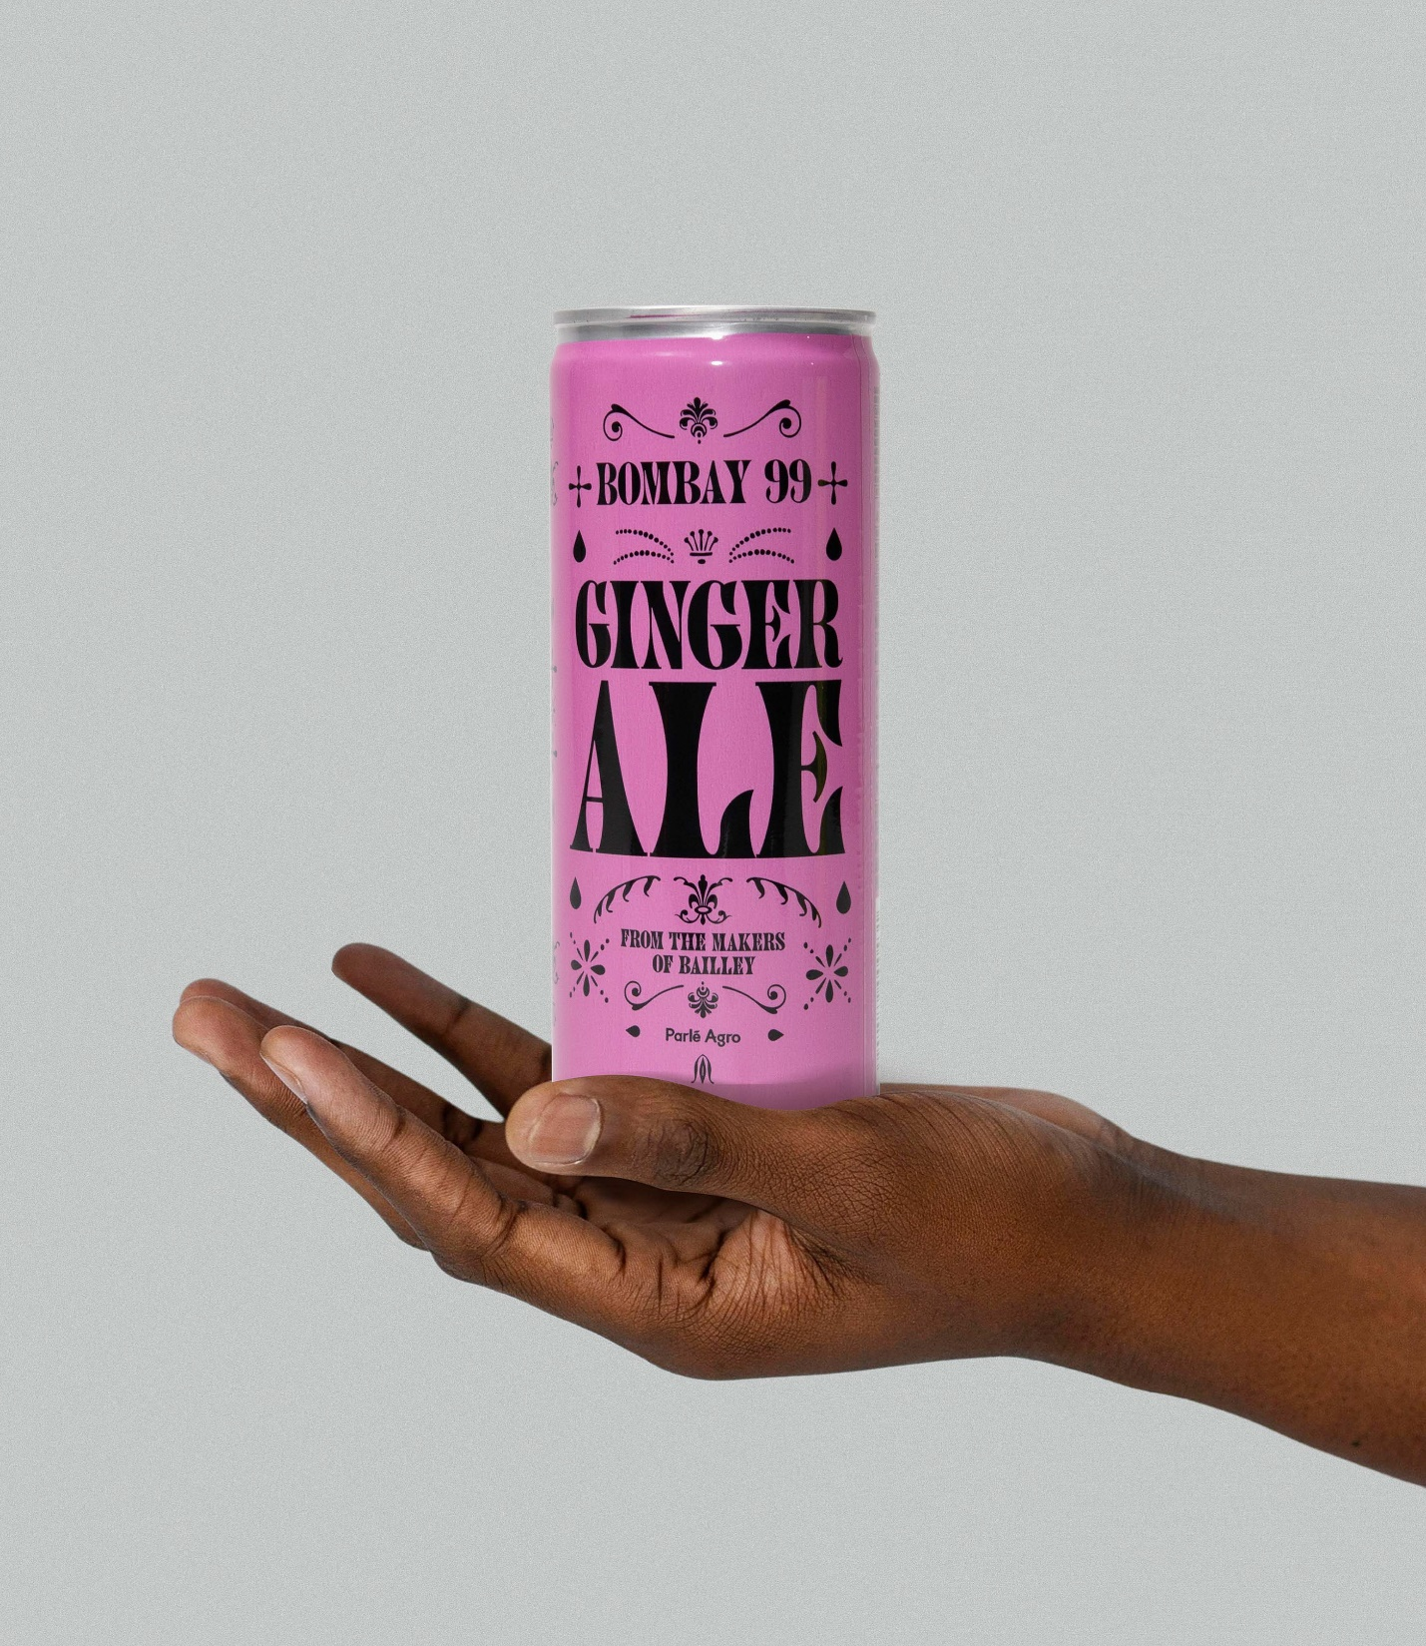
Learnings & Brand Imperatives
Analyzing the peer positioning to identify brand space & imperative for crafting a premium identity

Slide 20
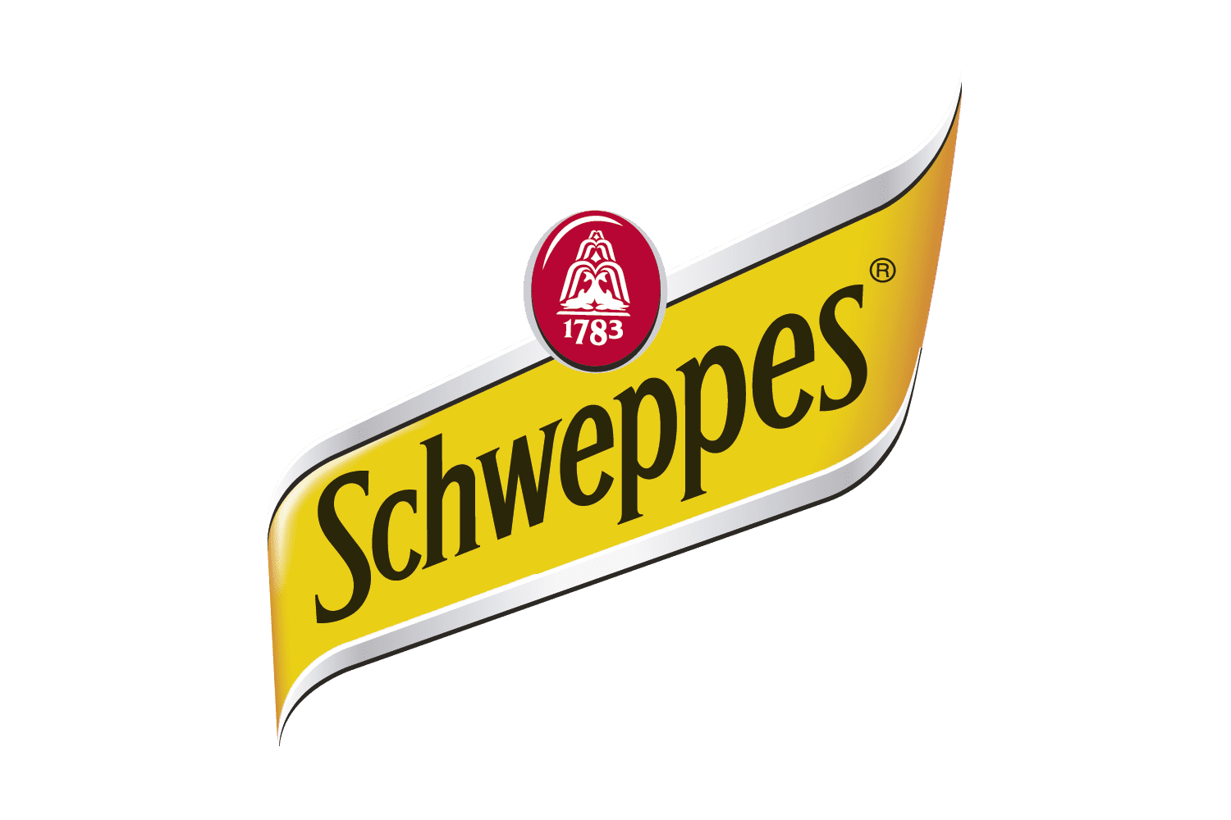
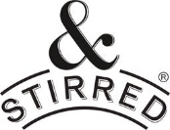
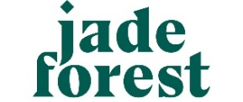
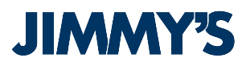




Therefore, mapping the modern-mixer landscape of India…
Universals
Specialists
LIFESTYLE PAYOFF
TASTE
CREATIVITY WITH CONVINIENCE
INGREDIENT
STORY
Accessible Premium
Simple to Make cocktails.
House of
Delicious Drinks
Bring the Bar Home
Mix it up with Schweppes
Thoughtfully Crafted Drinks
Aspirational Premium
Explore, experiment & experience cocktails with us!
Premium Botanical Mixers
Super Premium
Remarkable Drinks,
Without Compromise
Exquisite mixers from distilled botanicals

Slide 21
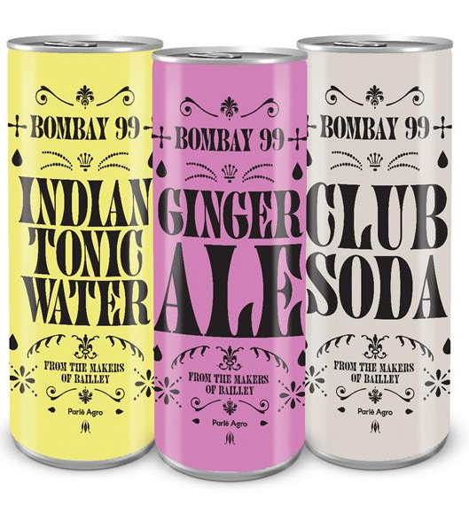
Therefore what it means for Bombay99
WHAT WE KNOW OF BOMBAY99
WHAT IT SYMBOLISES
From the
Makers of Baileys
Legacy
Trust, Familiarity & Quality (of established brand)
Created to
Enhance experience of drinks
Sensory Delight
Elevated indulgence (moving beyond the ordinary)
Taste that is
Powerful, Punchy & Intense
Impact
Bold, Unapologetic (taste that makes a statement)
Mixer Range to
Shake Up India!
Adventurous Spirit
Energy, Excitement & Enjoyment
Design that is
Lively, Intricate yet bold, India-inspired
Captivating
Individuality, Authenticity (Sophisticated yet daring)
Notes:
A design that is lively, intricate yet bold symbolizes a brand that celebrates vibrancy, attention to detail, and a fearless spirit. It represents a brand that is not afraid to make a statement, capturing the attention of its audience with its energetic and lively visual appeal. The intricate elements of the design showcase a dedication to craftsmanship, sophistication, and a rich depth of creativity. This design symbolizes a brand that values individuality, creativity, and a desire to stand out from the crowd. It resonates with an audience that appreciates boldness, artistic expression, and a sense of liveliness in their lifestyle choices. The combination of liveliness, intricacy, and boldness in the design reflects the brand's commitment to delivering a unique and captivating experience, appealing to a discerning audience seeking authenticity, artistic flair, and a touch of excitement.

Slide 22
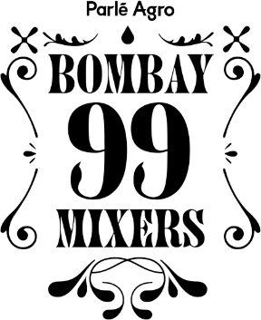
Learning 4: Therefore mapping Bombay99…
Universals
Specialists
LIFESTYLE PAYOFF
TASTE
CREATIVITY WITH CONVINIENCE
INGREDIENT
STORY
Accessible Premium
Simple to Make cocktails.
House of
Delicious Drinks
Bring the Bar Home
Mix it up with Schweppes
Thoughtfully Crafted Drinks
Aspirational Premium
Explore, experiment & experience cocktails with us!
The Brand takes the essence of mainstream appeal, but with a specialist allure, embodying a fusion of accessibility, legacy, elevation, with authenticity & a refined aesthetic.
The brand dares to stand out from the crowd, instilling a sense of exclusivity & representing the epitome of elevated mainstream lifestyle
Premium Botanical Mixers
Super Premium
Remarkable Drinks,
Without Compromise
Exquisite mixers from distilled botanicals

Slide 23
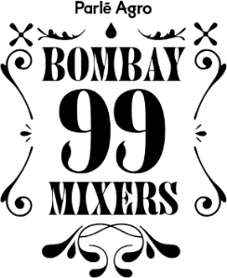
Therefore manifesting the brand canvas…
BRAND SPACE
Effortlessly Euphoric Drinking Experience
STATUS
INDICATOR
STATEMENT OF
AFFILIATION
SITUATION
DEFINER
Signals A Playful Attitude
Aspiring tastemakers in Social Circles
Relaxed & Refined Social Set-up
Masters of understated creativity, infusing subtle twists to ordinary experiences
Chasing the spotlight by confidently & smartly creating a noticeable impression
Effortlessly, elevating their entertaining experiences
NOTE: Brand Space is not consumer facing communication and will be used to guide messaging & other promotional activities
Notes:
Social validation

