Slide 1
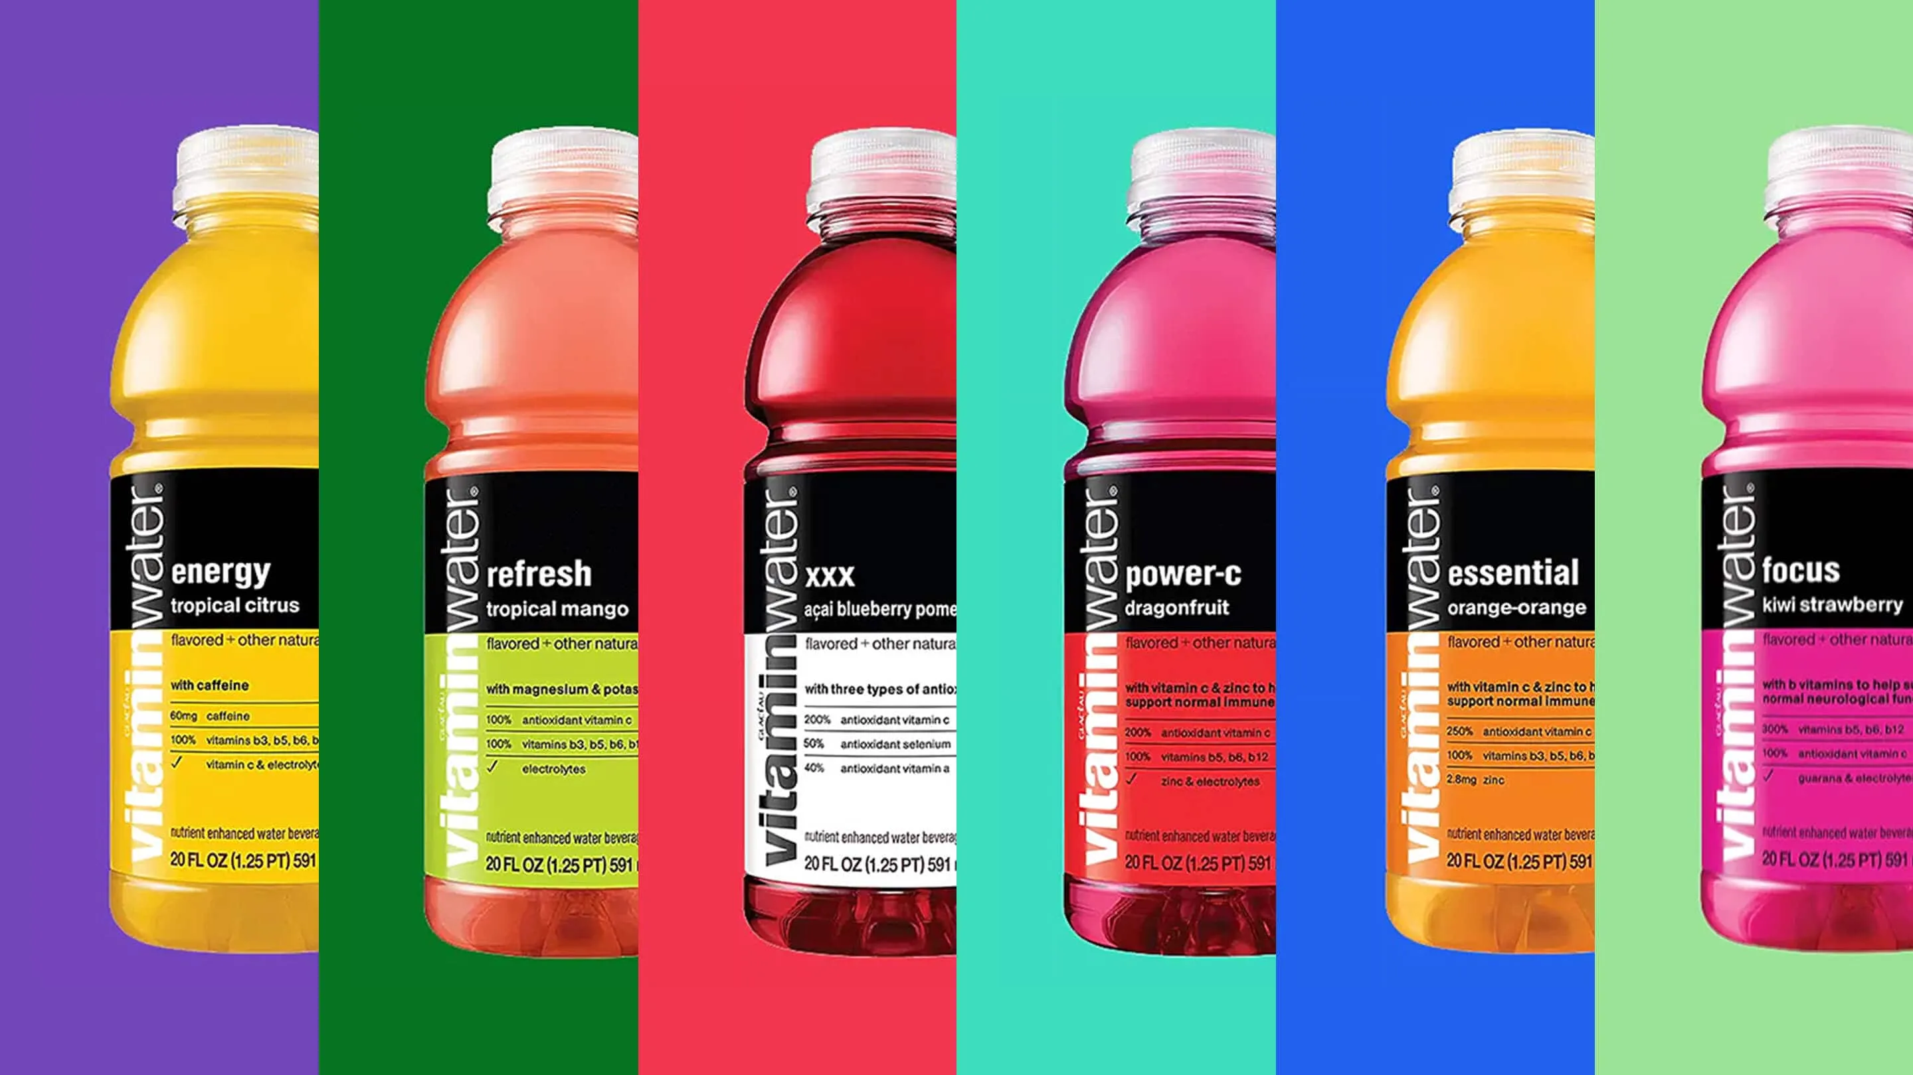

Outlining the
INFLUENCER OUTREACH
Built by

Slide 2
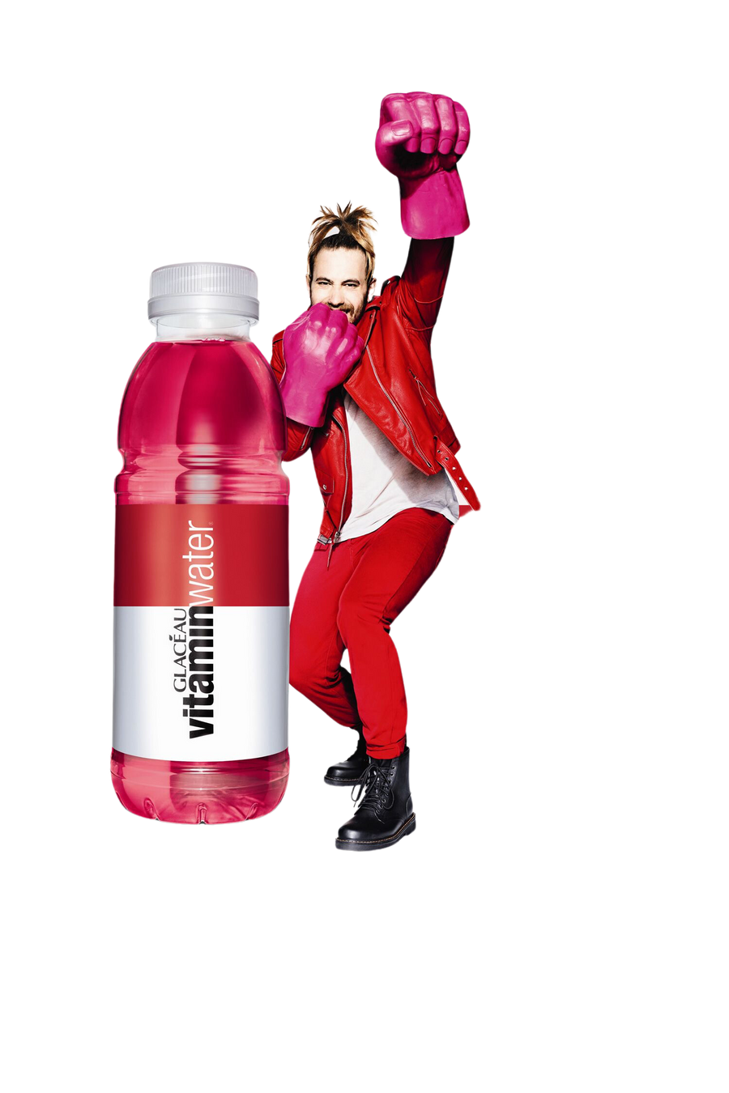
POINTS OF
DISCUSSION
1. Decoding our approach to influencer outreach
2. Defining Vitamin Water
‘Face of Influence’ & Selection Framework

Slide 3

From
ICONS to INFLUENCERS
The face of influence has transitioned from the red carpet to newsfeeds and is no longer just the famous, but also individuals with stories that are a reflection of everyday life
79%
of Indians trust social media influencers
90%
have made purchases based on influencer endorsement
Source: Influencer Trust Report, ASCI, 2023
Notes:
‘Influencer Trust Report’.
Read more at:
https://brandequity.economictimes.indiatimes.com/news/research/transparency-the-reason-to-trust-influencers-asci/97973974

Slide 4
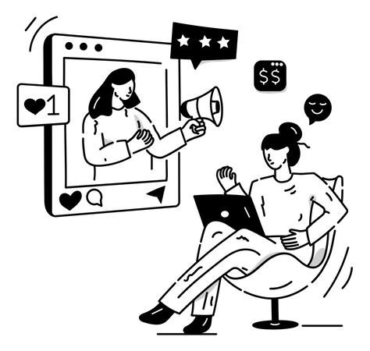


They serve as key sources of Message Amplification
70%
Indians believe influencer marketing has an impact on them
2X
Increase in budget for influencer marketing by > third of Indian brands
This Congruence generates
INFLUENCER - PRODUCT
Congruence
BRAND ATTITUDE
CONSUMER-INFLUENCER
Congruence
Which drives product evaluation & behavioral intentions
Influencers give character to a customer’s judgement, making decisions not just informed but personal. Thereby not only aiding decision-making, but also shaping brand perception.
Source: Impact Of Influencer Marketing In India, Dentsu India, 2023 I Journal of Business Research
CONSUMER-PRODUCT
Congruence
Notes:
https://www.sciencedirect.com/science/article/pii/S0148296321002307#b0095

Slide 5
Approach to Defining Faces of Influence
SOCIAL CAPITAL
ACTION
EFFECT
RELEVANCE
- Synergy: Influencer-Brand Congruence
- Identification: Consumer-influencer congruence
PERSONAL RESPONSE
Consumer act positively and complete the action intended by sponsored content. Personal Action
MEASURABLE EFFECT
RESONANCE
KPI’s
SOCIAL RESPONSE
S-o-V
Sales
Engagement Rate
Positive response to the stimulus and end up sharing the content. Social action.
REACH & ENGAGEMENT
- Popularity: Reach & Network
- Proximity: Popularity in category, region, segment
- Goodwill

Slide 6
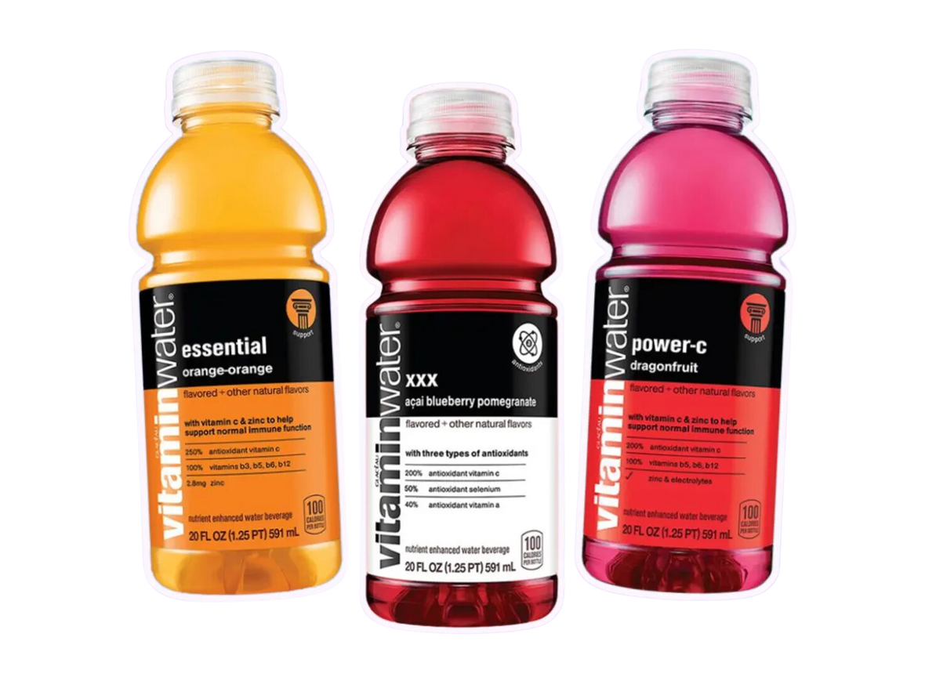
TRANSLATING OUR APPROACH TO VITAMIN WATER

Slide 7
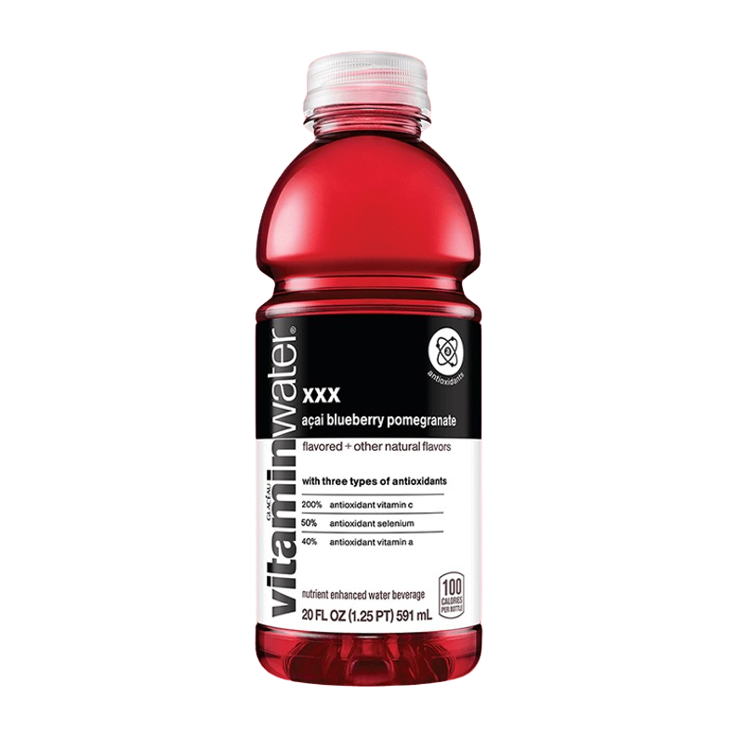

Proposed ‘Faces of Influence’
Outlining the
THE SPARKLERS
BRAND SPIRIT
In a world on autopilot, they are the electrifying jolt we all need. They are the light of the digital world who breathe life into every moment.
Their presence a shot of adrenaline for the spirit—uplifting and irresistibly fun, perfect for when you need a pick-me-up. Authentic and relatable, they create a sense of belonging where everyone is invited to join the party.
They ensure our newsfeeds feel a little more alive, colorful and engaging
CONTAGIOUSLY ELECTRIC
ADVENTUROUSLY BOLD
LIFE OF THE PARTY
PLAYFULLY QUIRKY
LIVING FIRECRACKER

Slide 8
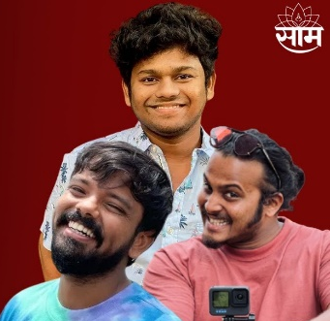
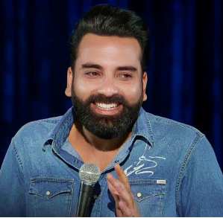
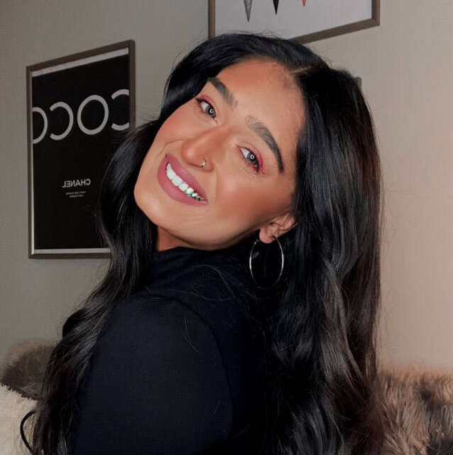

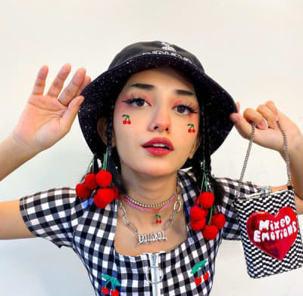
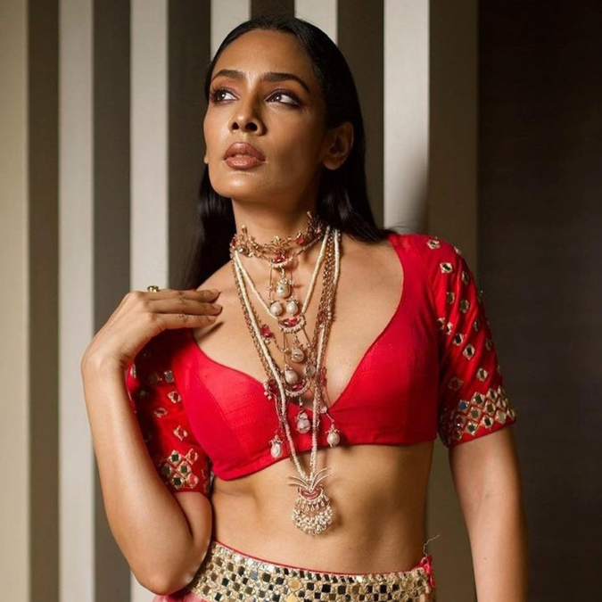
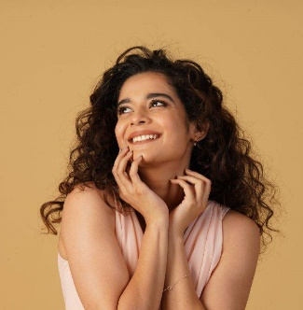
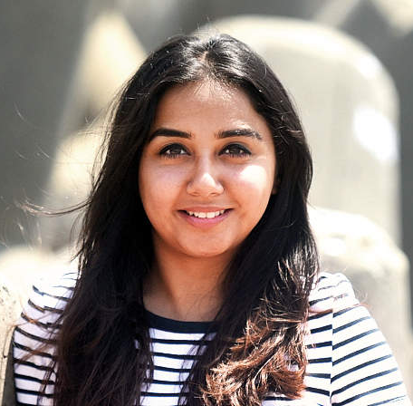
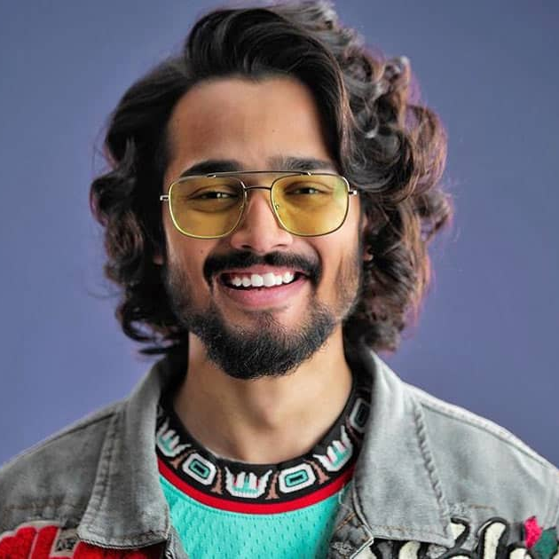
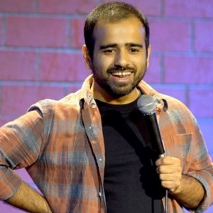
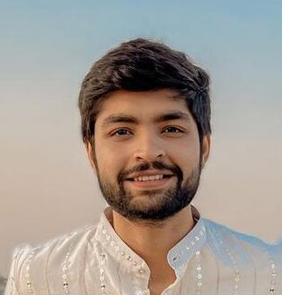
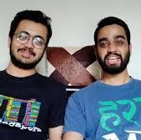
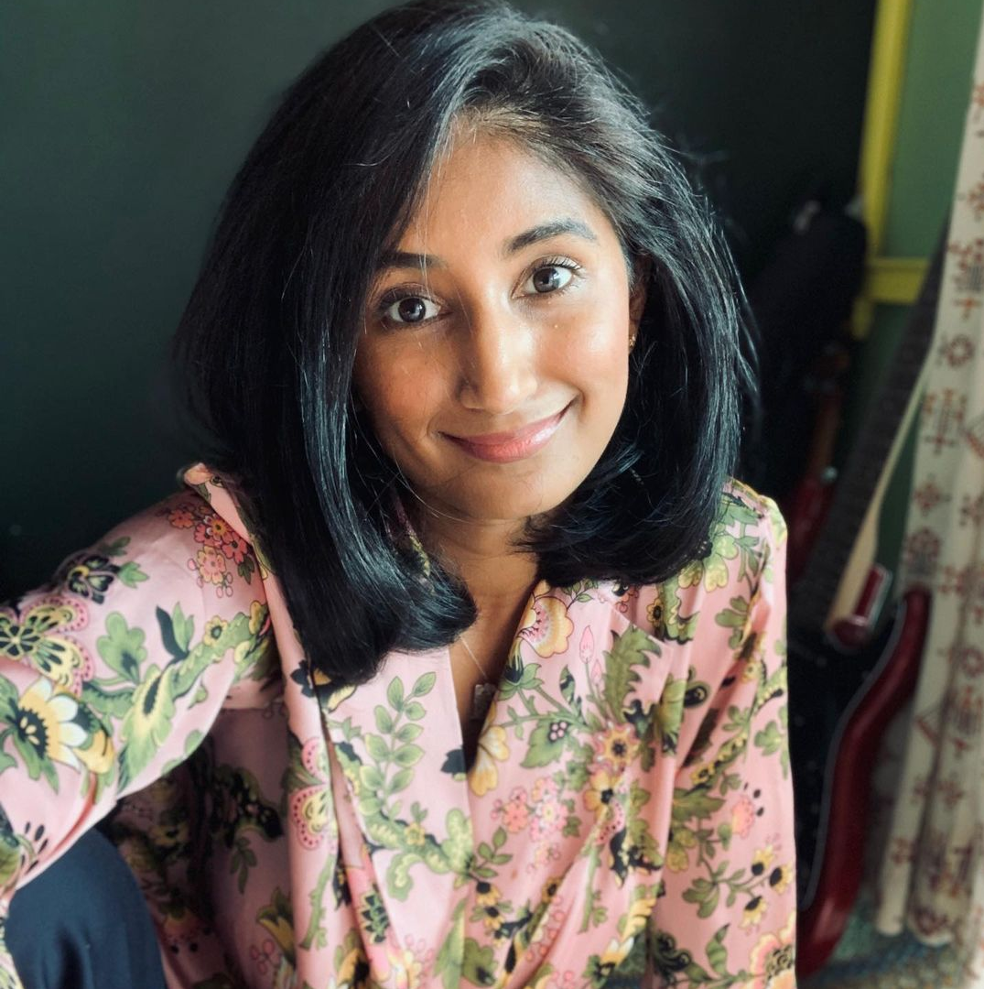
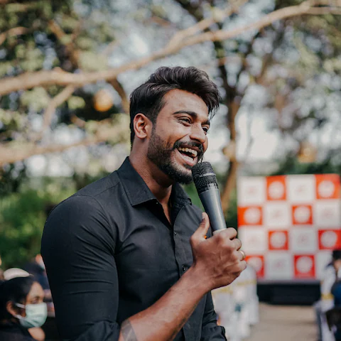
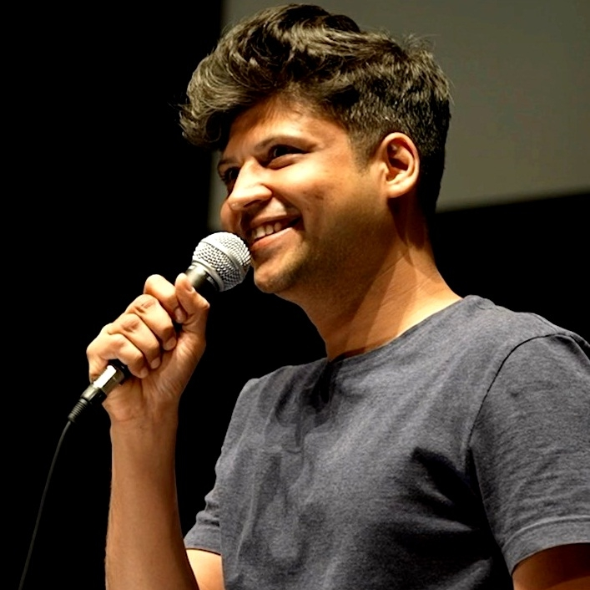
NOTE: Influencers Stated are for Representation Purpose Only
Meet the SPARKLERS
P1
P2
P3
PRIORITY
LIVEWIRES
PERFORMERS
JOYISTS
The ultimate entertainers, keeping their viewers engaged with their high-spirited antics and vibrant performances.
Their core content is not centered on enthusiasm, but their tonality and approach exude a sense of excitement that lift the mood
Eternally enthusiastic and spreading good vibes, they have a knack for energizing everyone around them by making every moment with them sparkle.
TRAVEL
FOOD
LIFESTYLE
POP-CULTURE
OBJECTIVE: Lead carriers to build brand awareness for Vitamin Water
OBJECTIVE: Create a context for consumption while maintaining brand resonance
OBJECTIVE: Lend their good will and enjoyable vibes to the brand communication to build brand love
PAN INDIA
Orange Juice
Bassi
Niharika NM
Shehzaan K
(Dancer)
Krutika
(Lifestyle)
Ishita Mangal
(Fashion)
Mithila Palkar
Prajakta Koli
Bhuvan Bam
Gaurav Kapur
REGIONAL
Danny Pundit
(Maharashtra)
Because Why Not
(Maharashtra)
Aiyyo Shraddha
(Karnataka)
Pranit Shilimkar
(Fitness/Maharashtra)
Rahul S.
(Bengaluru)
TYPE
CAT A, B, C
CAT A, B, C
CAT A
Notes:
Live wire Niharika nm

Slide 9


Breaking down the associations
Mega Influencers (CAT A)
Follower Size: 1 Mn+ followers
Macro Influencers (CAT B)
Follower Size: 1,00,000 – 1 Mn
Micro Influencers (CAT C)
Follower Size: 10,000 – 1,00,000
Engagement
Reach
VISIBILITY
VISIBILITY
VISIBILITY
ENGAGEMENT
ENGAGEMENT
ENGAGEMENT
OCCASIONAL COLLABORATORS
FREQUENT
ACTIVATORS
BRAND FRIENDS
Brand’s partners for high-impact, large-scale campaigns, ensuring mass reach and visibility.
Amplifiers of brand messages across a larger audience, with frequent, yet strategically spaced, collaborations.
Always-on collaborators, acting as brand advocates, regularly promoting products by integrating it into their content style
Notes:
Influencer marketing is about gaining exposure, sure - but working with people who have the largest audience. In this space, bigger doesn’t always mean better
working with people who have the right audience so you can make connections with the people most likely to further connect with your brand.
As a general rule, targeted reach, cost-effectiveness, engagement, authenticity, and accessibility all go up as follower count goes down
Celebrity or megainfluencers are best for top-of-the-funnel campaigns promoting products or brands with mass appeal, like Coca-Cola. These influencers offer brands massive but less focused reach, often at substantial cost. For example, Kylie Jenner reportedly charges $1 million per sponsored Instagram post, per Hopper HQ.
Micro- or nanoinfluencers are best for more targeted campaigns that aim to reach a specific audience. This group tends to have stronger, more direct relationships with their followers, which often leads to greater authenticity, engagement, and returns.

Slide 10
Defining Their Interventions
BRAND FRIENDS
FREQUENT ACTIVATORS
OCCASIONAL COLLABORATORS
ALWAYS-ON
- Topical content
- Trending content
- Everyday brand conversations
CAMPAIGN
- Campaign reshare
- Collab reel
- Campaign stories
- Campaign participation/ post
CONTEST
- Brand challenge
- Driving UGC Content
Kindly define (STRAT)
Kindly define (STRAT)
INTERVENTIONS
ALWAYS-ON
CAMPAIGNS
ALWAYS-ON
CAMPAIGNS
CAMPAIGNS ONLY
DELIVERABLES
No. of Influencers:
X/ Month
Regional: X/ Month (for select geos)
Frequency: X/ influencer
No. of Influencers:
Campaign need
Regional:
No. of posts:
No. of Influencers:
X/ Month
Regional: X/ Month (for select geos)
Frequency: X/ influencer
No. of Influencers:
Campaign need
Regional:
No. of posts:
Kindly define (STRAT)
Notes:
Influencer marketing is about gaining exposure, sure - but working with people who have the largest audience. In this space, bigger doesn’t always mean better
working with people who have the right audience so you can make connections with the people most likely to further connect with your brand.
As a general rule, targeted reach, cost-effectiveness, engagement, authenticity, and accessibility all go up as follower count goes down
Celebrity or megainfluencers are best for top-of-the-funnel campaigns promoting products or brands with mass appeal, like Coca-Cola. These influencers offer brands massive but less focused reach, often at substantial cost. For example, Kylie Jenner reportedly charges $1 million per sponsored Instagram post, per Hopper HQ.
Micro- or nanoinfluencers are best for more targeted campaigns that aim to reach a specific audience. This group tends to have stronger, more direct relationships with their followers, which often leads to greater authenticity, engagement, and returns.

Slide 11

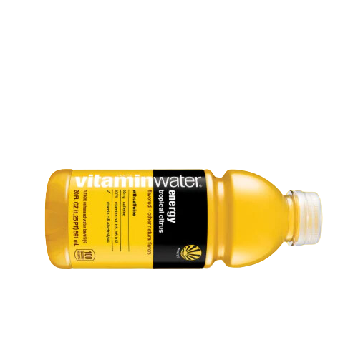
THANK
YOU

