Slide 1
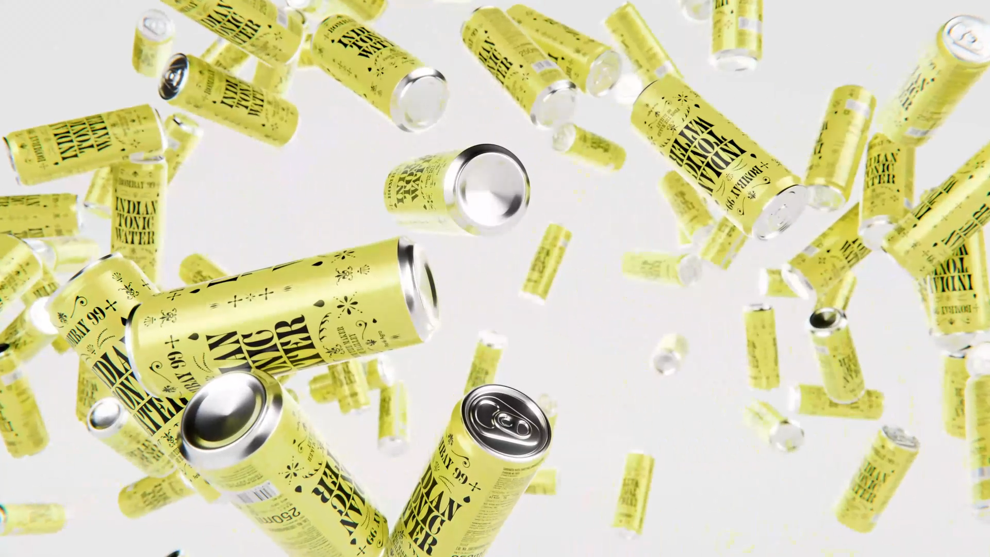

CONSUMER TRUTHS & BRAND LEARNINGS

Slide 2
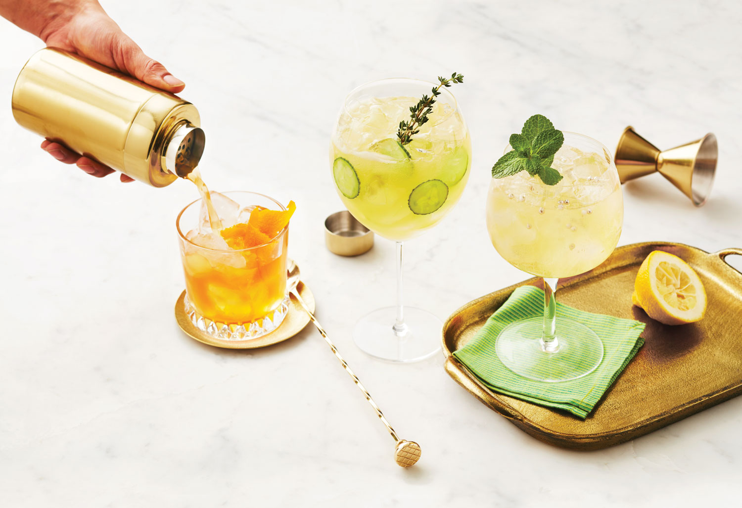
There’s a New Rising Renaissance
in India’s Drinking Culture
Artisanal, handcrafted, ‘good-for-you’, stuffed with botanicals and aromatics –
we have come a long way from Coke and lime cordial when it comes to what we mix our drinks with. India's booming alternative beverage market is driven a growing crop of conscious and progressive drinkers.

Slide 3
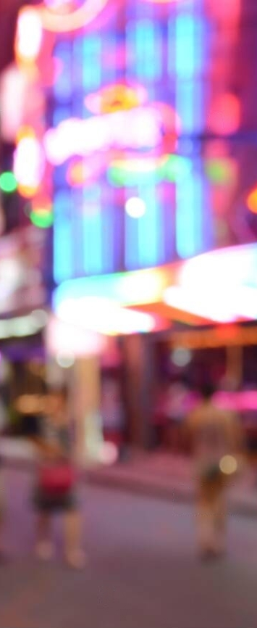

These new-age consumers have their own unique value systems, driven by their increasingly connected context…
VALUE Individuality
DRIVEN BY (Self)Discovery
They lean into their uniqueness, refuse to conform, celebrate diversity & inclusivity & hence also seek ways to express their authentic selves
They are constantly seeking ways to find and express their authentic selves & are not afraid to draw outside of the lines to fully unlock their spirit.
NURTURING Aspirations
CONSCIOUS IN Choices
With increased accessibility, they are seeking inspiration from experiences laced with global influence
They look for progressive alternatives that are ‘mindful’ of their self, across various aspects of their realities
GLOBAL YET Rooted
SEEK Reciprocity
Liberal yet pragmatic, ambitious yet rooted in family ties, gregarious yet acutely individualistic, multitaskers, with a strong grip in personally steering their lives.
Driven by their fluid expression, they push to unlock a mass of likeminded people to connect with, no matter how niche the interest.
Source: McKinsey ‘TrueGen’
Notes:
https://www.vogue.in/culture-and-living/content/what-indias-booming-alternative-beverage-market-says-about-our-drinking-habits
https://www.mckinsey.com/industries/consumer-packaged-goods/our-insights/true-gen-generation-z-and-its-implications-for-companies
https://www.ogilvy.com/sites/g/files/dhpsjz106/files/pdfdocuments/RedPaper_GenZ_OSL.pdf

Slide 4
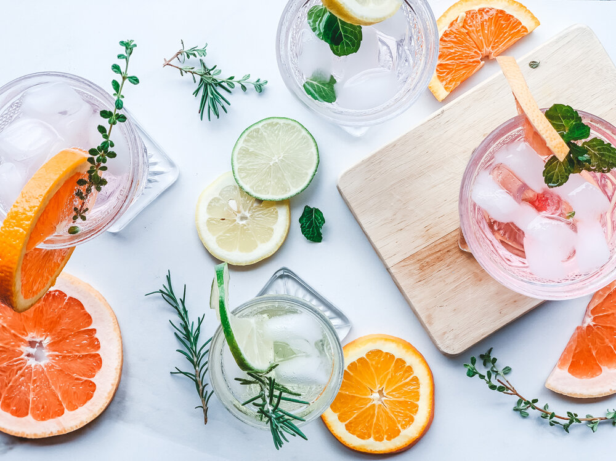
These traits also reflect in their alcohol consumption choices, ushering a shift in in attitude towards drinking being a “just-for-kicks” social act to savoring the experience itself
TRANSFORMATIONAL
SOPHISTICATED
CONSCIOUS
REGIONAL
SIMPLIFIED
Taste
Drams
Drinking
Pride
Sips
There is emergence of liberated attitudes, prioritizing experimentation with new ingredients and flavor combinations at home, during celebratory moments, and everywhere in between.
A discerning mindset and a revitalized attitude towards spirits is driving premiumization across category, as consumers lean into high-quality ingredients & sophisticated flavors
Driven by factors like health consciousness to aspiring for more authentic, less alcohol-influenced connections with people, mindful drinking brings self-reflection to a glass of drink.
While ‘imported is better’ still exists, for young drinkers the origin of the product is incidental; they are comfortable with Indianness. ‘Local’ is now associated with craftsmanship, authenticity
The world of drinking can be intimidating for many, making them seek simplified brands that unravel the complexities, guiding us to the heart of the experience without sacrificing the pleasure.
Source: Bacardi Cocktail Trends Report, 2023 I ET Brand Equity
Notes:
https://mpost.io/wp-content/uploads/BACARDI-Cocktail-Trends-Report-2023.pdf
https://bwdisrupt.businessworld.in/article/Evolving-Preferences-Of-Younger-Indian-Generation-In-Drinks/27-04-2022-426715/
https://brandequity.economictimes.indiatimes.com/news/business-of-brands/how-indian-alcohol-brands-are-raising-the-bar/96204353

Slide 5
These Evolving dynamics and drivers of alcohol consumption have given rise to multiple consumer mindsets…
HIGH EXPERIMENTATION
LOW EXPERIMENTATION
Chameleons
Sober Curious
Classics & Romantics
Purists
Just as chameleons blend in with their surroundings, their drinking behavior changes according to the atmosphere & occasion.
They enjoy adventure in their drink & hence also prioritize new ingredients, exciting flavor combinations & sensations, at home, during celebratory moments, & everywhere in between.
They practice ‘mindful drinking’, seeking NoLo drinks in place of full-strength drinks on certain occasions, rather than those who eschew alcohol altogether.
This moderation mindset or alcohol minimalism is driven by factors like health consciousness, social chatter or aspiring for more authentic connections and hence they are often also open to exploration.
These may or may not be big spend blenders, with a more nuanced taste in their drinks.
Classics: Stick to legacy/ sophisticated brands for their preferred drinks & prefer mixing classic elements/ seek nostalgic drinks.
Romantics: Seek classic drinks that are elevated with a subtle unexpected twist, which reflects their hidden facet.
They know what they like and aren’t interested in stepping out of the comfort zone.
To them, the social aspect of drinking is less important than the quality & essence of drink. They may or may not be big spenders, but prefer to savour the original taste of the drink. Experimentation is majorly limited to brands & not enhancement.
THE TARGET AUDIENCE FOR THE CATGEORY

Slide 6
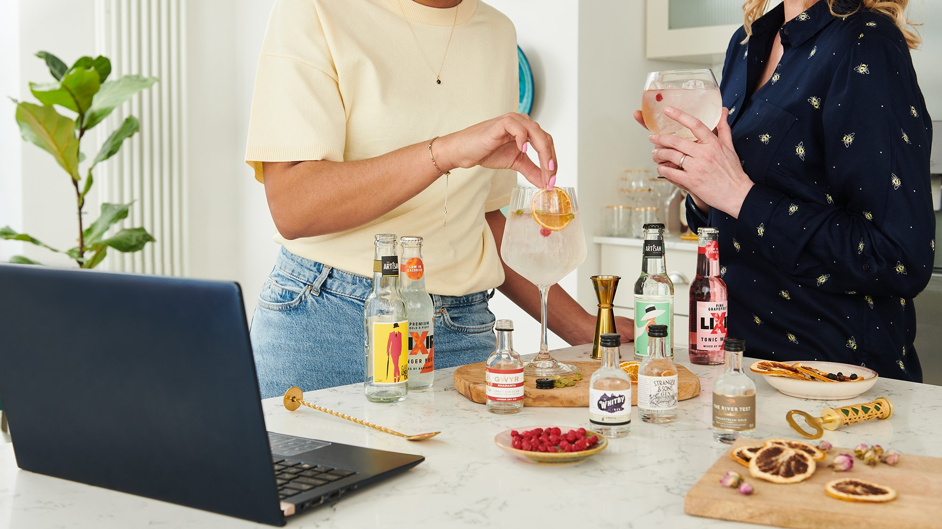
Digital & Social Media Exposure
have had an influential effect on the evolving social norms of alcohol consumption

Slide 7
They're turning to their devices at every stage of the journey – from inspiration to purchase
‘I-want-to-know’ Moments
‘I-need-some-ideas’ Moments
‘How-do-I-make-it’ Moments
‘I-want-to-buy’ Moments
In these moments, consumers are seeking simple ideas for experimenting with their drinks, specifically in terms of mixers to change or enhance the taste, add flavor, or simply to diversify.
The DIY journey starts with a spark — a curiosity about what to make. These moments can be confusing and hence they turn to search or social media for help, seeking ideas, inspiration basis their needs.
Once the decision is set, these moments strikes and individuals look for help in preparing it. They aren't necessarily experts in, so they seek practical advice - Questions around ingredients, alternatives, the ratios etc.
Consumers are searching for the ingredients, seeking product recommendations, understanding easy alternatives available, reading product reviews, product composition, deals available etc.
In these moments consumers are seeking guidance they need and they are first committed to their need.
Winning hearts & driving product need, will therefore require serving up complete assistance in such micro-moments.

Slide 8
‘I-want-to-know’ Moments
‘I-need-some-ideas’ Moments
‘How-do-I-make-it’ Moments
‘I-want-to-buy’ Moments
RIGHT COMBINATION
what to mix with vodka at home
what to mix with vodka low calorie
what to mix with whiskey besides soda
what mixes well with whiskey
Mixers for dark rum
what to mix with dark rum besides coke
what to mix with bacardi white rum
TASTE/ FLAVOUR-BASED IDEAS
Sweet cocktail recipes
Fruity cocktail recipes with vodka
Classic/ Tropical fruity cocktails
spiced rum/ dark rum cocktail
OCCASION-BASED
Cocktails for house party/ Christmas party
Cocktails for summer
whiskey cocktail recipes for winter
DRINK-BASED IDEAS
Cocktails with rum/ vodka/ gin/ whiskey
Gin/ whiskey/ rum/ tequila cocktails
spicy cocktails with gin
whiskey cocktail recipe for winter
EFFORT-BASED
simple tequila drinks 2 ingredients
easy cocktails for Christmas/ winter
NEED-BASED
dessert whiskey cocktails
Low-carb cocktails
low calorie tequila drinks
RECIPE/ INSTRUCTIONS
how to make sangria/ mojito/ mimosas/ manhattan
how to make homemade screwdriver
simple martini recipe without vermouth
margarita recipe without triple sec
INGREDIENT LIST
screwdriver cocktail ingredients
cosmopolitan cocktail ingredients
ANCILLARY SUPPORT
how to make spicy cocktail sauce
how to make simple syrup
How to make bitters
SEEKING ALTERNATIVES:
alternative schweppes tonic water
Margarita mix powder
mojita premix/ syrup
pinacolaa cocktail mix
best mojito syrup/ mix India
ready made cocktail mixers
Ready made cocktails India
WHAT ARE MY OPTIONS
Generic
Best mixer for
Mixer-Type based
tonic water brands India
Best tonic mixers for gin
What soda mixes well with gin
Brand-based
best Jimmy’s cocktail flavor
schweppes tonic water ingredients
sepoy tonic water review
This is 100% b2b consumer intent share available to brands. In these moments, consumers are forming opinions, shaping preferences & making decision by doing their own research online.
100% CONSUMER INTENT SHARE AVAILABLE TO BRAND

Slide 9















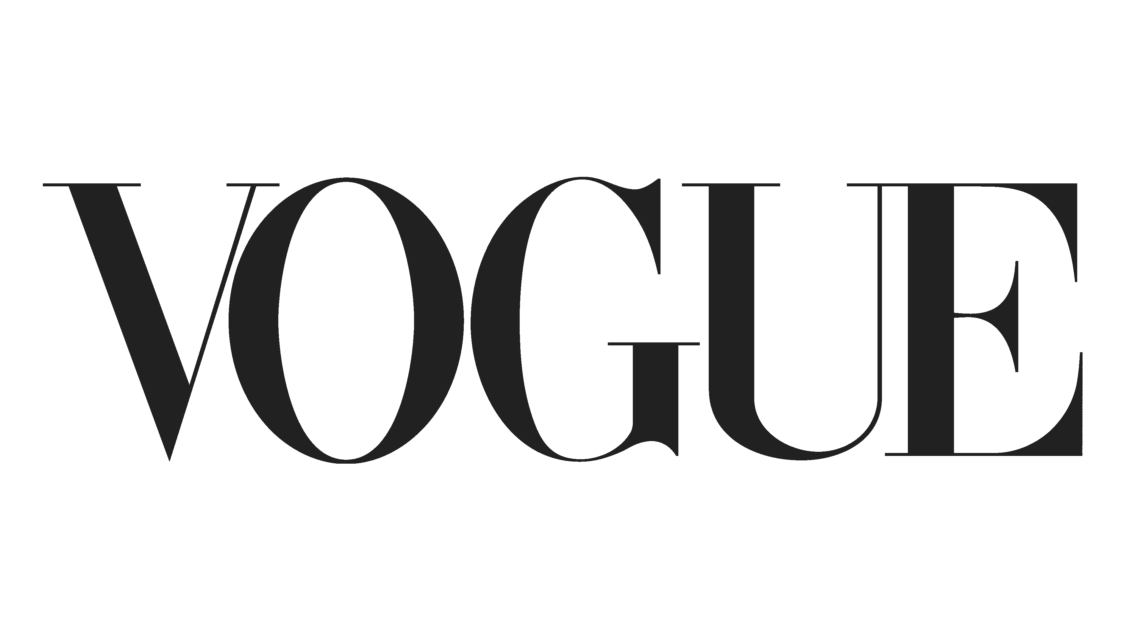




In these moments, consumers are turning to multiple touchpoints…
Marketplaces or grocery delivery portals
Mixologist Influencers
Technical guidance, product recommendations
E.g. Nitin Tewari, Happy High Academy, Sonal C Holland, Cocktails India, Tipsy Bartender)
Food publishers
Also provide inspiration, recipes, guidance for beginners
Search
Gateway to the entire journey – Ideas, Recipes, Ingredients, understanding of alcohol, mixing, etc.
YouTube
Unlike Instagram acts more as a source of technical guidance
Brand Websites & Social media handles
Product updates, shopping, recipes
Food Influencers
Focus on beginner-friendly recipes, with step-by-step guidance, with minimal efforts & tools
(E.g. Sanjeev Kapoor, Get Curried)
Lifestyle Publishers Inspiration, latest trends, product recommendations
Instagram with its Reels & Pinterest often tends to be a source of active or passive inspiration & discovery of new trends & quick mixes
Industry Publishers
Community Handles
Platform for spirits enthusiasts not just for inspiration or guidance, but also to discuss the art of drinking, helping beginners navigate the world of alcohol & drinking
E.g. The Cocktail Story, World Class IN, Gin Explorers Club, Alcohowl, The Dram Club
These touchpoints provide opportunity for distribution or audience sourcing

Slide 10

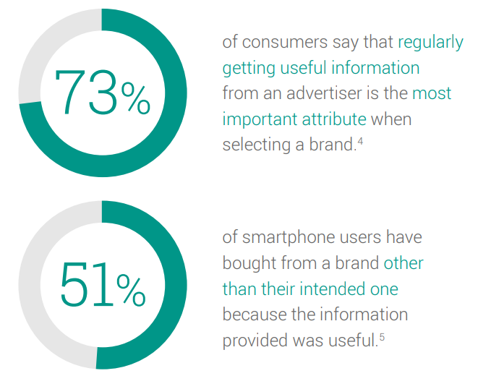
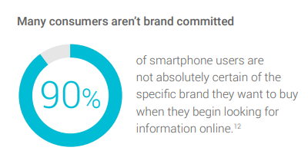
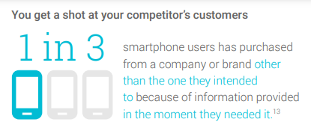
Thus, to win the hearts, minds and intent, capturing maximum share of consumer intent will be key by…
WHY: Build and influence brand perception
Being There
Being Useful
Consumers gravitate toward brands that provide ‘value’. Hence, it is key to find sweet spot where your customers’ goals and your own align & building symbiotic two-way ‘value exchange.
Strategically selecting such micro-moments
Being Quick
WHY: Build and Grow Share of Intent
Identify the micro-moments of prospective customers that fit the business, then commit to being there to help when they happen.
Provide immediate action, instant gratification and a fast & frictionless experience to keep pace with impatient consumers.

Slide 11
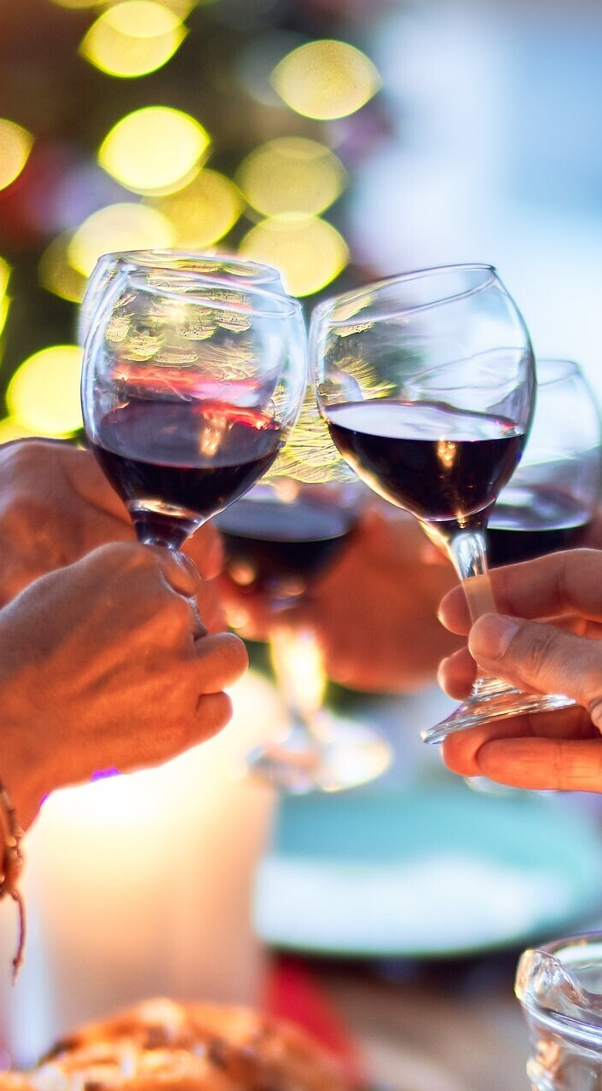
Choice of beverage however isn’t just a matter of personal taste, but is also a symbolic vehicle…
STATUS INDICATOR
Choice of beverage is an indicator of social status. The drinking practice acts as ‘definitional ceremonies’ through which people enact not only ‘what they think they are’.
E.g. Wine was, and is today in many cultures, "a focus of eloquent choices“. Its sophistication is an expression of ones taste and aspirations.
SITUATION DEFINER
The act of drinking & the choice of beverage defines the nature of occasion & establish the context for social interactions allowing individuals to initiate a sense of situational appropriateness, be it for creating shared experiences or for individualistic pleasure.
STATEMENT OF AFFILIATION
Communicating exclusiveness, beverages acknowledge aspects of one’s identity, or their declaration of membership in a particular group, generation, class, ‘tribe’, sub-culture & its associated values or beliefs. .
Notes:
http://www.sirc.org/publik/drinking6.html

Slide 12
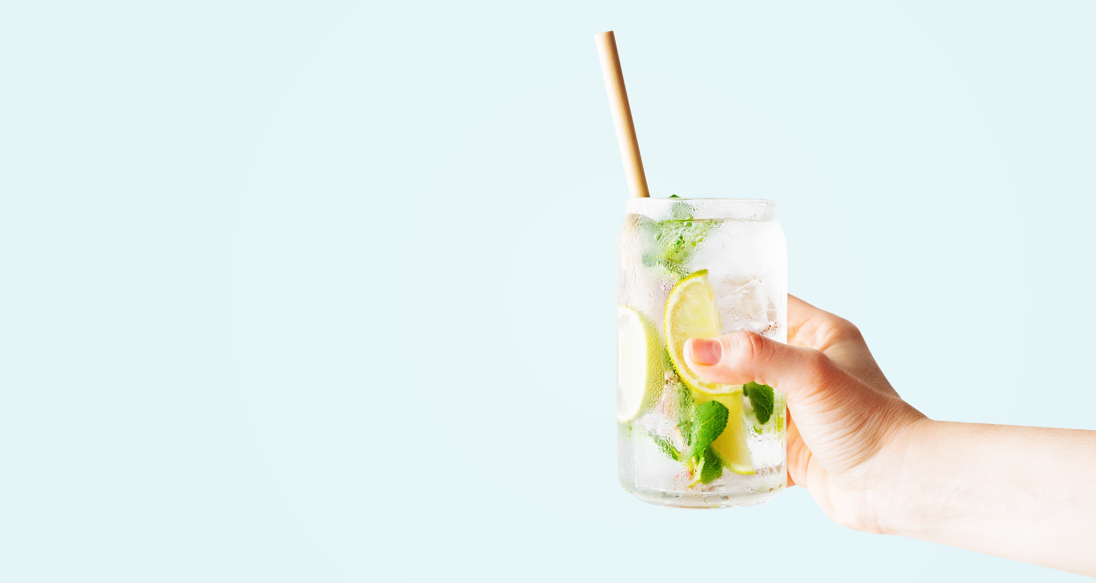
Peer Analysis
Analyzing how our peers are delivering value to the consumers with the evolving tastes

Slide 13
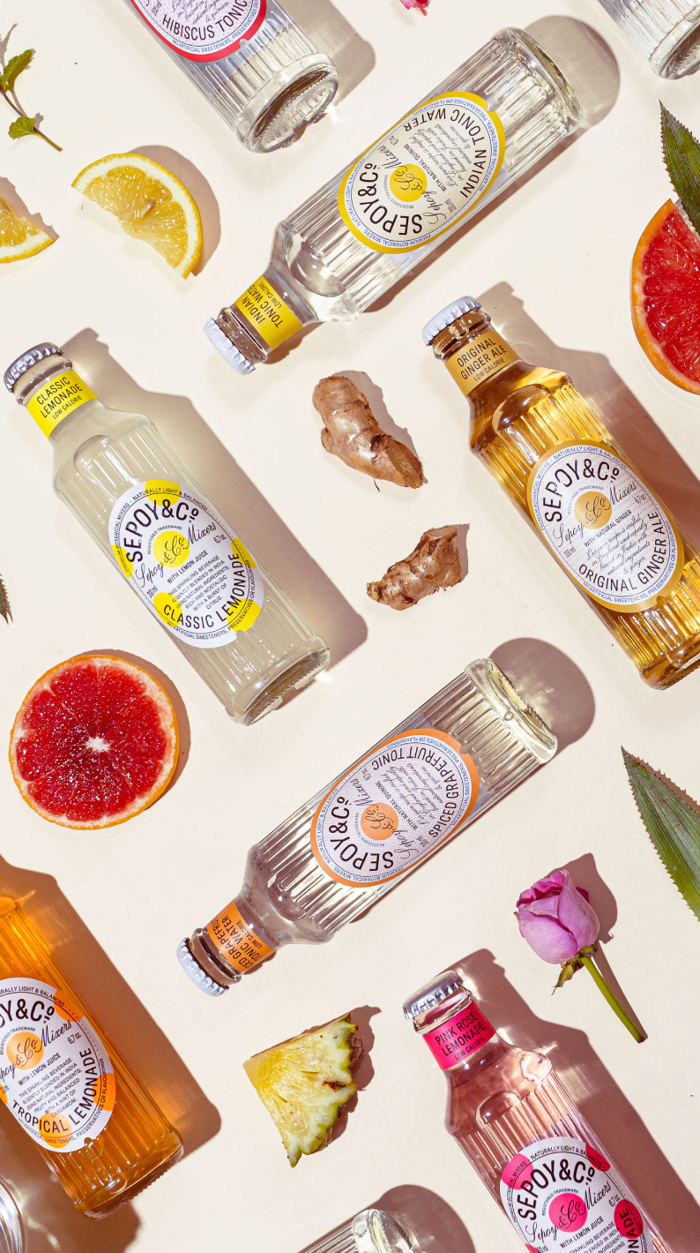

BRAND COMMUNICATION
STATUS INDICATOR: REFINED INDULGENCE
Portrays an upscale lifestyle with visual styling and collaborations leaning towards artistic affiliations, & refined aesthetics, creating a sense of luxury & elegance
DEFINED BY
Tonality: Stylish, fresh, refined, upscale, minimalist
Collaboration Events: Art exhibitions, Jazz Festivals, Golf tournament etc.
Associations: Indian Cocktail Week, Bar Convent Berlin, Roma Bar Show etc.
SITUATION DEFINER: CELEBRATORY SOCIAL DRINKING
Carries the essence of premiumness and refined experiences. These associations shape brand perception as a premium mixer, making brand synonymous with luxury and sophistication.
DEFINED BY
Cues: Big ticket wedding, refined social parties, refined settings at-home consumption moments etc.
BRAND SUMMARY
STATEMENT OF AFFILIATION: LUXE ENTHUSIASTS
KEY ASPECT: INGREDIENTS
(Category Affiliation: Sophisticated Sips)
Appeals to a community of tastemakers and connoisseurs who share a passion for the finer things in life. Sepoy and Co becomes a symbol of status and taste, aligning with the desires and aspirations of its target audience.
BRAND SPACE: Ingredient Story
Premium Botanical Mixers
Brand stands as a testament to the timeless allure of flavors, building a narrative around its ingredients while striving to create a symphony of taste experiences that elevate moments of pure indulgence.
DEFINED BY
Awards: Superior Taste Award, Brand Bottle Design Award etc
The brand's presence builds appeal for individuals who aspire to be part of exclusive social circles and embrace a refined lifestyle.

Slide 14
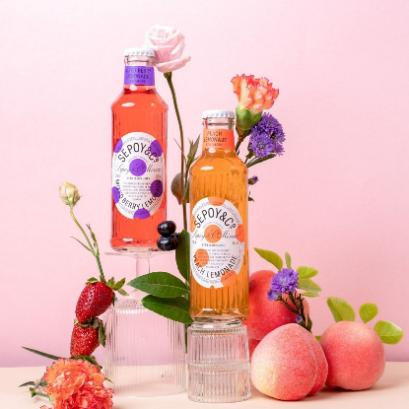

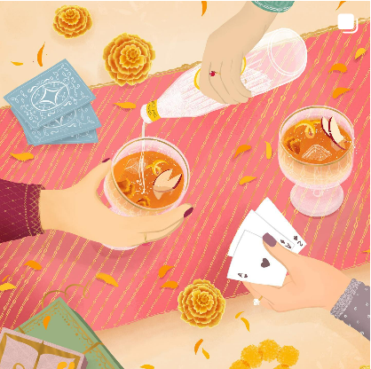
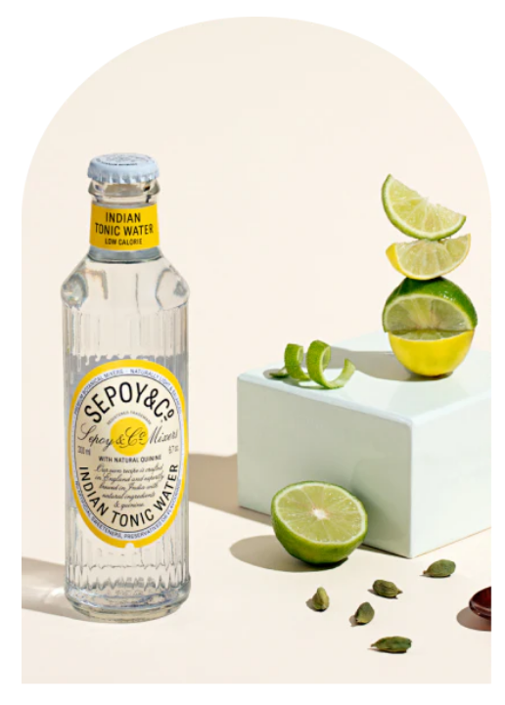
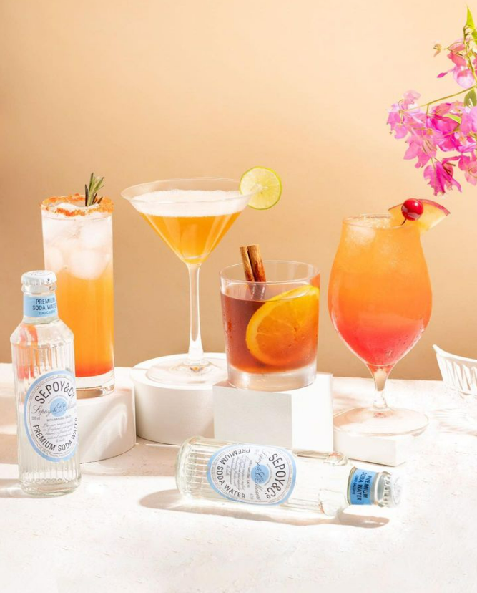

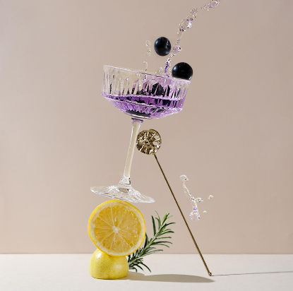
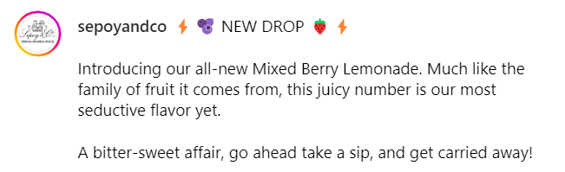
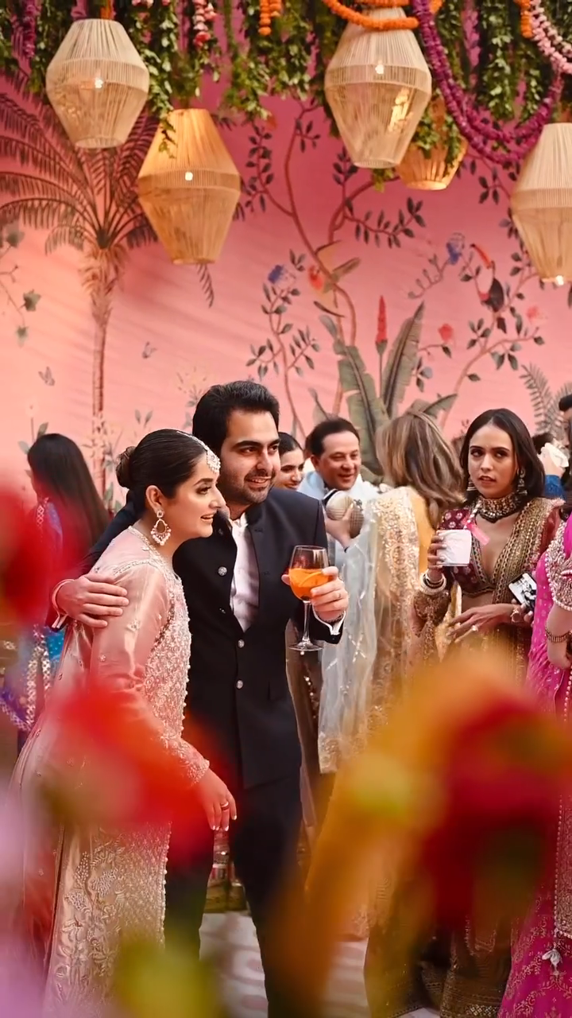
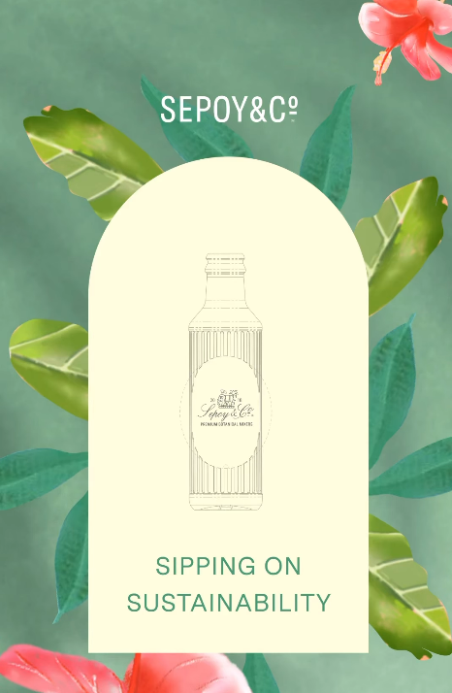
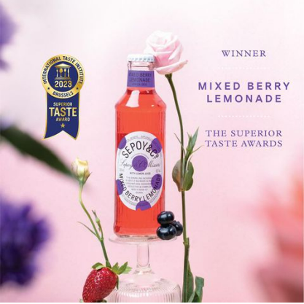
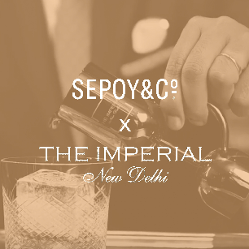
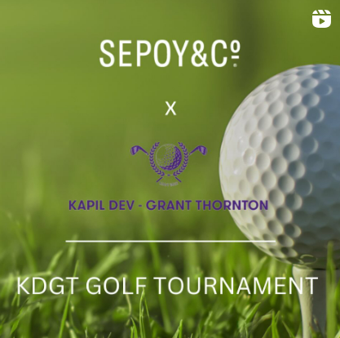
Mood
BOARD
Utilizing pastel color palette communicates vitality and freshness of the “botanical” mixer while maintaining an aesthetic
PRESS PLAY
Brand's visual approach creates a sense of elegance, sophistication, and exclusivity with a minimalist design furthering the luxury appeal
High-end associations build an aspirational appeal around the brand
Awards, initiatives and causes help reach niche audiences and strengthen affiliation

Slide 15
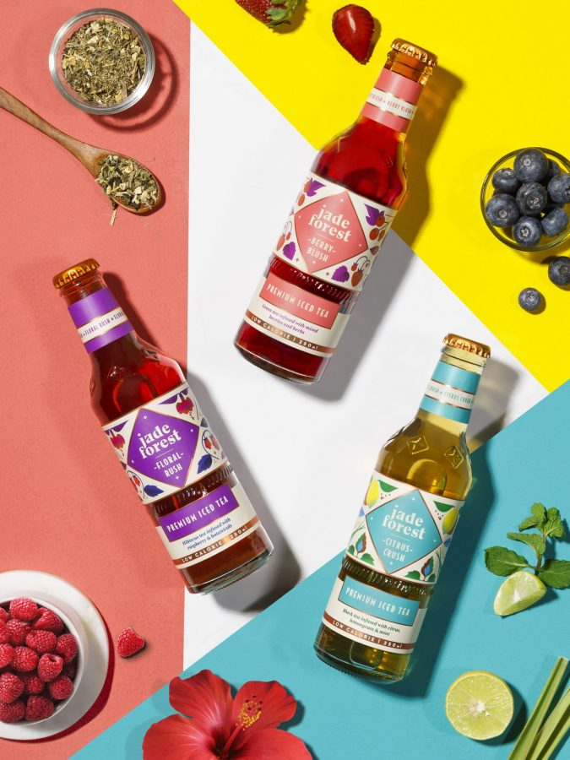

BRAND COMMUNICATION
STATUS INDICATOR: CONSCIOUS CURATED LIFESTYLE
Brand appeals to aspirations of conscious lifestyle seekers, who prioritize thoughtful choices, sustainability, and overall well-being
DEFINED BY
Tonality: Cool, young, fun, earthy
Collaborations: Fitness enthusiasts, Master Bartenders, seasoned mixologist
Partnerships: Gin Explorers’ Club, Bar Takeover, Luxury hotels
SITUATION DEFINER: A.M. TO P.M. CELEBRATORY SOCIAL
Showcases versatile consumption scenarios catering to different tastes and preferences throughout the day
DEFINED BY
Cues: WFH set-up, post-workout hydration, brunch, clubs & at-home parties etc.
STATEMENT OF AFFILIATION: CONSCIOUS LIFESTYLE CURATION
BRAND SUMMARY
(Category affiliation: Conscious Drinking)
Jade Forest has built a community of adventurers “Friends of Jade”, fostering a space that thrives on inspiration and the joy of discovery.
BRAND SPACE: Mindful Lifestyle
DEFINED BY
Guilt Free Indulgence
Associations: Brand Founder mixologist series, Jade Untamed (Brand event) ft. Indie artists & DJs, brand founders etc
The brand's association with music festivals resonates with younger audience, initiating an affinity around concept of mindful consumption
Brand endeavors to bring about a holistic change to how people consume beverages by providing drinks in the "Better for you" category, keeping up with evolving consumer preferences

Slide 16

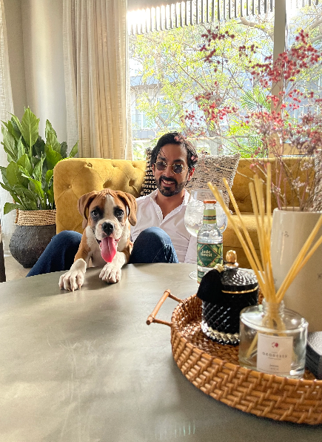
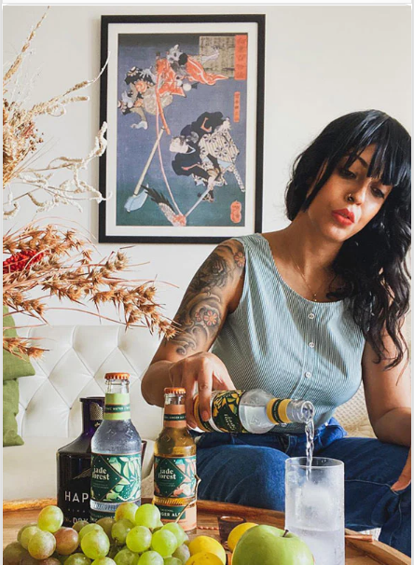


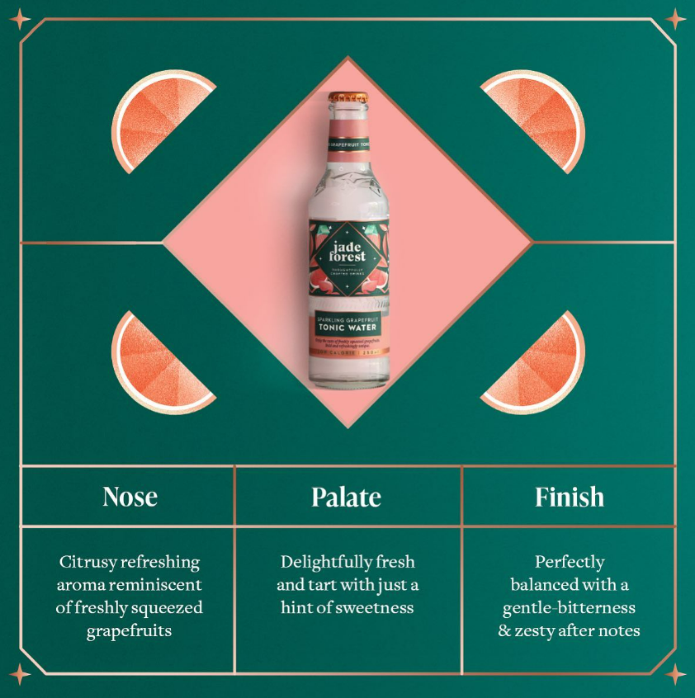
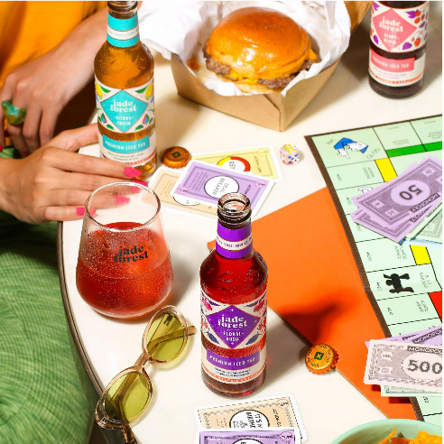
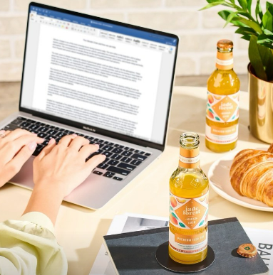
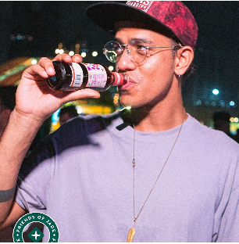
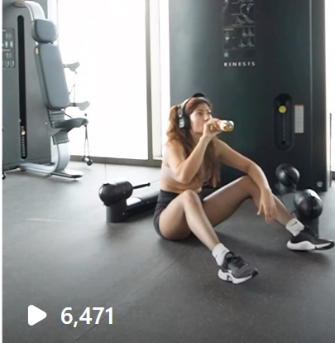
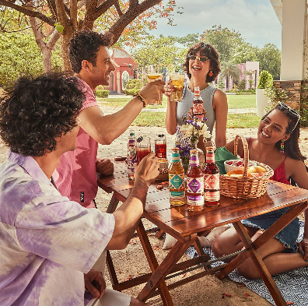
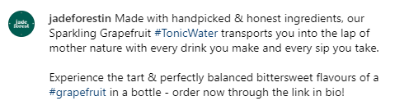

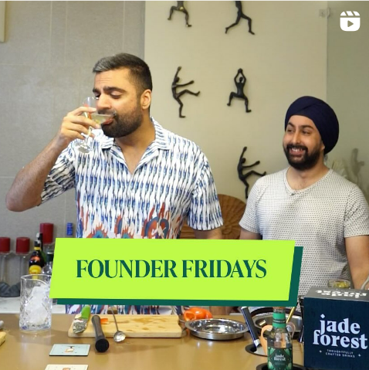

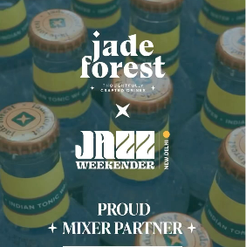
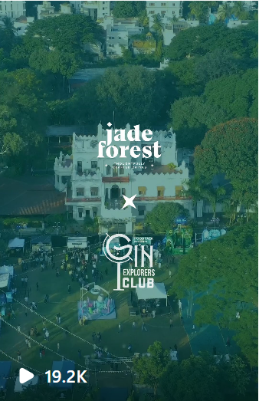
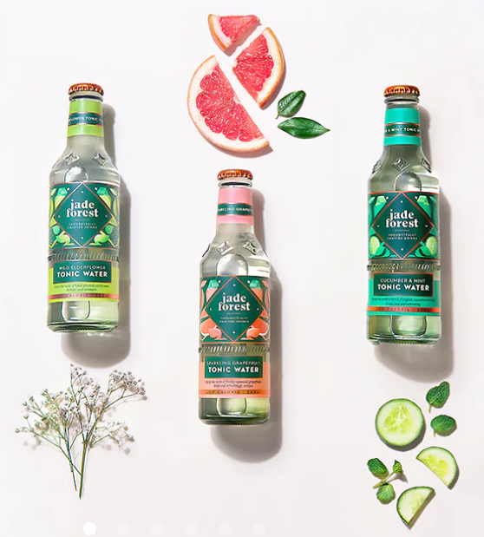
Mood
BOARD
Consumption moments inspire a lifestyle change to healthier indulgences
Fostering community of enthusiasts, exploring flavors while keeping a mindful mindset towards consumption
PRESS PLAY
Communication around ingredients highlighting transparency to build appeal
Association with music festivals majorly helps brand visibility and aligning brand with the energy, passion, and spirit of the TG
Brand founder/ mixologists collaborations gives an authentic value to the engagement – building community
Earthy tones helps communicate natural-ness and authenticity, helping stay true to the brand feel

Slide 17
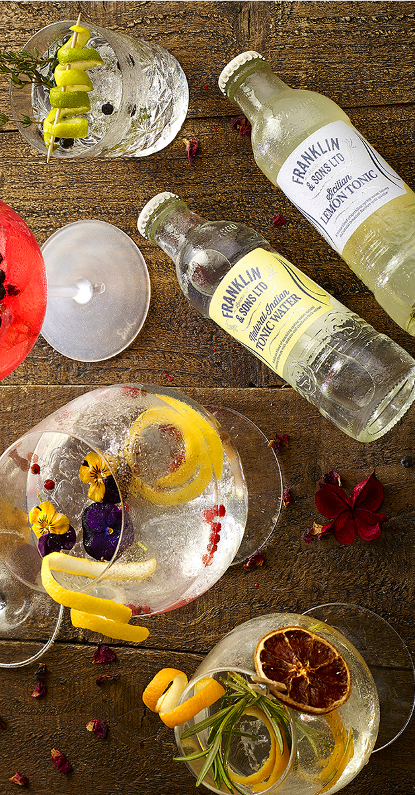

BRAND COMMUNICATION
STATUS INDICATOR: EXPERIENTIAL LIFESTYLE
Brand strives to inspire a journey of taste and deliver value to discerning palates that are seeking unparalleled flavor and savory experiences
DEFINED BY
Tonality: Bold, Premium
Collaborations: Seasoned Mixologists, cocktail enthusiasts, Master bartenders
Associations: Bartenders’ Brand Awards, HORECA events and award shows
SITUATION DEFINER: REFINED SOCIAL INTERACTIONS
Places brand mixers as the centerpiece of memorable occasions, capturing the the refined lifestyle and the moments of indulgence that our audience seeks – becoming a gateway to a world of flavor and sensory pleasure.
DEFINED BY
Cues: Work events, premium bar interactions, top cocktail bar guides, cocktail DIY presentation, etc
BRAND SUMMARY
STATEMENT OF AFFILIATION: REFINED GOURMANDS
KEY ASPECT: TASTE
(Category Affiliation: Sophisticated Sips)
Appeals to a community of tastemakers and connoisseurs who share a passion for the finer things in life
BRAND SPACE: Lifestyle Payoff
Remarkable Drinks, Without Compromise
Brand lays great emphasis on not only complimenting but committing to deliver quality by creating delicious high-quality sips, endeavoring to strike a balance in taste and textures
DEFINED BY
Awards: Great Taste Awards, Bartender Brand Awards, Tonic & Mixer Mastera

Slide 18

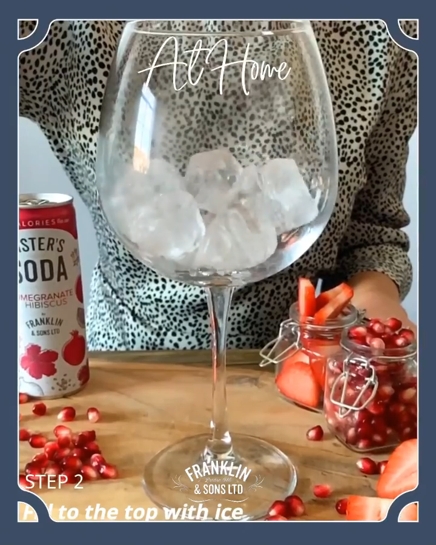
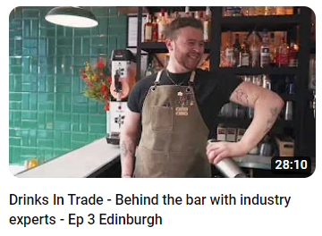
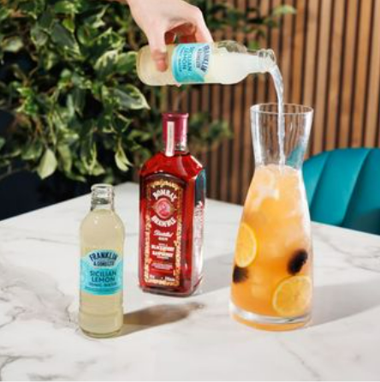
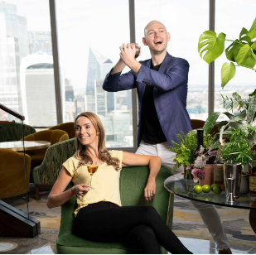
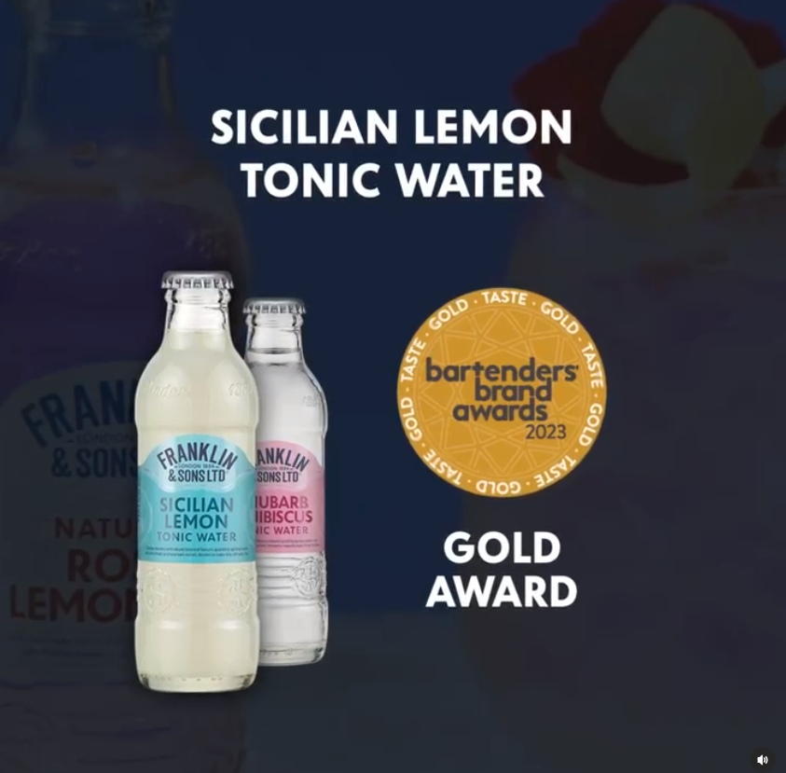

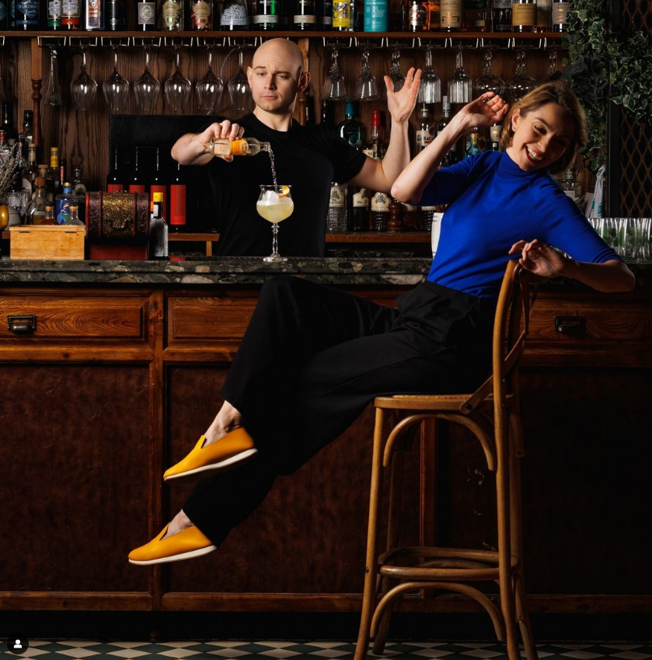

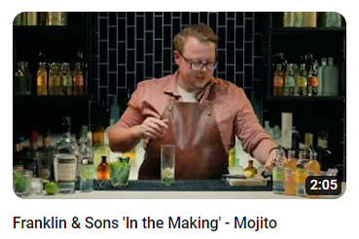
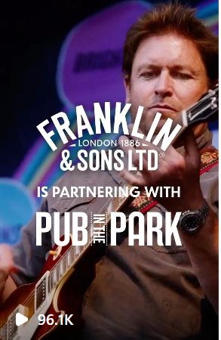
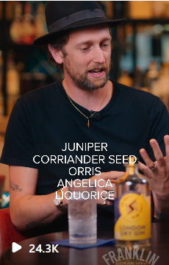
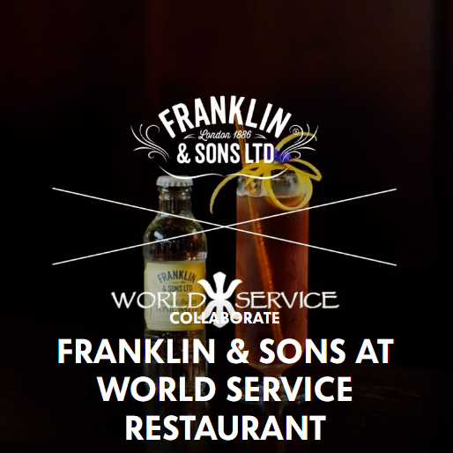
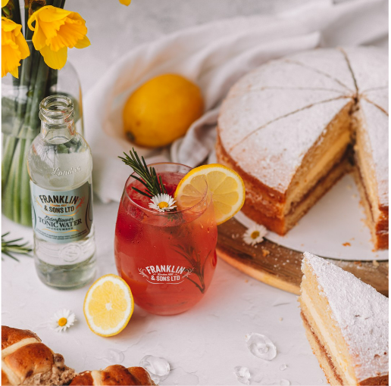
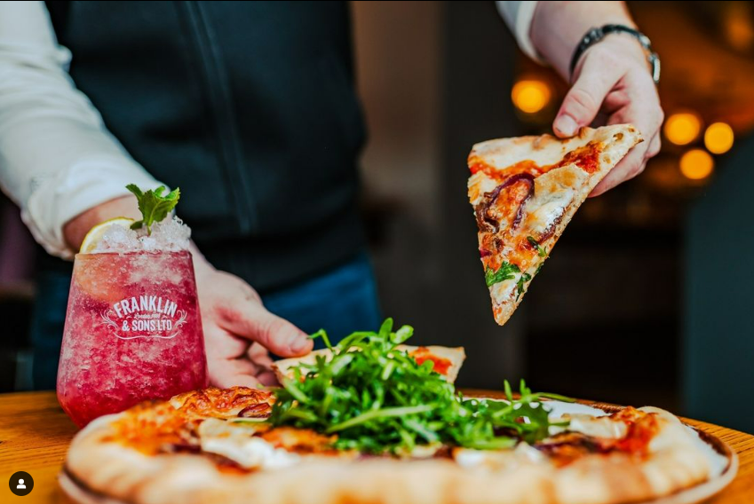

Mood
BOARD
PRESS PLAY
Awards and pop-culture associations help in strengthening brand affiliations among audience
Rich and dense color palate helps in providing a premium feel for audience, also giving a masculine feel to the brand
Expert collaborations to showcase flavor combinations through their craft cocktails entices experimentation among audience
Moment of consumption to communicate the ambiance of enjoying brand offerings
Leveraging partnerships and collaborations across HORECA events help foster a sense of familiarity and set a narrative for the brand

Slide 19


BRAND COMMUNICATION
STATUS INDICATOR: REFINED INDULGENCE
With legacy deeply rooted in London's rich cocktail culture, the brand brings a touch of sophistication and craftsmanship to every drink providing a statement of style.
DEFINED BY
Tonality: Rich, Millennial, elegant
Collaborations: Seasoned Mixologists, cocktail enthusiasts, Master bartenders
Associations: Michelin Restaurants, Luxury hotels, London Cocktail week etc.
SITUATION DEFINER: HIGH-END SOCIAL APPEASEMENT
Believing mixology to be an art form deserving of the utmost attention and care, the brand includes perspectives of high-end bartenders from behind the bar POV in addition to placing brand in elite social settings
DEFINED BY
Cues: best-in-all Luxurious bars, Premium gatherings. Eye-catching premium drinks, featuring refined lifestyle underscoring a luxurious experience.
BRAND SUMMARY
BRAND SPACE: Ingredient Story
STATEMENT OF AFFILIATION: REFINED GOURMANDS
KEY ASPECT: INGREDIENT
London essence fosters a community of essence lovers who seek the pinnacle of sophistication in their drinking experience
Exquisite mixers from botanical essences
DEFINED BY
Brand aspires to provide exquisitely good taste, placing brand mixers as the perfect compliment to reimagined drink creations or simply delicious when served alone
Exclusive Clubs: Highlighting niche interests Rare Auto-Owners’ club (Salon Prive Week)

Slide 20














Mood
BOARD
BRAND FEEL
TRUSTED BY OROFESSIONALS
Collaborations with industry experts brand-led recommendations to strengthen the premium association among consumers
Visual imagery while leveraging neutral and soft tones embodies spirit of sophistication and refinement, highlighting it as a the perfect choice to elevate occasions.
PRESS PLAY
PREMIUM PARTNERSHIPS
AFFILIATION
Partnerships with high-end events brings an aura of exclusivity and prestige to drinking rituals, redefining boundaries of sophisticated indulgence
Brand offers mixology resources for audience, providing guidance around ingredients while they navigate their creativity and experimentation

Slide 21


BRAND COMMUNICATION
STATUS INDICATOR: TRENDSETTERS & TREND-CHASERS
Schweppes aims at inclusivity with a belief that everyone deserves to experience the joy and excitement that comes with indulging in life's pleasures.
DEFINED BY
Tonality: Vibrant, Enthusiastic, Energetic, Quirky
Collaborations: Mixologists, Influencers from all leagues (Niki Mehra, Shivesh Bhatia)
Associations: GEC, Zomaland, Arts Festival, Indian Cocktail Week, SpokenFest
SITUATION DEFINER: SOCIAL CELEBRATION
Brand focuses on celebration with friends in moments of occasions – enticing audience to embrace the fun side of life and indulge in delightful experiences
DEFINED BY
Cues: Mainstream Club parties, At-the-bar serves, Classic cocktail recipes etc
Playful composition of the elements adds a sense of whimsy, serving as a visual invitation for our audience to indulge in a moment of relaxation, pleasure, and fun.
BRAND SUMMARY
BRAND SPACE: Refreshment
KEY ASPECT: FUN & DELIGHT
Mix It Up With Schweppes
STATEMENT OF AFFILIATION: STYLE SEEKERS & TREND CHASERS
Leading as a commercial brand, Schweppes aims at celebrating the young and refreshing spirit building an appeal for every type of consumer
Schweppes celebrates the brand as the perfect mixer to ensure that each sip is a refreshing and satisfying experience – enhancing moments of consumption while placing themselves at the core of enjoyment
DEFINED BY
Brand Ambassadors: Siddhant Chaturvedi, Manushi Chillar extending the massy and young brand spirit

Slide 22


















Mood
BOARD
Schweppes is placed as a constant companion to enhance enjoyment across moments of consumption
PRESS PLAY
Brand ambassadors helping extend the brand tonality and fostering a defined audience
PRESS PLAY
SITUATION DEFINER
More focus at enjoyment with friends
Associations with diverse festivals lends a versatile and adaptable essence to the brand
Collaborations with influencers range from Seasoned mixologists to lifestyle, lending a wider appeal for TG – being inclusive of niche interests to massy affinities among audience

Slide 23


BRAND COMMUNICATION
STATUS INDICATOR: EXPERIMENTAL LIFESTYLE
Brand inspires an appetite for experimentation, encouraging audience to explore art of mixology and create bar-quality drinks at home and otherwise
DEFINED BY
Tonality: Vibrant, bold, young, peppy, celebratory
Collaborations: Mixologist specialist, Lifestyle influencers, micro influencers
Associations: Live kitchen, Beach-house events, bar takeovers, Music festivals (VH1 Supersonic), Launch events (Lifestyle-oriented)
The associations shed a light upon the experimental alliances the brand aspires to have in order to define their tonality.
SITUATION DEFINER: AT-HOME & SOCIAL CELEBRATIONS
Brand captivates the sense of unleashing one’s inner mixologist, building an appeal that inspire creativity to explore new flavors, techniques, and creative possibilities.
DEFINED BY
Cues: At-home consumption moments, house parties, outdoor parties, DIY cocktail recipe etc.
BRAND SUMMARY
BRAND SPACE: Experimentation
KEY ASPECT: EXPERIMENT
STATEMENT OF AFFILIATION: CREATIVE EXPERIMENTERS
Bring bar home
(Category Affiliation: Transformational Taste)
Celebrates community of people creative at heart that that seek thrill of experimentation & unique experiences
Brand indulges in the consumer desire to replicate bar-like drinking experience at home through easy creativity – making the art of mixology as a personal journey of discovery.
DEFINED BY
Awards
Associations: Partnership events (Gin Explorers Club, Indian Cocktail Week etc.), cocktail creations

Slide 24














Mood
BOARD
PRESS PLAY
Partnering with a music festival like VH1 Supersonic, Jimmy's Cocktails positions itself as a brand that embraces the spirit of exploration and creativity
Moments of consumptions highlight the versatility of the mixer, covering most possible social moments that inspire creativity
PRESS PLAY
Vibrant color palate conveys the brand to be young at heart, playful and has positive associations
Appeal for a defined creative audience across drinking & non-drinking space with visuals heavy on mixer creations

Slide 25






Thoughtfully Crafted Drinks
Premium Botanical Mixers
Remarkable Drinks, Without Compromise
Endeavours to bring a holistic change with ‘Better for you’ drinks, that can be consumed from AM to PM for social or personal enjoyment, appealing to ‘conscious lifestyle curators’, who prioritize thoughtful choices, love to experiment & have fun.
(E.g. Association with fitness influencer, Gin Club, labeling as ‘guilt-free’, ‘Friends of Jade’, ‘Jade Untamed’ Music nights)
Stands as a testament to the timeless allure of flavors, building a narrative around its ingredients, appealing to connoisseurs & community of tastemakers who share a passion for the finer things in life and consumed in refined set-ups.
(E.g. Associations with art, ballet, jazz, golf, subtle romantic colors that points to freshness of ingredients, editorial feed)
Lays great emphasis on its commitment to creating quality, sophisticated drinks, appealing to connoisseurs & refined gourmands & positioning itself as centerpiece of refined & memorable occasions.
(E.g. Collaborations with Seasoned Mixologists, cocktail enthusiasts, HORECA Events, featuring premium bars, work events etc.)
BRAND SPACE: Conscious Lifestyle
BRAND SPACE: Ingredient Story
BRAND SPACE: Lifestyle Payoff
Bring bar home
House of Delicious Drinks
Mix It Up With Schweppes
Instills a sense of unleashing one’s inner mixologist & creating bar-quality drinks at home, appealing to bold creative experimenters, seeking thrill of experimentation & positioning the brand as a social drink
(E.g. Alliances with mixologists, lifestyle influencers, bar takeovers, beach parties, music festivals, live kitchen, vibrant & peppy tonality)
Champion of taste & flavor elevation, appealing to community of people creative at heart that actively seek thrill of experimentation & going beyond the ordinary
(E.g. Engagement with Bartenders #ForThePros, cocktail-sippers, Niche fests like Tapped Fest, Sunday Soil Sante)
Aims at inclusivity - everyone deserves to experience the joy and excitement that comes with indulging in life's pleasures, appealing to young drinkers, positioning itself as a high-octane celebratory social drink
(E.g. Siddhant Chaturvedi as Ambassador, vibrant, energetic tonality, collaborations with Zomaland, SpokenFest, Easy Cocltail DIY)
BRAND SPACE: Creativity
BRAND SPACE: Taste & Creativity
BRAND SPACE: Elevation

Slide 26




Status Indicator: Conscious Curated Lifestyle
Tonality: Young, Encouraging, enterprising
Status Indicator: Trendsetters & Trendchasers
Brand Tonality: Vibrant, Enthusiastic, Energetic, Quirky
Brand appeals to aspirations of conscious lifestyle seekers, who prioritize thoughtful choices, sustainability, and overall well-being
Schweppes aims at inclusivity with a belief that everyone deserves to experience the joy and excitement that comes with indulging in life's pleasures.
Status Indicator: Refined Indulgence
Tonality: Stylish, fresh, refined, upscale, minimalist
STATUS INDICATOR
Status Indicator: Experimental Lifestyle
Brand Tonality: Bold, young, peppy, celebratory
Portrays an upscale lifestyle with visual styling and collaborations leaning towards artistic affiliations, & refined aesthetics, creating a sense of luxury & elegance
Brand appeals to engaged socializers with appetite for experimentation, encouraging them to explore art of mixology and up their bar-game
Status Indicator: Premium Aspirations
Brand Tonality: Rich, Millennial, elegant
Status Indicator: Refined Indulgence
Brand Tonality: Bold, Premium
Brand aligns with an aspirational mindset that loves exploration, staying ahead of the curve, and going beyond the ordinary.
Brand strives to inspire a journey of taste and deliver value to discerning palates that are seeking unparalleled flavor and savory experiences

Slide 27


STATEMENT OF AFFILIATION:
Conscious Lifestyle Curators
STATEMENT OF AFFILIATION:
Style Seekers & Trend Chasers
Building “Friends of Jade”, a supportive network who prioritise conscious choices
(association with fitness influencers
Leading as a commercial brand, Schweppes aims at celebrating the young and refreshing spirit building an appeal for every type of consumer
STATEMENT OF AFFILIATION:
Refined Gourmands
STATEMENT OF AFFILIATION
STATEMENT OF AFFILIATION:
Creative Experimenters
Appeals to a community of tastemakers and connoisseurs who share a passion for the finer things in life (associations with art, ballet, jazz)
Celebrates community of people creative at heart that that seek thrill of experimentation & unique experiences (engagement outreach to both cocktail lovers & bartenders)
STATEMENT OF AFFILIATION:
Creative Experimenters
STATEMENT OF AFFILIATION:
Refined Gourmands
Celebrates community of people creative at heart that that seek thrill of experimentation & unique experiences (engagement outreach to both cocktail lovers & bartenders)
Tastemakers and connoisseurs who share a passion for the finer things in life (often feature highly-regarded establishments)

Slide 28

SITUATION DEFINER:
A.M. TO P.M. CELEBRATORY SOCIAL
Cues: WFH set-up, post-workout hydration, brunch, clubs & at-home parties etc.
SITUATION DEFINER:
SOCIAL CELEBRATION
Cues: Mainstream Club parties, At-the-bar serves, Classic cocktail recipes etc
SITUATION DEFINER
SITUATION DEFINER:
CELEBRATORY SOCIAL DRINKING
Cues: Big ticket wedding, refined social parties, refined settings at-home consumption moments etc.
SITUATION DEFINER:
AT-HOME & SOCIAL CELEBRATIONS
Cues: At-home consumption moments, house parties, outdoor parties, DIY cocktail recipe etc.
SITUATION DEFINER:
HIGH-END SOCIAL APPEASEMENT
Cues: Holiday-esque relaxing moments, enjoy-with-friends moments, Bartender serves etc
SITUATION DEFINER:
REFINED SOCIAL INTERACTIONS
Cues: Work events, premium bar interactions, top coktail bar guides, cocktail DIY presentation, etc

Slide 29

Learnings & Brand Imperatives
Analyzing how our peers are delivering value to the consumers with the evolving tastes

Slide 30


LEARNING 1: The current market landscape can be broadly mapped into…
Specialists
Mainstream
Notes:
They navigate choices laced with grace & higher level of sophistication,

Slide 31
LEARNING 1: The current market landscape can be broadly mapped into…
Specialists
Mainstream
Communication Indicators of
Specialist Peers
An uprising against the industrialised, a return to traditions, crafted by masters themselves, imagined in India, revisiting the culture of ‘sophisticated cocktail-sipping’.
Communication Indicators of
Mainstream Peers
Elevating beverage experience, where every sip is a statement, transporting you to a world of refined enjoyment & elevating any moment with style
Taste I Ingredient Story I Creativity & Convenience I Lifestyle Payoff
Enjoyment & Refreshment
Notes:
They navigate choices laced with grace & higher level of sophistication,

Slide 32








Mainstream
Specialists
LIFESTYLE PAYOFF
TASTE
INGREDIENT
STORY
CREATIVITY WITH CONVINIENCE
Accessible Premium
Simple to Make cocktails.
Schweppervescence
(Let it Out)
Aspirational Premium
Bring the Bar Home
Thoughtfully Crafted Drinks
House of
Delicious Drinks
Explore, experiment & experience cocktails with us!
Premium Botanical Mixers
Super Premium
Remarkable Drinks,
Without Compromise
Exquisite mixers from distilled botanicals
Notes:
They navigate choices laced with grace & higher level of sophistication,

Slide 33

LEARNING 2: Therefore what it means for Bombay99
WHAT WE KNOW OF BOMBAY99
WHAT IT SYMBOLISES
From the
Makers of Baileys
Legacy
Trust, Familiarity & Quality (of established brand)
Created to
Enhance experience of drinks
Sensory Delight
Elevated indulgence (moving beyond the ordinary)
Taste that is
Powerful, Punchy & Intense
Impact
Bold, Unapologetic (taste that makes a statement)
Mixer Range to
Shake Up India!
Adventurous Spirit
Energy, Excitement & Enjoyment
Design that is
Lively, Intricate yet bold, India-inspired
Captivating
Individuality, Authenticity (Sophisticated yet daring)
Notes:
A design that is lively, intricate yet bold symbolizes a brand that celebrates vibrancy, attention to detail, and a fearless spirit. It represents a brand that is not afraid to make a statement, capturing the attention of its audience with its energetic and lively visual appeal. The intricate elements of the design showcase a dedication to craftsmanship, sophistication, and a rich depth of creativity. This design symbolizes a brand that values individuality, creativity, and a desire to stand out from the crowd. It resonates with an audience that appreciates boldness, artistic expression, and a sense of liveliness in their lifestyle choices. The combination of liveliness, intricacy, and boldness in the design reflects the brand's commitment to delivering a unique and captivating experience, appealing to a discerning audience seeking authenticity, artistic flair, and a touch of excitement.

Slide 34

Mainstream
Specialists
LIFESTYLE PAYOFF
TASTE
INGREDIENT
STORY
CREATIVITY WITH CONVINIENCE
Accessible Premium
Simple to Make cocktails.
Schweppervescence
(Let it Out)
Aspirational Premium
Bring the Bar Home
Thoughtfully Crafted Drinks
House of
Delicious Drinks
Explore, experiment & experience cocktails with us!
The Brand takes the essence of mainstream appeal, but with a specialist allure, embodying a fusion of accessibility, legacy, elevation, with authenticity & a refined aesthetic.
The brand dares to stand out from the crowd, instilling a sense of exclusivity & representing the epitome of elevated mainstream lifestyle
Premium Botanical Mixers
Super Premium
Remarkable Drinks,
Without Compromise
Exquisite mixers from distilled botanicals
Notes:
They navigate choices laced with grace & higher level of sophistication,

Slide 35

LEARNING 3: Therefore manifesting the brand canvas…
BRAND ESSENCE
Simplifying & Stylizing Drinking Experience
STATUS
INDICATOR
STATEMENT OF
AFFILIATION
SITUATION
DEFINER
Signals A Playful Attitude
Aspiring tastemakers in Social Circles
Relaxed & Refined Social Set-up
Masters of understated creativity, infusing subtle twists to ordinary experiences
Chasing the spotlight by confidently creating a noticeable impression
Effortlessly, elevating their entertaining experiences

