Slide 1

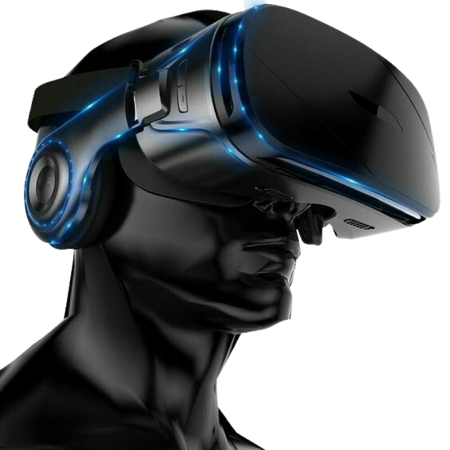


Digital Vision
2024

Slide 2

Through this presentation we are looking to answer some burning questions
  Which consumer segment will drive conversations in 2024?
  What is the next big content opportunity?
  What are some exciting mediums to leverage?

Slide 3



“ Consumer perception is your brand’s reality ”
But, ensuring the right perception is being built, is a challenge with the new-age consumers
Connected
Expressive
Conscious
Mobile centric
Conscious
Enterprising
Information Seekers
Experiencers
Resonant
Digital Natives
Data Fluent
Agile

Slide 4

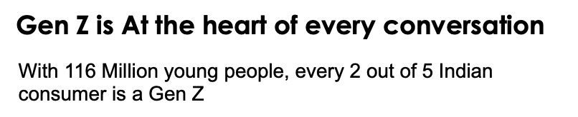
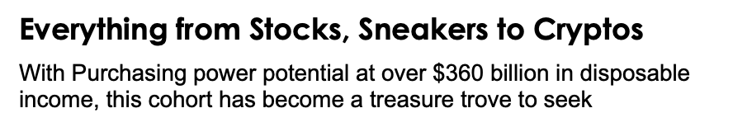
Gen Z
(Born between 1997- 2012)
Source : Livemint

Slide 5


But Gen Z is not just…
Dripping with rizz | Finsta sledging | Mic dropping cool kids...
But also, humble stars from non metros leading with a desire to hustle their way to their aspirations
In their quest to catch up, 51% Bharat Gen Z spend twice as much at 16% of their income on e-commerce platforms as a contrast to their urban counterparts who spend 8%
Source : The Print

Slide 6


What sets them apart as consumers?
They seek real representation
They are not just looking for what you sell but also what you share
Gen Z embrace imperfection with a visual style best described as messy realness, seeking raw and real images and rejecting hyper polished perfection
For 80% of Indian Gen Z authenticity plays an influential role in their choice of brands, making them seek a direct relationship with the brands
They are high on signaling
They are value-conscious at the core
Gen Zers from Tier 2 and 3 cities account for 40% of international brand orders on e-commerce platforms
Gen Z consumers regard affordability and value as paramount while indicating that they are ready to pay an extra fee for premium quality
Source: Adgully, Mintel, Kantar

Slide 7

And when it comes to the BFSI sector, Gen Z has asserted itself as a dynamic force, ingeniously reformulating the narrative within the category. Their impact is undeniable, ushering in a fresh perspective that revitalizes the discourse on financial matters.

Slide 8

Making Bank and Cracking the Code to Being GenFin
The Ultimate DIY consumers who are actively engaged at every level.
71% of Indian Gen Z aspire to achieve financial independence. This indicates a strong desire for autonomy and financial stability among the cohort.
46% of Indian Gen Z express their desire for education about finance-related tasks and choose the online medium for guidance
Source : Economic Times, home credit
Notes:
https://bfsi.economictimes.indiatimes.com/news/industry/whats-your-wealth-number-for-achieving-financial-independence/101218605

Slide 9
These shifts can be broadly understood as
Attitude towards
Attitude towards
Attitude towards
Borrowing
Spending
Growing

Slide 10

3S of Gen Z’s Credit Impetus
“I prefer the convenience and simplicity of UPI over credit card, as even a vendor on road accepts UPI”
-Naveen 26 Yrs Old
Gen Z seeks credit with Speed, Simplicity, and Security, driving the rise of new age financial institutions that offer quick loans without the complexity of traditional banks.
They are diligent and aware:
2.9X growth in Gen Z consumers monitoring their credit regularly
53% are concerned about the data collected
They are cautious and in search of flexible options for credit
73% Gen Z have used BNPL services
Notes:
https://www.youtube.com/watch?v=nGpir4oUfJI&t=43s (1:28:10-1:29:00)
https://www.icicibank.com/about-us/article/press-release-icici-bank-introduces-upi-payments-via-rupay-credit-cards#:~:text=The%20customers%20can%20link%20ICICI,payment%20app%20including%20iMobile%20Pay.

Slide 11



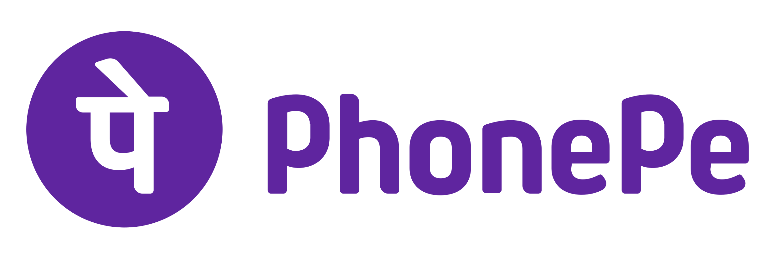


Gen Z are discerning and
dynamic spenders
Gen Z prioritizes self-indulgence and personal enhancement when allocating their own financial resources, reflecting a discerning focus on personal gratification and overall well-being
Popular Spending Apps are anchored in UPI
Top Spending Categories
Apparel
Electronics
Beauty & Personal Care
70% Gen Z in India use mobile wallets for ease of transactions
54% Indian Gen Z spends on Clothing and Accessories every month
Notes:
https://redseer.com/media/mass-consumers-may-drive-more-than-usd-135-bn-gmv-of-the-usd-300-bn-total-ecommerce-opportunity-in-india-by-2030/
https://www.bepragma.ai/blogs/brands-making-a-move-on-gen-z-via-digital-payments#:~:text=Increased%20use%20of%20mobile%20wallets,and%2049%25%20of%20Gen%20X.

Slide 12











Gen Z Pioneers: Nurturing a Growth Mindset in the World of Investing
Laced with ambition
Popular Investment Apps among Gen Z
77% want to become Homeowner
59% dream of buying a car
55% want to travel abroad
They also seek Immediate Gratification
35% Gen Z desire to buy electronics and furniture
While most believe that they are oscillating between YOLO and FOMO, they are looking for long-term dreams
They are fueled with entrepreneurial spirit
35% Gen Z invest to start a business in future
Notes:
https://www.mintel.com/press-centre/indian-gen-z-financially-savvy-socially-conscious-and-ready-to-travel/
https://commercial.yougov.com/rs/464-VHH-988/images/YouGov-Investment-Behaviour-GenZ-Millenials-Report-India-Aug-2023.pdf

Slide 13

Therefore, to truly connect with this consumer on digital, we need to leverage the common thread that ties these consumers together
and that’s their need to express, build and belong

Slide 14
This has given way to the emergence of new content opportunities
Introducing, Subcultures

Slide 15
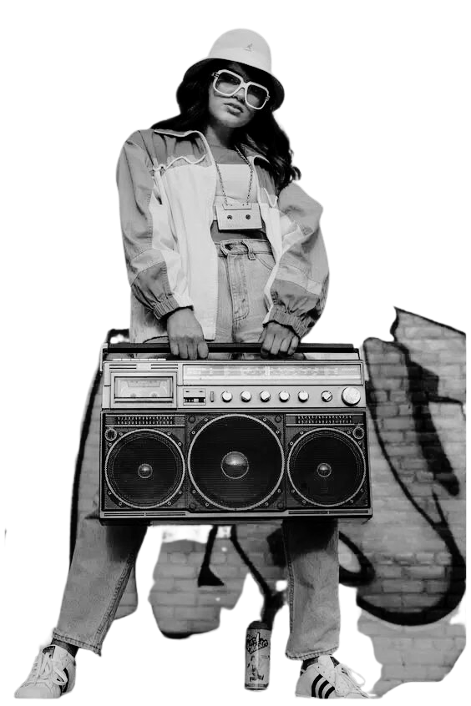



What?
A group of people with a strong sense of shared cultural capital
Why?
Highly immersed audience
Authentic
connections
Targeted
impact

Slide 16

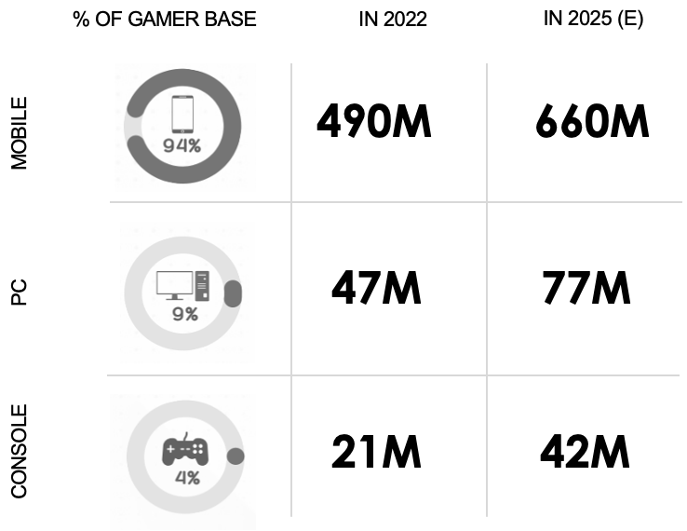
E- Gaming
Home to the world’s 2nd largest base of gamers , E-gaming has become a leading subculture in India
Source : Livemint

Slide 17






E-gaming has harnessed a dedicated and passionate audience, driven by multiple motivations, creating a highly engaged community.
Monetary
gratification
Socializing
Relaxing
Killing time
AVG TIME SPENT ON GAMES PER WEEK
Casual
Gamers
Active Gamers
Professional Gamers
While the known protagonists of E-gaming are young males, Indian women are just as present, making up >45% of the gamer base with their smartphones
Source : State of India Gaming

Slide 18



This growth has propelled a whole new category;
ESports (Passionate competitive gaming and viewing)
ESports gamers
The no. of gamers is expected to reach 25 lakh and growing
ESports viewers
85 million viewers of esports events on 20 different platforms by 2025.
Leading to a pool of a highly unique and engaged audience
Source : FICCI, money control

Slide 19
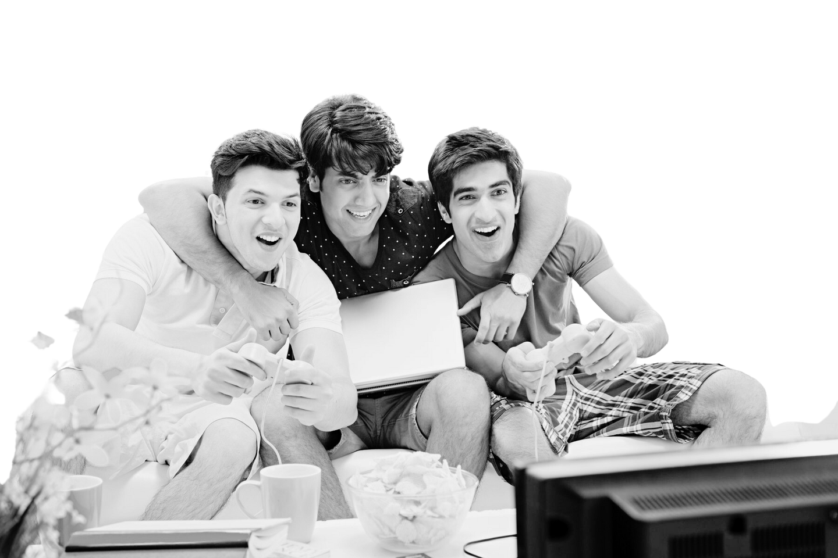
These audiences can be really lucrative for marketers as they are redefining receptivity...
Whilst 45% of all global adults would prefer a deeper, more meaningful connection with brands, 50% of gamers said that they form positive attitudes towards advertising that creates a more meaningful deeper bond, is tailored to them and is entertaining.
And 46% of global weekly gamers agreeing that advertising helps them decide what to buy
Source: YouGov -gaming and E-sports

Slide 20
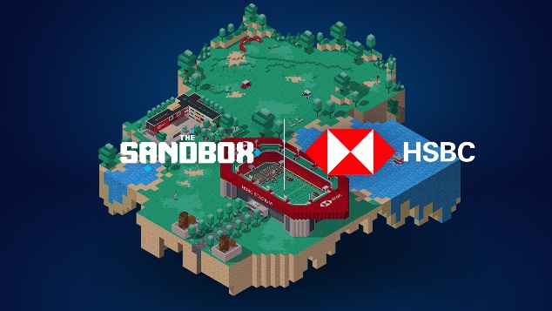
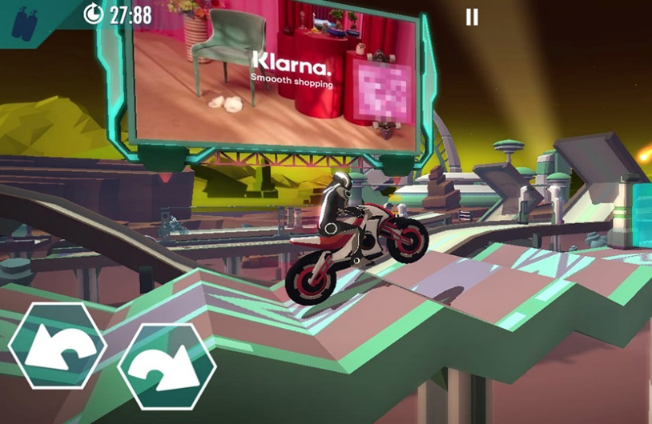

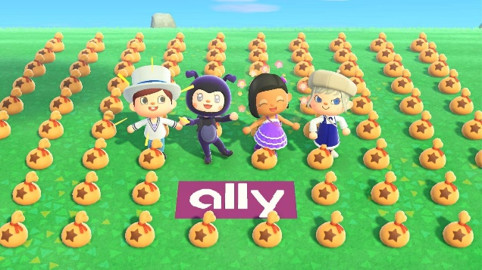

Therefore,how can marketers truly impact this audience?
HSBC acquired a land, virtual real estate in The Sandbox metaverse, which will be developed to engage and connect with sports, esports and gaming enthusiasts
With the help of Anzu’s integrated advertising solution, Digital Turbine delivered the ads in a format called VDOOH
Financial services company Ally sponsored an island in Nintendo's 2020 smash hit title, Animal Crossing: New Horizons.
State Farm is officially extending its sponsorship of League of Legends esports through 2021

Slide 21
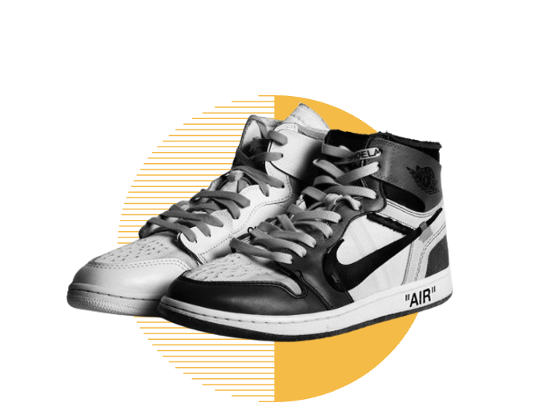

While e-gaming is a strong contender for marketers, there are also other unique emerging subcultures that should be considered...
Sneakerheads
Standing at $2.46 Billion, the sneaker segment will be growing at 6.18% annually with the market volume expected to reach 65.97m pairs by 2028
Anime Lovers
India ranks 4th globally in viewership of anime content, with more than 30 million viewers nationwide.

Slide 22
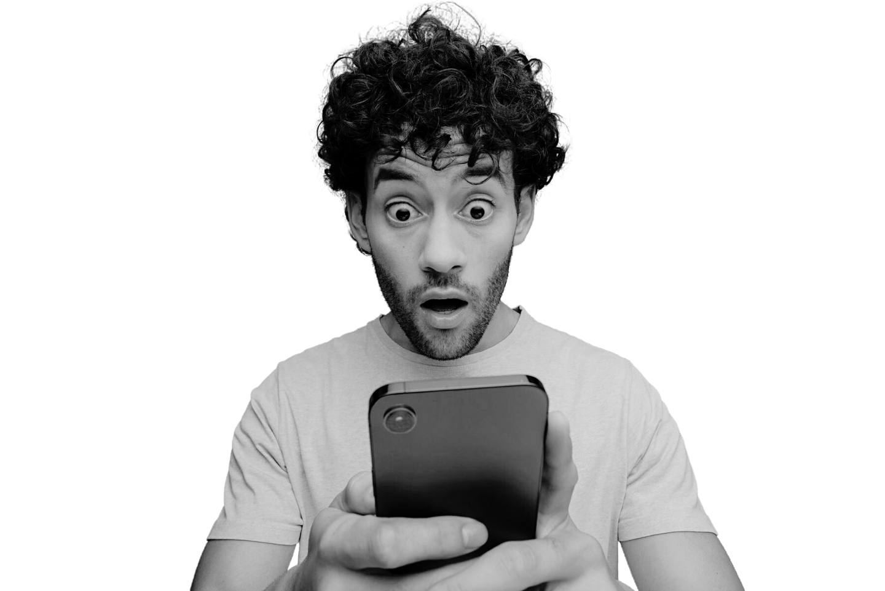
The new-age consumers are also redefining the mediums they lean on for content consumption
Micro communities
Collaboration
Shared Experiences
Expression
Content Creation
Entertainment
Learning

Slide 23
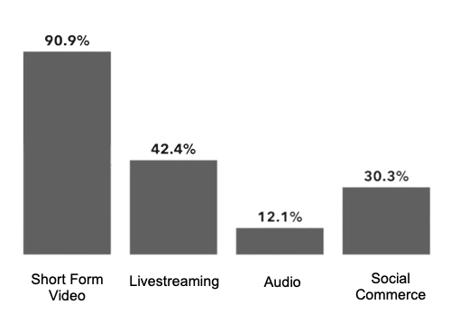

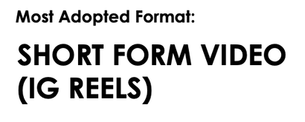
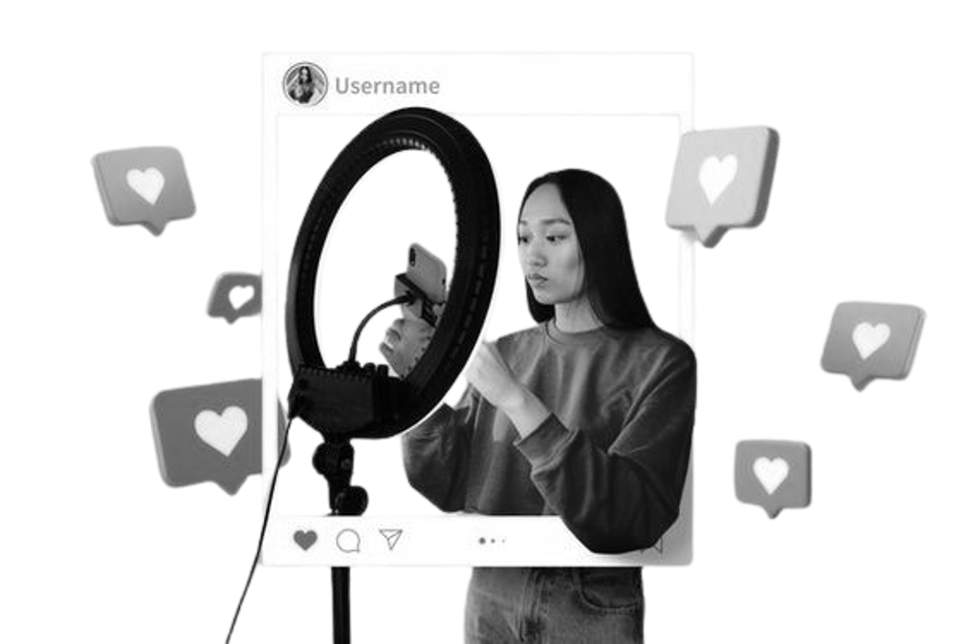

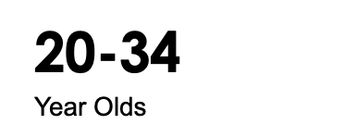

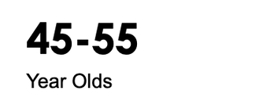
These promising mediums include #Influencers who have immense potential to help brands converse and connect with their consumers
70% of Indians believe that influencer marketing impacts their decision making
What roles do they play in the lives of consumers?
Source of inspiration and product discovery
Source to induce product trials
Source : INCA, Dentsu

Slide 24

While most of us are not strangers to the impact that influencers have, there are certain nuances that will be a part of influencer partnerships going forward...
  1. Long term partnerships and Co-creation
They want to steer clear of doing just gig work as it forces them to endorse competition brands, diluting their credentials. They want to have a say in the brand they are lending their voice to
2. Co-navigating by narrowcasting
Breakaway from being seen as content with an agenda, lean on creators that might not have aspiration but enjoy camaraderie and relatability which help create distinction in a live market
3. Trust Trinity
Be mindful of this relationship that includes brands, influencers and consumers that shapes effective production of content and aids consumption in a backdrop of authenticity and transparency.
Source : ASCI, INCA

Slide 25
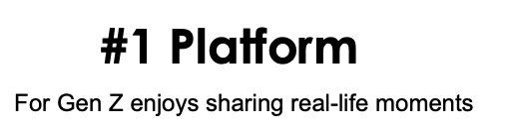


With almost every digital native exuding some kind of influence, certain platforms have emerged as epicentres of authentic conversations
With 200Million active users
4 out of 5
Indian believe Snapchat to be a Hub of Happiness
Believe Snapchat to be more intimate to build connection with friends
7 in 10
87%
See snapchat as the best way to shop with their friends when they aren’t together
Source : Snapcha, ALEPH

Slide 26



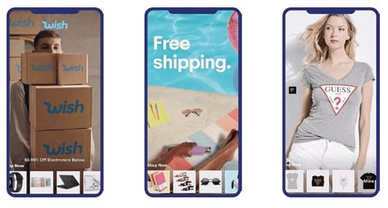

Snapchat provides new ways for brands to bring out their playful side and express themselves, redefining engagement
Snap Ads
With it’s effective lifestyle category targeting and video storytelling potential, snapchat has emerged as the new relatable brand narrative HubSpot
Commercials
Reinventing the Shopping experience
Lenses
While brands think AR is for fun, 1 in 4 consumers save or share lenses making it an important path to purchase
Collection Ads
Story Ads
Source : Snapchat, Aleph

Slide 27










Our new age consumers have also created a thriving uptick in the number of digital campfires
Rooted in the need for intimate and authentic environments, where people gather virtually to share stories, engage in discussions, and build a sense of community.
What makes it enticing for brands?
  Becoming a Meaningful Part of Online Culture
  Fostering authentic relationships
  Niche Audience
  Real time feedback and insights
Private Messaging
Micro communities
Shared Experiences

Slide 28

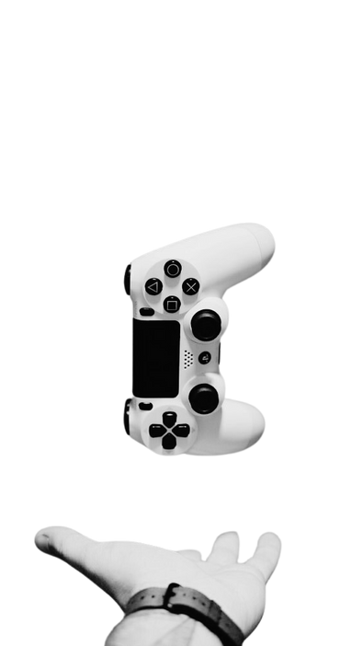

Key Takeaways
Acknowledge and adapt to evolving consumers
Be mindful of the brand story and the universe of touchpoints you create as that’s just as crucial as the product
Recognize the influence of subcultures and the power of micro-communities
Engage with communities through strategic partnerships, sponsorships, or on culture integrations to authentically connect with this passionate and deeply engaged audience.
Embrace Immersive Experiences and Social Commerce
Leverage platforms like Snapchat to create immersive experiences and integrate social commerce.

Slide 29
Thank You

