Slide 1



MAPPING LIFE INSURANCE ON YOUTUBE
COMPILED BY:

Slide 2

POINTS OF DISCUSSION
Spotlighting the Modern Indian Mindset & Outlook towards Money
Outlining the investor mindset
Mapping the YouTube Behaviour – User Journey & Content Consumption
Identifying Unaddressed Information needs - Whitespaces
Observations & Learnings from Peer Analysis
Spotlighting The Modern Indian Mindset - Whitespaces
Mapping the Sources of Influence & Peer Strategy

Slide 3

Consumers in India have journeyed from necessity to aspiration, from buying local to thinking global, and now, to demanding purpose and value, thereby also transforming their relationship with money.
OUTLINING THE PORTRAIT OF
THE MODERN INDIAN MINDSET

Slide 4









How Young People View Their Lives, Futures & Finances
LIFESTYLE CHOICES
MONEY MANAGEMENT
MONEY MINDSET
NON-CONFORMITY
IN TRADITIONS & VALUE
STATUS-SEEKING SPENDING, FREEDOM-FOCUSSED SAVINGS
FINANCIALLY AWARE, BUT UNSURE OF THE END GAME.
Lifestyle of individuality & self-expression, prioritizing experiences & independence, redefining what living, success & happiness mean in today’s world.
A tug-of-war between indulgence and restraint, desire to live in the moment, but also brace for the future and control their destiny tomorrow.
An inner turmoil reflecting s a deeper, unresolved tension between what they know and how they feel about their financial standing – aware of the path, unsure of the destination

Slide 5
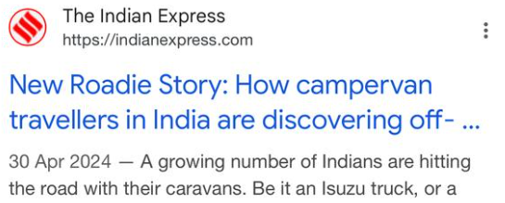
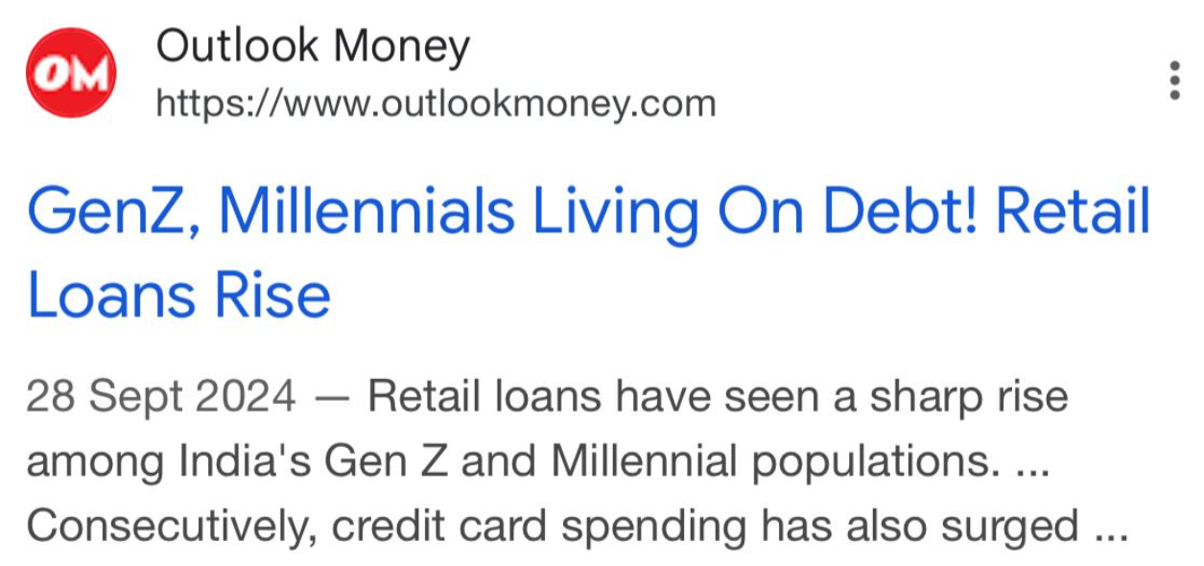
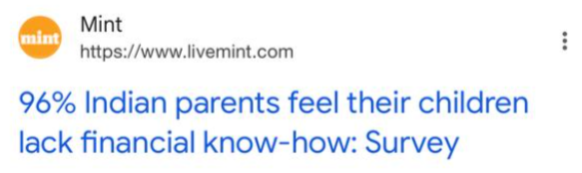
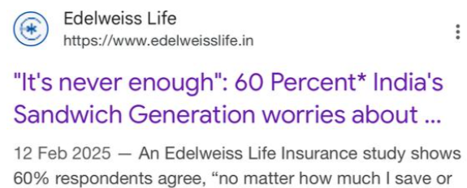
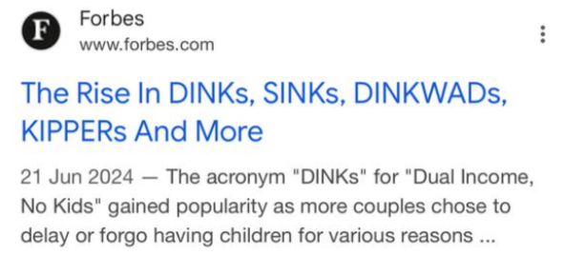
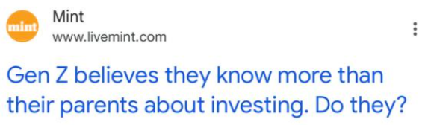

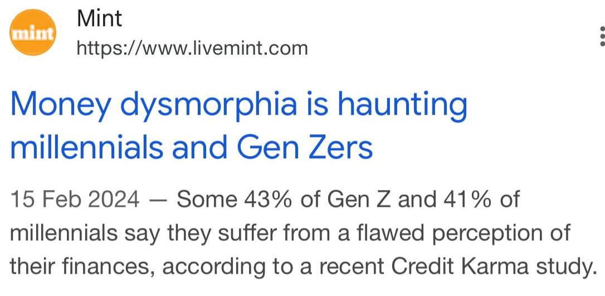
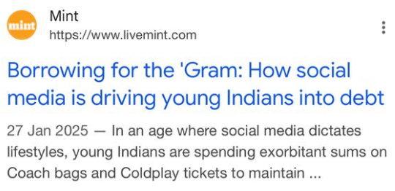
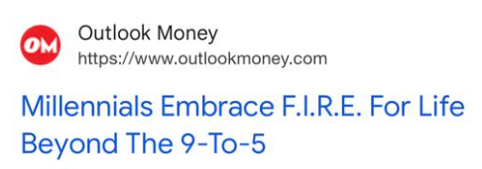
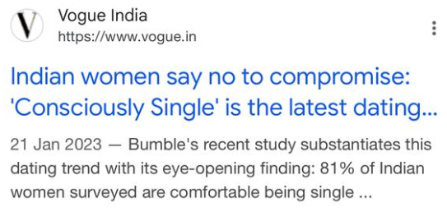
LIFESTYLE CHOICES
MONEY MANAGEMENT
MONEY MINDSET
SPENDING-BEYOND-MEANS
“THEIR OLD SCHOOL ADVICE IS HOLDING ME BACK”
“I’M MY PARENT’S RETIREMEMT PLAN”
ALWAYS-ON-THE-GO
CHILD-FREE & LOVING IT
“I ALWAYS ‘FEEL’ SHORT, EVEN WHEN I’M NOT”
BORROWING FOR THE GRAM
ACCUMULATING FOR LIBERATION
CHOOSING SELF, OVER SETTLING

Slide 6

SUMMARISING THE
THE MODERN INDIAN MONEY MINDSET
1
Money isn’t just a transactional or survival tool—it represents autonomy, choice, and the ability to ‘curate one’s lifestyle’ – that feels uniquely theirs
2
The act of earning, spending, or investing money is, for them, an expression of who they are, what they stand for, and how they engage with the world.
3
It's not about accumulation for status but also about liberation—from financial stress, societal pressures, and rigid timelines.
4
Financial success is less about the numbers on a paycheck/ bank balance & more about how those numbers allow them to curate a lifestyle that feels true to their evolving identity.

Slide 7

INVESTOR MINDSET
RESULTING IN A SHIFT FROM ‘SAVINGS’ TO
FINANCIALISATION OF SAVINGS
Always a land of savers, India’s relationship with money is evolving – it is no longer just about preservation but about active wealth creation, shaped by increased financial literacy, digital accessibility & exposure to global economic narratives
The shift also mirrors evolving aspirations—where wealth is not just a safety net but a means to upgrade lifestyles, gain social mobility, and achieve long-term autonomy.
Source: Bajaj Aallianz Survey, 2023 I CRISIL Report, 2022
Notes:
https://www.retropoplifestyle.com/bajaj-allianz-life-indias-life-goals-preparedness-survey-2023/
https://www.crisil.com/content/dam/crisil/our-analysis/reports/Research/documents/2022/12/the-big-shift-in-financialisation.pdf
https://www.salesforce.com/in/blog/7-trends-wealth-management-industry-india/ - combining financial goals with ethical and life goals. They’re looking for more holistic investment options that include retirement planning, impact investing, estate planning, and social welfare.

Slide 8

TRANSFORMING
PERCEPTIONS OF LIFE INSURANCE
It is no longer just a fallback for dependents in case of an emergency—it is now a calculated component of long-term wealth creation, risk management, and legacy building.
INSTRUMENT OF CONTROL, NOT JUST OF CAUTION
BUILDING BLOCK
FOR REALISING AMBITIONS
A self-made assurance, that financial & life trajectory is dictated by choice, not just circumstance
Offers a mental safety net & confidence in risk-taking, from making life’s big moves
A LIFESTYLE GUARDIAN
No longer about preventing a fall; but maintaining momentum - to uphold the aspirations they have collectively built

Slide 9








THEY’RE NO LONGER PLANNING FOR JUST ‘WHAT IFS’;
THEY ARE PLANNING FOR ‘WHAT’S NEXT’
The future implications of life events & life stages drives a buyer’s sense of responsibility
Too early to make an impact
Ideal Life Stage; Right motivation & financial standing
Already Saturated
15
20
25
30
35
40
45
50
55
60
FIRST JOB
GETTING MARRIED
HAVING
A CHILD
BUYING
A HOME
CARING FOR AGING PARENTS
STARTING A BUSINESS
PREPPING FOR GOLDEN YEARS
Social Media
Death of a relative
Major Health Event
Financial change
Tax benefit
Natural disaster
OBSERVATION
While, there is a growing realization that financial planning & insurance is essential, many still face significant mental blocks & barriers, that can delay the decision-making process or make it feel like a daunting task.

Slide 10

There are so many insurance companies & product types—how do I know which one is right for me?
"I don’t have the time or energy to figure out all the details right now."
So many conflicting views about ULIPs & endowment plans. Who should I listen to?
"Is this agent pushing a product because it’s good for them, or because it’s right for me?"
Will I get enough value for my premiums? What if in future markets don’t respond well and I lose money
"I don’t have the time or energy to figure out all the details right now."
I've heard stories of people struggling to get their claims settled
"I don’t even know how much coverage I need. What if I end up paying for too much or too little?"
What if my financial situation changes? Will I be able to keep paying?"

Slide 11


LEADING TO
TWO DISTINCT WAYS OF DECISION-MAKING
GUIDED
INDEPEDENDENT
"This is overwhelming. I need help making sense of all of these options & finding the right coverage for me."
I want space to explore & build knowledge on my own to find out which coverage option is best for me."
“COACH-ME”
SELF-GUIDED
Value expertise and human connection, seeing agents or advisors as trusted partners to guild knowledge, understanding & confidence to make decisions
Shaped by a mix of uncertainty, time constraints, aversion to complexity & the ‘emotional weight’ of the purchase.
A small subset also cross-check or validate advice independently before fully committing.
They know their needs & prefer to be in control of the entire process, using their own research to compare, analyze & choose the best option.
Many are concerned that an agent might push an agenda, leading them to second-guess recommendations and hence prefer On-Demand Assistance to reinforce or refine their choices.
They may or may not be in learning phase & hence appreciate experts who can help them connect the dots, rather than just sell a policy.
LOW RELIANCE
DIGITAL AIDS DECISION-MAKING JOURNEY
HIGH RELIANCE

Slide 12
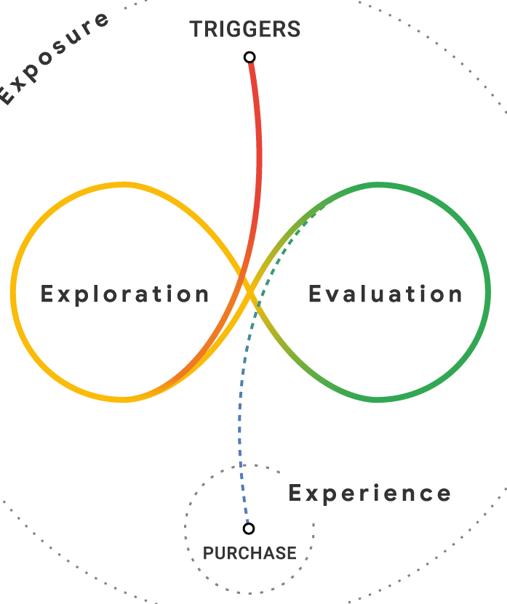


YOUTUBE BEHAVIOR
DECODING THE
CONSUMER JOURNEY ON YOUTUBE
TRIGGERS
CHOOSING THE RIGHT POLICY
PLANNING FINANCES
The user journey while researching for life insurance is highly fragmented, not a linear progression, rather a constant oscillation, marked by the ebb and flow of curiosity, doubt & decision-making.
This journey is full of micro-moments & with each video consumed in these moments, the user’s confidence grows or fluctuates, which leads to either progressing further in the decision-making or returning to earlier doubts & refining their understanding.
UNDERSTANDING INSURANCE
FINDING THE BEST POLICY
ACTION

Slide 13
DECODING THE JOURNEY ON YOUTUBE
PLANNING
FINANCES
UNDERSTANDING INSURANCE
CHOOSING THE RIGHT POLICY
FINDING THE BEST POLICY
Self-reflection, confusion, sense of responsibility, urgency
Confusion, curiosity, apprehension
Sense of responsibility, urgency, self-doubt
Confusion, anxiety, second-guessing, decision-fatigue, analysis paralysis
MINDSET
Idea-gathering, looking to understand financial tools, options & strategies to secure their future (Wealth growth, retirement planning, financial security)
No immediate intent to buy. The primary goal is to demystify the topic—phase is akin to a crash course on insurance.
Looking for ‘actionable advice on how to buy the right policy - seeking guidance to identify needs & structure the policy
Looking for best policies, nervous about committing - seek validation, reassurance, cross-check advice, fact-check agents, refine options
USE OF YOUTUBE
CONTENT SEEKED
Foundational financial advice & financial planning knowledge
Simple & clear Foundational insurance knowledge
Practical, logical insurance buying guides and insights
Top recommendations, Rankings, Reviews, comparisons, advice
CONTENT EXPECTATIONS
Simple, easy-to-follow, with relatable examples & actionable insights
Simple, jargon-free, offering immediate clarity, with relatable examples, with visual aids
Honest, transparent, no sugar-coating, in-depth, Un-biased, updated
Honest, transparent, no sugar-coating, in-depth, Un-biased, analytical
NOTE: The Journey is not linear. There is constant back and forth between the micro-moments

Slide 14

OUTLINING THE
YOUTUBE INSURANCE CONTENTVERSE
INSURANCE PLANNING GUIDES
INSIDER INSIGHTS
Practical, step-by-step guides with real-world examples for personalized decision-making to plan the policy (tenure, coverage, riders to buy, premium calculation and cost saving strategies ) removing guess-work from the process
Professional insights and expert opinions often hosted by or with industry professionals
TRAP ALERTS
Act as consumer watchdogs - scam alerts about phony insurance agent, misleading sales tactics, uncovering the fine print, consumer rights, Fact-check claims, address misinformation, debunk myths
ROI CALCULATORS
Project potential returns or future payouts (maturity/ surrender value) based on assumed interest rates, policy terms, and riders
POLICY SHOWDOWN
POLICY MANAGEMENT
Side-by-side visual comparisons of different plans, products/ plan feature & benefit reviews, best-of-lists, pros and cons with analysis
Explainer videos to navigate the administrative side of their insurance to manage their policy benefits – maturity/ surrender claim process, application process, check claim status etc.
LIFE INSURANCE 101
NEWS & UPDATES
Simplify complex insurance jargon, policy structures, smart practices that help consumers grasp the fundamentals, feature specific deep dives,
Inform consumers about legal changes, industry updates, policy shifts, and new insurance products
Notes:
In a landscape where transparency, clarity, and trust drive conversions, YouTube is no longer just an awareness tool—it is a decision enabler.
1. Simplifiers: These videos eliminate confusion and make policy features digestible, helping consumers build a strong foundational understanding before moving to more decision-oriented content.

Slide 15
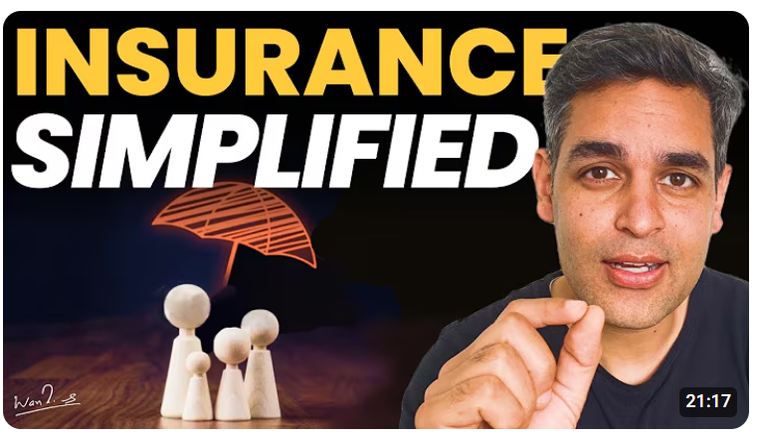
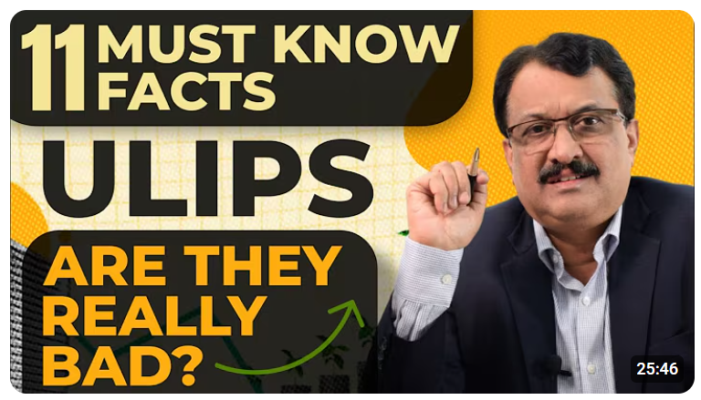


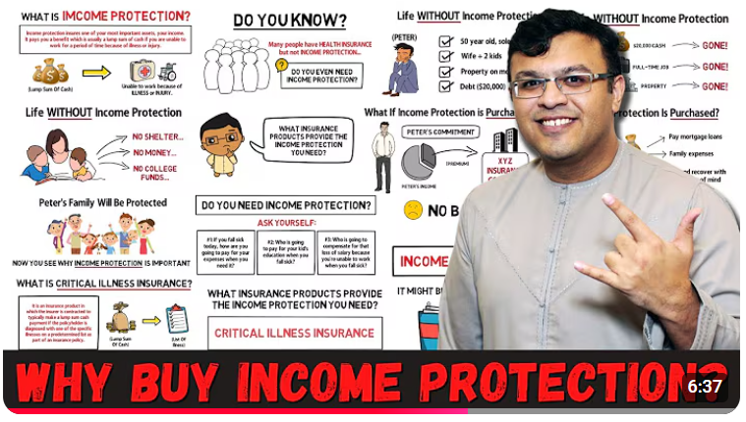

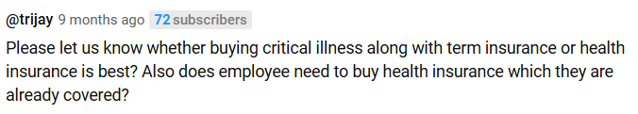

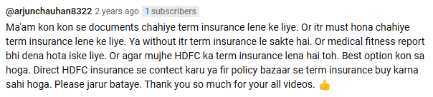
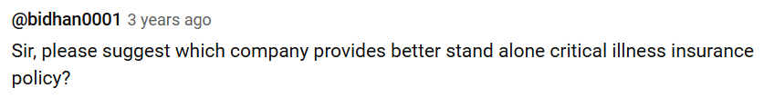
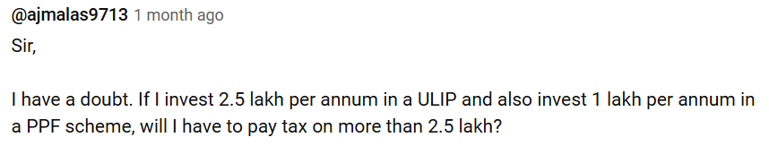
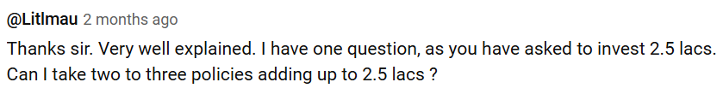
SNAPSHOT & CONSUMER SENTIMENT
INSURANCE 101
ABC’s OF INSURANCE
PRODUCT GUIDES
INSURANCE LINGO SIMPLIFIED
STARTING RIGHT
CONSUMER AWARENESS
DEBUNKING MYTHS
- Though foundational, this content is valuable to both beginners and advancing consumers (as they inevitably encounter new concepts further down the decision journey)
- Display a spectrum of queries - Early-stage consumers are not just absorbing content but actively mapping their next steps (spotlighting decision inertia)
- Advancing consumers seek personalization and their needs become more nuanced—focusing on policy fine print, calculation methodologies, ROI estimation etc.
CONSUMER SENTIMENT
BRAND IMPERATIVE
BE THEIR GUIDING COMPASS – SET THE DIRECTION, ENCOURAGE EXPLORATION

Slide 16

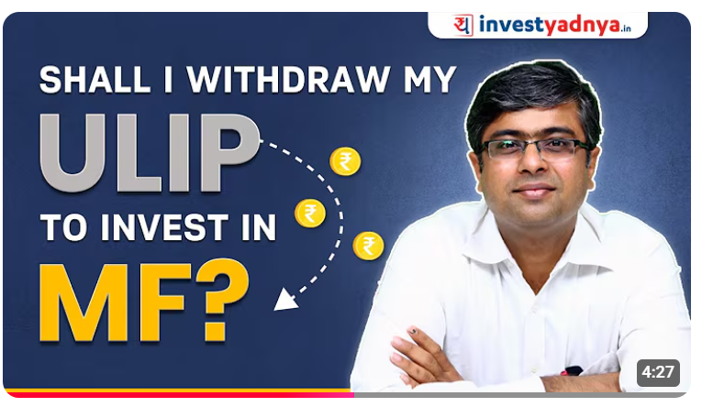
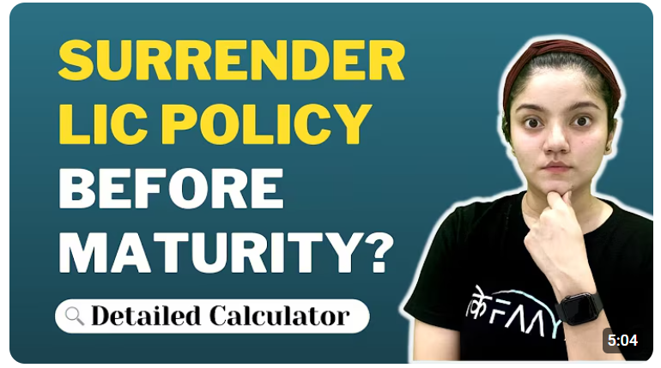
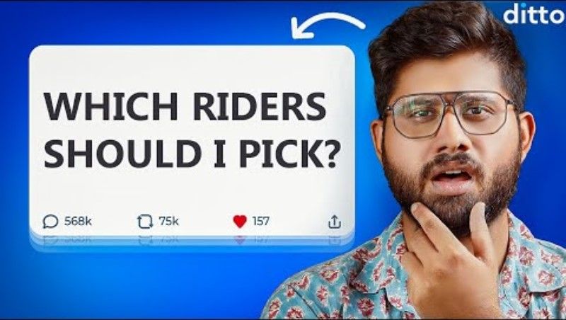
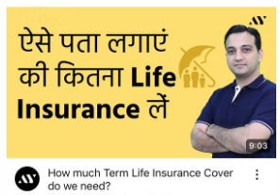
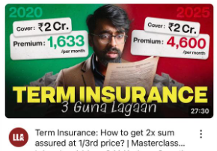
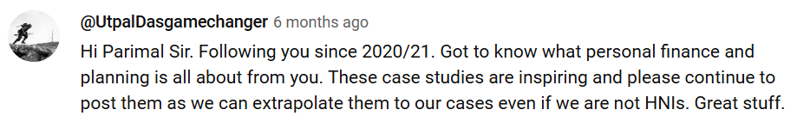
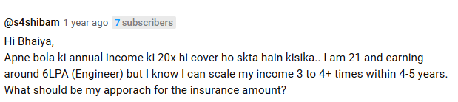
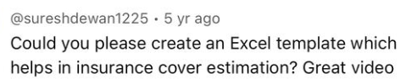

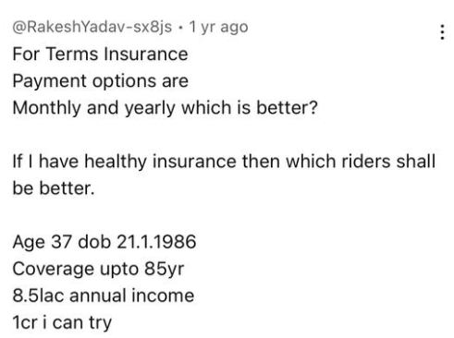
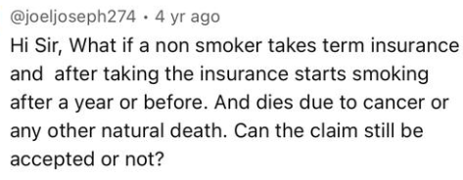
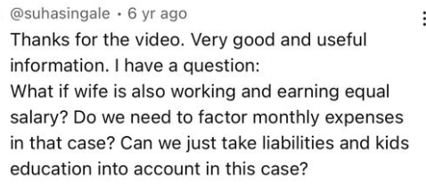


SNAPSHOT & CONSUMER SENTIMENT
ROI CALCULATORS
INSURANCE PLANNING GUIDES
Highly valued for its practical, no-frills approach, as it helps them independently assess the policies. Suggest that viewers are actively trying to apply the content. They are engaging with the content in a very hands-on, personalized way.
- Seek structured guides & advice with real-world scenarios for higher relevance & comprehension
- Asking for concrete tools like Excel templates, Calculators, formulas that allow them to visualize the trade-offs and ensure that their choices are backed by reliable, data-driven insights
CONSUMER SENTIMENT
BRAND IMPERATIVE
BE THEIR GUIDING COMPASS – HELP CHART THEIR ROUTE, KEEP THEM ON COURSE

Slide 17
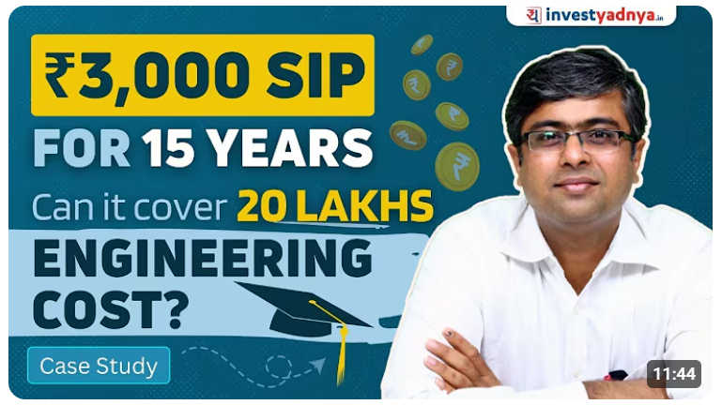
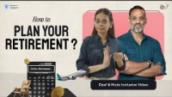


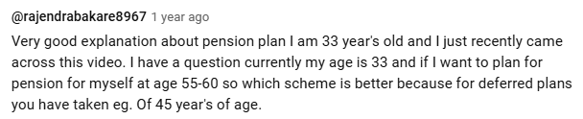
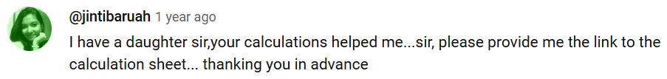
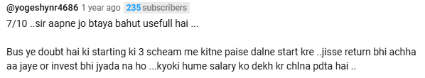

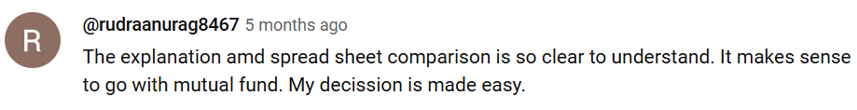
SNAPSHOT & CONSUMER SENTIMENT
FINANCIAL PLANNING GUIDES
- Consumers are drawn to content that provides real-world applications and practical examples
- Asking for concrete tools like Excel templates, Calculators, formulas, indicates that the audience is very invested in implementing the information they learn
- A recurring sentiment in the comments is the appreciation for content that feels accessible as it helps build confidence
CONSUMER SENTIMENT
BRAND IMPERATIVE
SHOW THEM THE BIG PICTURE
PERSONALISE THEIR JOURNEY

Slide 18
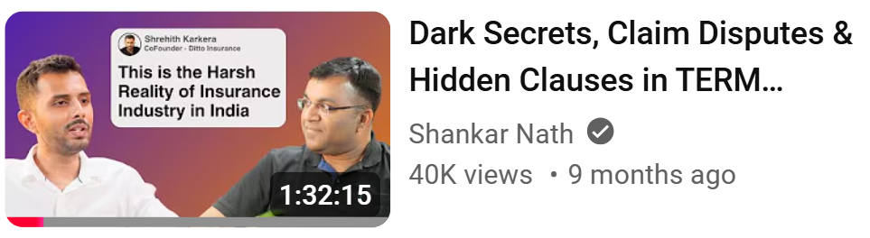


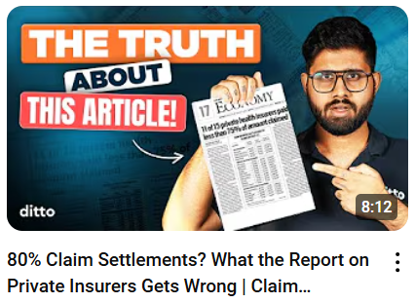
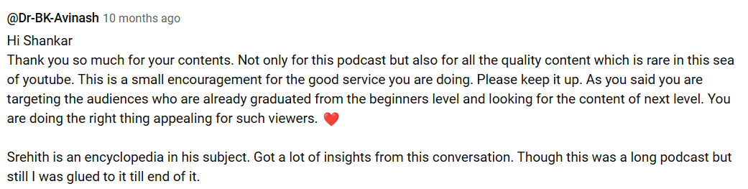
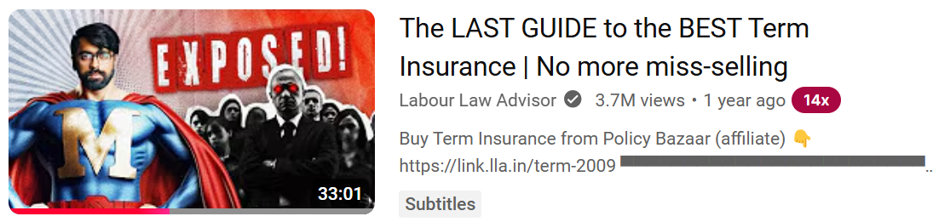

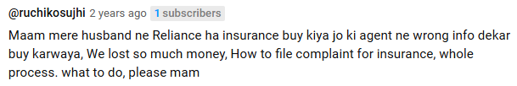
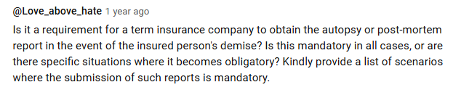
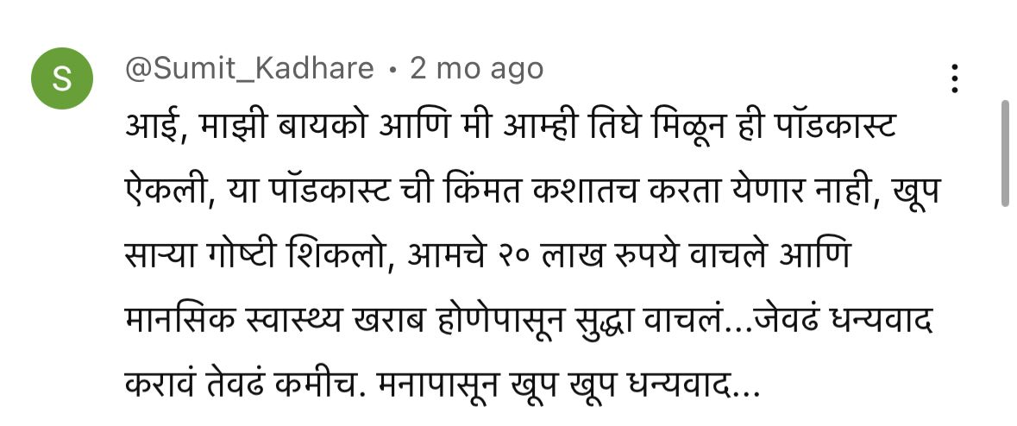
SNAPSHOT & CONSUMER SENTIMENT
INSIDER INSIGHTS
TRAP ALERTS
- Reflect a profound sense of gratitude and trust from viewers for not gatekeeping important industry knowledge
- Reflect on how insights relate to their own circumstances & are motivated to engage in dialogue to validate their decisions, cross-check agent recommendations etc.
- Trap alerts make people feel heard and supported. The creator, in this context is perceived as someone who cares about their financial well-being and perceived as trusted advisor
- Serves as an echo chamber where people share personal stories - calls for help, reflections of real struggles, platform for solidarity. Feels it offers a safe space
- Empowers them to be more vigilant, as they seek actionable advice for various scenarios
CONSUMER SENTIMENT
BRAND IMPERATIVE
UNLOCK THE UNSEEN/ UNHEARD
EMPOWER WITH INSIGHT & FORESIGHT

Slide 19
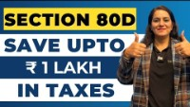
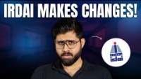
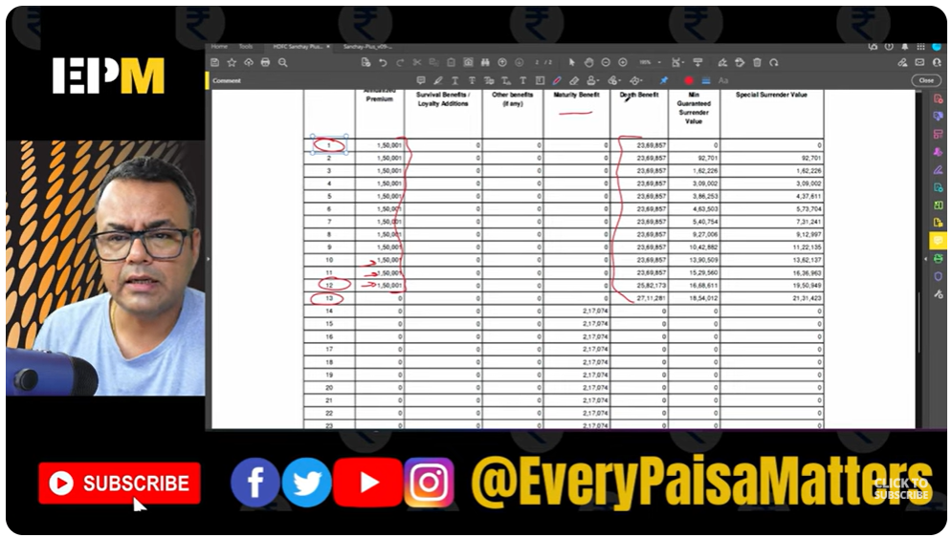
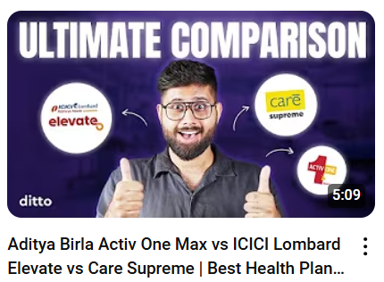
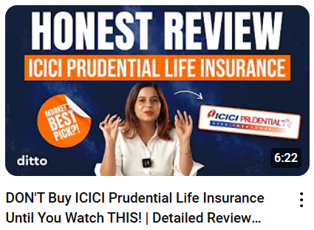
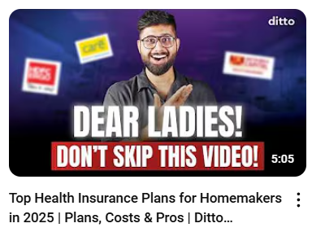


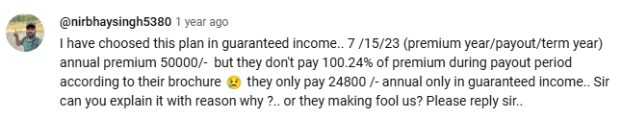




SNAPSHOT & CONSUMER SENTIMENT
NEWS & UPDATES
POLICY SHOWDOWNS
Seek direct clarity on how industry updates impact their personal financial decisions like customization concerns, applicability queries, demographic implications etc.
- Data-driven curiosity; Want mathematical insights into how policy promises translate into actual benefits and evaluate their current policies they have purchased (identify weaknesses or gaps)
- Seek data-driven, technical comparisons into how different products stack up to understand the value proposition of different plans
CONSUMER SENTIMENT
BRAND IMPERATIVE
BE THEIR PULSE ON THE LATEST
SIMPLIFY CHOICES, STREAMLINE DECISIONS

Slide 20







SUMMARISING THE
CATEGORY IMPERATIVES FOR LI BRANDS
BE THEIR GUIDING COMPASS
PERSONALISE THEIR JOURNEY
EMPOWER WITH INSIGHT & FORESIGHT
SIMPLIFY CHOICES, STREAMLINE DECISIONS
01
03
05
07
02
04
06
04
SHOW THEM
THE BIG PICTURE
UNLOCK THE
UNSEEN & UNHEARD
BE THEIR PULSE
ON THE LATEST

Slide 21











HOWEVER,
SOME INFORMATION NEEDS REMAIN UNADRESSED ON THE PLATFORM
INFORMATION NEEDS
1. INCLUSION/ REPRESENTATION IN INSURANCE
DISCLOSURE DILEMMA
NEEDS BEYOND THE NORM
INSURANCE WITH INTEGRITY
SOURCE: Reddit Threads
Notes:
Dilemma: In the world of insurance, the disclosure dilemma often arises when consumers are faced with the choice of whether to reveal seemingly insignificant details like a single cigarette a day or a benign condition such as lipoma. These conversations explore the fine line between transparency and omission, questioning how much disclosure is necessary and whether small truths could lead to big consequences down the line.

Slide 22

HOWEVER,
SOME CONVERSATIONS REMAIN UNADRESSED ON THE PLATFORM
INCLUSION/ REPRESENTATION IN INSURANCE
DISCLOSURE DILEMMA
NEEDS BEYOND THE NORM
IMPERATIVE
The conversations highlighted here reflect critical gaps in the mainstream insurance discourse and present valuable white space opportunities for Aditya Birla Sun Life Insurance to establish themselves as thought leaders and start building brand affinity.
INSURANCE WITH INTEGRITY
Notes:
Dilemma: In the world of insurance, the disclosure dilemma often arises when consumers are faced with the choice of whether to reveal seemingly insignificant details like a single cigarette a day or a benign condition such as lipoma. These conversations explore the fine line between transparency and omission, questioning how much disclosure is necessary and whether small truths could lead to big consequences down the line.

Slide 23

COMPETITION AUDIT
THIS CONTENTVERSE ALSO INCLUDES
BRANDS AS ACTIVE PARTICIPANTS
In order to extend their presence beyond traditional advertising and become a part of the broader category dialogue, brands are contributing through their own life insurance narratives and strategic collaborations. The kinds of brands can be understood as…
1. CREATOR BRANDS
2. PROMOTER BRANDS
They act as guides, advocates by helping consumers navigate their options and positioning their own products within this guidance to build credibility and drive consideration
They prioritize the promotion of their products and services with a focus on promotional messaging, with educational content (value-adding) playing a supporting role

Slide 24




















CREATOR BRANDS
Function like creators themselves, prioritizing value-driven content for empowering users to make informed choices by providing high-quality, simplified educational content, relevant advice & practical knowledge free from heavy-handed promotion or overt sales tactics.
This approach fosters an environment where viewers feel respected and supported, resulting in high degree of brand affinity and advocacy, creating a cycle of trust and loyalty.
FULL-FUNNEL CONTENT MARKETING
INSURANCE EDUCATION
CONSUMER AWARENESS
POLICY PURCHASE ADVICE
POLICY RECOMMENDATIONS
EVALUATION
BRAND PROMOTION
REAL-WORLD INSIHGTS
INCLUSITVITY
LEARNINGS:
LED BY IN-HOUSE CREATORS
SOURCE OF INSIDER KNOWLEDGE
Brand spokespersons who consistently represent the brand across their content. Their tonality, persona & expertise shape how the brand is perceived, making these spokespersons integral to the brand's identity.
Because these brands are authentic to the industry, it allows them to offer unique insights and nuanced perspectives, based on first-hand experience that external influencers or traditional marketers might miss
LACK LINGUISTIC INCLUSIVITY
POSITION AS FORWARD-THINKING LEADER
Opportunity for growth - break down barriers for a larger, more varied audience.
Their insider knowledge is the cornerstone of their value proposition.
Notes:
In a landscape where transparency, clarity, and trust drive conversions, YouTube is no longer just an awareness tool—it is a decision enabler.

Slide 25









COMPETITION AUDIT
THIS HOWEVER IS VASTLY DIFFERS FROM
APPROACH OF PROMOTER BRANDS
Promoter brands on YouTube prioritize the promotion of their products & services, with educational content (value-adding) playing a supporting role rather than taking center stage.
Notes:
In a landscape where transparency, clarity, and trust drive conversions, YouTube is no longer just an awareness tool—it is a decision enabler.

Slide 26


NOTE: Content Studied for the year 2024 only
CONTENT STRATEGY:
PROMOTER BRANDS
BRAND AMPLIFICATION
CONSUMER EDUCATION
NOTE: ‘Product’: LI Plan Types I ‘Policy’: Brand Offering For Each Type
CONTENT DISTRIBUTION
ON YOUTUBE
P1: BRAND/ POLICY AMPLIFICATION
P2: CONSUMER EDUCATION
P1. PRODUCT EDUCATION
P2. CATEGORY EDUCATION
GOAL: MAXIMISE CONSUMER AWARENESS
GOAL: DRIVE DISCOVERY & BRAND CONFIDENCE
Brand campaigns for Policy/ product Promotion
Always-on content for policy education primarily, followed by
CONTENT PROMOTION:
VERNACULAR
CONTENT:
DUBBED
CONTENT:
CTA:
VISIT WEBSITE
CONTENT PROMOTION:
VERNACULAR CONTENT:
DUBBED
CONTENT:
CTA:
VISIT WEBSITE
CONTENT TYPES:
CONTENT TYPE: PRODUCT EDUCATION
CONTENT TYPE: CONSUMER EDUCATION
- Product & policy education
- Social Proof (testimonials)
- Building appeal to focus TG (GenZ) – select brands
- Policy Management
- Product/ policy explainers
- Insurance 101
- Insider Insights (Minimal)
- Policy showdowns
- Planning Guides (Minimal)
- Trap Alerts
TREATMENT:
DUBBED LANGUAGES:
Hindi, Tamil, Telugu, Malayalam, Bengali, Oriya, Assamese, Marathi, Kannada
TREATMENT: PRODUCT EDUCATION
TREATMENT: CONSUMER EDUCATION
- Creator collaborations
- Brand Ambassador-led
- DVCs majorly in English/ Hinglish, tapping into emotional territories/ triggers
- Animated instructional explainers
- Animated policy demos (with e.g.)
- Podcasts with employees & partners
- In-house creators (for select brands)
- Scripted interviews with company reps
YT SHORTS:
Bite-sized cuts of long-form
FREQUENCY:
Around 5 a month
DVC – 1 every 3 to 4 months
YT SHORTS:
- Bite-sized cuts of long-form
- Duplicated
POSTING FREQUENCY:
2 (Select promoter brands)
VISUAL LANGUAGE:
Distinct for select
Notes:
leading with wordplay approach – “protect your family’s future”, “responsibility” for term insurance, “Worry-free”, “secure future”, “right time to plan” for retirement plans etc. to drive rational consideration by creating mental shortcuts for consumers that reinforce necessity of insurance. However, this approach also limits differentiation, as all brands speak in a similar lexicon, making it harder for consumers to distinguish between them

Slide 27






THE CONTENTVERSE IS FILLED WITH
VARYING SENTIMENTS ON VARIOUS INSURANCE PRODUCTS
TERM INSURANCE
PENSION/ ANNUITY PLANS
SAVINGS PLANS
ULIPS & ENDOWMENT PLAN
The phenomenon surrounding investment-linked insurance products on YouTube is one where financial influencers act as educators, consumer advocates, and whistleblowers.
These products are framed as ‘Scam’ and ‘Fraud’, demonstrated through ‘Exposés’ - using calculations, side-by-side comparisons with pure-investment products like mutual funds, and real-life examples
Notes:
In a landscape where transparency, clarity, and trust drive conversions, YouTube is no longer just an awareness tool—it is a decision enabler.
1. Simplifiers: These videos eliminate confusion and make policy features digestible, helping consumers build a strong foundational understanding before moving to more decision-oriented content.

Slide 28

BRAND OUTLOOK TOWARDS
STRATEGIC CONTENT PRIORITIZATION ACROSS INSURANCE PRODUCTS
TERM INSURANCE
PENSION/ ANNUITY PLANS
SAVINGS PLANS
ULIPS & ENDOWMENT PLAN
PRIORITY: HIGHEST
Fundamental safety net to protect dependents
PRIORITY: MID TO LOW
Financial independence channel post-retirement
PRIORITY: LOW
Guaranteed return for goal-based financial security
PRIORITY: LOWEST
More intricate and risk-based growth
- Frame product as an income replacement tool, ensuring dependents’ stability
- Messaging focuses on it as a smart budgeting move
- Use life coverage calculators, policy explainer content to simplify its functioning
- Position it as a way to turn old age into golden years
- Messaging focuses on guaranteed, tax-free income
- Spotlight it’s hassle-free and accessible policy-issuance nature to address the complicated attribute attached with it
- Position it essential financial tool to future-proof aspirations (buying second home, no compromise on passion etc)
- For Child Savings Plans, emphasis is on preparedness and enabling “Bachcho ki khushi”, their ambitions without financial stress.
- Focus on demystification of product’s dual nature to position it as a wealth creation tool
- Narrative leans toward goal-based financial planning source that allows for a “Fikr-free life” and connect to life-stage-based financial responsibilities
Notes:
In a landscape where transparency, clarity, and trust drive conversions, YouTube is no longer just an awareness tool—it is a decision enabler.
1. Simplifiers: These videos eliminate confusion and make policy features digestible, helping consumers build a strong foundational understanding before moving to more decision-oriented content.

Slide 29














CONTENT SNAPSHOT
BRAND PODCASTS
SPONSORED FEATURES
CORPORATE CREDIBILITY
CAMPAIGN-FIRST PRESENCE
Operate within a campaign-heavy, product-led content ecosystem where product communication is built around word associations that reinforce necessity through predictable yet effective narratives. While these associations help simplify consumer understanding and drive rational consideration, they lack differentiation, as all brands operate within the same emotional and functional lexicon
RETIREMENT PLANS:
FEAR-TO-RELIEF MESSAGING
TERM INSURANCE:
PROTECTION-FIRST MESSAGING
SAVINGS PLANS (ULIP):
FUTURE PREPAREDNESS
EMOTIONAL STORYTELLING
CUSTOMER TESTIMONIALS
FRAME INSURANCE AS A PROACTIVE STEP
TRANSACTIONAL EDUCATION IN MIDDLE FUNNEL CONTENT
Promoter life insurance brands approach middle-funnel content with a transactional mindset, majorly prioritizing product explainers over broader category education. While educational content plays a role in building trust and reducing friction in decision-making, it is often sporadic and secondary to direct product promotions. Heavier reliance on animation-based, lending an impersonal nature that might limit engagement
INSURANCE EDUCATION
CONSUMER AWARENESS
PRODCUCT EXPLAINERS & EVALUATION
Notes:
leading with wordplay approach – “protect your family’s future”, “responsibility” for term insurance, “Worry-free”, “secure future”, “right time to plan” for retirement plans etc. to drive rational consideration by creating mental shortcuts for consumers that reinforce necessity of insurance. However, this approach also limits differentiation, as all brands speak in a similar lexicon, making it harder for consumers to distinguish between them

Slide 30



MAPPING HOW OUR PEERS ARE
KEEPING UP WITH CATEGORY IMPERATIVES
Creator brands cut across category narratives by contextualizing and demystifying insurance while promoter brands operate within the confines of policy-centric promotions
Demystify category
Explain in silos
Mirror
Real-life
Choices & triggers
Tailoring limited
To policy
Anticipate
Blind spots & prepare users
Prompt
Policy-related action
Guide decision making
Inform on solutions
BE THEIR GUIDING COMPASS
PERSONALISE THEIR JOURNEY
EMPOWER WITH INSIGHT & FORESIGHT
SIMPLIFY CHOICES, STREAMLINE DECISIONS
01
03
05
07
02
04
06
04
SHOW THEM
THE BIG PICTURE
UNLOCK THE
UNSEEN & UNHEARD
BE THEIR PULSE
ON THE LATEST
Contextualize for broader goals
Limited to milestone moments
Tackle overlooked truths
Stick to sanitized narratives
Translate timely shifts
Update without urgency
CREATOR BRANDS
PROMOTER BRANDS
Notes:
1. BE THEIR GUIDING COMPASS
- Creator Brands: Actively lead with clarity, demystifying insurance through relatable education content.
- Promoter Brands: Provide policy-level clarity, not journey-led understanding
2. SHOW THEM THE BIG PICTURE
- Creator Brands: Situate insurance within broader life/financial goals.
- Promoter Brands: Limit conversation to milestone moments like education or retirement
3. PERSONALISE THEIR JOURNEY
- Creator Brands: Break down complexity with tools, visuals, and analogies that simplify smart action
- Promoter Brands: Rely on explainers and service touchpoints, but lack a larger strategy to reduce decision fatigue.
4. UNLOCK THE UNSEEN AND UNHEARD
- Creator Brands: Tackle overlooked truths in the category
- Promoter Brands: Play it safe, sticking to sanitized, promotional narratives
5. EMPOWER WITH INSIGHT & FORESIGHT
- Creator Brands: Prepare users for evolving needs and financial blind spots
- Promoter Brands: Focus on immediate decision-making rather than cultivating long-term insurance fluency.
6. BE THEIR PULSE ON LATEST
- Creator Brands: Equip audience simplified explainers on policy shifts, IRDAI changes, tax updates etc
- Promoter Brands: Formal, animation-led updates without urgency or relatability
7. SIMPLIFY CHOICES, STREAMLINE DECISIONS
- Creator Brands: Equip audience simplified explainers on policy shifts, IRDAI changes, tax updates etc
- Promoter Brands: Formal, animation-led updates without urgency or relatability

Slide 31


BEYOND THE CATEGORY, ALSO LIE
OPPORTUNITIES TO ‘CONNECT’ WITH MODERN MINDSET

Slide 32
RECAPPING THE MINDSET
LIFESTYLE CHOICES
MONEY MANAGEMENT
MONEY MINDSET
NON-CONFORMITY
IN TRADITIONS & VALUE
STATUS-SEEKING SPENDING, FREEDOM-FOCUSSED SAVINGS
FINANCIALLY AWARE, BUT UNSURE OF THE END GAME.
Lifestyle of individuality & self-expression, prioritizing experiences & independence, redefining what living, success & happiness mean in today’s world.
A tug-of-war between indulgence and restraint, desire to live in the moment, but also brace for the future and control their destiny tomorrow.
An inner turmoil reflecting s a deeper, unresolved tension between what they know and how they feel about their financial standing – aware of the path, unsure of the destination
“I’M MY PARENT’S RETIREMEMT PLAN”
ALWAYS-ON-THE-GO
SPENDING-BEYOND-MEANS
“THEIR OLD SCHOOL ADVICE IS HOLDING ME BACK”
CHILD-FREE & LOVING IT
BORROWING FOR THE GRAM
“I ALWAYS ‘FEEL’ SHORT, EVEN WHEN I’M NOT”
CHOOSING SELF, OVER SETTLING
ALWAYS-ON-THE-GO

Slide 33

THESE NUANCES ARE ALSO
DRIVING CONVERSATIONS ON DIGITAL
From social media exchanges to blogs and podcasts, these platforms become spaces for seeking advice, exchanging knowledge, experiences, coping strategies & offering support.

Slide 34














SNAPSHOT OF DIGITAL CONVERSATIONS ON MONEY MANAGEMENT
BORROWING FOR THE GRAM
CHILD-FREE & LOVING IT
SPENDING BEYOND MEANS

Slide 35














SNAPSHOT OF DIGITAL CONVERSATIONS ON LIFESTYLE CHOICES
CHILD-FREE & LOVING IT
CHOOSING SELF, OVER SETTLING
ALWAYS-ON-THE-GO

Slide 36













SNAPSHOT OF DIGITAL CONVERSATIONS ON MONEY MINDSET
“THEIR OLD SCHOOL ADVICE IS HOLDING ME BACK”
“I ALWAYS ‘FEEL’ SHORT, EVEN IF I’M NOT”
“I’M MY PARENTS’ RETIREMENT PLAN”

Slide 37

SUMMARISING THE
OBSERVATIONS OF DIGITAL CONVERSATIONS
1
FINDING A ‘HOME’ FOR THEIR IDENTITY
They are yearning for a community that “gets them” – a mirror that reflects their new worldview & contemporary approach to life and Reinforces the idea that their life is not an outlier – it’s a different version of success.
3
SEEKING EMOTIONAL REFUGES IN DIGITAL CAMPFIRES
2
In a world where financial uncertainty feels like a constant hum in the background, people are turning to digital campfires not only for practical advice to manage financial pressures, but also for emotional support to validate their feelings
ENGAGING IN DIGITAL SOUND-BOARDING
Search for insights that help them see their financial decisions not just as numbers, but as part of a larger life plan – engaging in dialogue & reflection to shape a financially coherent life vision, not just to optimize outcomes
4
CREATORS ARE THE CULTURAL FIRST RESPONDERS
They are shining a light on emotional and financial truths that often stay in the shadows, facilitating mainstream visibility, offer empathic framing, and hold up a mirror to the quiet
chaos within us.
Notes:
Reinforces the idea that their life is not an outlier – it’s a different version of success.
They offer not just empathy, buta ffirmation, not just comfort, but alignment with life someone is actively choosing to building towarss. Quest for spaces wherte ambition, emotion and ideantity as allowed to coexist without contrdictiron ,or felt felt judges
Search for insights that help them see their financial decisions not just as numbers, but as part of a larger life plan. It isn’t just about finding the best investment strategy; rather constructing a worldview where financial decisions align with broader aspirations, creating a sense of purpose, agency, and direction.

Slide 38



THEREFORE,
ADDITIONAL OPPORTUNITIES FOR FOR BRANDS
CONNECTING BEYOND THE PRODUCT
These nuances of the modern mindset offers a fertile ground for brands to build content narratives that go beyond product and allow us to connect with the consumers in more culturally resonant ways.
REFRAMING LIFE INSURANCE IN FRESH CONTEXTS
These evolving truths give us the creative latitude to move beyond traditional, utility-first narratives and instead embed our products within fresher stories
GOING BEYOND PEER NARRATIVES
Tapping into the emerging consumer realities allows us to occupy a more emotionally intelligent and culturally fluent space than our peers that continue to orbit around dated tropes of protection and financial foresight

Slide 39

INFLUENCER AUDIT
THIS CONTENTVERSE IS BUILT BY VARIOUS
SOURCES OF INFLUENCE
In the life insurance space, trusted voices play a crucial role in shaping consumer decisions, given the complexity of the category. These faces of influence include…
1. CREATORS - AMICABLE ORACLES
2. (CREATOR) BRANDS
Creators that act as trusted teachers, advisors or guides, tailoring content to practical goals - decision-making, skill-building, or inspiration addressing specific questions, challenges, or curiosities
They act as guides, advocates by helping consumers navigate their options and positioning their own products within this guidance to build credibility and drive consideration
Notes:
In a landscape where transparency, clarity, and trust drive conversions, YouTube is no longer just an awareness tool—it is a decision enabler.

Slide 40














AMICABLE ORACLES
FINFLUENCERS
SURVIVAL WIZARDS
INSURANCE GURUS
WHO: Digital financial educators that simplify category, and guide investment decisions based on consumer needs in a space seen as complex and transactional
WHO: Not insider experts, but smart curators that put together information and advice, keeping everyday concerns of Indians in mind
WHO: Industry insiders & professionals, specializing in insurance & related financial products, reviewing policies, updating on regulatory nuances, consumer education etc.
RACHANA R
PRANJAL KAMRA
SHANKARNATH
ANKUR W.
LABOR LAW ADVISOR
GURLEEN K.
POLICYX
POLICY BHANDAR
WHAT: Access to largest-potential audience
WHAT: Access to In-market audience
Policy purchase checklist to ensure right coverage
Identifying category hacks/ trap to keep in mind during policy selection
Deep diving into Policy specifics/ side-by-side comparisons
Education around insurance riders to make the most out of insurance policies
Advice on policy buying basis age and future cost obligations
Step-by-step guide for claim settlement process
Trap alerts basis insider knowledge
Notes:
In a landscape where transparency, clarity, and trust drive conversions, YouTube is no longer just an awareness tool—it is a decision enabler.

Slide 41















OBSERVATION:
However, consumer preference for influencers is also driven by their learning curve/ mindset maturity & not just influencer category
INSURANCE RESEARCHER MINDSET
PREFERRED INFLUENCER TYPE
BEGINNER
Mass-market influencers, the most
visible ones, with large followings
Exploring the fundamentals; knowledge is sparse, hence attracted to content that is introductory & accessible, created by influencers who can explain the subject in a way that feels approachable.
They create content on topics that are
highly searched by new consumers, appealing
to large audience. YT’s algo prioritizes such
Content, pushing their videos to the top of search
RACHANA R.
SHARAN H.
ANKUR W.
PRANJAL K.
ASSET YOGI
Bridge Creators - may / may not have the same reach as
INTERMEDIATE
Mass-market influencers but have a loyal audience and
Starting to develop an understanding, beginning to delve into more specific details
focus on providing detailed, actionable advice for viewers who
re actively refining their knowledge. These influencers are also
followed by advanced researchers.
LABOR LAW
ADVISOR
ANUPAM GUPTA
(PAISA VAISA)
ADVANCED
Industry leaders, subject matter experts, or niche influencers who
provide no-nonsense practical, content - highly detailed, data-backed
Well-read, highly discerning & selective of influencers they engage with
insights & actionable advice (e.g. with case studies) without unnecessary
SHANKARNATH
PARIMAL ADE
BASANT M
embellishments. Their content delves into layered, nuanced discussions, covering
topics that go beyond what is usually discussed by mainstream creators.
SOURCE: Reddit

Slide 42
LEARNING: To resonate with the intended audience mindset & maturity level, the brand's narrative must go beyond simply aligning with the audience's needs & influencer type —it must also align with the level & nature of resonance with their followers
MASS MARKET INFLUENCERS:
- Access to large audience base
- introduction to new consumers
- opportunity for soft brand positioning
BEGINNER
Exploring the fundamentals; knowledge is sparse, hence attracted to content that is introductory & accessible, created by influencers who can explain the subject in a way that feels approachable.
RACHANA R.
SHARAN H.
ANKUR W.
PRANJAL K.
ASSET YOGI
INTERMEDIATE
BRIDGE & NICHE INFLUENCERS
Starting to develop an understanding, beginning to delve into more specific details
ANUPAM GUPTA
(PAISA VAISA)
- Access to high-intent & highly involved audience base
- Building trust & credibility
- Opportunity to engage with more complex consumer needs
- Piggybacking on their thought-leadership to establish brand authority
LABOR LAW
ADVISOR
ADVANCED
Well-read, highly discerning & selective of influencers they engage with
SHANKARNATH
PARIMAL ADE
BASANT M
SOURCE: Reddit

Slide 43






NOTE: Influencer Content Studied for the year 2024 only
Our peers too are tapping into the influence of creators, collaborating with diverse influencer types
INFLUENCER STRATEGY: TYPE OF ASSOCIATION
PROMOTER BRANDS
VOLUME OF CREATOR COLLABS BY PEERS
CATEGORY CREATORS
ADJACENT CONNECTORS
CATEGORY RESONANCE: HIGH | RELEVANCE: HIGH
CATEGORY RELEVANCE: LOW I RESONANCE: LOW-MID
FINFLUENCERS
SURVIVAL WIZARDS
DIGITAL ENTERTAINERS
TASTEMAKERS
COMICS
PLATFORM
RELEVANCE: HIGH
INFLUENCER
TIER: MEGA
REGIONAL
INFLUENCERS:
PLATFORM
RELEVANCE: LOW
INFLUENCER
TIER: MEGA
REGIONAL
INFLUENCERS:
CONTENT PROMOTION:
CTA:
VISIT WEBSITE
CONTENT PROMOTION:
Some used as YouTube Ads
CTA:
VISIT WEBSITE
BRAND ASSOCIATION: TRUST-BUILDING ASSETS
BRAND ASSOCIATION: MEDIA VEHICLES
Product (not policy) Education I Category Education I Targeted Reach
Product (not policy) Promotion I Reach Amplification I TG Alignment
CONTENT: GENRIC (PRODUCT-FIRST)
CONTENT: GENRIC (PRODUCT-FIRST)
TYPE: Video Podcast with Company Reps| Scripted One-on-One Discussions
Skits I Roundtable Conversations| One-on-One Discussions
Transactional content & Structured delivery - Doesn’t fit within their natural style, does not align with their core of offering value – addition
Structured to fit seamlessly within entertainment, lifestyle, or pop culture formats; combines an unfamiliar topic with commercial intent
AUDIENCE RECEPTION:
AUDIENCE RECEPTION:
High targeted awareness, but limited content engagement
Maximized reach & views with no engagement
NOTE: ‘Product’: LI Plan Types I ‘Policy’: Brand Offering For Each Type

Slide 44














INFLUENCER CONTENT SNAPSHOT
DOMINANT FACES
PODCASTS
CATEGORY CREATORS FOR PERCEPTION SHIFT
BRAND-LED
- Moderated with established Finfluencers; Act as controlled environments for direct product education and promotion
- Since the content is brand-owned, audiences approach it with an awareness of its promotional intent, leading to passive consumption
Viewers voice preference for content that provides expert-backed insights, and structured discussion. Their presence ensures that the brand’s messaging is more digestible, even in a low-engagement environment.
BRAND REPRESENTATIVES-LED APPEARANCES
External podcasts led by category creators position the brand within broader industry conversations, building top-of-funnel credibility
BUILDING BRAND UNIVERSE WITH CROSS CATEGORY CREATOR-LED BRAND IPs
PRODUCT INSPIRED
CONSUMER BEHAVIOR INSPIRED
HEAVY ON PROMOTIONAL MESSAGING
FOCUS: LEGACY PROTECTION
CREATOR TYPE: 2ND GEN ENTREPRENEUR
FOCUS: FINANCIAL BEHAVIOR
CREATOR TYPE: GEN Z CREATORS
FOCUS: FINANCIAL PLANNING
CREATOR TYPE: TASTEMAKERS
PRODUCT CAMPAIGN
PRODUCT EDUCATION
PRODUCT BENEFIT
Promotional Boosting for Visibility creates an environment that is highly transactional with very low consumer engagement as audiences quickly identify as promotional.

Slide 45




SUMMARISING
THE OBSERVATIONS & LEARNINGS
FINANCE CREATORS
ADJACENT CREATORS
CAPTURING ESSENCE OF KEY MOMENTS
HUMAN ELEMENT & AUTHENTICITY
VALUE ADDING
CULTURAL FIRST RESPONDERS
SPEAK LANGUAGE OF AUDIENCE
PRIORATISE SHARED EXPERIENCES
CATEGORY CONGRUENCE
CULTURAL CONGRUENCE
Content addresses the intent-driven, results-oriented mindset of viewers who are focused on making informed, often high-stakes, financial decisions.
Prioritize emotional connection, shared experiences, tapping into the core of what the audience is thinking, feeling, and experiencing in the moment.
BRIDGE THE TRUST & KNOWLEDGE GAP
BRIDGE THE RELATABILITY GAP
In an environment where financial institutions might be seen as distant, corporate, or inaccessible, finance influencers humanize the process, offering not just facts, but also empathetic guidance.
Act as cultural translators, making brands feel more approachable, grounded & connected to audience’s lived experience, while bringing a fresh, human perspective to the corporate message.

Slide 46
THANK YOU

Slide 47














SNAPSHOT OF YOUTUBE CONTENT ON ATTRACT
TVC/DVC
TVC/DVC
DIGITAL CAMPAIGNS
Better than your 9-5 Job, because you work on your own terms
FARMERS
HOUSE WIVES
Freedom
Always-on campaign like #BharoseKaAdvisor, positioning the advisor as a larger-than-life figure who secures others — inspiring more to become one
Easy to establish business with zero investment and unlimited possibilities
MOMS
UNEMPLOYED
Promoted as a Business
You need not be an finance expert and anyone can be an insurance advisor
Physical events like #BharoseKaTour to celebrate top advisors and showcase their success and perks of being advisor — inspiring others through digital sneak-peek shorts
It’s a NOBLE profession of protecting others future in same lines to that of soldiers or police
ADDITIONAL INCOME FOR CONSULTANTS
PRIDE IN BEING ADVISOR
If you’re already a consultant, then expand your portfolio of services by adding insurance to it
Note that all the TVC/DVCs are also dubbed in vernacular languages

Slide 48
SNAPSHOT OF YOUTUBE CONTENT ON GRABBING ATTENTION
Purpose: Targeting potential advisors to propose them a new career
MAKING THE CAREER ACCESSIBLE
MAKING THE CAREER ATTRACTIVE
GIVING DEEPER MEANING TO CAREER
TVC/DVC
Better than your 9-5 Job, because you work on your own terms
TVC/DVC
TVC/DVC
It’s a NOBLE profession of protecting others future in same lines to that of soldiers or police
FREEDOM
FARMERS
HOUSE WIVES
TVC/DVC
PRIDE IN BEING ADVISOR
Easy to establish business with zero investment and unlimited possibilities
ALWAYS ON DIGITAL CAMPAIGNS
PROMOTED AS A BUSINESS
TVC/DVC
MOMS
UNEMPLOYED
You need not be an finance expert, anyone can be an insurance advisor
Always-on campaign like #BharoseKaAdvisor, positioning the advisor as a larger-than-life figure who secures others — inspiring others to become one
ADDITIONAL INCOME FOR CONSULTANTS
If you’re already a consultant, then expand your portfolio of services by adding insurance to it
Note that all the TVC/DVCs are also dubbed in vernacular languages

Slide 49








SNAPSHOT OF YOUTUBE CONTENT ON PEEK INTO ADVISOR LIFE
Purpose: Inspiring existing and potential advisors to unlock their full potential and aim higher
UPLIFTMENT (CELEBRATING ADVISORS)
SOCIAL PROOF AND VALIDATION
OFFLINE EVENTS
TESTIMONIALS
Gratifing advisors through #BharoseKaTour and Pehla Shanivaar, Mera Parivaar to celebrate their dedication and showcase perks of being an advisor — inspiring others through digital sneak-peek shorts of events
Encouraging specially-abled individuals to become insurance advisors by showcasing inclusive support like exam fee waivers, audio study material, and the unique ability to empower others like them — proving that anyone can pursue this career
DIGITAL IPs
Curating recurring digital IPs like “Life Influencers” that recognizes the top performing advisors by shedding light on their success through interviews to encourage and boost morals of other advisors
Highlighting professional journey and financial success through tangible gains like a home or car, along with perks like timely training and sponsored upskilling (e.g., IIM courses)

Slide 50







SNAPSHOT OF YOUTUBE CONTENT ON EMPOWERING ADVISORS
Purpose: To educate advisors and equip them with right tools to be efficient and effective
ENLIGHTENING POTENTIAL ADVISORS
EDUCATING EXISTING ADVISORS
TUTORIALS & EXPLAINERS
WEBINAR
webinars offer a deep dive into the insurance advisor role — decoding responsibilities, requirements, and the financial rewards of the career
Dubbed content*
Educating advisors on app features that simplify their work, boost efficiency, and enhance effectiveness
INFOGRAPHICS
APP USAGE REVIEWS
Dubbed content*
Dubbed content*
Digital infographic videos highlight key advisor role benefits — flexibility, incentives, and impact — making it appealing for those seeking autonomy and purpose
Real-life app testimonials showing how it simplifies tasks, boosts productivity, and aids in accurate policy recommendations — driving higher app adoption

Slide 51
EXISTING ADVISORS
POTENTIAL ADVISORS
CONTENT DISTRIBUTION
ON YOUTUBE
POTENTIAL ADVISORS
EXISTING ADVISORS
SNAPSHOT OF YOUTUBE CONTENT ON GRABBING ATTENTION
(TVC/DVC and Digital Campaigns)
SNAPSHOT OF YOUTUBE CONTENT ON EMPOWERING ADVISORS
(Webinar, Infographics, Tutorials, Reviews)
SNAPSHOT OF YOUTUBE CONTENT ON PEEK INTO ADVISOR LIFE
(Offline events, Digital IPs, Testimonials)
MAKING THE CAREER ACCESSIBLE
ENLIGHTENING POTENTIAL ADVISORS
UPLIFTMENT (CELEBRATING ADVISORS)
MAKING THE CAREER ATTRACTIVE
EDUCATING EXISTING ADVISORS
SOCIAL PROOF AND VALIDATION
GIVING DEEPER MEANING TO CAREER
PROMOTED
ORGANIC

